Slide 1
S
SEVA FIRST INNOVATION CHALLENGE 2026 • OFFICIAL SYNOPSIS
Education Dept, Govt. of Gujarat • SSIP 2.0
PROBLEM STATEMENT CODE: PS000183
SAHARA: Human–Wildlife Early Warning
AI links forest cameras into animal paths, sends a drone only when an elephant or leopard is truly heading for a village, and warns officers and villagers in English and Hindi.
TEAM ID
TRACK CATEGORY
INSTITUTION / ORGANIZATION
TEAM LEADER
TM000714
College
Chandubhai S. Patel Institute of Technology, Anand, Gujarat
Urja Ashokbhai Gajera

Slide 2


CHALLENGE DEFINITION
Problem Statement & Real-World Context
Focus: Root Cause & Citizen Friction
PROBLEM STATEMENT · PS000183
AI-Powered Solutions for Mitigating Human–Wildlife Conflict
The Ground Challenge
Target Beneficiaries & Flaws
Elephants and leopards leave the forest at night and walk into crop fields and villages. A fixed camera sees about 150 m, then the animal is lost.
Villagers and farmers on the forest edge, forest officers and rapid-response teams, and the animals themselves.
Root cause: cameras work alone. No system joins sightings into a direction of travel, so each alert means panic or is ignored.
Existing gap: towers detect but don't follow the animal or judge where it is going.
≈ 2,860
392
~150 m
people killed by elephants in India, 2019–24
elephants electrocuted in five years
what one fixed camera can see before the animal is lost
Sources: MoEFCC data in Lok Sabha replies (PTI, July 2024 and July 2025).

Slide 3



SOLUTION APPROACH •
Proposed Solution & Innovation Novelty
Ethos: Frugal, Accessible, Scalable
HIGH-LEVEL EXECUTIVE SUMMARY
Existing forest cameras become a path-aware network: AI confirms an elephant or leopard is heading for a village, then a drone launches by itself to follow it while officers and villagers get alerts in English and Hindi.
Core Novelty
Technical Moat
"Seva First" Value
Launch on the path, not on a sighting: camera order gives direction, speed and village ETA.
Animals are measured in metres on the ground, so cattle and dogs never alert. Runs offline on one laptop GPU.
Villagers are warned in time, in their own language, by Telegram or a phone page. Fewer false alarms, fewer deaths.
Proposed Solution Explanation /Demonstration Video
Video Link : https://www.youtube.com/watch?v=9VgM8PDK3PQ

Slide 4
SYSTEM ARCHITECTURE •
Technical Architecture: End-to-End Pipeline
Sense → Detect → Decide → Act → Inform
1
SENSE
2
DETECT
3
DECIDE
4
ACT
5
INFORM
Cameras & reports
Sentinel AI
Path logic
Autonomous drone
Alerts & console
● Trail cams C1, C2, L1
● Towers T1–T5 at the forest edge
● RGB by day, thermal by night
● Villager & imported alerts
● YOLOv8m + thermal size rules
● Size measured on the ground (m)
● Alert only after 2 frames
● Cattle and dogs: no alert
● Order of cameras = direction
● Speed and village ETA
● Watch → warning → critical
● Launch only on a confirmed path
● S500, ArduCopter GUIDED
● Intercepts ahead of the herd
● Follows 25 m back, never descends
● Elephants outrank other tasks
● Officers first, village on confirm
● Telegram in English + Hindi
● Live web console and map
● Villagers' phone report page
Drone sightings keep the track up to date
Built and tested in: Gazebo Harmonic forest world (200 × 200 m) · ArduPilot SITL · ROS 2 Humble · Flask console · Telegram Bot API

Slide 5
METHODOLOGY •
How SAHARA Decides to Launch the Drone
Camera chain → decision → drone mission
Elephant trail: cameras in a chain from the forest to the village
DRONE LAUNCHES HERE
C1
C2
T2
T4
Trail cam
deep forest
Trail cam
mid forest
Tower
forest exit
Tower
village edge
Village
East nullah (leopard route): L1 → T1 (launch) → T5 → village
Spotted
Approaching
Path confirmed
Turned back
Seen by one camera
Seen in order toward the village
Reaches the launch camera (T2 / T1)
Seen again further up the path
Watch only. Officers told. No launch.
Speed and the next camera's expected time.
Drone launches. Village warned.
No launch. All-clear to officers.
Drone mission after launch
Take off
Intercept ahead
Track 25 m back
Reacquire if lost
Hand over & return
Verified in simulation: a tusker went C1 → C2 → C1 = turned back, no launch. A herd went C1 → C2 → T2 = launch at T2; the drone found all 3 elephants (incl. a calf) and followed them.

Slide 6
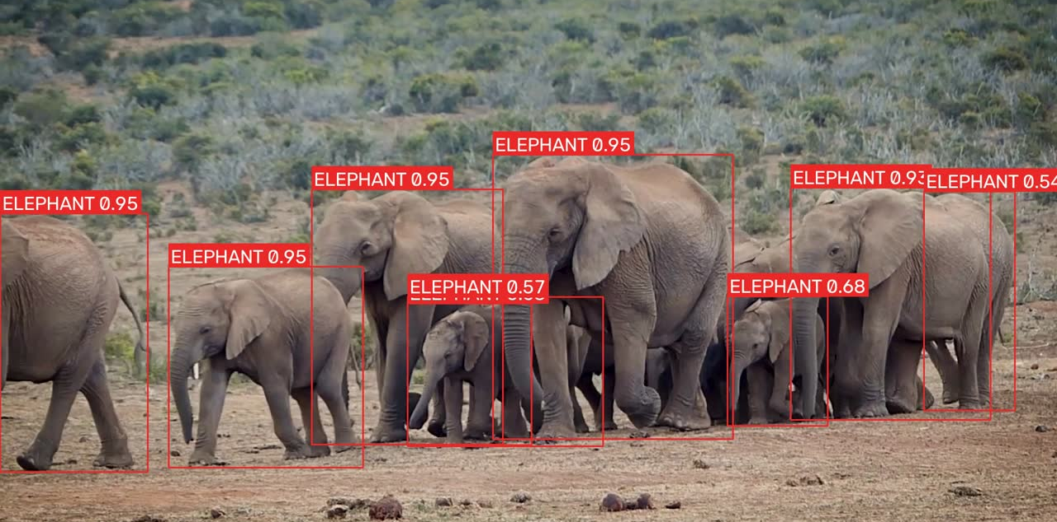
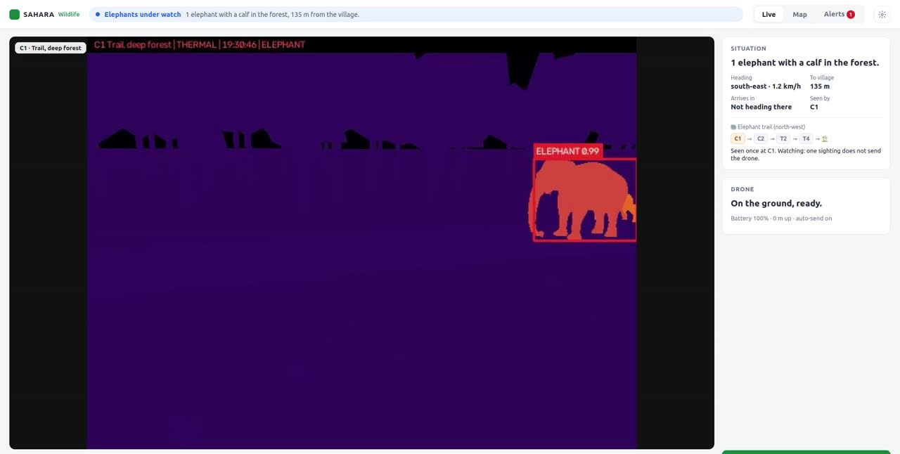
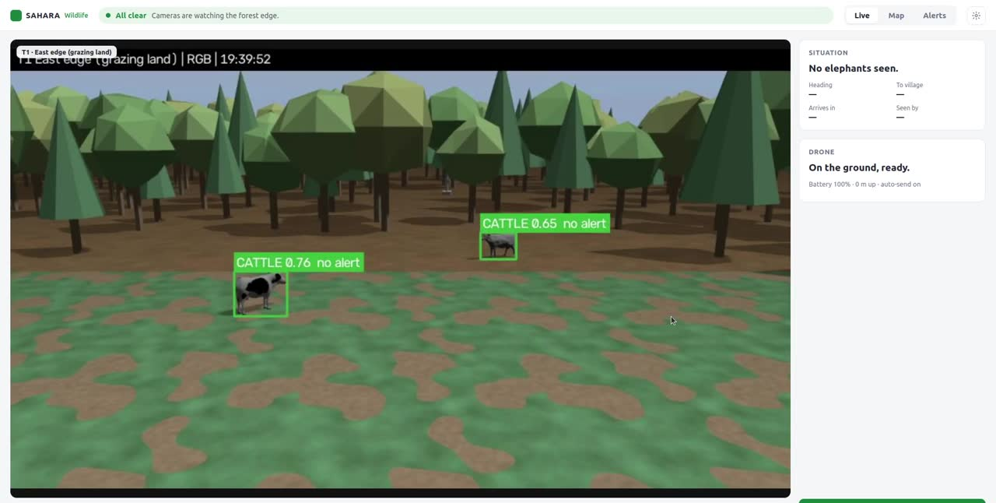
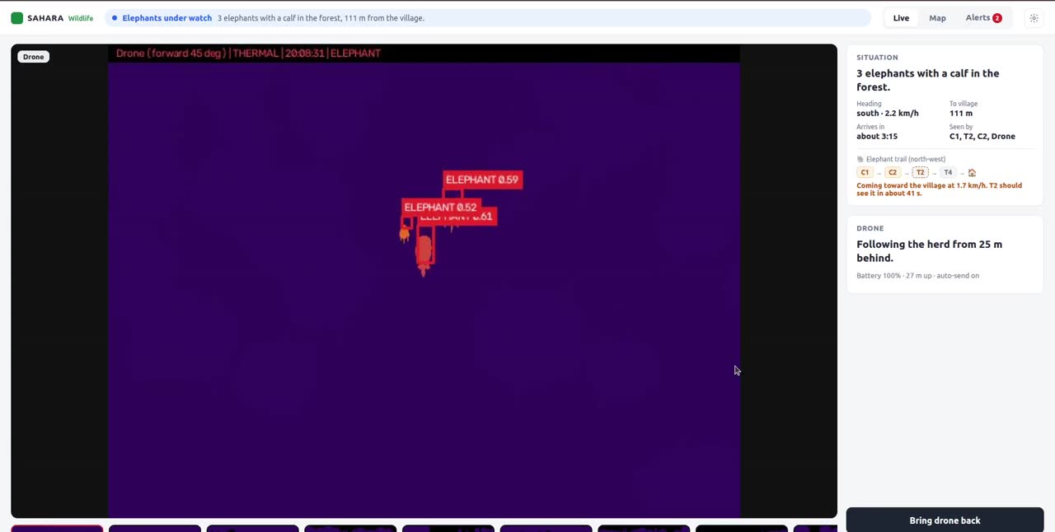
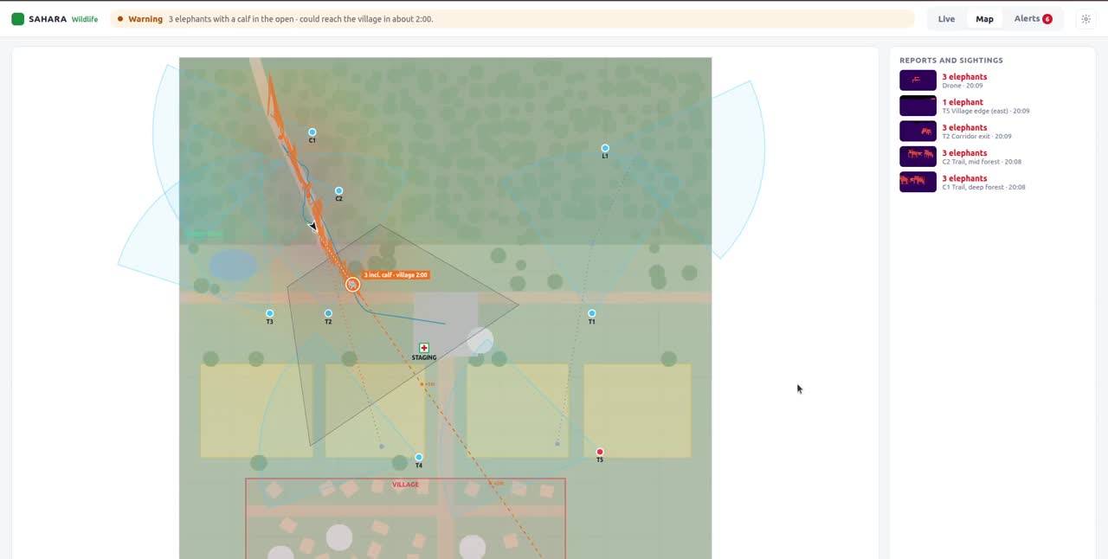
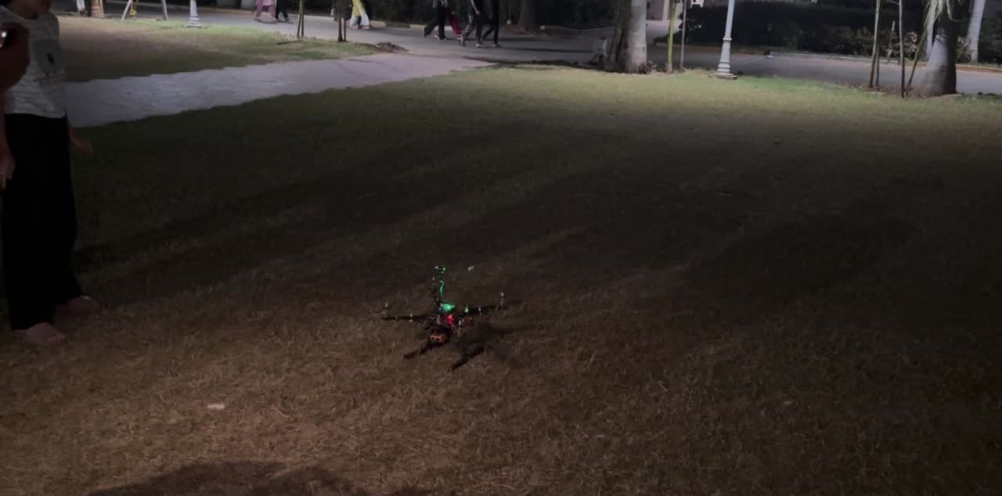
PROTOTYPE EVIDENCE •
Working Prototype: What the System Sees
REAL = real footage / hardware · SIM = simulation
REAL
SIM
SIM
Same detector on real elephant footage: elephants found in 235/235 frames
Night, thermal trail camera C1: elephant detected and sized
Cattle at tower T1 are measured and get no alert
SIM
SIM
REAL
Drone follows the herd of 3 at night on thermal
Console map: herd track, predicted path and village ETA
Our S500 drone flown at night on campus (manual)

Slide 7
ENGINEERING STACK •
Technology Stack & Feasibility
Component Readiness & Dependencies
SIMULATION
PERCEPTION
MIDDLEWARE
FLIGHT
Gazebo Harmonic, ArduPilot SITL 4.8
YOLOv8m (Ultralytics), OpenCV, thermal size rules
ROS 2 Humble, ros_gz, pymavlink, MAVProxy
S500 frame, Pixhawk 2.4.8, ArduCopter GUIDED
Working in sim
Sim + real footage
Working in sim
Flown manually only
BACKEND
CONSOLE
ALERTS
INTEGRATION
Python, Flask, MJPEG streams, JSON map APIs
Plain HTML, CSS, JS and Canvas; works offline
Telegram Bot API, English + Hindi templates
Ingest adapters: camera-trap folders, alert text
Working
Working
Working
Tested on samples
Feasibility: open-source stack, no licence cost · runs fully offline on one laptop GPU · reuses existing towers and camera traps

Slide 8
IMPACT ASSESSMENT • SIH SECTION 05
Socio-Economic Impact & Viability
Quantifiable Citizen Outcomes
Measured results
Who benefits, and how
1
Earlier warning
235 / 235
0
The drone keeps the village ETA updated, so families have time to move.
real-footage frames with elephants detected (threshold 0.5)
false elephant alerts in the full night run
2
Fewer false alarms
REAL
SIM
One sighting never launches; cattle never alert. Trust in alerts stays high.
3
Low cost
1.6 m
0 launches
Reuses existing towers and camera traps; open-source software, one laptop.
median herd position error vs truth, while tracking
when the tusker turned back: village not disturbed
4
Inclusive
SIM
SIM
Alerts in English and Hindi; villagers report sightings from a phone.
Safer villages and fewer elephants killed in retaliation or electrocuted.

Slide 9
EXECUTION TIMELINE • SIH SECTION 06
Implementation Roadmap & Milestones
From Prototype to Field Rollout
1
2
3
4
5
DONE
MONTHS 1–3
MONTHS 3–6
MONTHS 6–9
MONTHS 9–12
Prototype
Better AI
Real cameras
Field trial
Scale up
● Simulated forest, path logic, drone mission and alerts
● S500 flown manually at night
● Train on Indian camera-trap images
● Tell leopard from sloth bear
● Connect towers and camera traps
● Detector on the drone (Pi 5)
● One forest-edge village
● Drone permissions (Digital Sky)
● Re-identify individual animals
● Sirens + SMS where no internet
Honest limits we are fixing
Animals walk scripted paths in the simulation · the size rule can confuse a leopard with a sloth bear · two groups on one path can't be told apart · dense canopy blocks the drone camera

Slide 10

SQUAD CAPABILITIES
Multi-Disciplinary Team & Mentorship
Complementary Skill Sets
UG
Urja Ashokbhai Gajera
DA
Dhrumil Nirenkumar Amin
HP
Heet Rakesh Parikh
AP
Akshat Mehulkumar Patel
Team Leader
Drone & simulation
ROS 2
AI detection
Path logic & integration
Mission, ArduPilot, Gazebo
Nodes, bridges, MAVLink
Sentinel, YOLOv8, thermal
PC
Parva Prakash Chhatrola
KU
Khushi Sanjaybhai Undhad
YT
Yashvi Rakeshbhai Tanna
Console & alerts
Hardware
Hardware
Flask, web UI, Telegram
S500 build, flight controller
Cameras, sensors, power
All members: Computer Science & Engineering, Semester 5, CSPIT, CHARUSAT
Faculty Mentor: Dr. Jigar Sarda
Ready for Jury Review & Evaluation
Chandubhai S. Patel Institute of Technology, Anand, Gujarat

