Slide 1
HAM RADIO 101

Slide 2
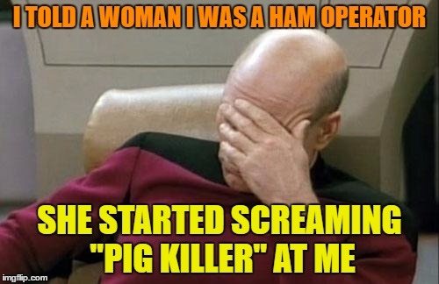

Slide 3
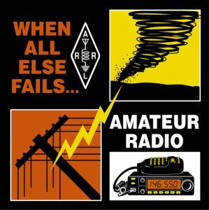
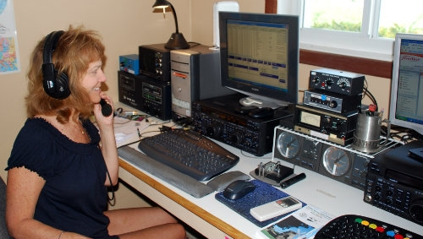
What is Amateur Radio?
Amateur Radio is a popular hobby and service that brings people, electronics and communication together. People use ham radio to talk across town, around the world, or even into space, all without the Internet or cell phones.

Slide 4
History of HAM
Became popular around 1910​
Sinking of Titanic and Radio Act 1912​
World Wars​
Further Research​
Astronomy​
Development of Mobile Telephone-Inspired from HAM

Slide 5
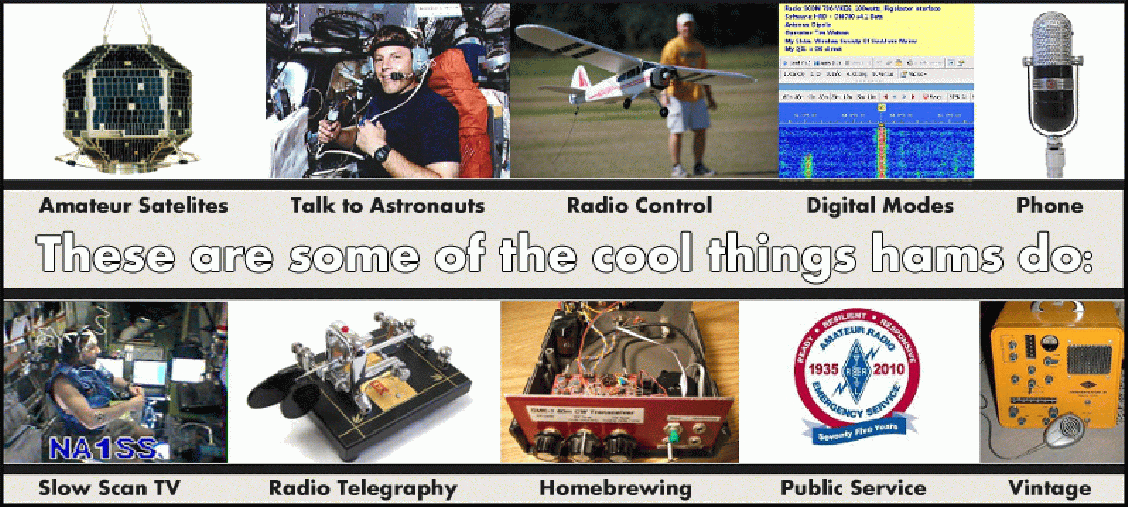
What HAM clubs do?

Slide 6
Significance of HAM
Astronomy research
Disaster relief management
The most reliable form of communication
Tough to hack into
Important to improve communications
Tight-Knit Community

Slide 7
Why HAM?
Learn things not available easily online
Opportunity to talk to tech enthusiasts worldwide !!
Talk to Astronauts
Awesome Field Days
Develop skills to make your own mobile !!
International Awards
A fun Hobby
And Plenty More ...

Slide 8
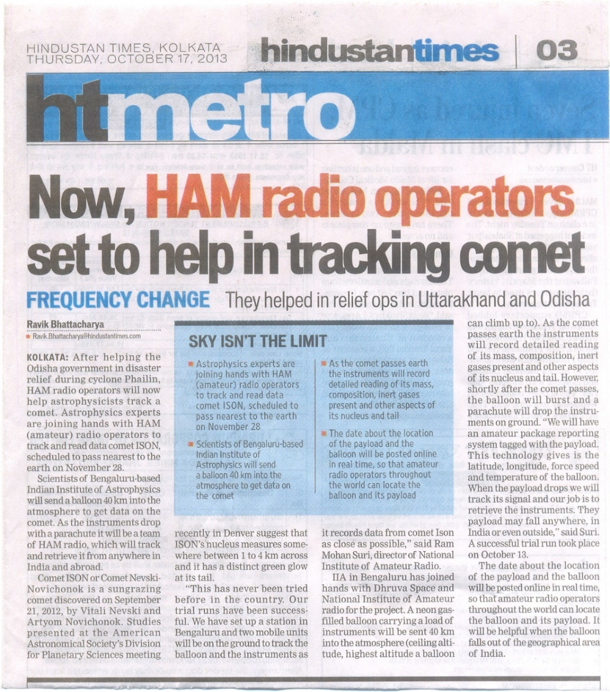
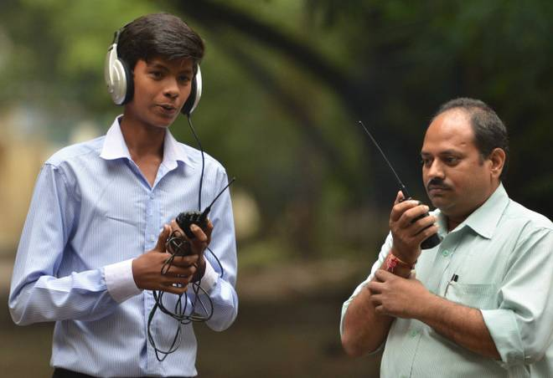
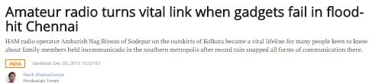
Recent contributions of HAM

Slide 9
Importance of HAM examination
An agreement between you and the Telecommunication Community.
Gives you the power to talk throughout the universe !!
Gives you the freedom to experiment
Get your own Call Sign

Slide 10
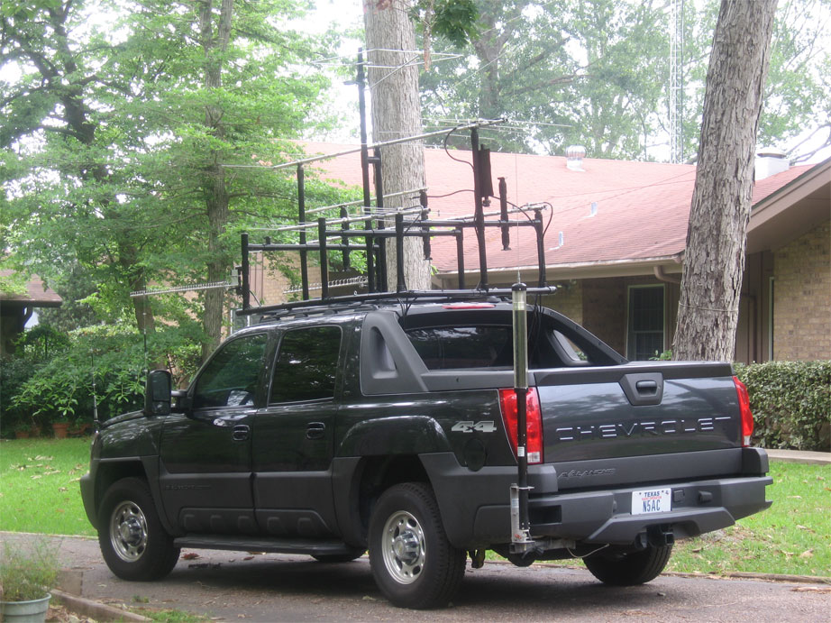
THANK YOU

