Slide 1
FairAC: Smart & Fair AC Billing for Hostels
IoT-Powered Transparent Billing System
Pitch to Hostel Management

Slide 2

The Problem: Unfair Billing & Wastage
• Flat Fees: Fixed monthly AC fees are unfair to students who use it less.
• Roommate Disputes: Constant arguments over who left the AC on and who pays.
• Massive Wastage: Students leave ACs running while in class because they 'already paid'.
• No Analytics: Management has zero visibility into per-room energy consumption.

Slide 3
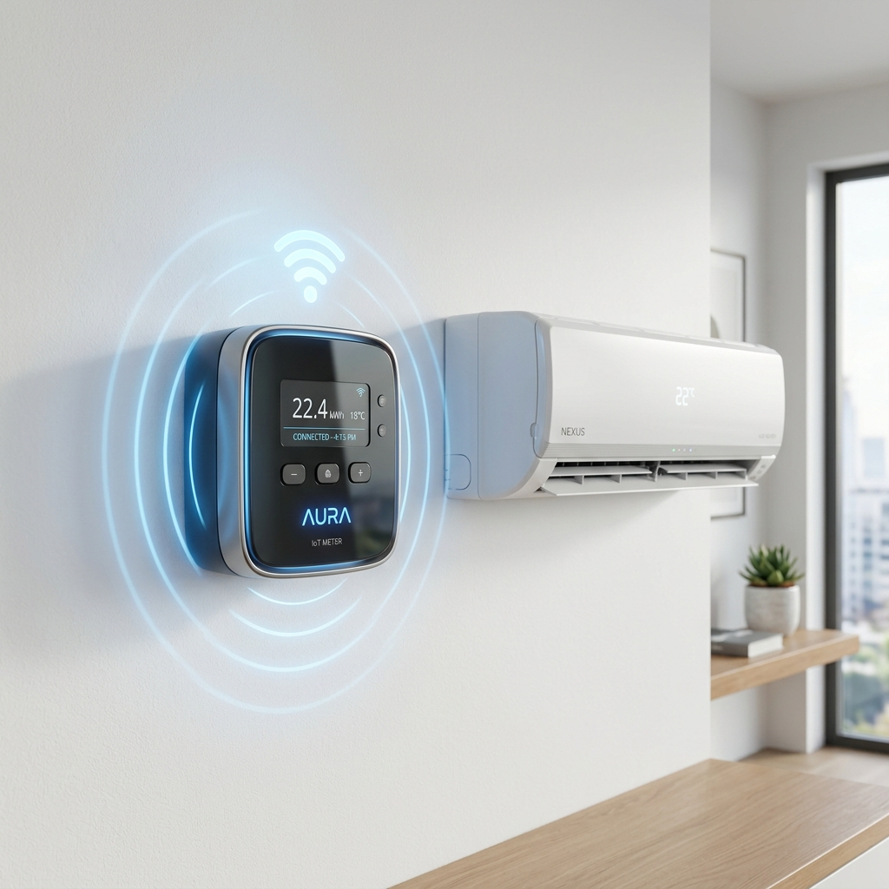
The Solution: FairAC System
• IoT Smart Meter: A low-cost Wi-Fi device installed on the AC switchboard.
• Session Tracking: Students use the App to 'Start a Session' and add present roommates.
• Automated Splitting: The exact kWh consumed is split evenly ONLY among the present roommates.
• Digital Wallet: The AC shuts off automatically if their prepaid wallet runs out.

Slide 4

Benefits for Hostel Management
• Zero Manual Work: No more reading sub-meters at the end of every month.
• Advance Payment: Wallet system collects money BEFORE electricity is used.
• Energy Conservation: Students turn off the AC to save their own money.
• Admin Dashboard: Live visibility into active sessions and monthly revenue.

Slide 5
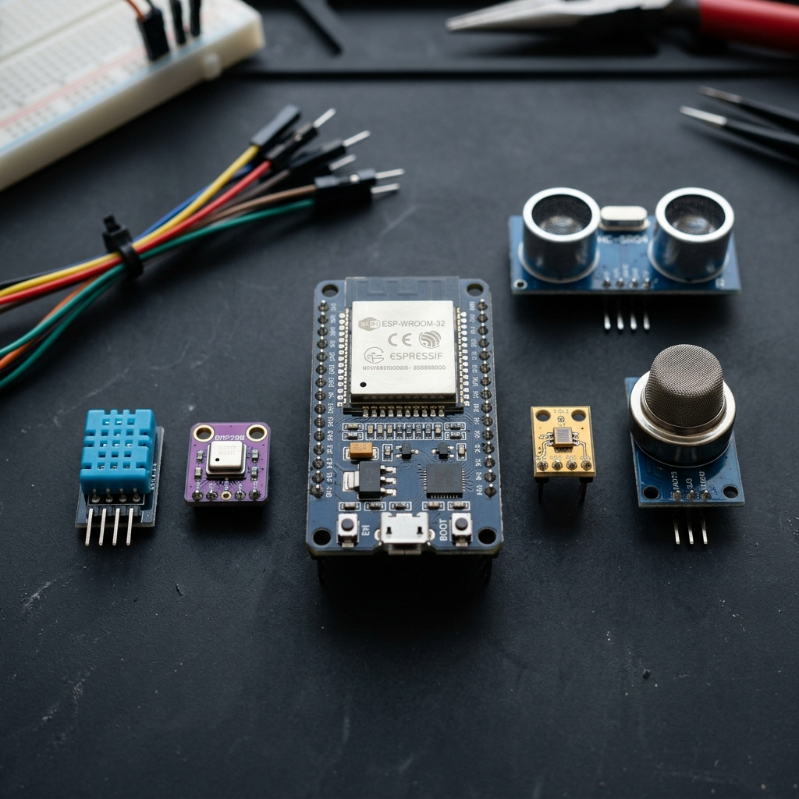
Hardware Costing (Per Room)
• ESP32 Microcontroller: ~₹350
• ACS712 Current Sensor: ~₹150
• ZMPT101B Voltage Sensor: ~₹100
• 30A Relay Module: ~₹200
• OLED Display (0.96"): ~₹150
• Enclosure & Wiring: ~₹100
Total Estimated Cost: ~₹1,050 per room

Slide 6
Next Steps: Pilot Deployment Proposal
We propose a low-risk pilot program to prove the value:
Phase 1: Install the FairAC hardware in 5 rooms (Cost: ~₹5,250).
Phase 2: Onboard the students of those rooms onto the platform.
Phase 3: Run the system for 1 month and compare energy usage and revenue collection with traditional rooms.
Phase 4: Full roll-out across the entire hostel.

