Slide 1
Diabetes prediction model using logistic regression
Name: Dhrumil Savalia
Email id: dhrumilsavalia99@gmail.com
Submitted to: Exposys data labs
Submission date:30/11/2021

Slide 2

Why do we need to predict diabetes through ML model?
The healthcare industry collects big amounts of healthcare data which, unluckily, are not “mined” to search concealed information.
Sensible decisions are usually made based totally on doctor’s instinct instead of analyzing statistics concealed in the database.
This exercise terminates in unwanted biases and errors. The existing process is very slow to give the result. It is very problematic to predict diabetes.

Slide 3
Our proposed system
Diabetes prediction is done by inputting clinical information in the model. The set of rules will compute the opportunity of existence of diabetes.
This thus saves time and money instead of conducting various tests. Format of statistics plays crucial role on this software.
Our device will implement the logistic regression algorithm. 80% of the entries in the statistics set can be used for training and the last 20% for testing the accuracy of the set of rules.

Slide 4
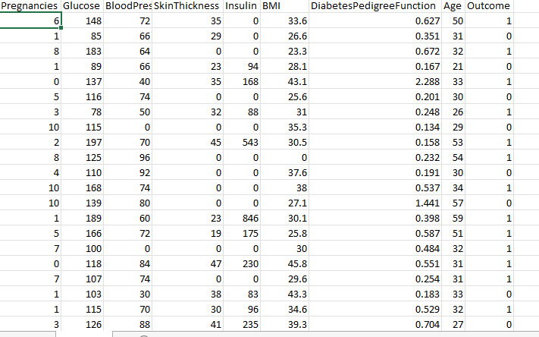
PIMA dataset

Slide 5

Learning about parameters
Diabetes pedigree function: a function which scores likelihood of diabetes based on family history.
Glucose: Plasma glucose concentration over 2 hours in an oral glucose tolerance test
Insulin: 2-Hour serum insulin (mu U/ml)
Blood Pressure: Diastolic blood pressure (mm Hg)
BMI: Body mass index (weight in kg/(height in m)2)
Outcome: Class variable (0 if non-diabetic, 1 if diabetic)

Slide 6
Logistic regression (supervised ML algorithm)
It is used when the dependent variable (target) (in our case target variable is outcome) is categorical
This binary logistic model is used to estimate the probability of a binary response based on one or more predictor (or independent) variables (features).
Binary logistic regression is estimated using Maximum Likelihood Estimation (MLE), unlike linear regression which uses the Ordinary Least Squares (OLS) approach.

Slide 7
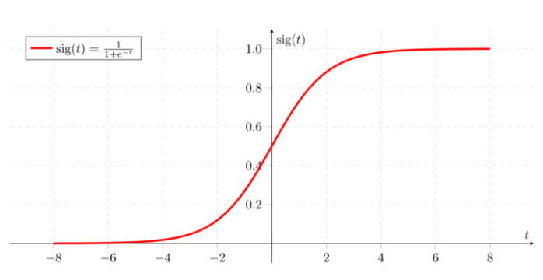
Sigmoid function for LR

Slide 8
SVM(support vector machine) linear classification
In linear SVM, the data points from different classes can be classified by a straight line (hyperplane).
SVM can use kernel functions to implicitly transform the input features into a much larger bunch of features. this is called "kernel trick“
In general terms SVMs are very good when you have a huge number of features. For example for text classification in a bag of words model.
SVMs work better when you have a plenty of samples for each class.

Slide 9
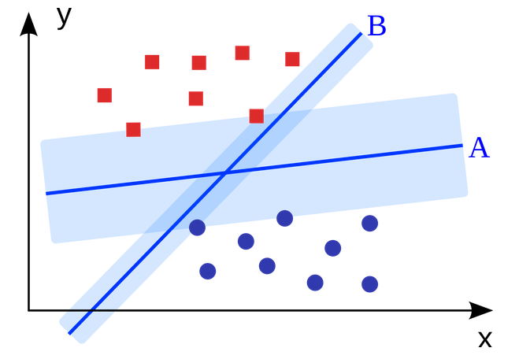
Linear classification using optimal hyperplane

Slide 10
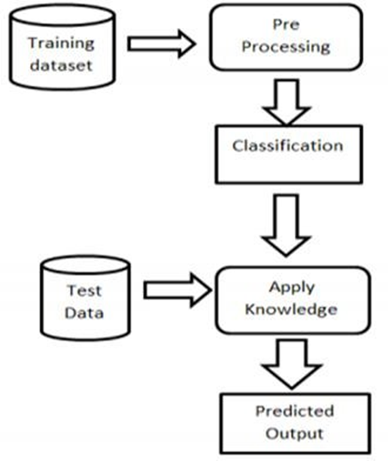
System architecture

Slide 11
Data standardization
Data standardization is this process of making sure that your data set can be compared to other data sets.
The importance of having standardized data for comparison can be seen across the globe.
In 2015, the United Nations outlined their “2030 Agenda for Sustainable Development”. In doing so, they outlined key indicators/goals to aid in ending poverty, protecting the planet, and ensuring prosperity for all.
In our case we standardize data to be bring it in common range, We do it so by fitting & transforming the dataset by a standard scaler function.

Slide 12

Data visualization
In our data we have 768 rows and 9 columns
Using describe method we can find the relation between the various parameters with the outcome.
We need to group by elements of the data set with respect to the mean of the parameter values based on the outcome values (0 &1)
This provide us an outlook of how the parameters affect the outcome
We have also plotted a multiple bar graph with respect to 2 outcome values and the parameters.

Slide 13
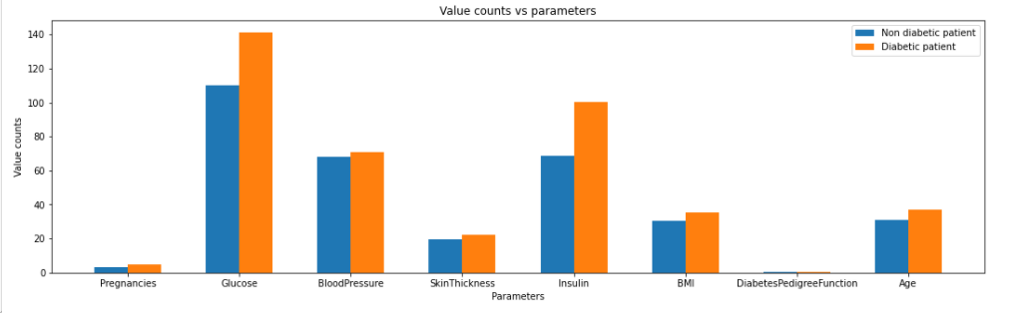

Slide 14
Training and testing data set
We have split the data set according to test size 0.2 i.e. 80% of the data is training data and 20% of it is testing data
We standardize data before this step
The training set contains a known output and the model learns on this data in order to be generalized to other data later on.
We have the test dataset (or subset) in order to test our model’s prediction on this subset.

Slide 15

Hyperparameter tuning
This is done to select an appropriate model for the data.
As in our case logistic regression is the best method for binary classification as a part of supervised learning model.
We can use Grid search CV method to identify which method is suitable in our case, with respect to the data set we compare SVM (Support vector machine) & logistic regression using 5 cross fold validation.
According to this grid search cv suggested logistic regression for better accuracy.
Our result

Slide 16
Model training and generating accuracy score
Solver used: Lib linear-Library for Large Linear Classification. Uses a coordinate descent algorithm.
The model here is fitted with X train and Y train data set
The accuracy score is calculated by creating y train prediction variable and fitting it to the data set, since the data requires standardization,
Our result

Slide 17
Confusion matrix, precision & recall score
Confusion matrix is the measurement of how many times our model was confused while predicting true values
Precision score is described as the ratio of true positive and sum of true positive and false positive.
Our result precision score=74%
Recall describes the ratio of true positives and sum of true positive and false negative.
Our result recall score=58.4%
F1 score is the harmonic mean of the precision and recall scores. For a model to be precise and accurate it requires to have better precision and recall, indirectly better F1 score.
Our result F1 score=65.2%

Slide 18


Confusion matrices comparison
Obtained confusion matrix
Ideal confusion matrix

Slide 19
Conclusion & Future enhancement
Studying deep we were able to identify the influence of machine learning techniques in the prediction of chronic diseases for immediate clinical diagnosis.
Some techniques of deep studying has been discussed which may be applied for Diabetes prediction, alongside spearhead machine learning algorithms.
In future our aim is to carry ahead the work of varying scientific dataset, wherein dataset varies with time
The proposed diabetes prediction model can be used for prediction of various other diseases depending on the complexity of the data, and appropriate algorithms can be selected by proper analysis.

Slide 20


