Slide 1


GROUP 2: CLIMATE
Probabilistic Forecasting of Extreme Weather Events
Shlok Shah
Abhi Jain
Dhruti Kobawala
Prarthana Gajera
Pearl Patel

Slide 2
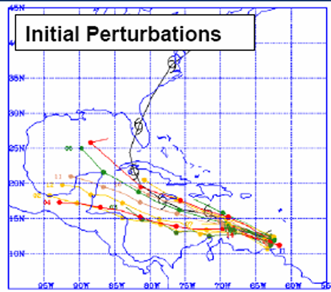
Project Context and Motivation
Title: Probabilistic Modeling of Extreme Weather Events for Risk-Informed Decision Support
Application Domain: Defense operations, infrastructure resilience, and weather risk assessment
Context: Weather forecasts are critical for operational planning and infrastructure protection.
Atmospheric systems are chaotic and highly sensitive to initial conditions and model assumptions, making uncertainty unavoidable—especially for rare and high-impact events.
https://www.weather.gov/owp/hdsc_aep
01/07/19
| 2

Slide 3
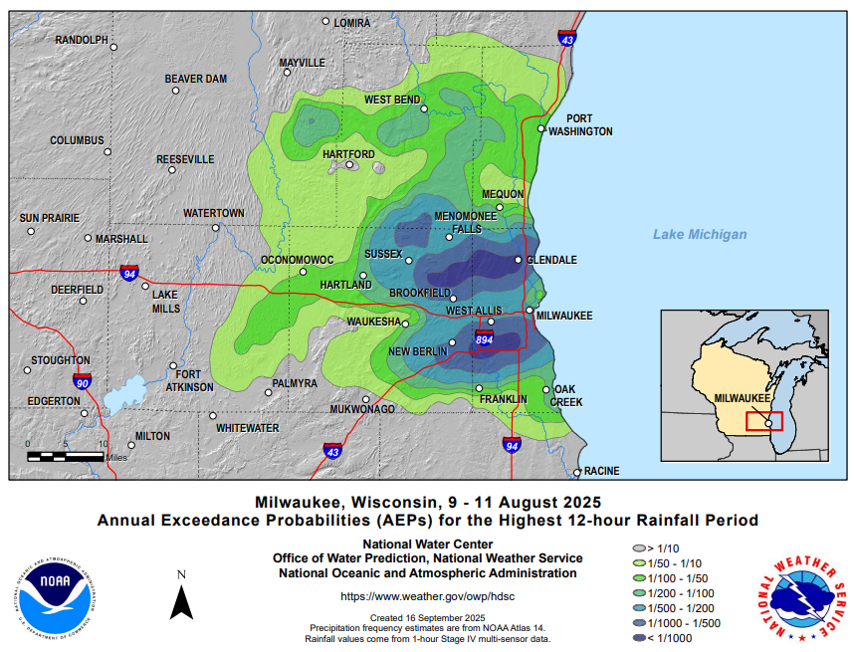
Project Objective and Scope
Objective: To quantify uncertainty in extreme weather events using probabilistic methods.
Scope:
Use ensemble forecasting to generate multiple plausible weather outcomes
Apply Bayesian inference to estimate event likelihoods
Provide probabilistic risk estimates rather than deterministic predictions
https://www.weather.gov/owp/hdsc_aep
01/07/19
| 2

Slide 4
Project System Overview
End to End Pipeline:
Generate ensemble weather forecasts
Extract relevant extreme-event indicators
Model uncertainty probabilistically
Apply Bayesian inference for likelihood estimation
Major Components:
Ensemble forecast data
Probabilistic model
Bayesian inference module
01/07/19
| 2

Slide 5
Sources of Uncertainty
Initial Condition Uncertainty: Imperfect observations of the atmosphere
Model Uncertainty: Approximations in physical parameterizations
Environmental Variability: Natural randomness in weather evolution
Data Uncertainty: Limited or noisy historical observations of extreme events
01/07/19
| 2

Slide 6
Key Random Variables and Their Roles
Atmospheric State Variables (e.g., rainfall, wind speed):
Ensemble Forecast Outputs
Extreme Event Indicator
Model Uncertainty Term
Prior Event Probability
01/07/19
| 2

Slide 7
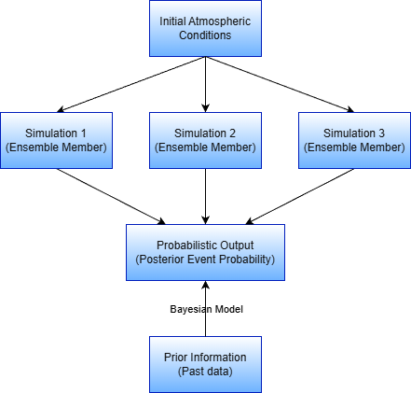
Probabilistic Models and Assumptions
Ensemble Weather Forecasting
Approximate the uncertainty via multiple ensemble members
Assumptions
Conditionally independent members
Bayesian updating using past data
01/07/19
| 2

Slide 8
Probabilistic Reasoning and Inference Logic
Uncertainty Propagation
Ensemble Variability
Conditional Inference
Probability Aggregation
Risk-Based Decision Support
01/07/19
| 2

Slide 9
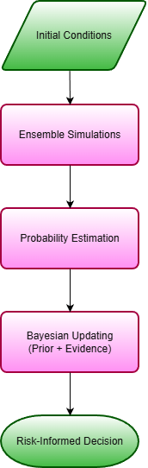
Operationalizing Probabilistic Reasoning in the Project
Available ensemble forecast data are considered probabilistic samples.
Ensemble outputs are interpreted with Bayesian reasoning.
Performance is evaluated using probability based metrics.
Ensemble models represent uncertainty, rather than giving a deterministic value
01/07/19
| 2

Slide 10
Current Limitations and Conceptual Gaps
Component | Current Limitation/Gap
Initial condition perturbations | Need Refinement
Model Uncertainty | Not fully captured
Prior distributions | Data-limited
Independence assumption | Correlation possible
Ensemble size | Maybe Insufficient
01/07/19
| 2

Slide 11
Planned Refinements and Role Coordination
Next Milestone Refinements:
Formalize random variables and distributions
Introduce Bayesian updating for probability estimates
Conceptual and Modelling Tasks:
Define probabilistic thresholds for extreme events
Choose suitable measures to evaluate probability accuracy.
Role Coordination:
Github Manager: Keep model organized and consistent.
Scribes: Note changes and update assumptions
Video Team: Explain how system works and how uncertainty is handled
01/07/19
| 2

Slide 12
Summary of Group-Level Understanding
Probabilistic Model
Inference
Logic
Project
Direction
Ensemble simulations represent uncertainty
Extreme events are estimated using probability
Bayesian updating combines prior + evidence
Conditional independence assumed for members
Integrate model uncertainty in next milestone
Evaluate using probability based metrics
01/07/19
| 2

Slide 13
THANK YOU!
01/07/19
| 2

