Slide 1
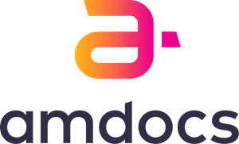
Student management system
Presented by : DHRUTI THAKRAR(200010)

Slide 2
AGENDA
Introduction
Tools and Technologies
Project Structure
Snapshot of project
About Jenkins
Snapshot of Jenkins

Slide 3
INTRODUCTION
Student Management System web application using Spring Boot, Spring MVC, Thyme leaf, Spring Data JPA, and MySQL database.
We will build a CRUD operation for the Student entity in our Student Management System web application.

Slide 4

Tools and technology
Java 17
Spring Boot
Spring Data JPA ( Hibernate)
MySQL
Thyme leaf
Eclipse

Slide 5
SPRING BOOT:
Spring boot is an open source Java Based Framework used to create a microservice. It allow us to build a Standalone application with minimal or zero configurations.
SPRING DATA JPA
Spring Data JPA provides repository support for the Jakarta Persistence API (JPA). It eases development of applications that need to access JPA data sources.
MYSQL:
MySQL is a widely used relational database management system (RDBMS). MySQL is free and open-source. MySQL is ideal for both small and large applications.
THYME LEAF:
Thyme leaf is a Java-based library used to create a web application. It provides a good support for serving a XHTML/HTML5 in web applications.
ECLIPSE:
the Eclipse platform can be used to develop rich client applications, integrated development environments and other tools.

Slide 6
PROJECT STRUCTURE
Controller
Service
Repository
Entity

Slide 7
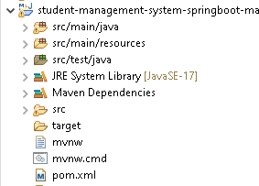

FIG-1 PROJECT FOLDER

Slide 8
POM is an acronym for Project Object Model. The pom.xml file contains information of project and configuration information for the maven to build the project such as dependencies, build directory, source directory, test source directory, plugin, goals etc.
Element | Description
project | It is the root element of pom.xml file.
modelVersion | It is the sub element of project. It specifies the model Version. It should be set to 4.0.0.
groupId | It is the sub element of project. It specifies the id for the project group.
artifactId | It is the sub element of project. It specifies the id for the artifact (project). An artifact is something that is either produced or used by a project. Examples of artifacts produced by Maven for a project include: JARs, source and binary distributions, and WARs.
version | It is the sub element of project. It specifies the version of the artifact under given group.

Slide 9
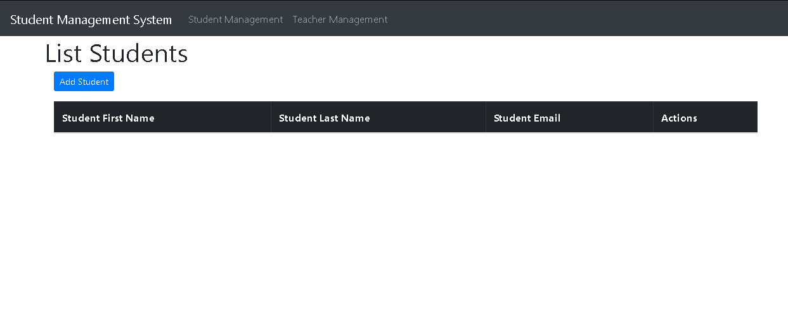
Snapshot of project
FIG-1 DASHBOARD OF STUDENTS WHERE USER CAN ADD STUDENT AND CAN SEE LIST OF STUDENT

Slide 10
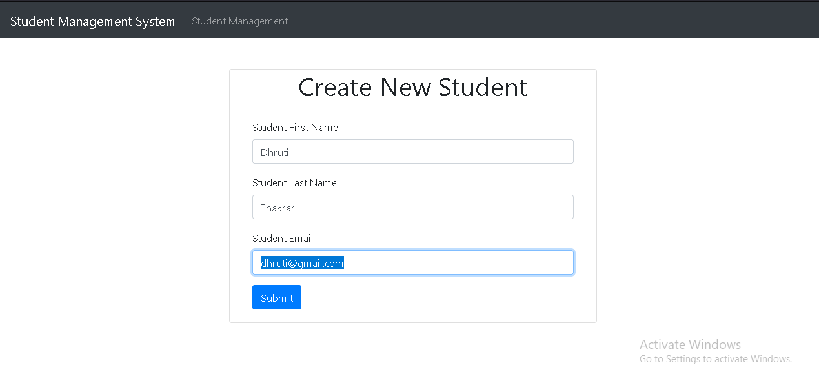
Snapshot of project
FIG-2 ADD STUDENT PAGE

Slide 11
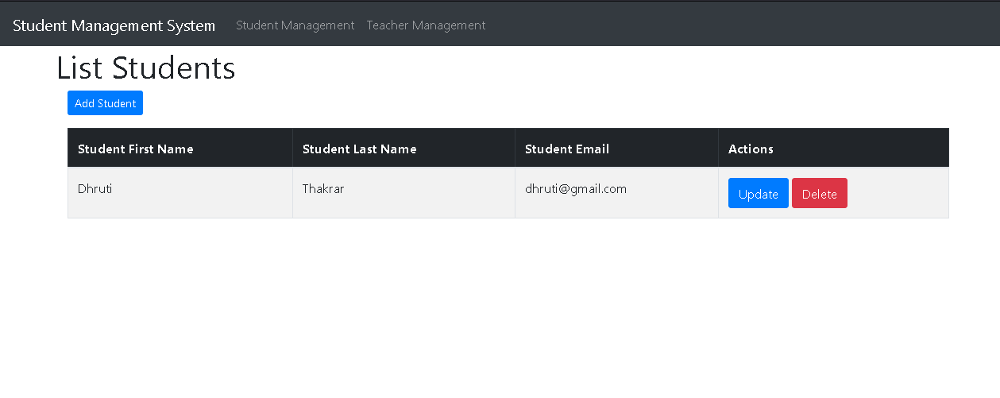
Snapshot of project
FIG-3 LIST OF STUDENTS

Slide 12
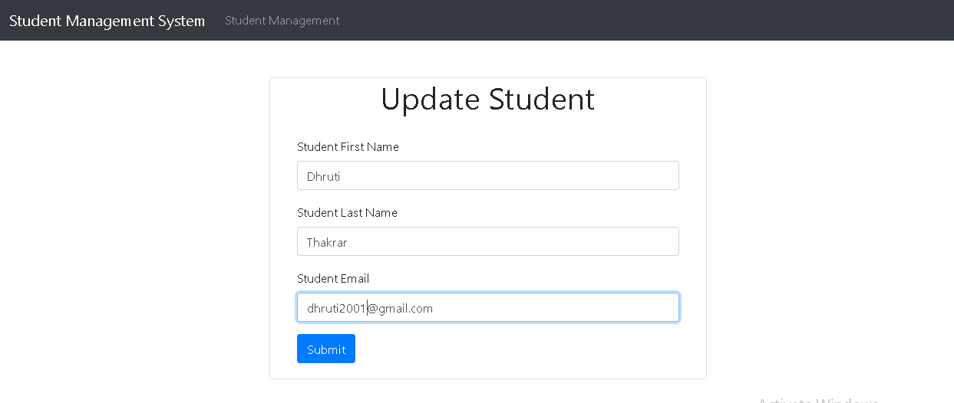
Snapshot of project
FIG-4 UPDATE STUDENTS

Slide 13
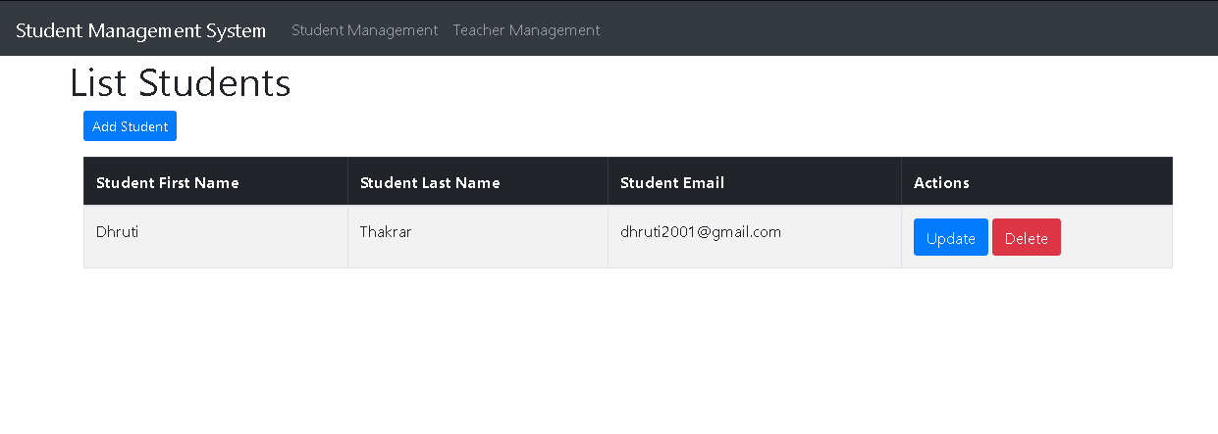
Snapshot of project
FIG-5 UPDATED STUDENTS

Slide 14
Snapshot of project
FIG-5 DELETE STUDENTS

Slide 15
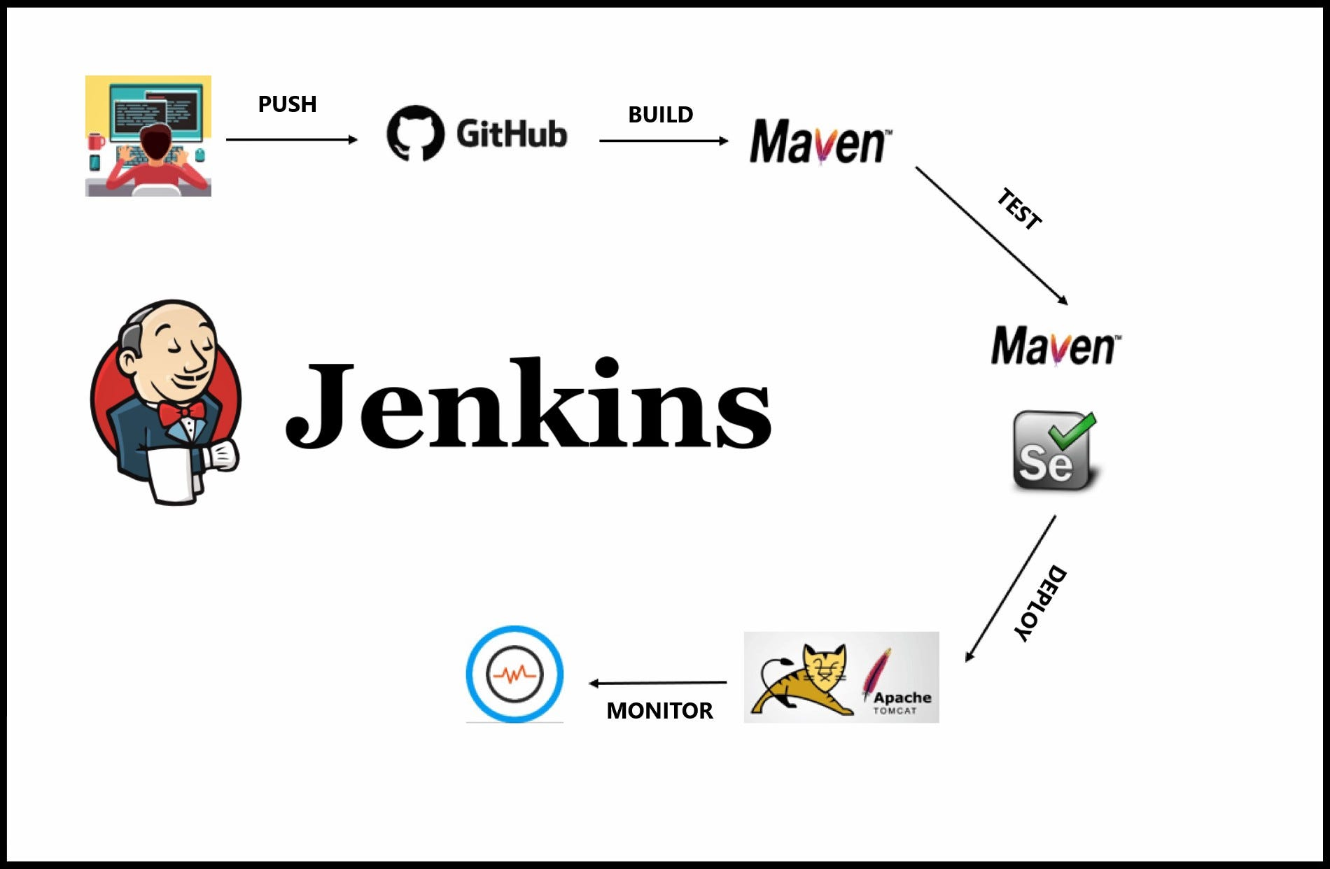
ABOUT JENKINS
Jenkins is an open source automation server. It helps automate the parts of software development related to building, testing, and deploying, facilitating continuous integration and continuous delivery. It is a server-based system that runs in servlet containers such as Apache Tomcat.

Slide 16
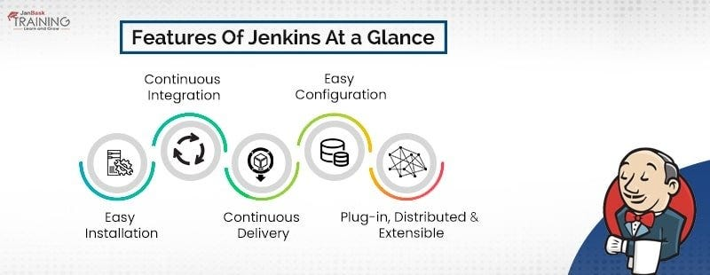
JENKIN FEATURES

Slide 17
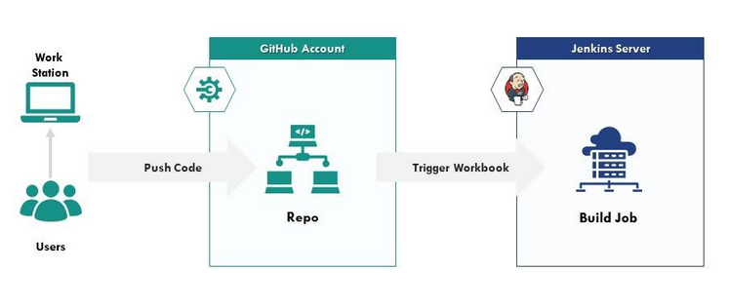
JENKIN ARCHITECTURE

Slide 18
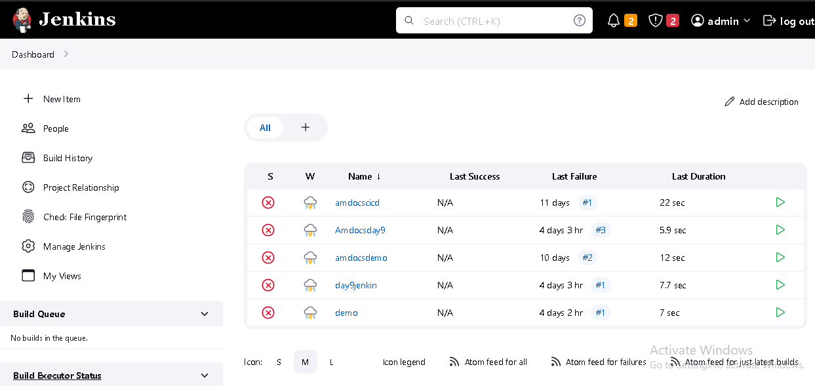
Jenkin dashboard

Slide 19
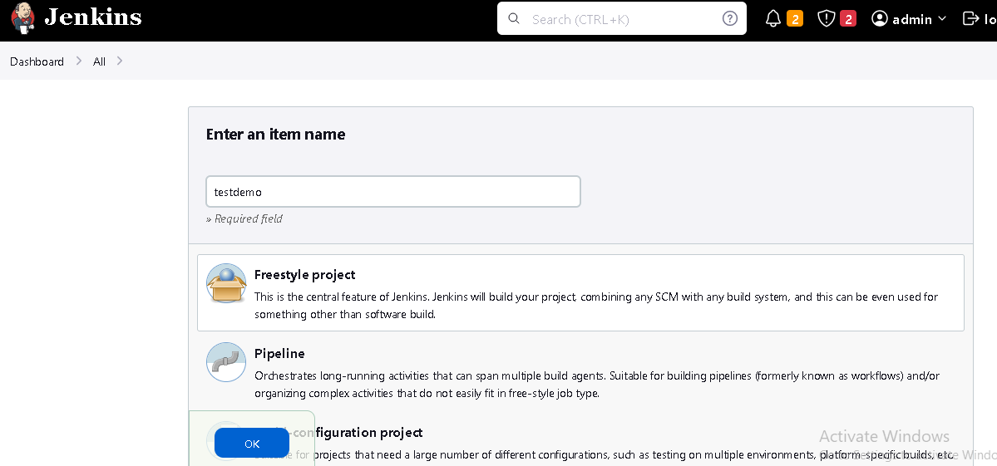
CREATE PROJECT IN JENKINS

Slide 20
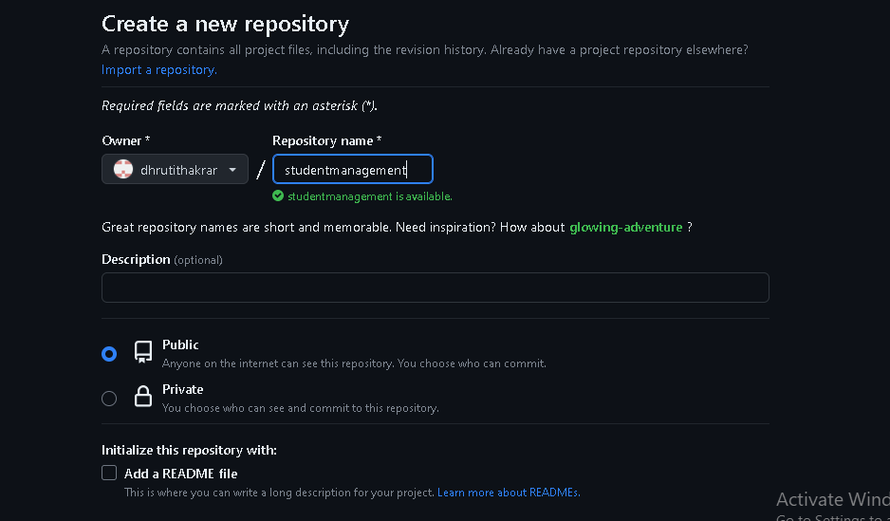
PUSH CODE IN GITHUB

Slide 21
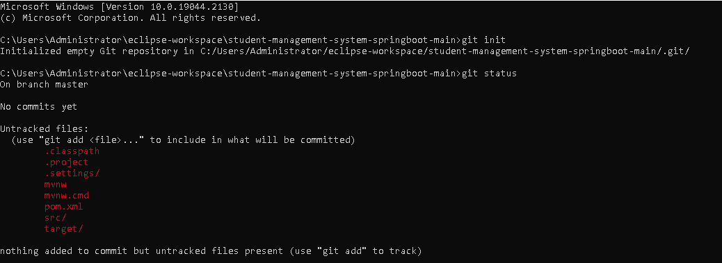
COMMANDS

Slide 22
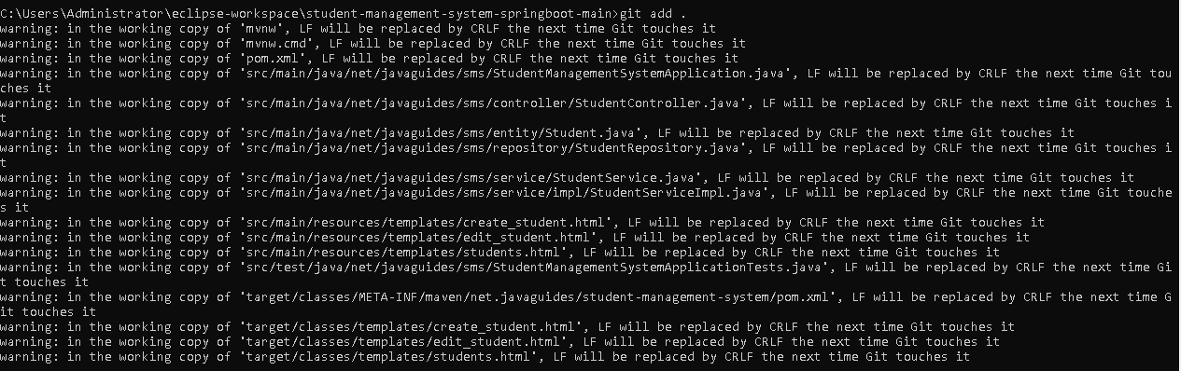
COMMANDS

Slide 23
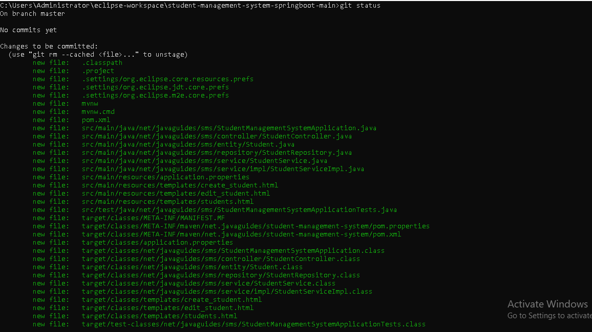
COMMANDS

Slide 24
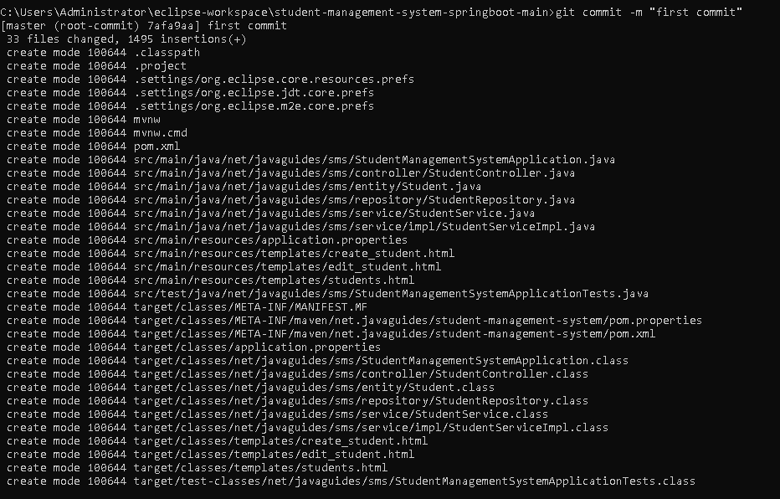
COMMANDS

Slide 25
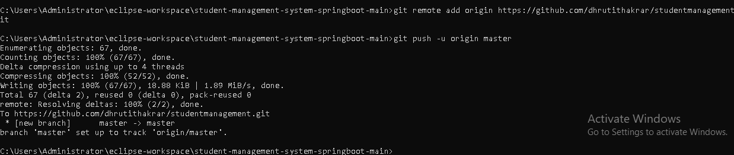
commands

Slide 26
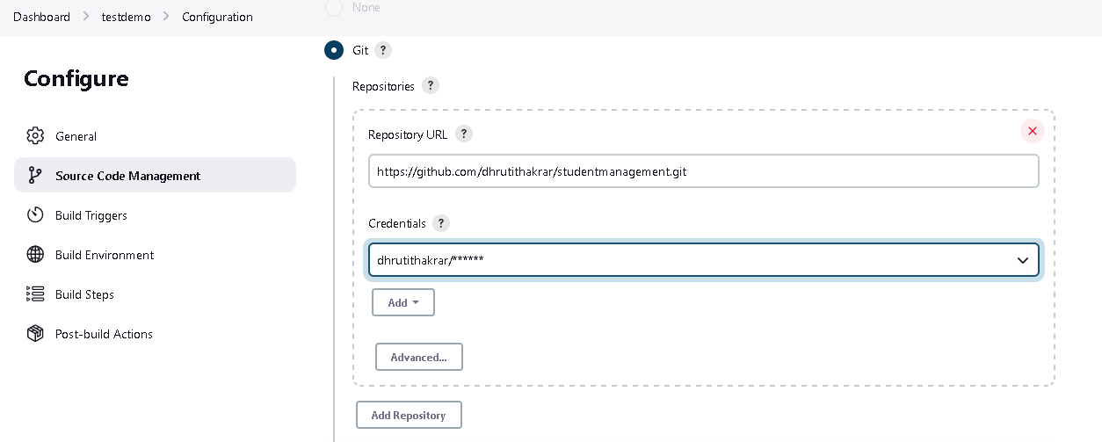
DEPLOYMENT IN JENKINS

Slide 27
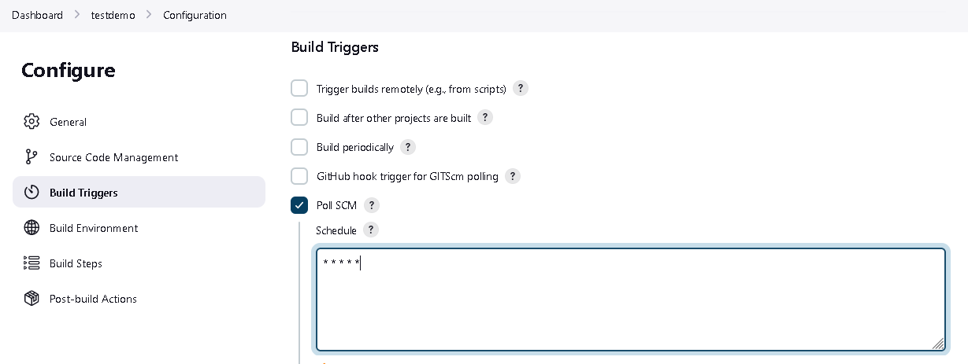
DEPLOYMENT IN JENKINS

Slide 28
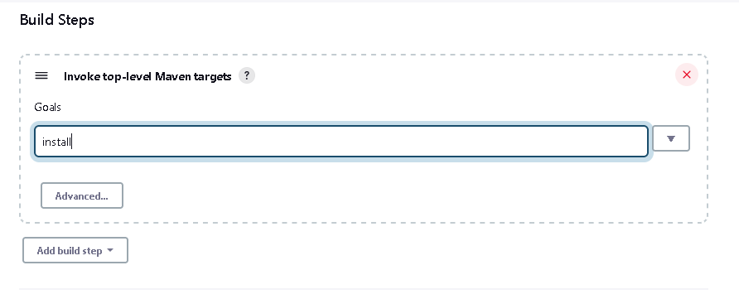
DEPLOYMENT IN JENKINS

Slide 29
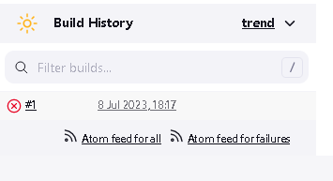
DEPLOYMENT IN JENKINS

Slide 30
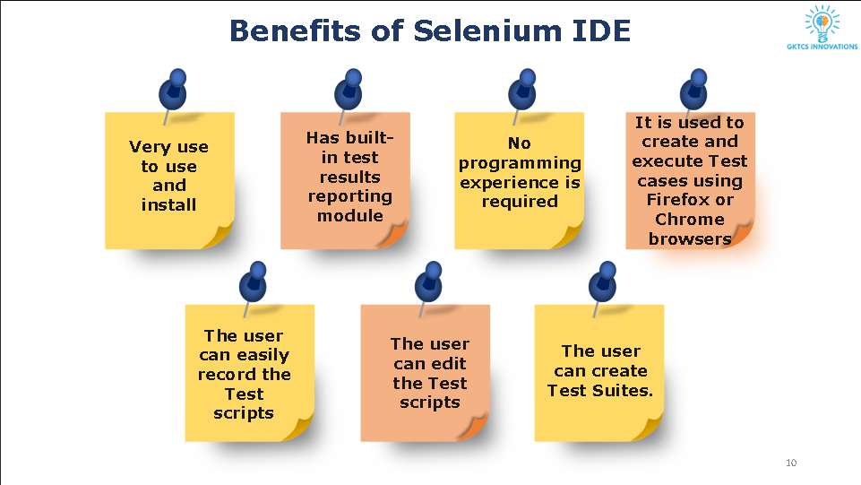
SELENIUM

Slide 31


