Slide 1
Krishi Mitra

Slide 2

Krishi Mitra
Farmers face various challenges including climate change, scarcity of information, market access and inventory management. By understanding this needs, KrishiMitra solves all the needs and ensures that farmers have necessary to thrive in a competitive market

Slide 3
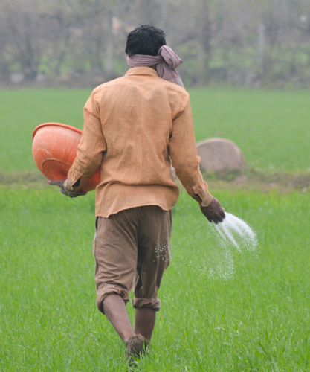
Modules
Farming Suggestion
Faq(Knowledge Sharing)
Governments Schemes
Seamless Communication between farmers
Expert farming tips
Real time market rates

Slide 4
Farming Suggestions
Farmer will need to enter his village and type of soil his farm has, then experts will suggest him the crop to grow for that season
Farmer will also get tips for their farming and what resources they can use instead of harmful chemicals and pesticides
It will also be used for finding all the tools, seeds and workers for farming

Slide 5

Government Schemes
This module will provide all the schemes and grants provided by the government to the farmers

Slide 6
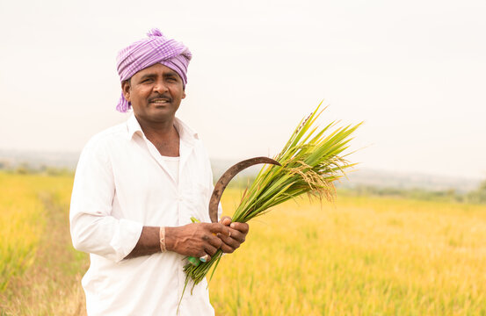
Crop Inventory
It will help farmer track his inventory of crops

Slide 7

Live market rates
It will help farmer get all the market rates of all grains daily

Slide 8
Future Scope
Weather Prediction
Chatbot

Slide 9
Thanks!

