Slide 1
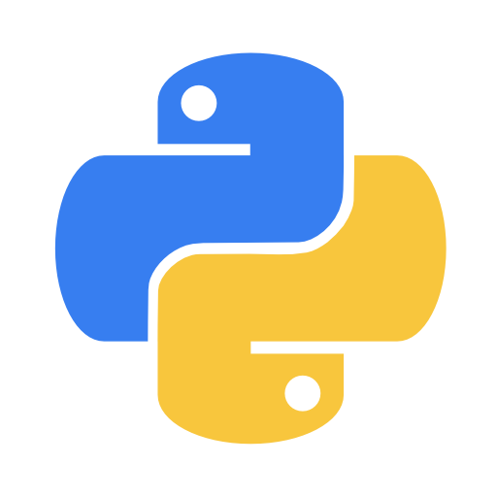
Introduction to Python
A technology awareness session on Python programming language
By Dhruv Desai,
Software Engineer, Narola Infotech

Slide 2
Contents
Introduction to Python
Basic programing concepts
Python with Files & Database
GUI with Python
Building a simple website
Technology trends & Python
Resources & Materials

Slide 3
What is Python?
Definition: Python is an interpreted, high-level, general-purpose programming language
Just another one those popular & trending programing languages out there.
Actually : A fun tool to play around and make things and explore our technological advancement.

Slide 4
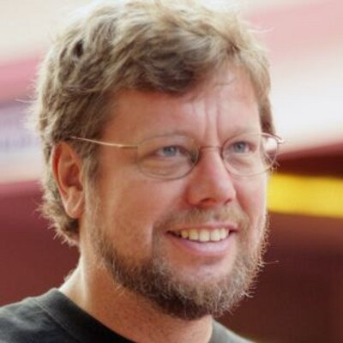
Some background history
Creator: Guido van Rossum
First release: 1991
Python2 and Python3
Python3 release: 2008

Slide 5
Programing in Python
a = 2
b = 3
sum = a + b
print(sum)
im_a_parent:
im_a_child:
im_a_grand_child
im_another_child:
im_another_grand_child
Notes:
No variable declaration
No semi colons
No brackets

Slide 6
Data Types
bool: Boolean (true/false) types.
int: Signed integer types.
uint: Unsigned integer types.
float: Floating point types.
complex: Complex number types.
string: Raw string types
time: Data/time types
enum: Enumerated types
...boring.
Just remember these 3
number
string
boolean

Slide 7
Data Structures in Python
[] - List
{} - Dictionary
() - Tuple

Slide 8
same old “if else”
if number > 4:
print("greater than 4")
elif number > 8:
print("greater than 8")
else:
do_some_stuff_here()
lazy_about_brackets = True
if lazy_about_brackets:
print("Go Python")
else:
print("Go Java")
some_list = [10, 29, 44, 6]
if 29 in some_list:
print(True)
else:
print(False)
some_string = "python"
if 'y' in some_string:
print(True)
else:
print(False)

Slide 9
same old “for loop”
for i in range(1,11):
print(i)
for char in "python":
print(char)
print("Robert Downey Jr. is")
for char in ["Iron Man", "Tony Stark", "Sherlock"]:
print(char)

Slide 10
Oops…Classes & Objects
Yes, Python is an object oriented language means it supports & follows OOP concepts.
Object
Class
Method
Inheritance
Polymorphism
Data Abstraction
Encapsulation
Simple Stuff we need to know
Not simple stuff ?

Slide 11
Some example of class in Python
class Calculator:
def __init__(self, x, y):
self.x = x
self.y = y
def add(self):
return self.x + self.y
def subtract(self):
return self.x - self.y
calc = Calculator(30,17)
calc.add()
calc1 = Calculator(12,9)
calc1.subtract()

Slide 12
Modules & Packages
Module:
A Python module is a collection of related classes and functions. We have modules for mathematical calculations, string manipulations, web programming, and many more.
Package:
A package is a collection of related modules. You can either import a package or create your own.

Slide 13
Modules & Packages
from datetime import date
modules
package
from datetime import time

Slide 14
Connecting to Database
Default database: Sqlite
Python package to use sqlite database: sqlite3.
>>>import sqlite3
Establishing a database connection using connect() method of sqlite3.
>>>conn = sqlite3.connect('test.db')

Slide 15
executing SQL queries
execute() method which takes SQL queries as arguments is used to interact with database.
conn.execute('''CREATE TABLE COMPANY
(ID INT PRIMARY KEY,
NAME TEXT,
AGE INT,
ADDRESS CHAR(50),
SALARY REAL)'''
)
conn.execute("INSERT INTO COMPANY (ID,NAME,AGE,ADDRESS,SALARY) VALUES (1, 'Paul', 32, 'California', 20000.00 )")
cursor = conn.execute("SELECT * from COMPANY")

Slide 16
Graphical User Interface with Python
Python offers multiple options for developing GUI (Graphical User Interface).
tkinter
wxPython
PyQt
Kivy
Out of all the GUI libraries, tkinter is most basic & commonly used.

Slide 17
import tkinter as tk
GUI is made up of combinations of windows.
Main element is a window, which contains widgets.
Some basic widgets are
Button
Checkbox
Entry
Label
Frame
Menu

Slide 18
GUI cont.
tk.Tk()
master = Tk()
tk.Button()
Button(master, text='Submit', width=25, command=fetch_value)
tk.Label()
Button(master, text='Submit', width=25, command=fetch_value)
tk.Entry()
Button(master, text='Submit', width=25, command=fetch_value)

Slide 19
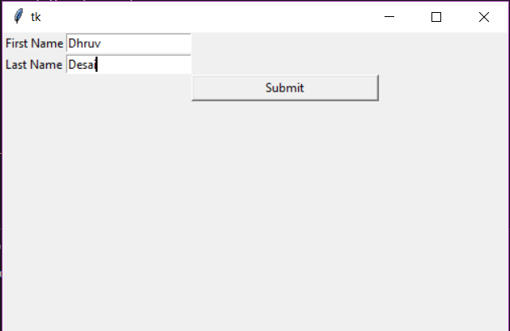
A simple GUI window

Slide 20
Building a website with Python
Web Frameworks:
Django:
Django is a high-level Python Web framework that encourages rapid development and clean, pragmatic design.
Flask:
Flask is a Python web framework built with a small core and easy-to-extend philosophy.
Notes:
Flask is easy to get started with as a beginner because there is little boilerplate code for getting a simple app up and running.

Slide 21
Building Website with Flask
Flask:
Flask is a micro web framework written in Python. It is classified as a microframework because it does not require particular tools or libraries.
Installing Flask in Python:
pip install Flask

Slide 22
Let’s see some Flask code
app.py
from flask import Flask
app = Flask(__name__)
@app.route('/')
def hello():
return 'Hello, World!'

Slide 23
Technology trends & Python
Web Development
Internet of Things (IOT)
Machine Learning & AI
Data Analysis
Data Science
Big Data

Slide 24
Reference & materials
Tkinter demos to get started
Basic: https://github.com/emailman/tkinter_demos
Some advance demos: https://github.com/errnox/tkinter-gui-demos
https://www.tutorialspoint.com/python3/python_gui_programming.htm
https://github.com/Miraj50/Awesome-Tkinter-Apps
For Flask
https://realpython.com/tutorials/flask/
Github Repository
https://github.com/dhruv-3d/PySession

Slide 25
Thank You

