Slide 1
FarmChainX AI Driven Agricultural Traceability Network
Problems:
1. No End-to-End Traceability
Once crops are mixed, origin is lost.
2. Paper-Based or Siloed Records
Data is: Manual, Fragmented, Not standardized
Risk of Food Adulteration
3. No Real-Time Monitoring
Temperature, humidity, spoilage risk — not tracked continuously.
4. Delayed Recall
If contaminated food is found:
It takes days or weeks to trace source.
Huge economic loss.
5. Farmer Exploitation
Lack of price transparency
Middlemen dominance
Agriculture Supply Chain
Farmers
Middlemen
Retailer
Consumer

Slide 2
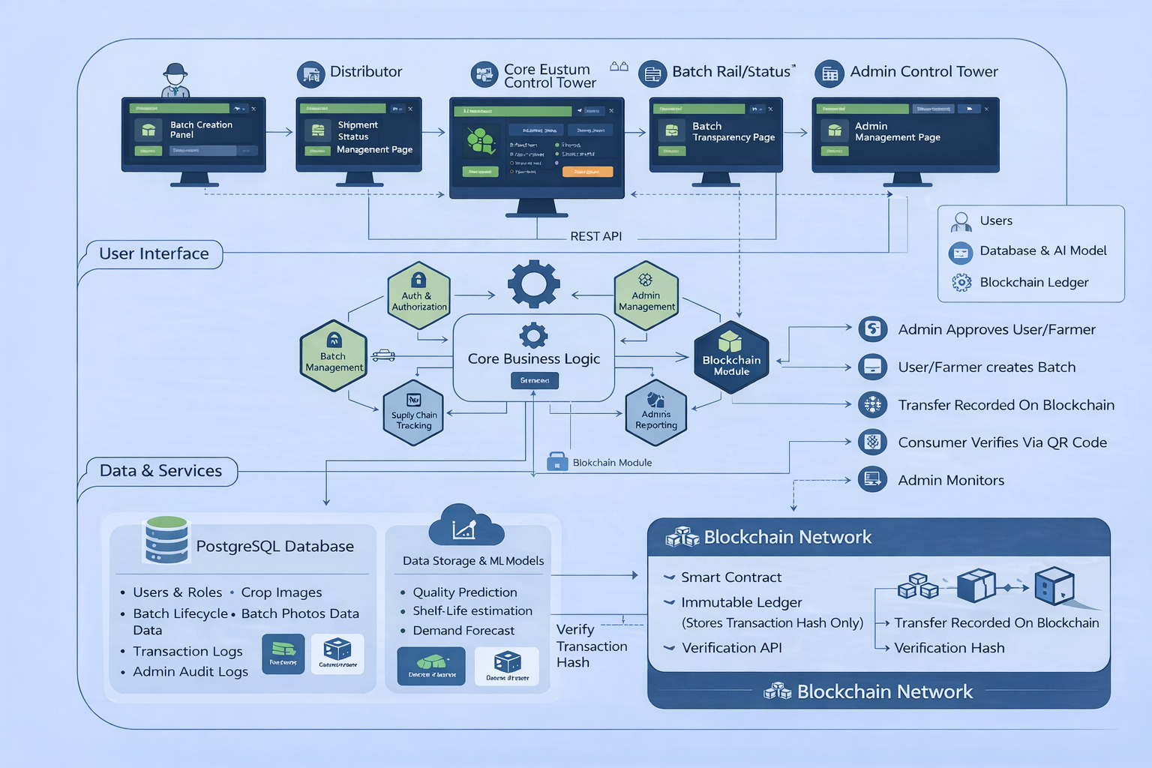
ARCHITECTURE DIAGRAM

Slide 3
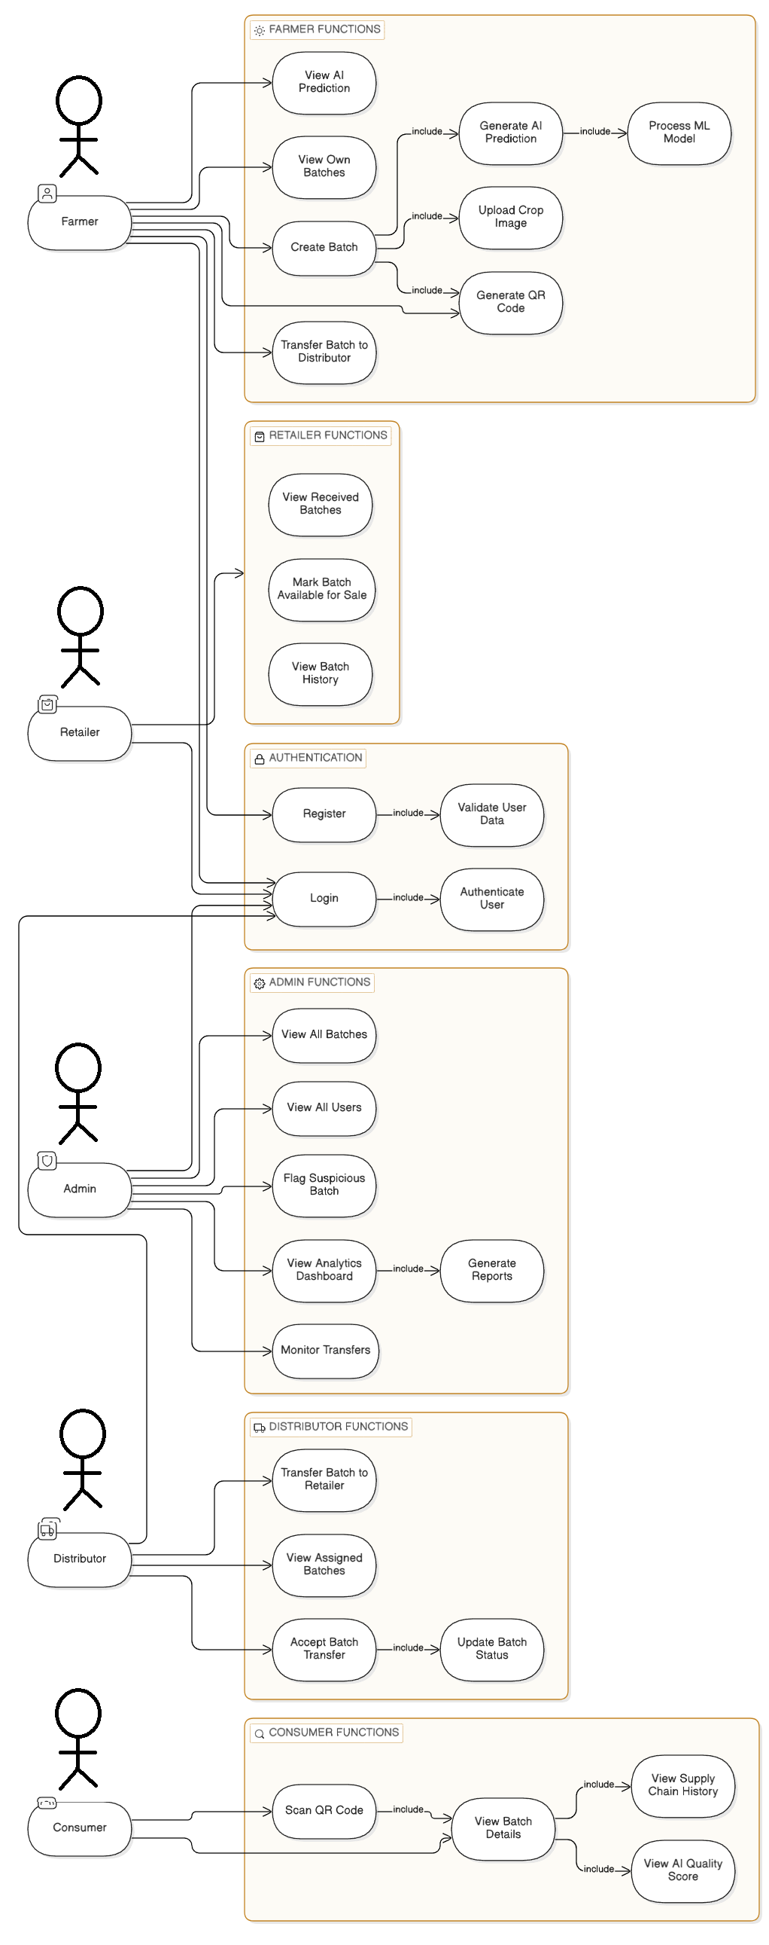
USECASE DIAGRAM

Slide 4
Modules
1. Authentication & Authorization Module
Purpose: Secure system access
Responsibilities:
User registration
Login
JWT generation
Role-based access control
Password encryption
Token validation
2. User Management Module
Purpose: Manage system users
Responsibilities:
Create users
Update profile
Fetch users
Admin user control
Activate/Deactivate accounts

Slide 5
3. Batch Management Module
Purpose: Core business module
Responsibilities:
Create batch
Update batch
Fetch batch details
Assign ownership
Store AI prediction results
Store image URL
4. Supply Chain Tracking Module
Purpose: Track movement of goods
Responsibilities:
Transfer batch (Farmer → Distributor)
Accept transfer
Transfer to retailer
Maintain transfer logs
Update batch status
5. QR Code Module
Purpose: Public transparency
Responsibilities:
Generate QR code
Map QR → Batch ID
Provide public endpoint
Return batch details
Used by: Consumer
6. AI Integration Module
Purpose: Connect backend to ML model
Responsibilities:
Send batch data to ML model
Receive prediction
Store quality score
Store shelf-life estimate
Handle prediction errors

Slide 6
7. Analytics & Reporting Module
Purpose: Admin dashboard insights
Responsibilities:
Generate summary stats
Total batches
Spoilage rate
Transfer counts
AI average quality score
Generate reports
8. NOTIFICATION MODULE
Purpose
To notify stakeholders when important events happen in the system.
Examples:
Batch transferred
Batch accepted
Batch flagged
Prediction generated
Batch recalled (future)
9. Blockchain Integration Module
Purpose: Record immutable transaction proofs on blockchain.
Responsibilities:
Create blockchain transaction
Store hash of transfer
Interact with smart contract
Verify blockchain record
Store transaction hash in DB
Handle blockchain errors

