Slide 1


Liver Disorder Prediction
Madhu Gaurav
Dhruv Mongia

Slide 2


Dataset
Data Set Information:
This data set contains 416 liver patient records and 167 non liver patient records. The data set was collected from north east of Andhra Pradesh, India. Selector is a class label used to divide into groups(liver patient or not). This data set contains 441 male patient records and 142 female patient records. Any patient whose age exceeded 89 is listed as being of age "90"
Attribute Information:
1. Age of the patient 2. Gender of the patient 3. TB Total Bilirubin 4. DB Direct Bilirubin 5. Alkphos Alkaline Phosphotase 6. Sgpt Alamine Aminotransferase 7. Sgot Aspartate Aminotransferase 8. TP Total Protiens 9. ALB Albumin 10. A/G Ratio Albumin and Globulin Ratio

Slide 3
What are we trying to do?
We are trying to compare the results of random forest and back-propagation in the detection of liver disorders.

Slide 4
why random forest and Back-Propagation
If there are more trees, it won’t allow overfitting trees in the model.(Low Generalization error)
Bootstrapping enables random forest to work well on relatively small datasets (Our dataset is small.)
Quick Prediction/ Training Speed
Robust to outliers and Non-Linear Data
Handles Unbalanced Data
Low Bias, Moderate Variance

Slide 5
Background
Two datasets
First dataset is taken from University of California at Irvine and it has 345 records with 6 attributes.
Second dataset is taken from Andhra Pradesh, India which has 583 records with 10 attributes.
common attributes :
Alkphos
SGPT
SGOT
In the UCI dataset, 145 patients were labelled as having liver diorder and in the Indian dataset, 416 patients were having liver disorder.
Accuracy, Precision, Sensitivity and Specificity better for Indian dataset

Slide 6
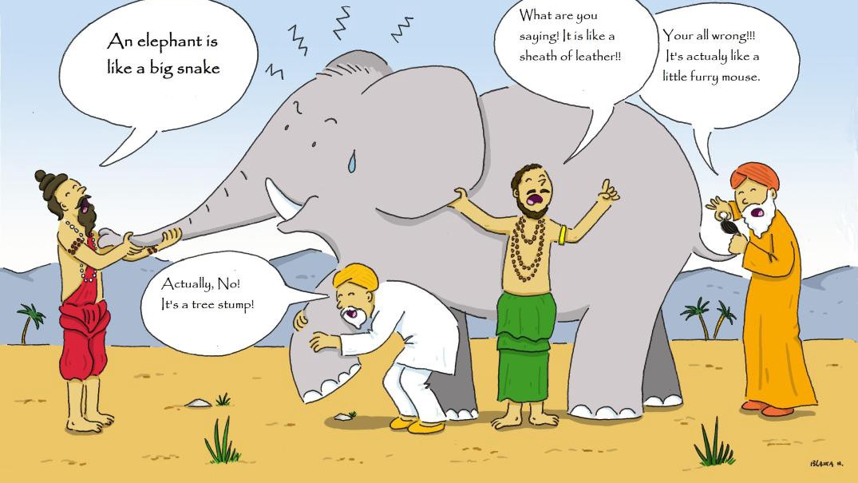

Random forest
WHAT IS EMSEMBLING?
Random forests are an ensemble learning method for classification and regression. operates by constructing a multitude of decision trees at training time and outputting the class that is the mode of the classes (classification).

Slide 7

Random forest
Scikit-Learn package
Train Data 80%
Test Data 20%
10-fold Cross Validation
Best parameters were found

Slide 8
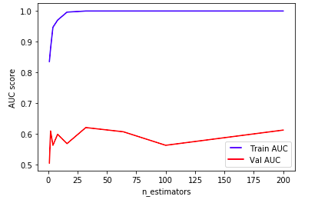
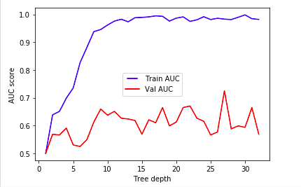

Parameter Tuning for Random Forest

Slide 9


True Error on random forest
The final model trained using
N-estimators: 32
Max-depth: 27
Accuracy: 70.94%

Slide 10
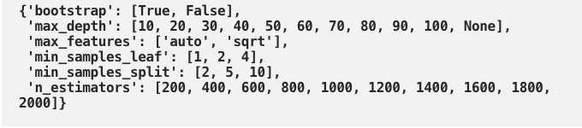
2 * 12 * 2 * 3 * 3 * 10 = 4320 settings

Slide 11
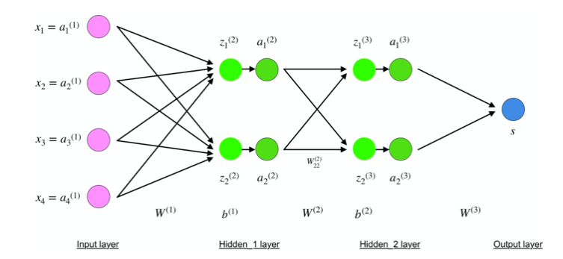
Back-Propagation
Multi-Layer Neural nets
Backpropagation is an algorithm widely used in the training of feed forward neural network for Supervised Learning.

Slide 12
Back Propagation
Keras
Train Data: 60%; Validation Data: 20%; Test Data: 20%
1 Hidden Layer
Activation: Relu for Input and Hidden Layer
Activation: Sigmoid for Output Layer
10 -> 8 -> 4-> 1
Optimizer: Adam
Loss Function: Binary Cross Entropy

Slide 13
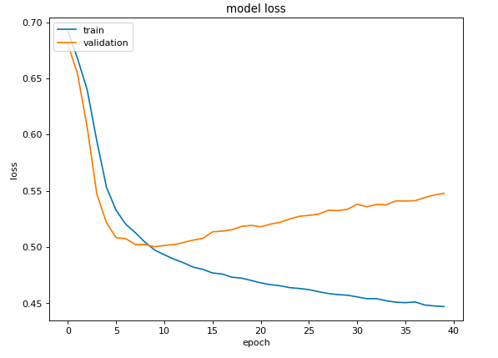
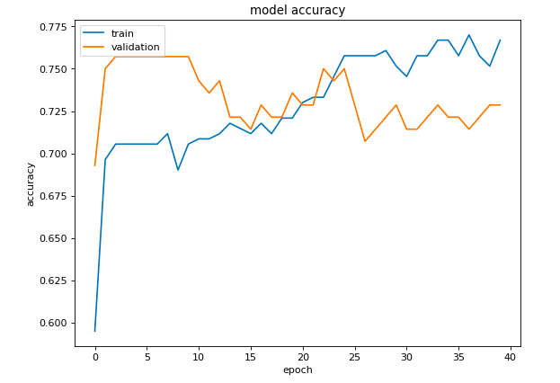
Number of Epochs to prevent overfitting

Slide 14
True error on Back propogation
Final model trained up to 9th Epoch
Accuracy: 70.08%

Slide 15
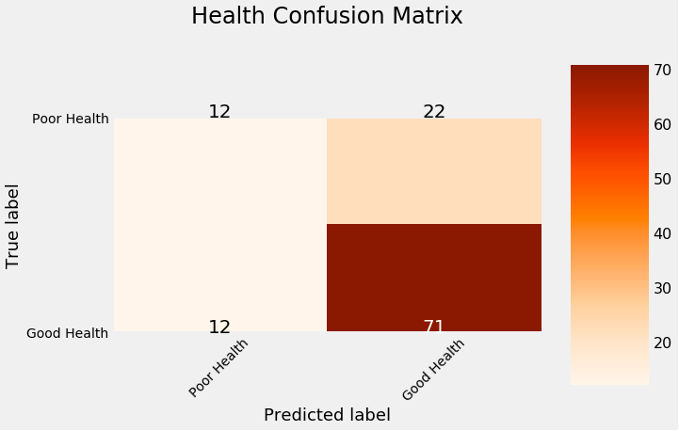
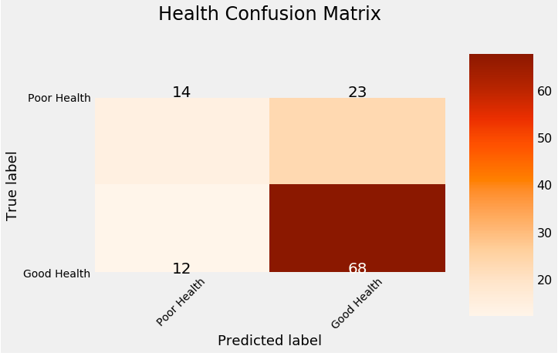
Random Forest
Back Propagation

Slide 16
 | Random Forest | Back Propagation
Accuracy | 70.94% | 70.08%
Sensitivity | 85.84% | 85.0%
Precision | 76.34% | 74.72%
Specificity | 35.29% | 37.83%

Slide 17
References
Bendi Venkata Ramana, Prof. M. S. Prasad Babu and Prof. N. B. Venkateswarlu, Critical Comparative Study of Liver Patients from USA and INDIA: An Exploratory Analysis, International Journal of Computer Science Issues, ISSN :1694-0784, May 2012.
Bendi Venkata Ramana, Prof. M. S. Prasad Babu and Prof. N. B. Venkateswarlu, â€œA Critical Study of Selected Classification Algorithms for Liver Disease Diagnosis, International Journal of Database Management Systems (IJDMS), Vol.3, No.2, ISSN : 0975-5705, PP 101-114, May 2011.

Slide 18

Thank YOu

