Slide 1

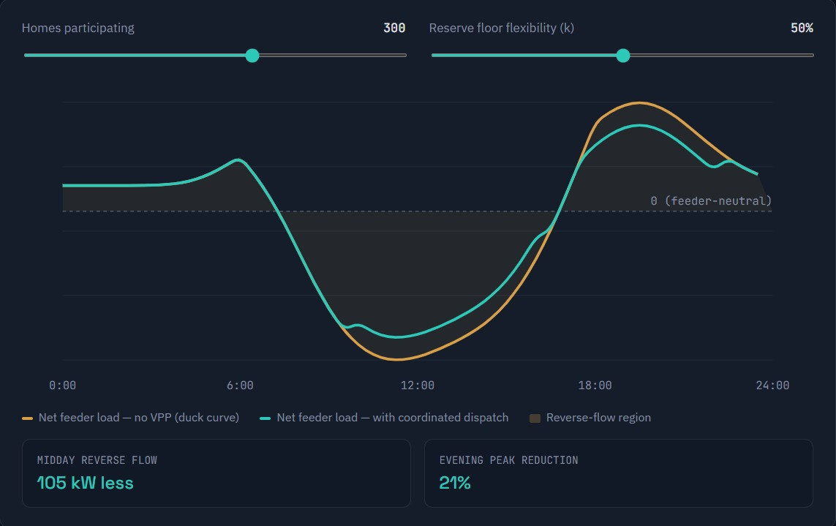
Avartan Sustainability Ideathon · Track 8
The Feeder as a power plant
Coordinating existing home batteries on an 11 kV feeder to flatten the load curve, respect every household’s backup reserve, and pay homeowners fairly without new hardware.
Team Name: Idea_buzz
Members :
Jenil Charadva
DhruvJodhani
Jay Patel

Slide 2
Problem
This is a coordination gap, not a hardware gap
The batteries and inverters already exist on these feeders. What’s missing sits in five places.
Visibility
No feeder-level view of individual battery state of charge, reserve setting, or generation.
Interoperability
No common protocol across inverter brands, every vendor speaks its own language.
Settlement
No structure that pays homeowners for dispatched energy without threatening their own backup power.
Trust
No mechanism that makes homeowners comfortable ceding any control over their battery.
DISCOM value
No quantified link between coordinated batteries and money actually saved.

Slide 3
Target user
One coordination layer, two customers either side
The homeowner
The DISCOM
Already owns a hybrid inverter and battery for backup. Wants to earn from spare capacity without ever risking their own reserve and wants that guarantee to be mechanical, not promised.
Watching rooftop solar push feeders toward reverse power flow (GERC already ties solar capacity to transformer capacity). Wants feeder stress relief and deferred capex, without waiting on new regulation to start.
And, Between them there will be a platform that makes existing storage visible, dispatchable and fairly paid.

Slide 4
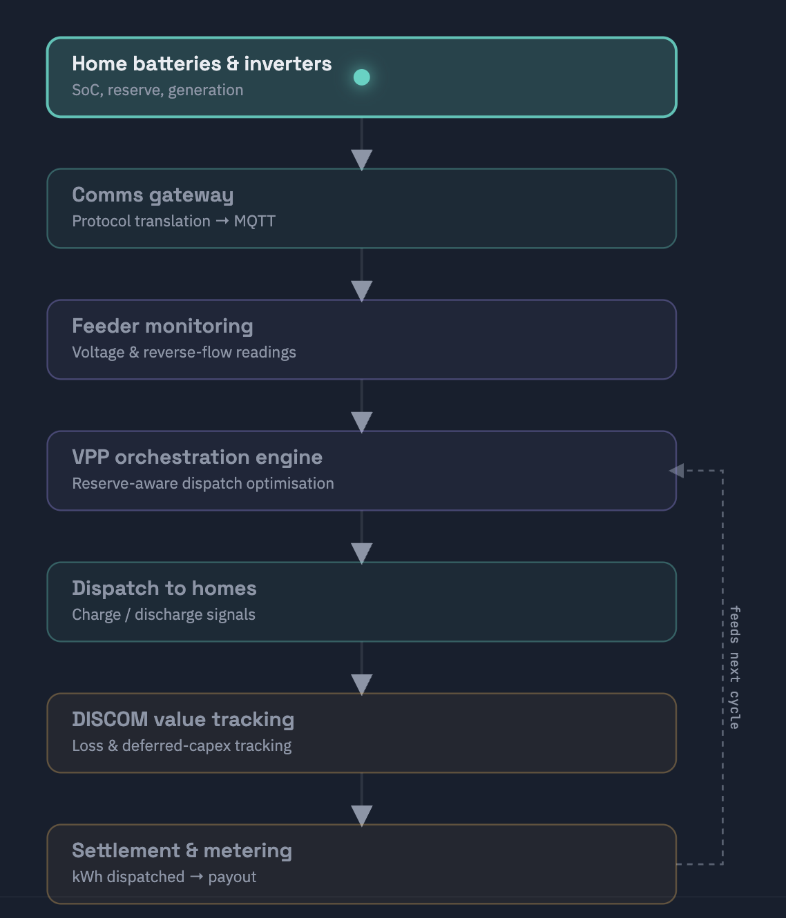
Technical concept
A closed loop: battery to payout, and back
- Home batteries & inverters
State of charge, reserve, generation
- Comms gateway
IEEE 2030.5 / SunSpec → one common feed
- Orchestration engine
Forecast-driven, reserve-aware dispatch
- Dispatch to homes
Never below a home’s own floor
- DISCOM value tracking

Slide 5
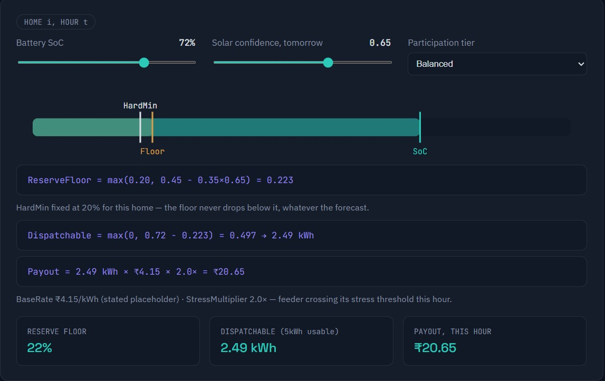
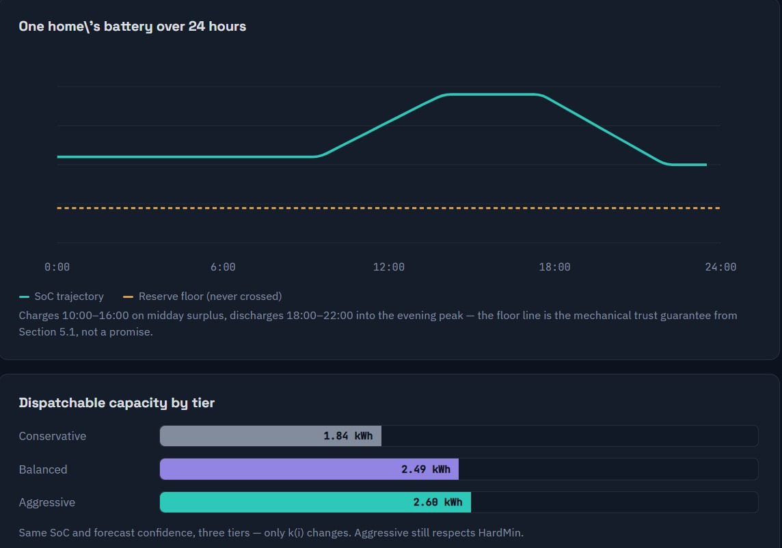
Assumptions
Three formulas carry the whole mechanism
ReserveFloor(i,t) = max( HardMin(i), BaseFloor(i) − k(i) × SolarConfidence(t+1) )
HardMin is never overridden — the trust guarantee, made mechanical. Confidence from a public forecast source (IMD / Open-Meteo).
Dispatchable(i,t) = max( 0, SoC(i,t) − ReserveFloor(i,t) )
Recomputed every cycle from live state of charge — never assumed static.
Payout(i) = Σₜ [ kWh dispatched × ₹4.15/kWh × StressMultiplier(t) ]
Participation tiers
Participation tier | k (reserve flexibility)
Conservative | 0.15
Balanced | 0.35
Aggressive (bounded) | 0.55

Slide 6
Feasibility evidence
Two arguments for the DISCOM, kept honestly separate
Loss reduction the real, modest
Deferred capex and the stronger case
Gujarat DISCOMs already run about 8.86% aggregate technical & commercial loss versus a 19.01% national average; Torrent Power reported 6.46% by FY21. The baseline is already efficient, so this argument is real but not transformative.
At an illustrative 1.4 kWh/home/day of coordinated dispatch, the feeder’s annual value already competes with a transformer’s purchase price:
Homes on feeder | Annual value | Against a reference transformer
200 | ₹4.24 L | ~76% of a 315 kVA unit (₹5.6–5.7L)
300 | ₹6.36 L | exceeds a 315 kVA unit
500 | ₹10.60 L | ~131% of a 630 kVA unit (₹8.0–8.1L)

Slide 7
Next 3 months
Phase 1: prove it on one feeder before scaling
Weeks 1–3
Weeks 4–7
Weeks 8–10
Weeks 11–12
Gateway deployment
Rule-based dispatch
Manual settlement
Validate trust
IEEE 2030.5 / SunSpec translation
50–100 homes, single feeder
Charge 10:00–16:00
Discharge 18:00–22:00
Reserve-floor formula live
Available SCADA feeder read
No DISCOM integration yet
Reserve dispatch in practice
Homeowner tier behaviour

Slide 8
Risks
What we haven’t solved yet, stated up front
Cybersecurity of dispatch commands
Authenticated MQTT, signed commands and not yet designed in detail.
Reserve model unvalidated against real telemetry
Phase 1 pilot exists to validate this.
Will homeowners actually trust the tiers?
User-tested in Phase 1, not assumed.
Rule-based dispatch is a simplification
Phase 2 replaces it with a real optimiser.
Transformer costs are cross-state
Illustrative; pilot needs a Gujarat-specific quote.
Every number in this deck is either a cited public source or a labelled assumption and nothing here is decorative.

