Slide 1
Wireless Communications
Wi-Fi CSI Gain and Phase Correction: Bandwidth and Synchronization Stress Test
Jenil Charadva - AU2440278
Jay Patel - AU2440269
Dhruv Jodhani - AU2440160
Lay Patel - AU2440258
Pratyusha Sharma - AU2440012
ECE 310
Group-4

Slide 2
Why we changed the base paper
M1 plan: stress-test the BVP motion indicator of Widar 3.0
Mentor asked: is Widar 3.0 the right base paper?
Widar 3.0 is from 2019; its extraction code has known problems
Not tied to an industry research lab
New base paper: Ratnam et al., IEEE TWC 2024 (Samsung)
Widar 3.0 becomes the downstream check planned for M3

Slide 3
Four reasons for choosing Ratnam et al.
1 · Peer reviewed
All authors at Samsung Research America (Standards and Mobility Innovation Lab)
2 · Targets our errors
Receiver gain and timing/phase synchronization
3 · Complete models
Complete models and algorithms; no code released, so we implement them
4 · Fits the course
OFDM, synchronization, SNR, channel estimation

Slide 4
Literature grouped by how errors are handled
Error-robust metrics (phase-only or amplitude-only, CSI ratio): throw away part of the CSI
Smooth or filter (Hampel, Savitzky-Golay, wavelet, median): distort CSI; no error model
Heuristic estimate-and-remove (sqrt of power, DBSCAN, line fit, 802.11az): not model-derived
Model-based (Ratnam et al.): validated at 20 MHz only, one respiration task, two receivers
Receiver comparison (Portner 2026 preprint): no wide bandwidth, no timing error
Above-signal fixes (Widar 3.0 BVP/DFS, test-time adaptation): assume clean CSI

Slide 5
Two layers that rarely talk to each other
Bottom layer: cleans raw CSI; tested at 20 MHz, simple settings
Top layer: generalisation methods that assume clean input
802.11bf makes wider bandwidth and multiband sensing normal
Multiband work: access-point synchronization still unsolved
So the bottom layer’s assumptions need checking

Slide 6
Technical gap: facts versus our hypothesis
Literature facts
Evaluated at 20 MHz (64 or 256 subcarriers), small timing error
Ignoring power variation works best when the signal is very weak (γ above about 0.95)
802.11bf and multiband work point to wider bandwidth; access-point clock sync unresolved
Our gap and hypothesis
Our gap (our reading): no controlled study of how corrections change with bandwidth and timing-error range, or of the effect on BVP/DFS
Our hypothesis (untested): corrections differ at 80 or 160 MHz; old baselines break first

Slide 7
Problem formulation: the CSI model (Eq. 2)
g[p]: receiver gain error (slow part plus AGC steps)
τ[p]: timing error from imperfect symbol-start detection
ψ[p]: common phase error left after CFO compensation
True channel h[p,k] = static b[k] + dynamic d[p,k]
γ: fraction of channel power in the static part
h̃[p,k] = g[p] · h[p,k] · exp(−j2π f_k τ[p]) · exp(−jψ[p]), f_k = k / T_s

Slide 8
Correction task (Eq. 3) and quality measure
Task: estimate g, τ, ψ per frame from h̃ only
Goal: corrected CSI as close as possible to the true channel
Quality: correlation χ of the corrected dynamic part with the true d (Eq. 29)
SNR = χ / (1 − χ), reported in dB
Paper’s SNR scale unstated (χ is a squared correlation there): compare ordering and trends only
ĥ[p,k] = h̃[p,k] · exp(j2π f_k τ̂[p]) · exp(jψ̂[p]) / ĝ[p]

Slide 9
Research questions RQ1 to RQ4
RQ1 · Reproduction
Do the model-based corrections of Ratnam et al. beat the baselines in our own implementation?
RQ2 · Bandwidth
How does quality change as subcarriers grow from 64 to 512 (20 to 160 MHz)?
RQ3 · Synchronization
How does it change when timing error grows far beyond the paper’s 100 ns?
RQ4 · Planned for M3
Do RQ2 and RQ3 carry over to real receiver data and to BVP/DFS after correction?

Slide 10
Pipeline and the six methods implemented
Raw CSI
Gain correction
Phase correction (timing + CPE)
Corrected CSI
χ / SNR
Gain methods
Eq. 6: divide by sqrt of mean power (Baseline)
Algorithm 1: DBSCAN on power increments, 0.1 Hz low-pass (Proposed, simple)
Algorithm 3: ML estimate on a uniform AGC grid (Proposed, best in paper)
Phase methods
Eq. 21: line fit on unwrapped phase (Baseline)
Eq. 22: 802.11az timing estimator (Baseline)
Algorithm 4 with Eq. 25: weighted least squares (Proposed, best trade-off in paper)

Slide 11
Simulator defaults
Python simulator (NumPy, SciPy, scikit-learn); defaults follow Sec. V-B of Ratnam et al.
T_s = 3.2 µs, frame interval 100 ms, 300 frames per trial
K = 64, γ = 0.9, i.i.d. complex Gaussian dynamic part
Static channel: random six-tap exponential profile, 200 ns spread
Large-scale gain: Gaussian process, 0.2 dB std below 0.1 Hz
AGC gain {−0.5, 0, +0.5} dB, probabilities {0.2, 0.6, 0.2}
Timing error uniform [0, 100 ns); CPE uniform [−π, π)
Fixed random seed: every number can be regenerated exactly

Slide 12
Experiments E1 to E5
Exp. | Type | Correction | What varies
E1 | Reproduction | Phase | γ varied; K = 64
E2 | Reproduction | Gain | γ varied; K = 64
E3 | Stress test | Phase | Max timing error 100 ns to 3.2 µs; K = 64, γ = 0.9
E4 | Stress test | Phase | K = 64, 128, 256, 512 (20, 40, 80, 160 MHz); γ = 0.9
E5 | Stress test | Gain | K as in E4; γ = 0.9
Each step is judged with the other step made ideal; median of 100 trials (paper: 2000)

Slide 13
Simplifications and why they matter
Static channel: random six-tap profile (200 ns spread), not 802.11ax Model-C
Only the i.i.d. dynamic component (type i), not the Doppler-structured type (ii)
100 trials per point, not 2000; no significance tests
Eq. 21 sign fixed by us; Eq. 16 garbled, so Algorithm 3 uses nearest-integer rounding
Both still to be checked against the published PDF
No cyclic prefix or ISI: matters for E3

Slide 14
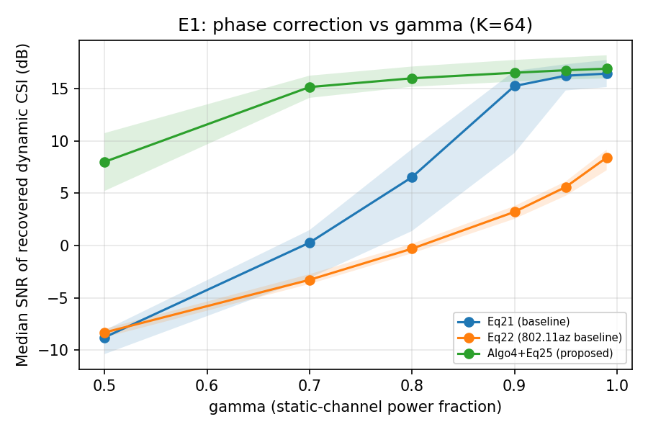
E1: phase methods versus γ
Ordering reproduced for γ ≥ 0.7: Algorithm 4 best, Eq. 21 second, Eq. 22 worst
At γ = 0.5: 8.0 dB versus −8.8 (Eq. 21) and −8.3 dB (Eq. 22)
Margin not reproduced at γ = 0.9: 16.5 vs 15.2 dB (about 35%); paper: over 1000%
Likely cause (untested): our simplified channel
Figure from the M2 report: median SNR (dB), 100 trials; shaded band = interquartile range

Slide 15
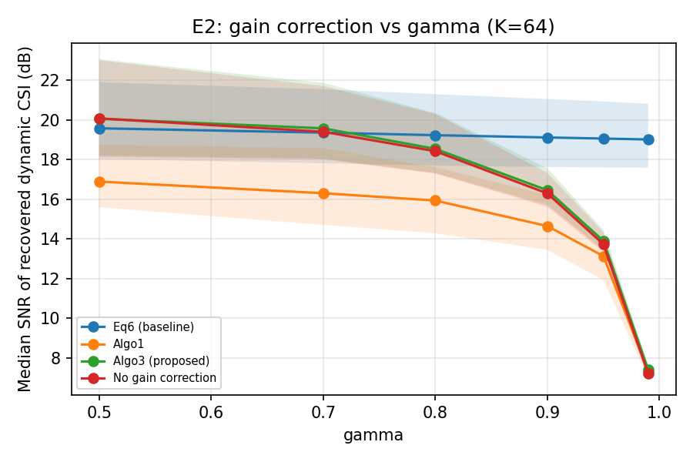
E2: gain methods versus γ
Not reproduced: Eq. 6 beats Algorithm 3 at every γ from 0.8 up (γ = 0.9: 19.1 vs 16.5 dB)
Algorithm 3 ≈ no correction (16.3 dB); Algorithm 1 lower (14.6 dB)
No correction falls from 20.1 to 7.2 dB as γ rises
Cause of the mismatch still unknown
Figure from the M2 report: median SNR (dB), 100 trials; shaded band = interquartile range

Slide 16
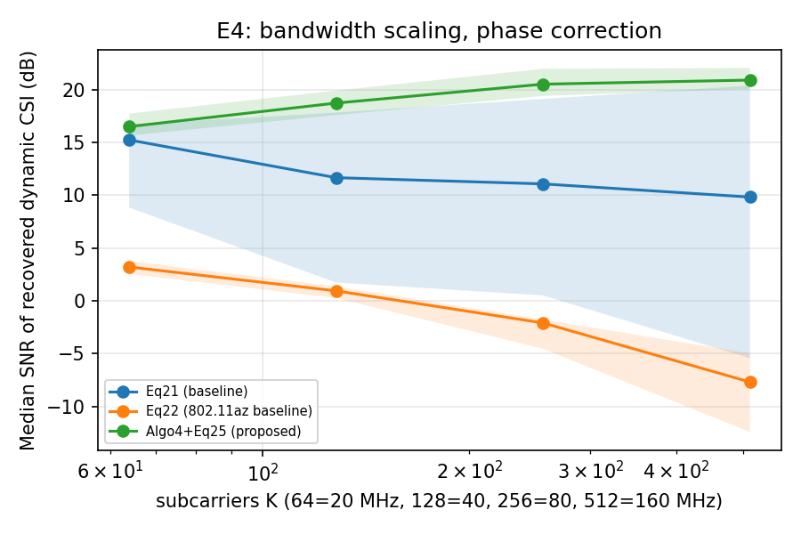
E4: phase versus bandwidth
Proposed improves: 16.5 to 20.9 dB from 20 to 160 MHz
Eq. 21: 15.2 to 9.8 dB; Eq. 22: 3.2 to −7.7 dB
Gap to Eq. 21 grows from 1.3 to 11.1 dB
Why baselines worsen: our guesses only, not isolated
Figure from the M2 report: median SNR (dB), 100 trials; shaded band = interquartile range

Slide 17
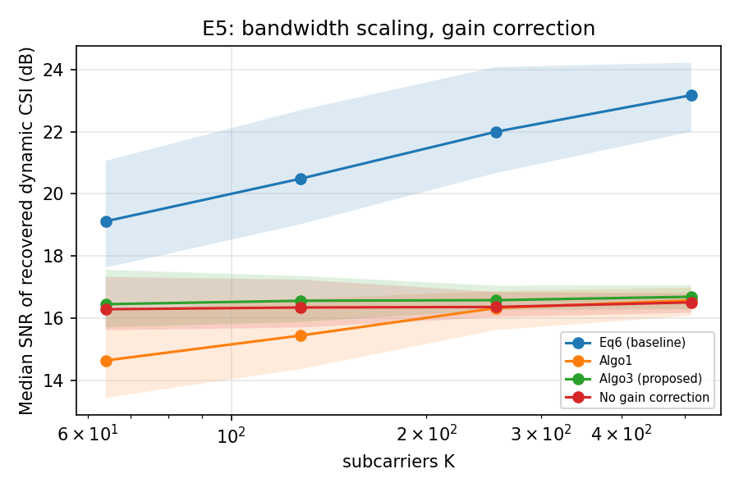
E5: gain versus bandwidth
Eq. 6 improves with K: 19.1 to 23.2 dB
Algorithm 3 flat at about 16.5 dB; Algorithm 1: 14.6 to 16.6 dB
Not reproduced: we expected Algorithm 3 to gain with K; it may have a bug (open item)
Figure from the M2 report: median SNR (dB), 100 trials; shaded band = interquartile range

Slide 18
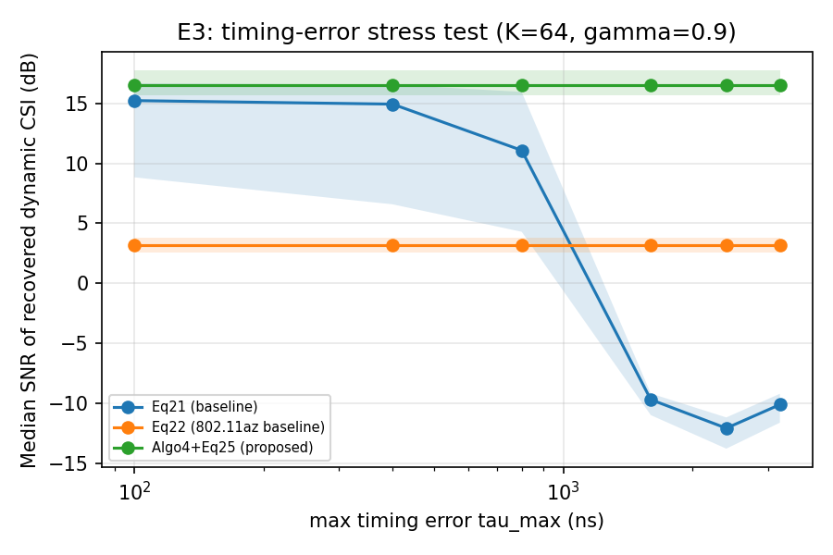
E3: timing-error range
Eq. 21 collapses near half a symbol: 11.1 dB (800 ns) to −9.7 dB (1.6 µs)
Eq. 22 flat but low at 3.2 dB; Algorithm 4 flat at 16.5 dB
No robustness claim: simulator has no cyclic prefix or ISI
Figure from the M2 report: median SNR (dB), 100 trials; shaded band = interquartile range

Slide 19
SOTA positioning
 | Ratnam et al. 2024 (anchor) | Our M2 | Our plan
Problem | Remove gain and timing/phase error, single antenna | Same problem, same model (Eq. 2) | Scale bandwidth and timing error; effect on BVP/DFS
Method | Model-based ML and weighted least squares | Algorithms 1, 3, 4 and baselines implemented | Verify Algorithm 3; targeted fix only if needed
Evaluation | 2000 trials (Model-C); respiration test, 75 episodes, 20 MHz | 100 trials, simplified channel, no real data | More trials, Model-C-like channel, real multi-device data [3]
Reproducibility | No code or data published | Code and results in our repository, seeded | Same, plus real-data scripts
Result | Beats baselines by 40% (gain), 200% or more (phase) | Phase: same order, smaller margin; gain: not reproduced | Explain or fix the gain discrepancy

Slide 20
Limitations
Own simulator, simplified channel; no real CSI results yet
100 trials per point, not 2000; no test beyond the interquartile range
Only the i.i.d. dynamic component simulated
Eq. 16 and Eq. 21 not yet checked against the published PDF
E2 and E5 disagree with the paper; we distrust our Algorithm 3
E3 has no ISI; single antenna only

Slide 21
Plan for M3 and M4
Now to M3 (1 Nov)
Check Eq. 16, Eq. 21, Algorithm 3 against the PDF
Retest Algorithm 3 at K = 256 and with a more realistic channel
Raise trials to 500 or more; add confidence intervals
Run baselines and our implementation on public multi-receiver CSI data (Portner et al.)
Correct before BVP/DFS on Widar 3.0 data (RQ4)
M3 to M4 (22 Nov)
Targeted fix if there is a clear wide-bandwidth failure
Final report and clean repository

Slide 22
Take-away
Phase correction
In simulation, phase correction matters more at wide bandwidth
Gain correction
Gain results remain open

Slide 23
THANK YOU !

