Slide 1
Chimera
A closed-loop adversarial lab for GenAI-era payment fraud.
Discover emerging fraud, simulate it at fidelity across card, real-time and agentic rails,
and harden a detector on what it misses. Identify, generate, defend - one feedback loop.
Mastercard Innovation Challenge @ GFF 2026 · AI Defense Lab for Payment Security

Slide 2
THE PROBLEM
Static defences decay the moment fraud changes shape
· GenAI made fraud faster, cheaper and adaptive: deepfakes ~11% of global fraud, biometric-fraud
deepfake attempts up ~58%, Fraud-as-a-Service from ~$50/mo.
· 2026 frontier: agentic commerce. Autonomous agents transact on delegated tokens with no step-up;
Visa logged a 450%+ rise in dark-web 'AI Agent' chatter; agents run live carding at machine speed.
· Real-time rails are the laundering surface: 524k mule accounts flagged in India in March 2026 alone.
· Evaluating one classifier on a fixed dataset measures fit to yesterday's fraud - not robustness to an
adaptive adversary. The challenge asks for a loop. I built one.

Slide 3
SYSTEM
One system, three pillars, one loop
IDENTIFY
GENERATE
DEFEND
ATT&CK-style taxonomy of 16 GenAI fraud techniques +
live RAG ideation agent (LangGraph / Groq gpt-oss-120b)
Multi-rail simulator + entity graph + hard negatives +
9 attack synthesizers + adversarial evasion search
LightGBM + novelty channel + agent-identity features +
SHAP reason codes + cost-aware operating point
The loop: identify → generate (evolve evasion) → detect → evaluate → retrain on what breaks through →
re-ideate. Shipped as a plain engine and as a LangGraph multi-agent StateGraph.

Slide 4
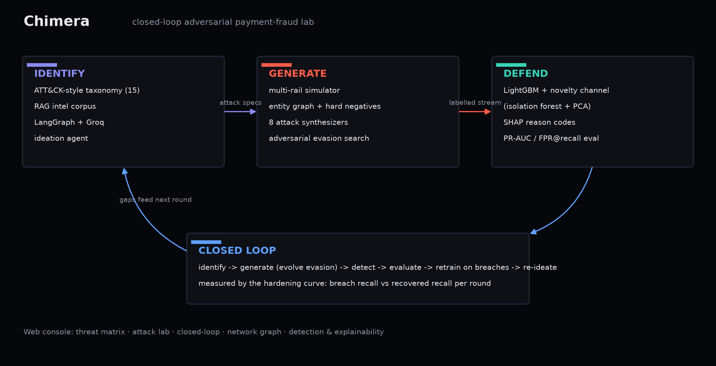
ARCHITECTURE
One codebase, three pillars, one loop

Slide 5
ORCHESTRATION
A live multi-agent system (LangGraph)
RECON
RED TEAM
ATTACK
BLUE TEAM
RAG-grounded ideation
proposes novel variants
(gpt-oss-120b)
>
evolutionary search
tunes each attack to
evade the live model
>
generates the evasive
stream, measures the
breach
>
retrains on the misses,
measures the recovery,
then the graph cycles
A compiled StateGraph cycles recon -> red_team -> attack -> blue_team until the round budget is spent.
Execution trace (this report was generated by the graph):
baseline: detector recall 72.9% @ thr=1.000
[round 1] red_team: evolved evasive parameters for 9 vectors
[round 1] recon: 9 RAG-grounded variants proposed (groq:openai/gpt-oss-120b)
[round 1] attack: evasive stream breaches to 19.2% recall
[round 1] blue_team: retrained, recovers to 82.9% recall
[round 2] red_team: evolved evasive parameters for 9 vectors

Slide 6
IDENTIFY
Mapping the threat landscape
A payment-fraud ATT&CK matrix: 6 kill-chain tactics x 16 techniques, each grounded in 2026
intelligence with the observable signatures a defender can exploit. Nine simulated end-to-end.
Novel, high-signal vectors I cover:
· Delegated-token / agent-identity abuse - a hijacked agent spends inside a cardholder's mandate
(Agent Pay, Trusted Agent Protocol). The 2026 frontier, and my headline new capability.
· Agentic-commerce carding - machine-speed abuse of delegated agent tokens.
· Deepfake-authorised push payments - cloned voice/video; the victim authorises, so auth can't stop it.
· Money-mule networks - fan-in / fan-out layering within minutes on real-time rails.
· Synthetic-identity bust-out, account takeover, pig-butchering, structuring, card testing.
Ideation agent: RAG-grounds where the detector is weak and proposes novel variants as structured
specs. Runs live on Groq gpt-oss-120b (every loop round is tagged with the model) or an offline
planner - the demo never breaks.

Slide 7
GENERATE
Fidelity is the point
· Realistic population: 237,905 events, 1.39% fraud, across
card-not-present, card-present and real-time A2A, plus a shared agentic channel.
· Entity graph (accounts, devices, merchants, payees) so coordinated attacks surface as structure.
· Hard negatives - the credibility centrepiece. I inject legitimate look-alikes (benign agentic
shopping, large first-time payees, travel, collector accounts, recurring investments) into the exact
feature regions where fraud lives. Without them any single flag separates the classes and AUC is a
meaningless 1.0.
· Adversarial evasion: a black-box evolutionary search tunes each attack's shape (not volume) to
minimise the live detector's risk - the generator becomes a live red team.

Slide 8
DEFEND
Accuracy with an honest novelty story
· Supervised: LightGBM on ~45 features - event, behavioural velocity (per-account windows,
inter-arrival, amount z-score vs own history), structural (device fan-out, counterparty
in-degree, A2A graph degree + PageRank), and an agent-identity family (attestation, directory
trust, mandate-cap breach, agent-id replay fan-out) for delegated-token abuse.
· Novelty channel: isolation forest + PCA reconstruction on legit-only traffic. Flags unseen attack
types the supervised model was never trained on - the zero-day answer.
· Explainability: per-event reason codes via exact TreeSHAP (no extra serving dependency).
· Cost-aware operating point: fraud value recovered + alerts per 10k + a cost-optimal threshold -
the metrics a fraud desk signs off. Mitigation: risk -> allow / step-up / hold / block.

Slide 9
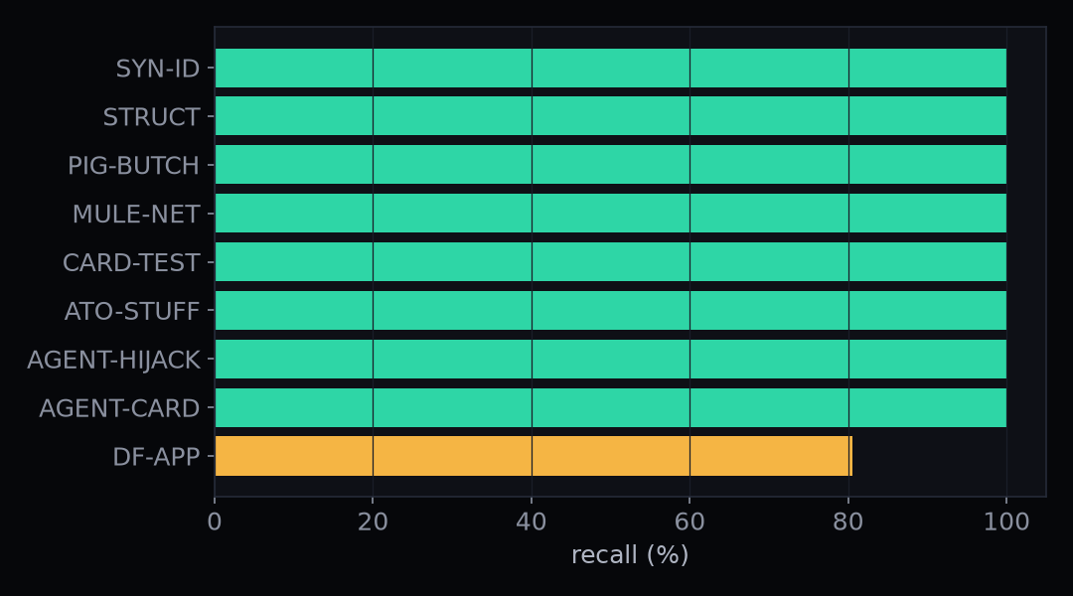
RESULTS · DETECTION
Strong, and reported honestly
ROC-AUC
PR-AUC
F1
FPR @ 90% recall
1.0000
0.9999
0.995
0.000%
Per-vector recall is deliberately uneven. Deepfake authorised-push sits lower - the victim uses
their own device and genuine auth, so it is the hardest to catch. Structural attacks are caught in
full. Near-perfect aggregate AUC reflects strong signatures on naive campaigns - the real test is
adversarial pressure (next slides).
Cost-aware operating point: 100% of fraud value recovered at
~140 alerts per 10k transactions.

Slide 10
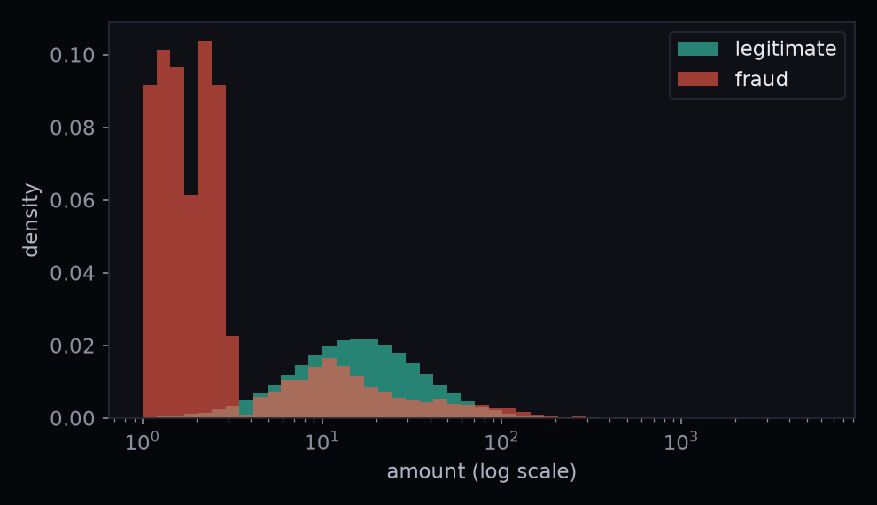
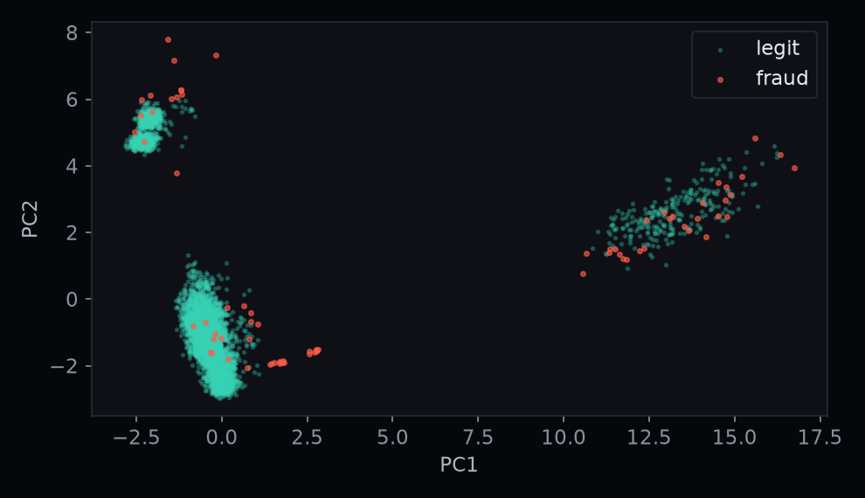
RESULTS · FIDELITY
The data is genuinely hard, by design
Fraud and legitimate traffic overlap in feature space (PCA, top). The single most
discriminative feature reaches only AUC 0.83
(acct_in_deg), so no one flag separates the classes - the model must
combine velocity, graph and behavioural signals.
Amounts follow realistic log-normal distributions per account; fraud is embedded in the same
space rather than bolted on. Hard negatives (benign agentic shopping, collector accounts,
large first-time payees) sit exactly where fraud lives - which is what makes the benchmark
credible instead of a trivial AUC of 1.0.

Slide 11
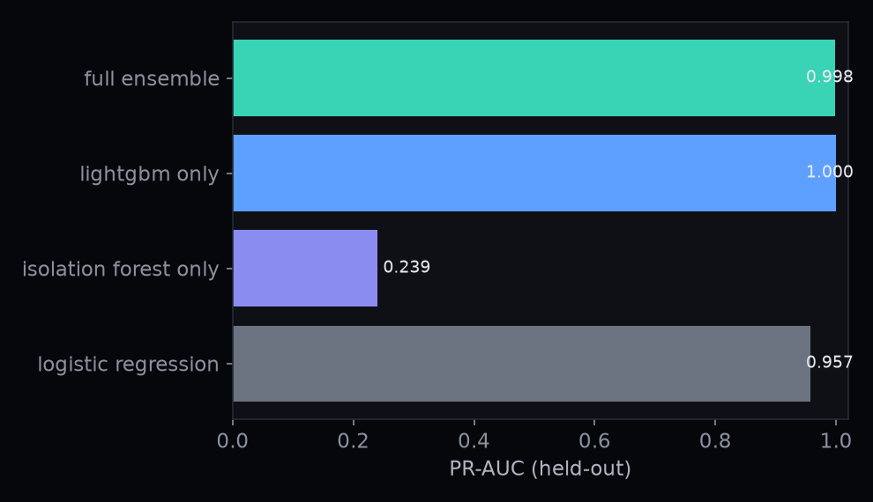
RESULTS · ABLATION
The ensemble earns its complexity
Held-out PR-AUC across models. Logistic regression and an isolation-forest-only detector
leave signal on the table; gradient boosting captures the non-linear velocity/graph
interactions; the novelty channel adds unseen-attack coverage on top.
Every number is a measured lift, not an assertion - the complexity is justified.

Slide 12
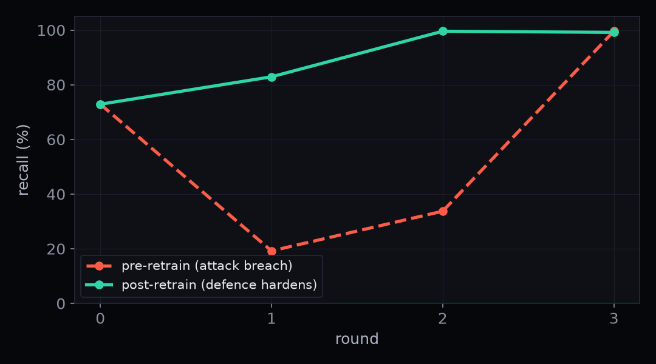
RESULTS · THE CLOSED LOOP
The hardening curve - the whole thesis in one chart
Round 1: the red team finds evasion that collapses recall to 19% - a static model would be
blind. Retraining on those samples restores it.
By rounds 2-3 the red team can no longer find easy evasion against the hardened detector: the loop
converges. The defence learned to generalise across the adversary's moves.
Behavioural attacks (deepfake push, pig-butchering, structuring) can be tuned to near-invisibility
against a static model; structural attacks can't. Closed-loop retraining is what recovers the
evadable classes - a single static model cannot.

Slide 13
HEADLINE CAPABILITY
Agentic-commerce identity abuse - the 2026 frontier
A payment can now be initiated by an autonomous agent on a cardholder's behalf (Mastercard Agent
Pay's Agentic Token; Visa's Trusted Agent Protocol). A hijacked or malicious agent - via prompt
injection, token theft, or a rogue SDK - spends inside someone else's mandate. It looks identical to a
legitimate agent on velocity, device and cadence. Only credential integrity separates them.
What I simulate
New defence family
Unseen-vector result
AGENT-HIJACK: one agent id
replayed across many mandates,
off-scope spend, weak attestation
attestation · directory trust ·
mandate-cap breach · agent-id
replay fan-out
supervised 15% -> novelty 100%
(trained with this attack fully
removed, then scored on it)

Slide 14
WHY IT WINS
Novelty & real-world feasibility
Novel: a working closed loop with a measured hardening curve; agentic-commerce identity abuse as a
first-class simulated vector with a matching defence family; live red-team ideation from an open-weight
model (gpt-oss-120b) running in the real loop; adversarial evasion as a live red team; a novelty channel
evaluated with leave-one-vector-out; cost-aware, hard-negative-driven reporting.
Feasible: the schema is what a real switch sees at authorisation; controls map to 3-DS step-up and
RBI friction / kill-switch; graph features mirror NPCI MuleHunter-style detection. On live data,
features move to a streaming store (point-in-time correct) and the loop becomes a scheduled retrain.
Paid infrastructure is a quality dial, not a rewrite: managed embeddings + vector DB for richer
ideation, a temporal GNN for large rings, a hosted endpoint for always-on live variant generation.

Slide 15
SELF-ASSESSMENT
How this maps to the five judging criteria
Diversity of attacks
16 techniques, 9 simulated across card / real-time / agentic rails, plus a live agent that proposes more.
Fidelity of simulation
Latent-profile population, entity graph, hard negatives - best single-feature AUC only 0.84.
Detection efficacy
LightGBM + novelty + agent-identity features; 100% of fraud value caught at ~140 alerts / 10k.
Novelty
Closed loop with a measured hardening curve; agentic-commerce identity abuse; a live multi-agent red team.
Real-world feasibility
Auth-time schema, graded controls, NPCI-style graph signals, Agent Pay / TAP field mapping, streaming path.

Slide 16
RESPONSIBLE USE
Defensive by construction
· Runs entirely on synthetic data it generates itself - no real cardholders, PII, credentials or
live payment connectivity.
· Attack modules are parameterised statistical patterns (amounts, timing, graph shape) that stress a
detector - not operational playbooks, social-engineering scripts, or working exploit code, and they
cannot be pointed at a real system.
· One-directional value: the red team exists only to harden the blue team. The output is a stronger
detector plus a prioritised view of which vectors most need human review and step-up controls.
· In production this belongs inside a bank's controlled environment with human oversight, aligned to
responsible-AI and model-risk governance.
Chimera · identify · generate · defend · one loop

