Slide 1
AUSTRALIAN BANK RISK ANALYTICS
& Portfolio Optimization — A 25-Year Empirical Study
CBA · NAB · WBC · ANZ · MQG vs ASX200 Accumulation Index
Milestone 7 — Final Synthesis | September 2026

Slide 2
Research Question & Objectives
1
Characterise return, volatility & tail risk per bank
“
How do Australia's major banks differ in market risk, tail risk, and systematic risk over a 25-year period spanning multiple crises — and can mean-variance portfolio optimisation improve risk-adjusted outcomes, robustly?
2
Estimate systematic risk via CAPM + full diagnostics
3
Compare beta across GFC, COVID-19 & rate-hike regimes
4
Build equal-weight, min-variance & max-Sharpe portfolios
5
Validate out-of-sample and under stress
6
Test robustness across 3 estimation windows
2

Slide 3
Dataset & Australian Banking Sector Context
25 yrs
2001–2026 sample
4 + 1
CBA, NAB, WBC, ANZ + Macquarie Group
6,293
daily observations
ASX200
Accumulation Index benchmark
The four major retail banks plus Macquarie Group make up a large share of the ASX200's market capitalisation and dividend income, and are widely held both directly (partly for franking-credit income) and indirectly through superannuation — an unusually concentrated sector by international standards.
Price source: Yahoo Finance (yfinance), adjusted close.
Benchmark: ASX200 Accumulation (Total Return) Index.
Risk-free proxy: RBA cash rate, mean 3.38% p.a.
No missing data across the regression sample.
3

Slide 4
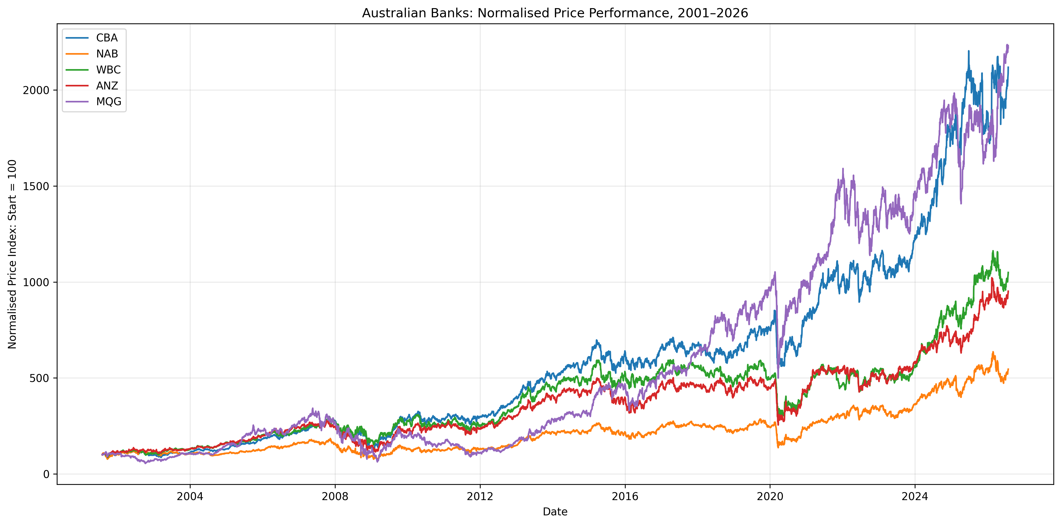
25-Year Performance Overview
MQG
Best return AND worst risk
17.6% p.a. return
32.5% volatility (vs 22–24% for the others)
−81.7% max drawdown
NAB was the weakest of the 4 majors: lowest return, highest volatility.
4

Slide 5
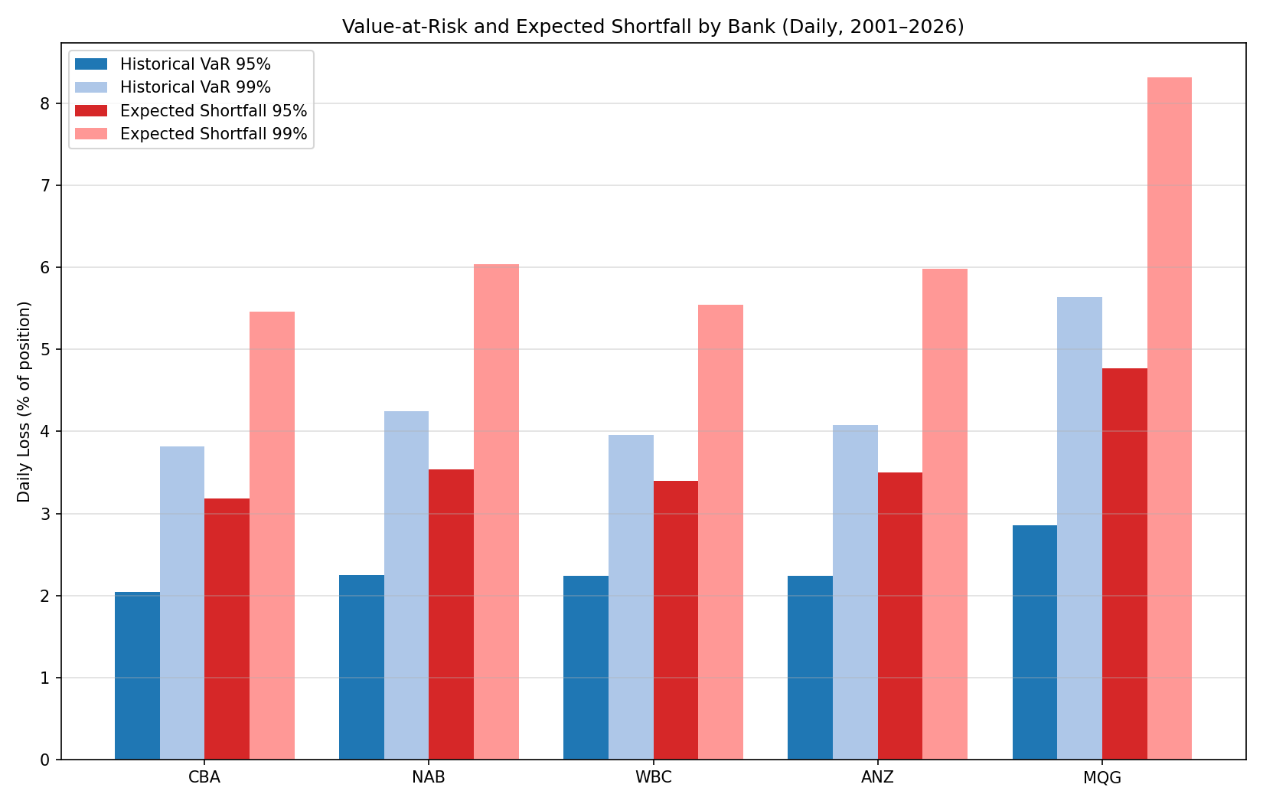
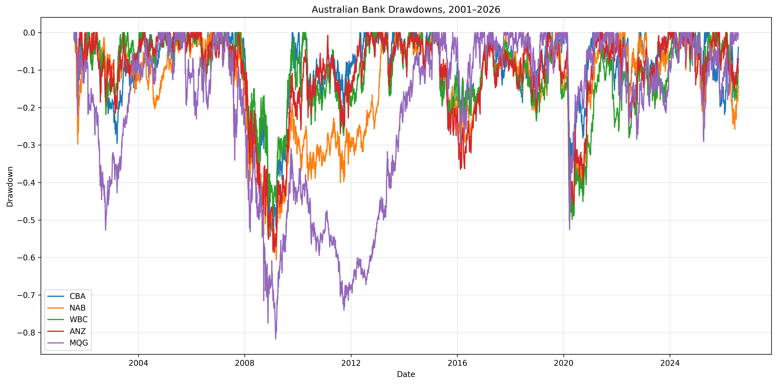
Market Risk: VaR, Expected Shortfall & Drawdown
ES99 exceeds VaR99 by ~45–50% for every bank — VaR alone understates true tail risk.
5

Slide 6
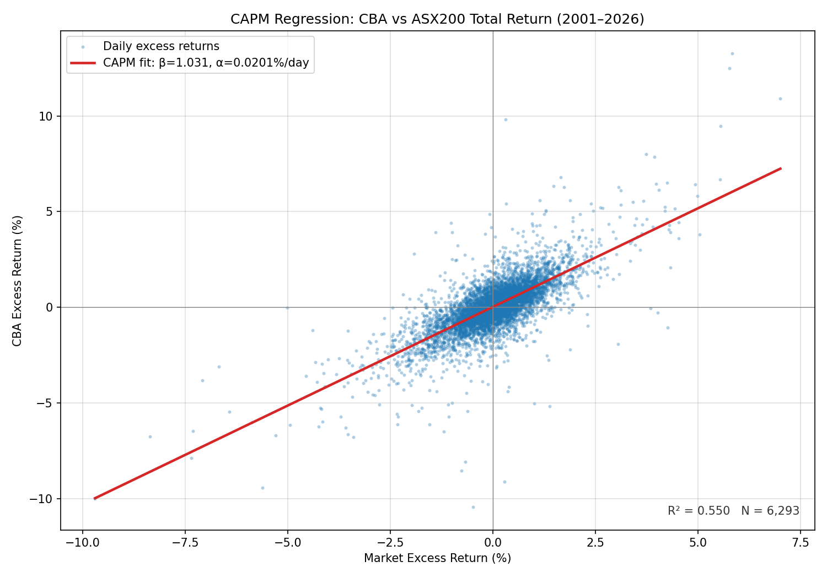
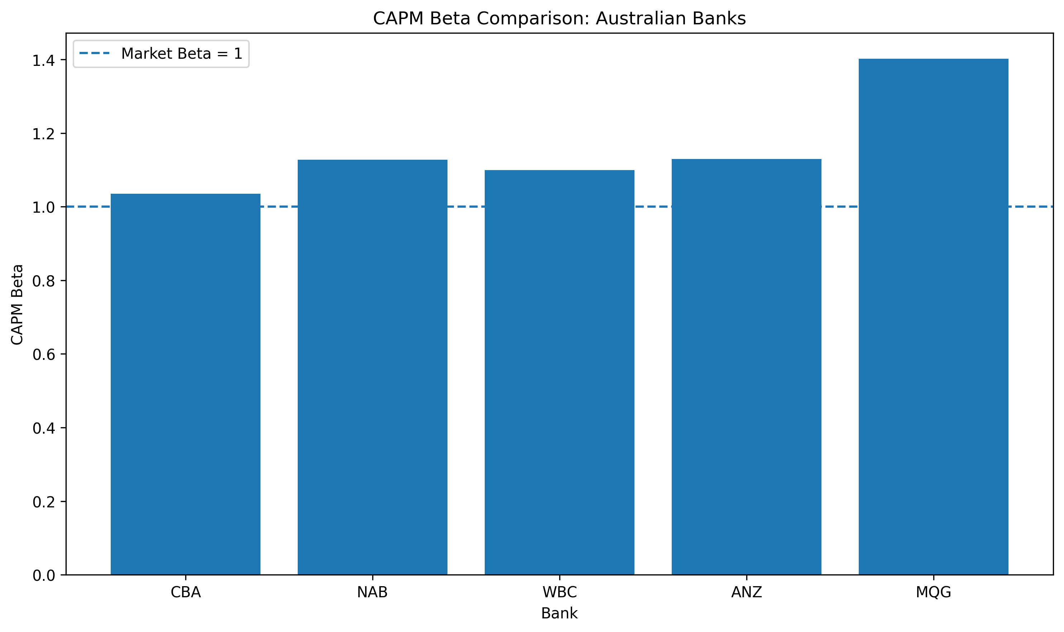
CAPM & Econometric Results
All 5 betas > 1 and highly significant (t = 73–88) • All 5 alphas statistically insignificant (p > 0.08) • R² ≈ 0.46–0.55 — the market factor explains only about half of daily return variance
6

Slide 7
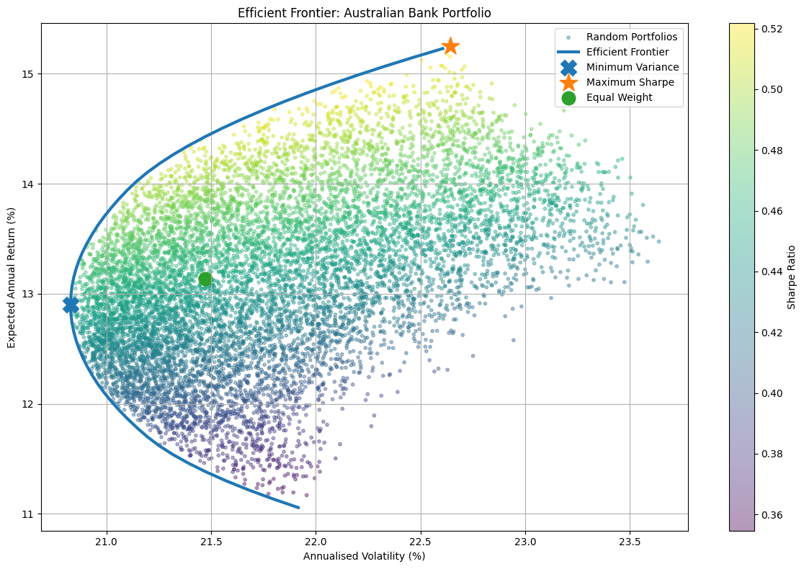
Efficient Frontier
10,000
randomly simulated feasible portfolios
53
target-return optimisations trace the analytical frontier
Validated:
best random-search Sharpe (0.522) sits within 0.003 of the optimiser's result (0.524)
7

Slide 8
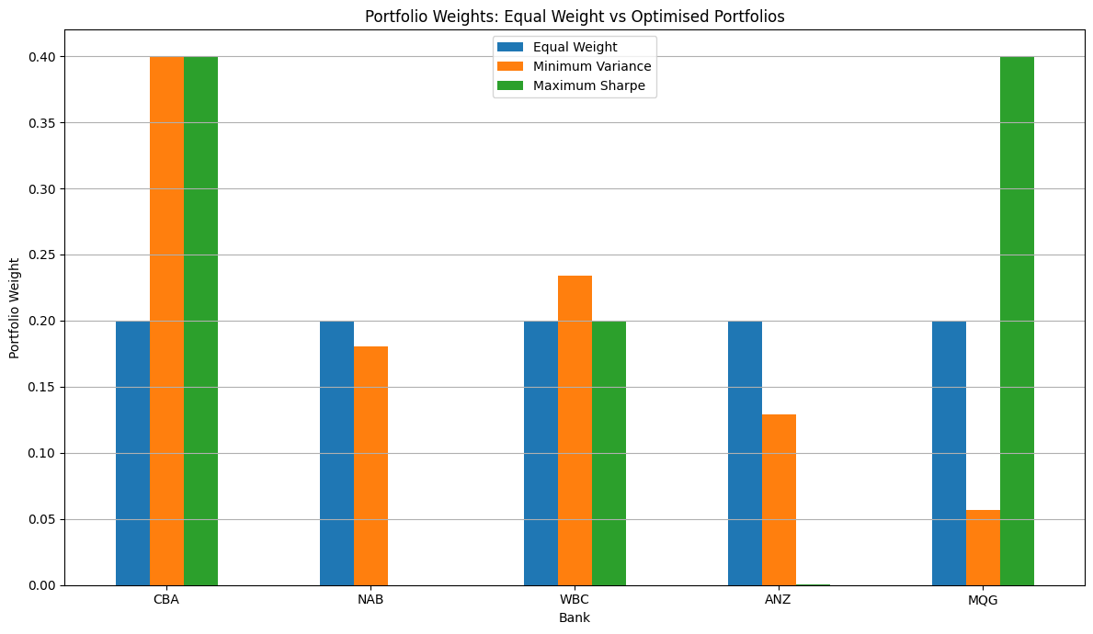
Optimal Portfolio Comparison
Portfolio | Return | Vol | Sharpe
Equal Weight | 13.13% | 21.47% | 0.454
Minimum Variance | 12.90% | 20.83% | 0.457
Maximum Sharpe | 15.25% | 22.64% | 0.524
Max-Sharpe hits the 40% cap on both CBA and MQG — 80% of the portfolio in two of five banks.
Min-variance cuts volatility below equal-weight at almost no return cost — a genuine, if modest, diversification gain.
8

Slide 9
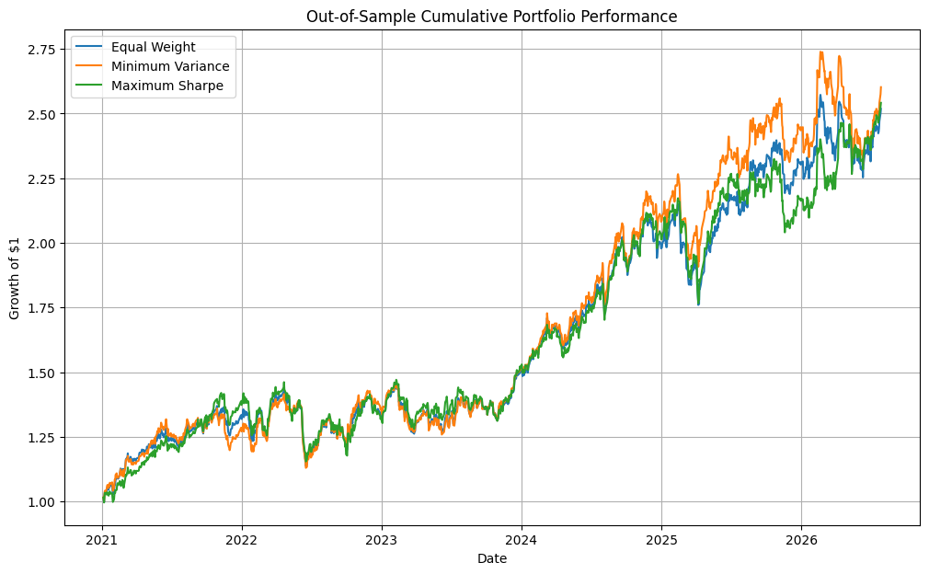
Out-of-Sample Performance (2021–2026)
The ranking flips.
Full-sample hindsight (2001–26): Max-Sharpe wins
0.524 vs 0.457 (Min-Var)
Genuine OOS — trained 2001–20 only, frozen, tested 2021–26: Min-Var wins
0.875 vs 0.848 (Max-Sharpe)
These are two separate optimisations, not the same weights re-tested — the OOS weights never see 2021–26 data. Classic estimation-error risk: Max-Sharpe depends on noisy mean-return forecasts; Min-Variance depends only on the more stable covariance matrix.
9

Slide 10
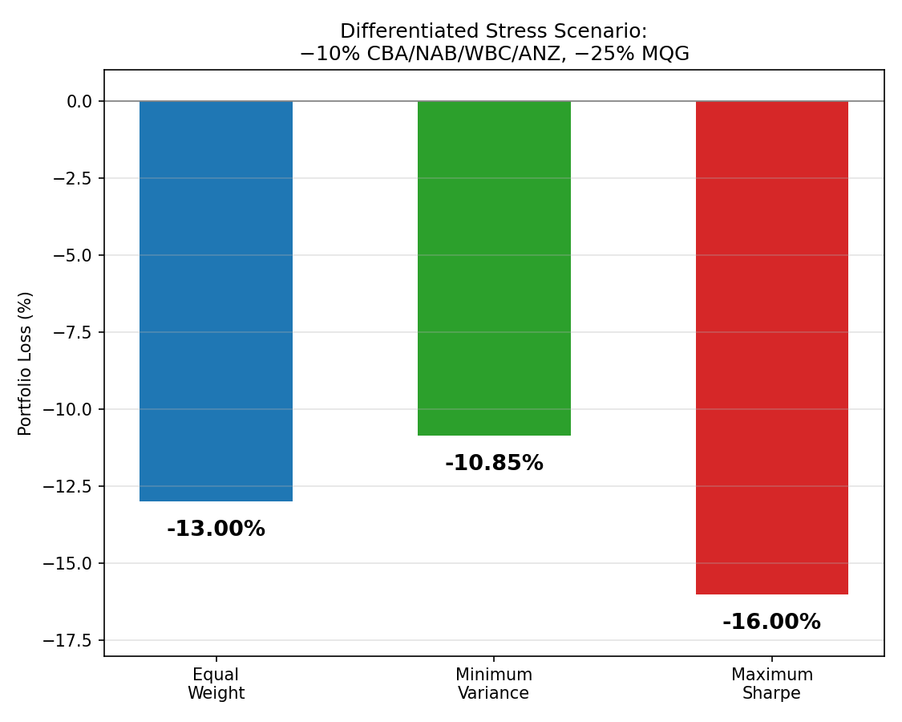
Stress Testing & Robustness
Differentiated shock: −10% majors, −25% MQG
Portfolio | Loss
Minimum Variance | -10.85%
Equal Weight | -13.00%
Maximum Sharpe | -16.00%
Weight instability across 3 re-estimation windows (total abs. weight change vs full sample):
 | 2001–15 | 2016–26 | 2021–26
Min-Var | 0.115 | 0.382 | 0.675
Max-Sharpe | 0.401 | 0.400 | 0.449
MQG's Max-Sharpe weight alone swings from 0% to 40% depending on the estimation window.
10

Slide 11
Key Findings
1
All banks: β > 1, α ≈ 0
Statistically significant systematic risk; no statistically significant CAPM alpha detected for any bank.
2
MQG is a structural outlier
Highest return, volatility (32.5%), beta (1.40) and drawdown (−81.7%) of the five.
3
Beta is regime-dependent
Rose for every bank in COVID-19; fell for 4 of 5 banks during the 2022–24 rate-hike cycle.
4
Min-variance beats naive weighting
Lower volatility at almost no return cost — a genuine diversification gain.
5
Max-Sharpe's edge doesn't survive
Best on full-sample hindsight (0.524), but most concentrated, worst under stress (−16.0%), and beaten in a genuinely disjoint OOS test by Min-Variance.
11

Slide 12
Conclusion & Limitations
Limitations
Conclusion
Mean-variance optimisation identifies genuine diversification gains over naive equal-weighting through the minimum-variance portfolio. But the higher-Sharpe maximum-Sharpe solution should not be mistaken for a robust one: its edge is concentrated in two banks, reverses out-of-sample, and is the least stable allocation across every re-estimation window tested.
Backward-looking, full-sample Sharpe-ratio optimisation alone is not sufficient grounds for portfolio construction.
CAPM explains ~50% of variance — a single-factor simplification
Optimisation is sensitive to estimated inputs, esp. expected returns
Historical VaR assumes the past informs future tail risk
Stress scenarios are hypothetical, not modelled
Market risk only — excludes credit, liquidity & operational risk
Robustness windows partly overlap the OOS test period (see notes)
12

