Slide 1

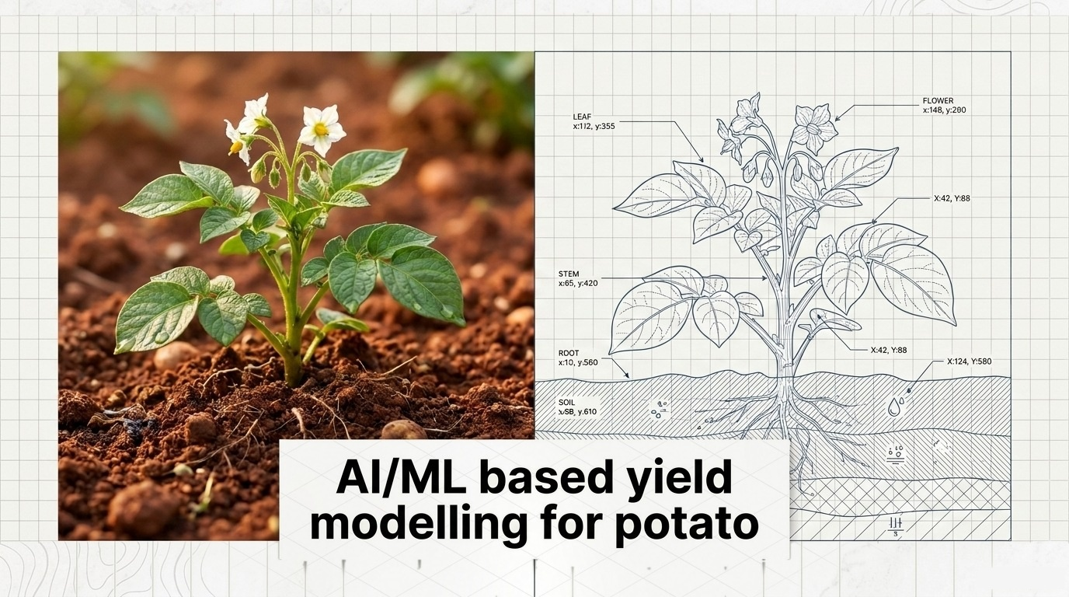


Submitted by: - Sibbala Yoshitha,
Vodnala Likitha, Swathi Patil, Yash Patel, Tushar Vadodariya and Dhruv Soni.
Submitted to: - Dr. V.B.Vaidya

Slide 2
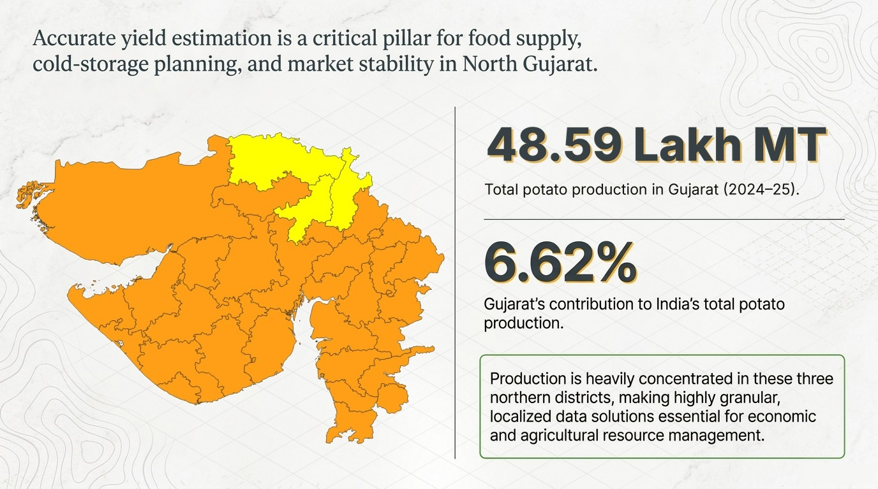
Banaskantha
Mehsana
Sabarkantha
Source: Directorate of Horticulture, Govt. of Gujarat (potato area, production & yield, 2023–24); Horticultural Statistics at a Glance, MoA&FW, Govt. of India

Slide 3

1996 to 2025
1996 to 2025
Source: NASA POWER – Prediction Of Worldwide Energy Resources (power.larc.nasa.gov); Directorate of Horticulture, Govt. of Gujarat

Slide 4
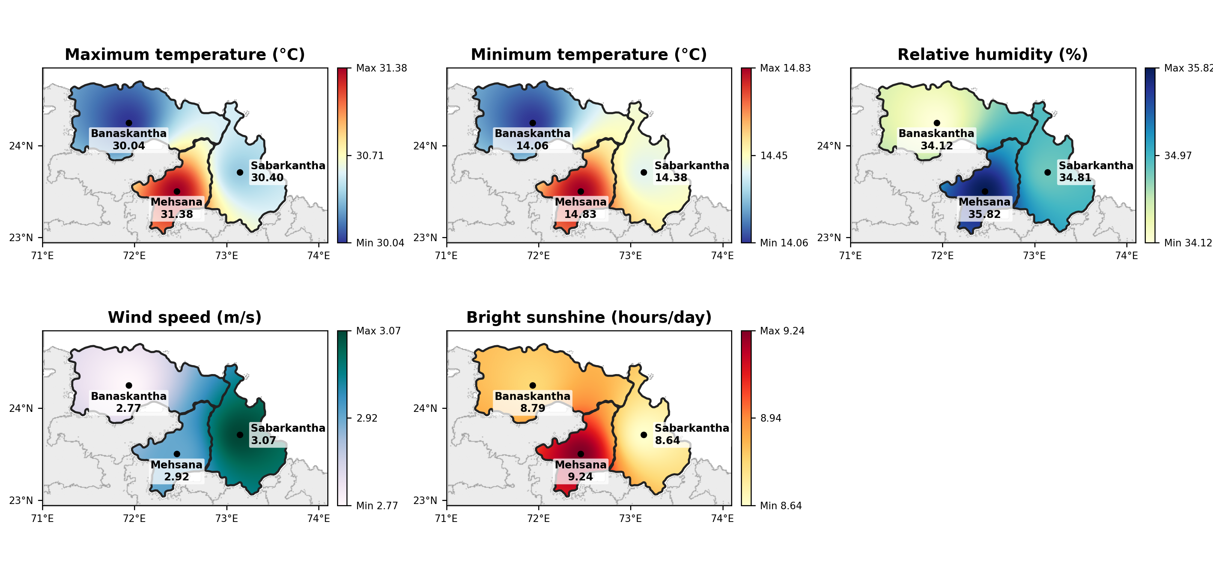
Interpolated weather maps of the three North Gujarat potato districts (rabi season, SMW 42–8)
Rabi-season mean by district
District | MAXT °C | MINT °C | RH % | WS m/s | BSS h/day
Banaskantha | 30.04 | 14.06 | 34.12 | 2.77 | 8.79
Sabarkantha | 30.40 | 14.38 | 34.81 | 3.07 | 8.64
Mehsana | 31.38 | 14.83 | 35.82 | 2.92 | 9.24
Colour scale runs from the minimum to the maximum district value of each parameter; surface interpolated by inverse-distance weighting (power 2) between district centroids and clipped to district boundaries.

Slide 5
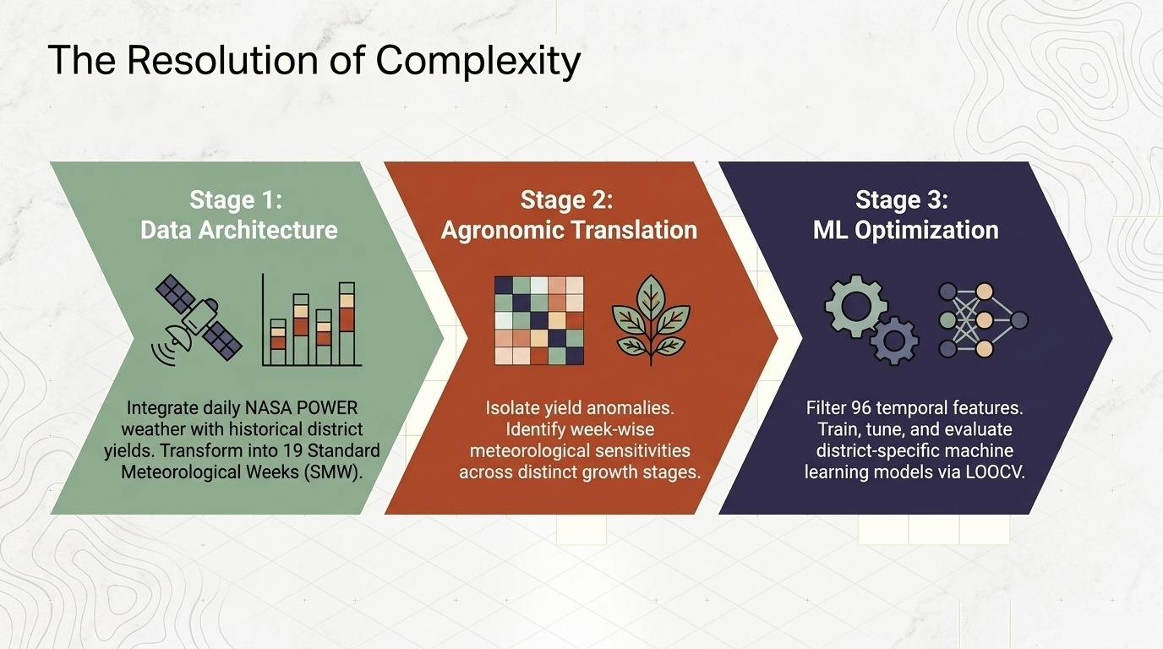

Slide 6
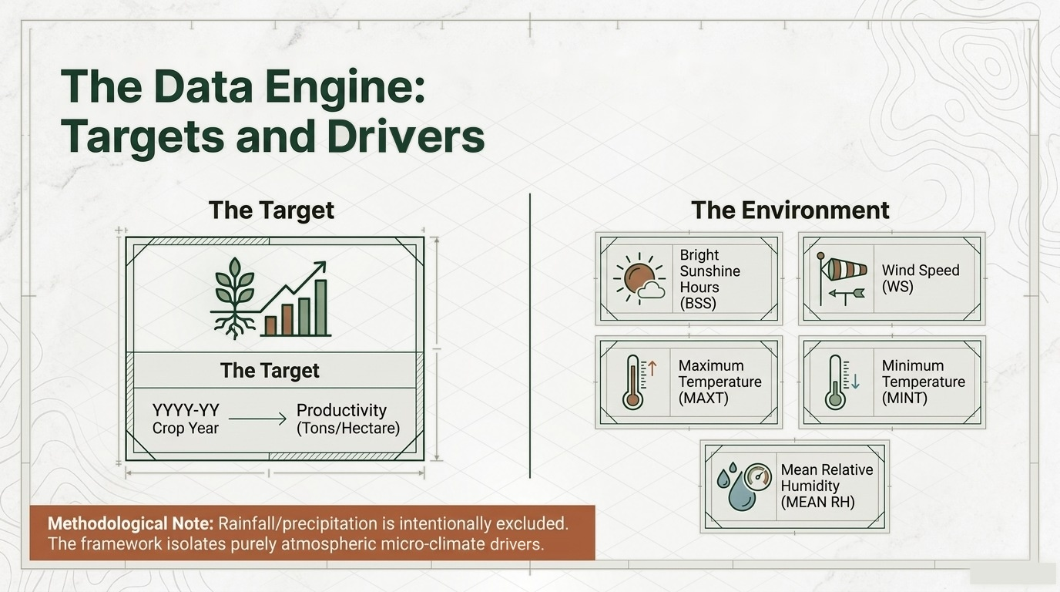

Slide 7
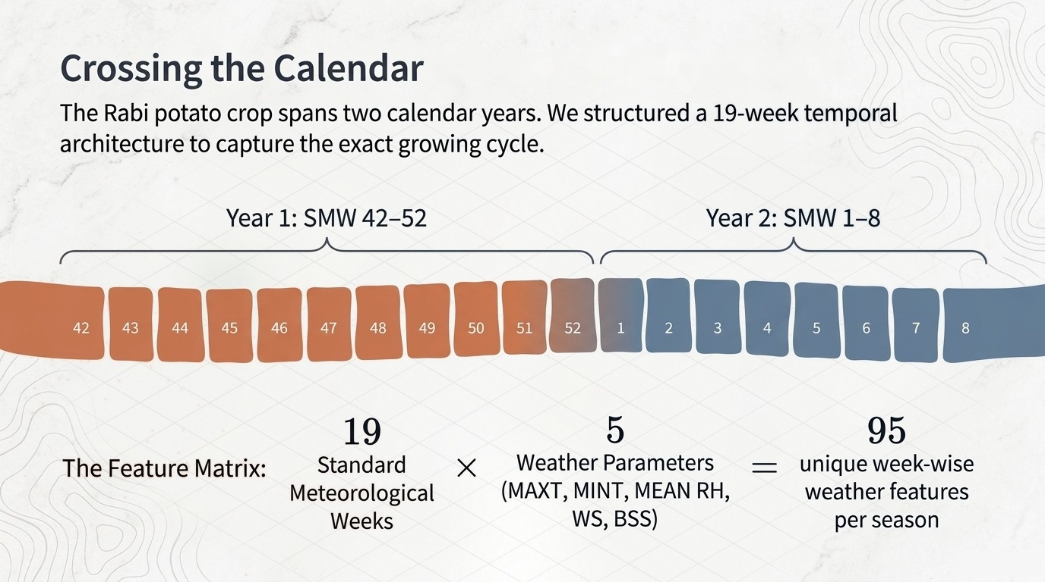
Source: India Meteorological Department (IMD) – Standard Meteorological Week (SMW) calendar; authors' 19-week Rabi-season design

Slide 8
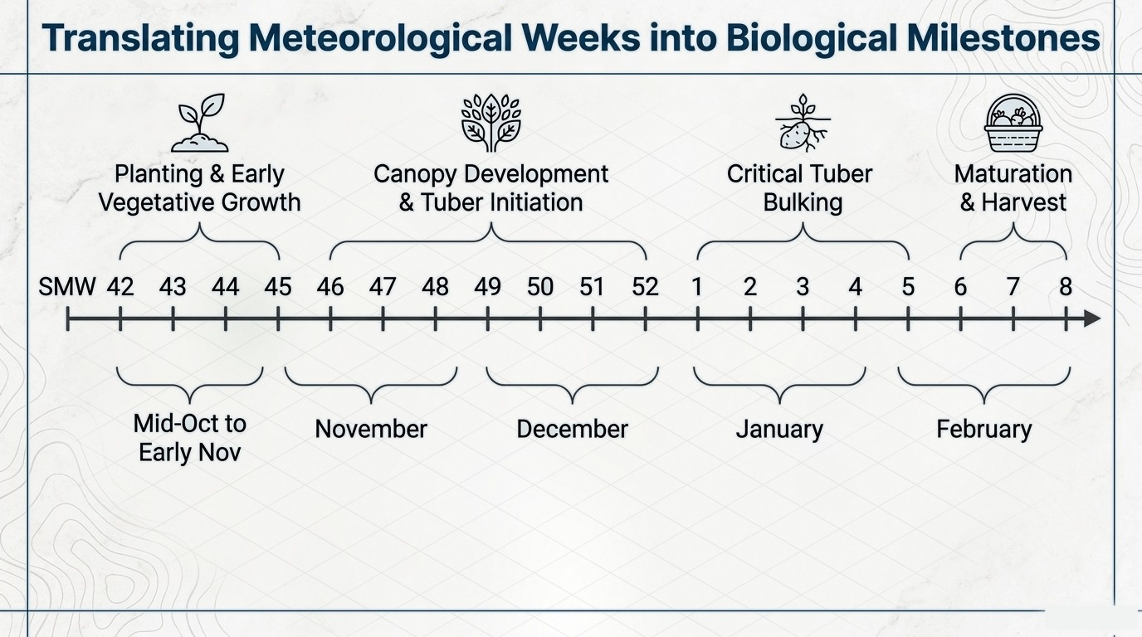
Source: SDAU, potato growth stages; IMD Standard Meteorological Week calendar

Slide 9
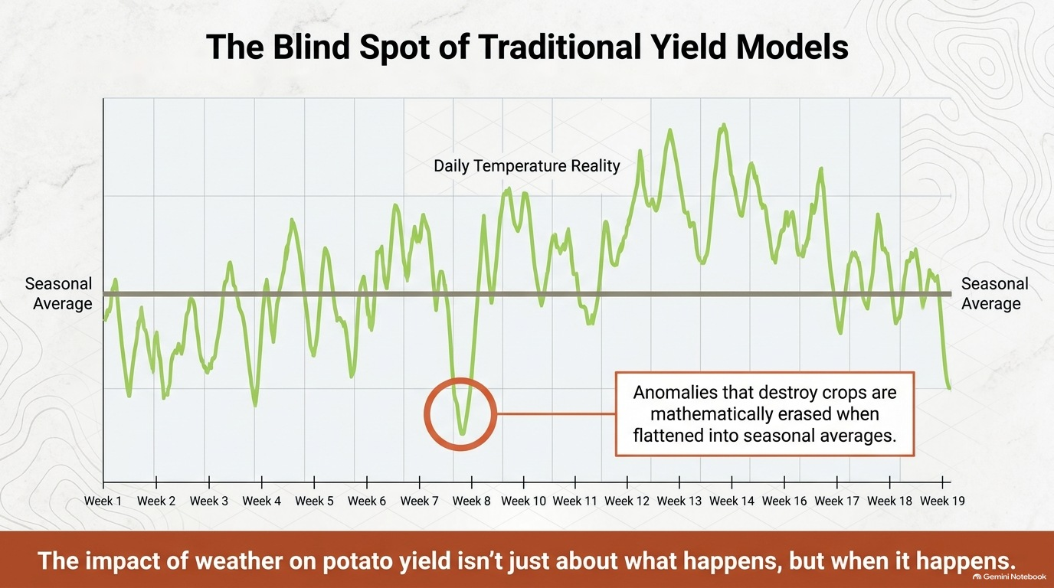

Source: Conceptual illustration of daily vs. seasonal-average temperature, based on NASA POWER daily meteorological data

Slide 10
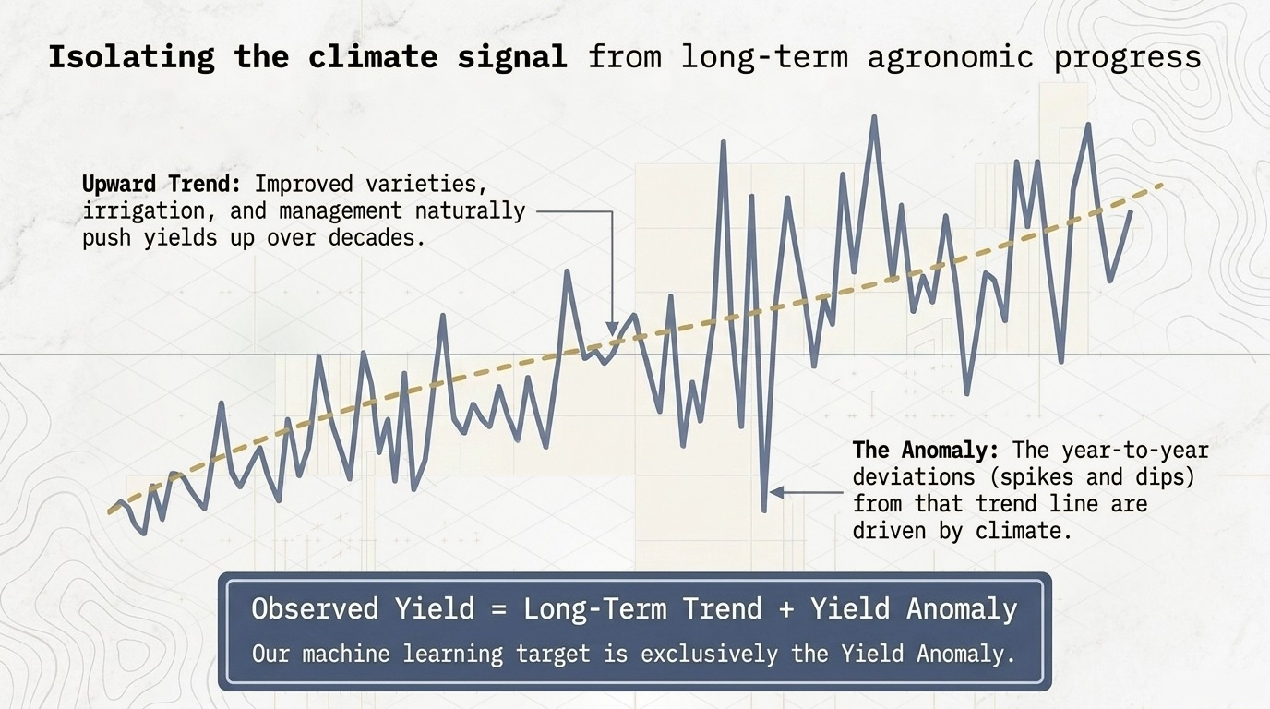
Source: Authors' detrending of district yield series (Directorate of Horticulture, Govt. of Gujarat): Yield = Trend + Anomaly

Slide 11
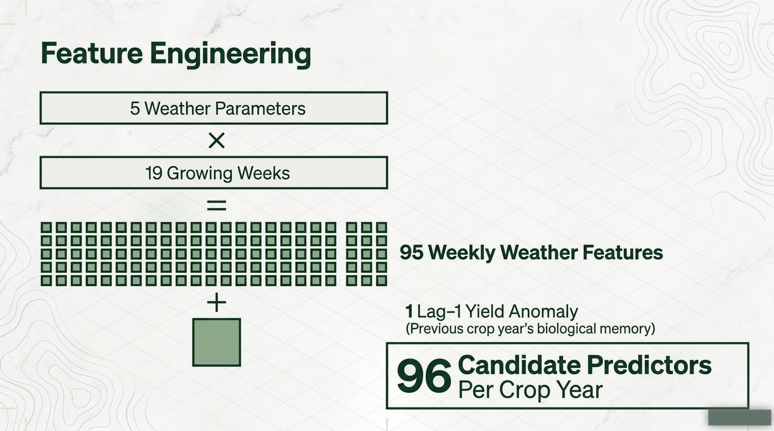
Source: Authors' feature engineering: 5 NASA POWER parameters × 19 SMW = 95 features, plus 1 lag-1 yield anomaly

Slide 12
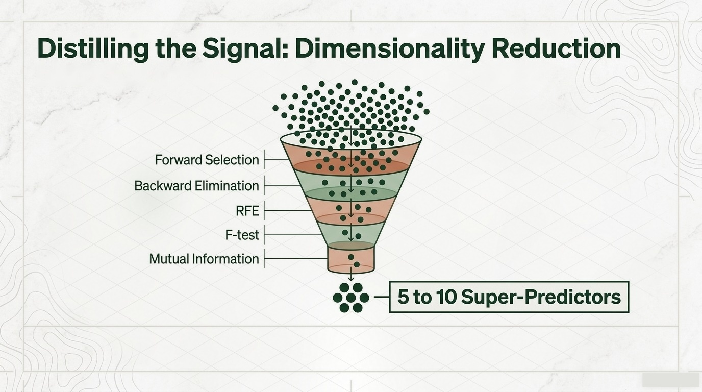
Source: scikit-learn feature-selection methods; Guyon & Elisseeff (2003), J. Machine Learning Research, 3:1157–1182

Slide 13
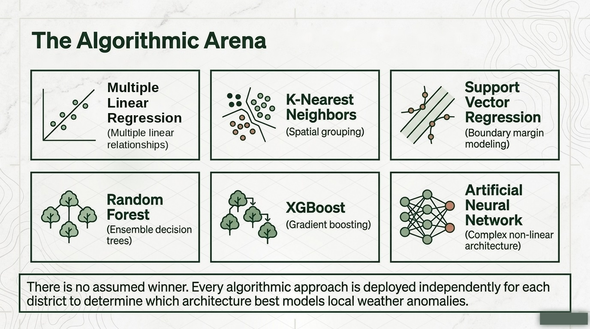
Source: scikit-learn; Breiman (2001) Random Forests; Chen & Guestrin (2016) XGBoost; Drucker et al. (1997) SVR

Slide 14
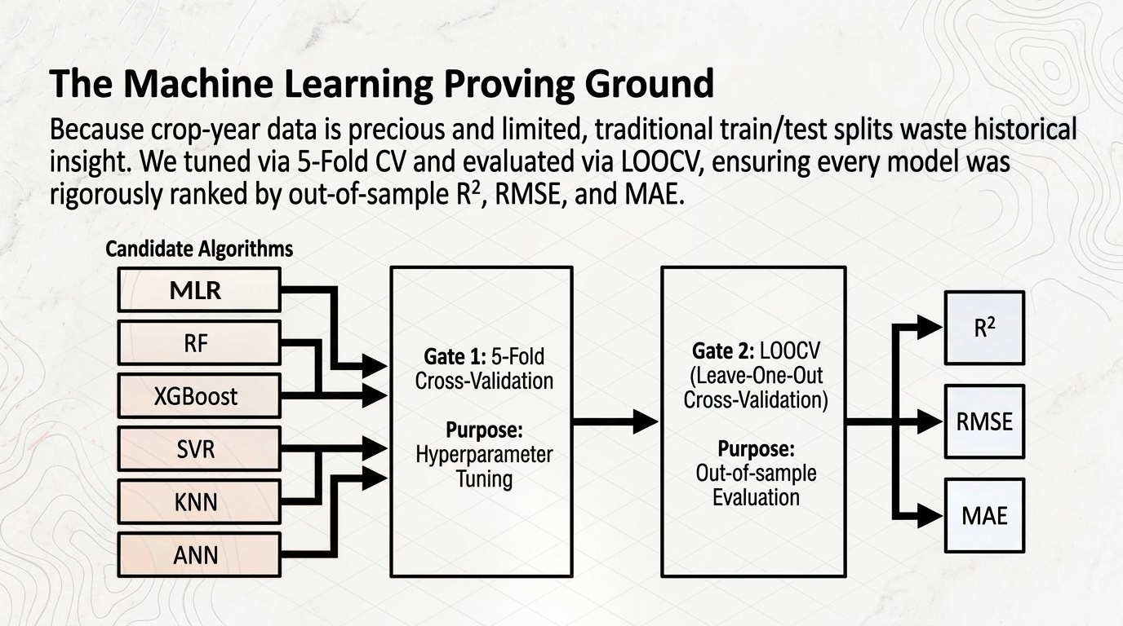
Source: Hastie, Tibshirani & Friedman (2009), The Elements of Statistical Learning (cross-validation); scikit-learn model selection

Slide 15
District-wise Results Across All Six Models
District | Model | R² | RMSE | MAE | Feature Selection Method | Selected Features (Weather Parameter – SMW)
Banaskantha | Stepwise Linear Regression | 0.714 | 1.119 | 0.922 | RFE | BSS–44, WS–44, WS–45, BSS–49, Tmin–50, Tmin–52, Tmax–5, BSS–5, Tmin–6, WS–8
 | Random Forest | -0.007 | 2.099 | 1.644 | SelectKBest | WS–6, Lag-1 Yield Anomaly, Tmax–3, Tmin–6, BSS–44, Tmin–42, Tmin–50, RH–44
 | XGBoost | 0.013 | 2.078 | 1.629 | SelectKBest | WS–6, Lag-1 Yield Anomaly, Tmax–3, Tmin–6, BSS–44, Tmin–42, Tmin–50, RH–44
 | SVR | 0.732 | 1.083 | 0.937 | RFE | BSS–44, WS–44, WS–45, BSS–49, Tmin–50, Tmin–52, Tmax–5, BSS–5, Tmin–6, WS–8
 | KNN | 0.23 | 1.836 | 1.461 | SelectKBest | WS–6, Lag-1 Yield Anomaly, Tmax–3, Tmin–6, BSS–44, Tmin–42, Tmin–50, RH–44
 | ANN (MLP) | 0.49 | 1.494 | 1.28 | RFE | BSS–44, WS–44, WS–45, BSS–49, Tmin–50, Tmin–52, Tmax–5, BSS–5, Tmin–6, WS–8
Sabarkantha | Stepwise Linear Regression | 0.714 | 2.669 | 2.109 | RFE | Tmax–2, BSS–46, BSS–48
 | Random Forest | 0.785 | 2.314 | 1.641 | RFE | Tmin–8, Mean RH–48, Mean RH–49
 | XGBoost | 0.784 | 2.318 | 1.869 | RFE | Tmax–2, Tmax–4, Mean RH–48, Mean RH–49, Mean RH–2, WS–45, WS–46, RF–42
 | SVR | 0.871 | 1.789 | 1.25 | Mutual Information | Tmax–48, Mean RH–49, Tmin–8
 | KNN | 0.824 | 2.094 | 1.472 | Mutual Information | Tmax–48, Mean RH–49, Tmin–8, Tmin–48, BSS–44, Tmax–43
 | ANN (MLP) | 0.541 | 3.378 | 2.526 | Mutual Information | Tmax–48, Mean RH–49, Tmin–8
Mehsana | Stepwise Linear Regression | 0.59 | 1.231 | 0.948 | SelectKBest (F-test) | WS–49, WS–52, WS–1, Tmin–43, Lag-1
 | Random Forest | 0.39 | 1.506 | 1.12 | SelectKBest (F-test) | WS–49, WS–52, WS–1, Tmin–43, Lag-1
 | XGBoost | 0.46 | 1.421 | 1.094 | SelectKBest (F-test) | WS–49, WS–52, WS–1, Tmin–43, Lag-1
 | SVR | 0.41 | 1.483 | 1.258 | Forward Selection | WS–49, WS–52, Tmin–44, Tmin–49, Lag-1
 | KNN | 0.45 | 1.434 | 1.265 | Forward Selection | WS–49, WS–52, Tmax–1, Tmin–44, Tmin–49, Lag-1
 | ANN (MLP) | 0.36 | 1.539 | 1.254 | RFE | BSS–45, BSS–51, BSS–52, WS–49, WS–52, WS–1, WS–5, Tmin–49, Mean RH–49, Lag-1
Source: Authors' district-wise LOOCV results for the six candidate models (Multiple Linear Regression, RF, XGBoost, SVR, KNN, ANN); NASA POWER and Gujarat Horticulture data

Slide 16
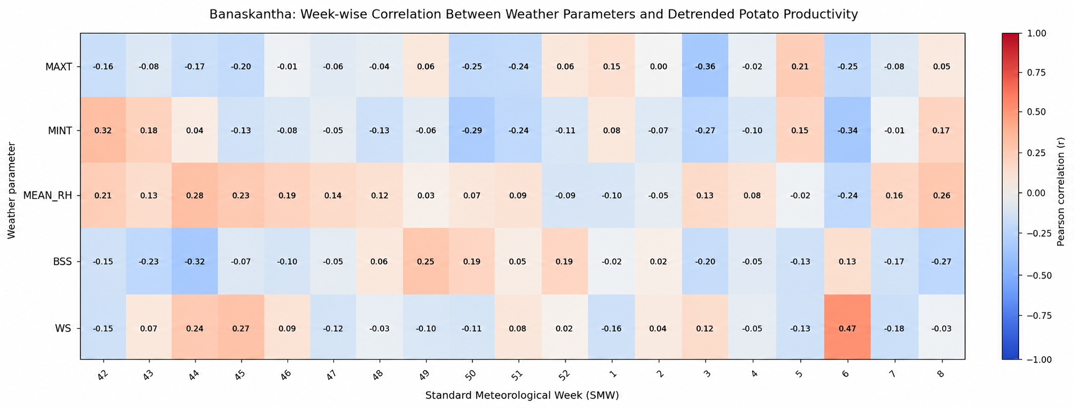
Strongest Positive Association
Wind Speed – SMW 6: r = +0.47
Strongest Negative Association
Maximum Temperature – SMW 3: r = −0.36
Source: Allen et al., 1998 and Haverkort, 1990

Slide 17
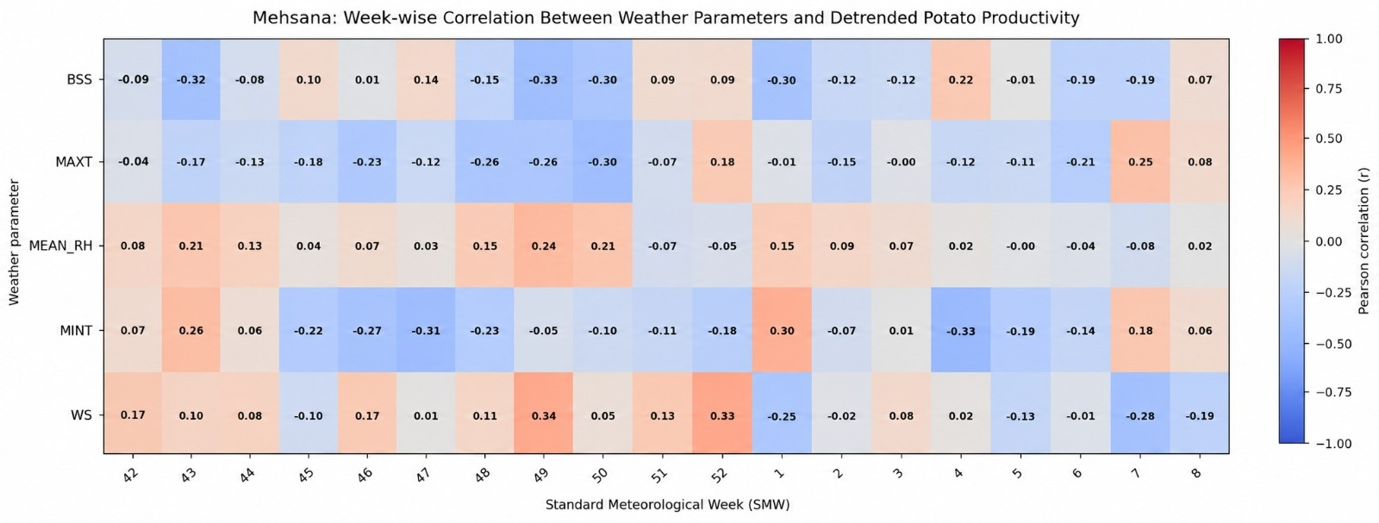
Strongest Positive Association
Wind Speed – SMW 49: r = +0.34
Strongest Negative Association
Bright Sunshine and MINT – SMW 49 and SMW 4: -
r = −0.33 and -0.33
Source: Twing, 1981 & Levy and Veilleux, 2007
Allen et al., 1981

Slide 18
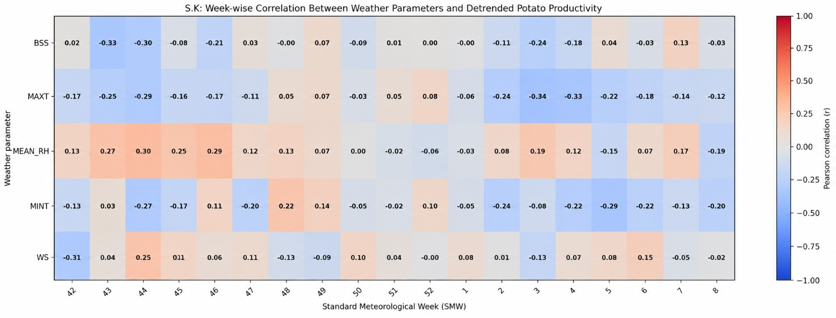
Strongest Positive Association
MEAN_RH – SMW 44 - 46: -
r = +0.30, +0.29
Strongest Negative Association
MAXT – SMW 3 & 4: -
r = -0.34, -0.33
Source: Haverkort 1990 & Hancock et al., 2014
Allen et al., 1998

Slide 19
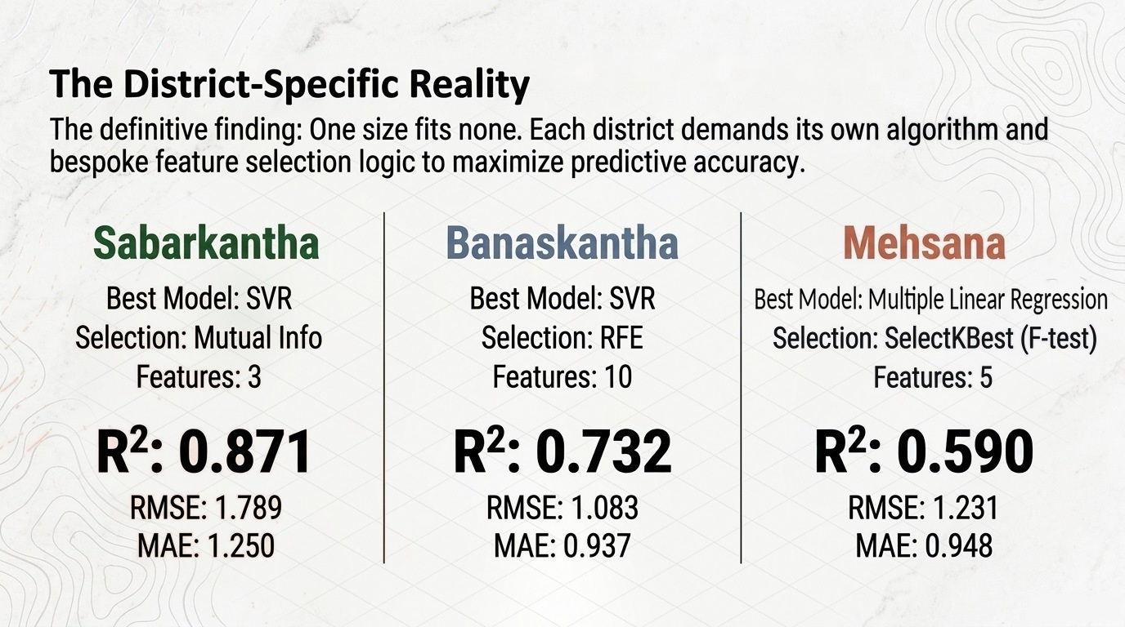
Source: Ewing, 1981 & Varaquaux, 2018 & Hatie et al., 2009 & Joeng et al., 2016

Slide 20
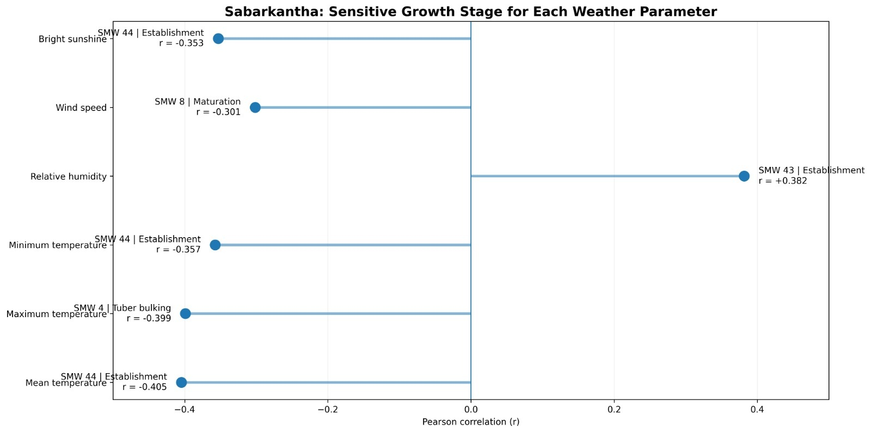
Primary Vulnerability: Establishment
Mean Temperature at SMW 44 r = −0.405

Slide 21
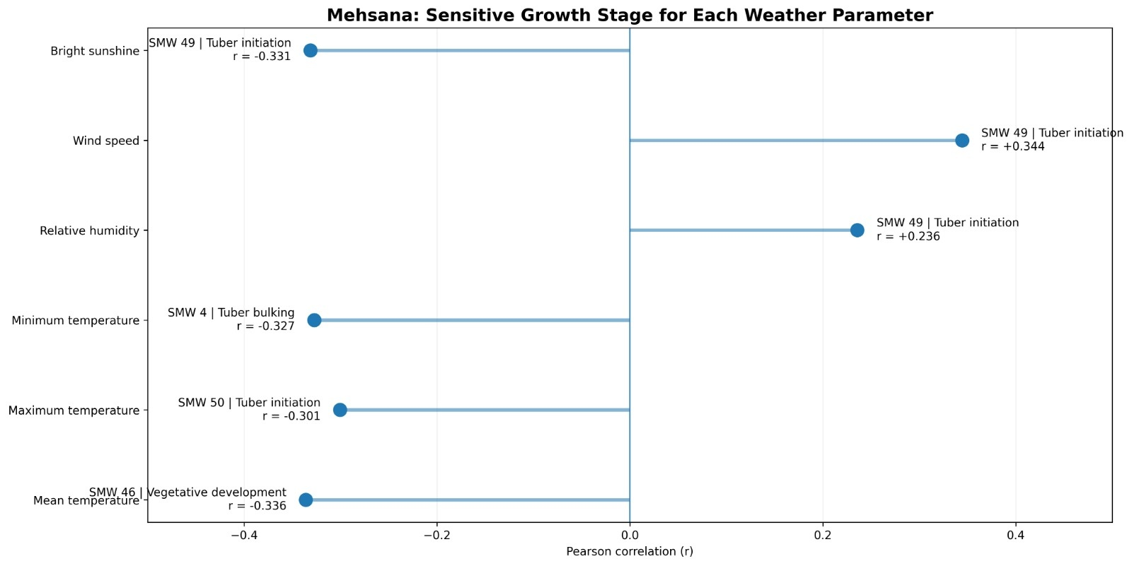
Primary Vulnerability: Tuber Initiation
Wind Speed at SMW 49 r = +0.344

Slide 22
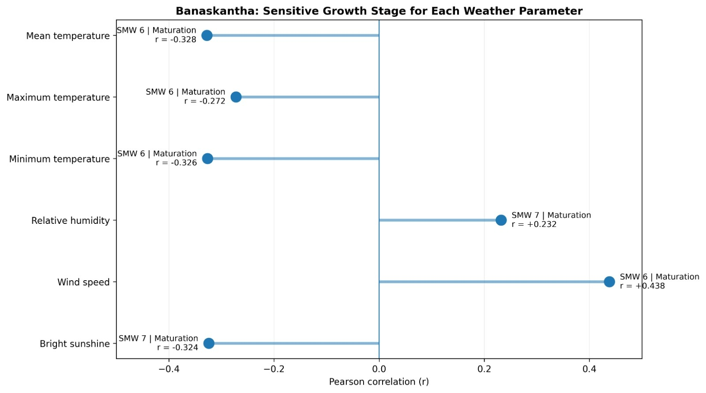
Primary Vulnerability: Maturation
Wind Speed at SMW 6 r = +0.438

Slide 23
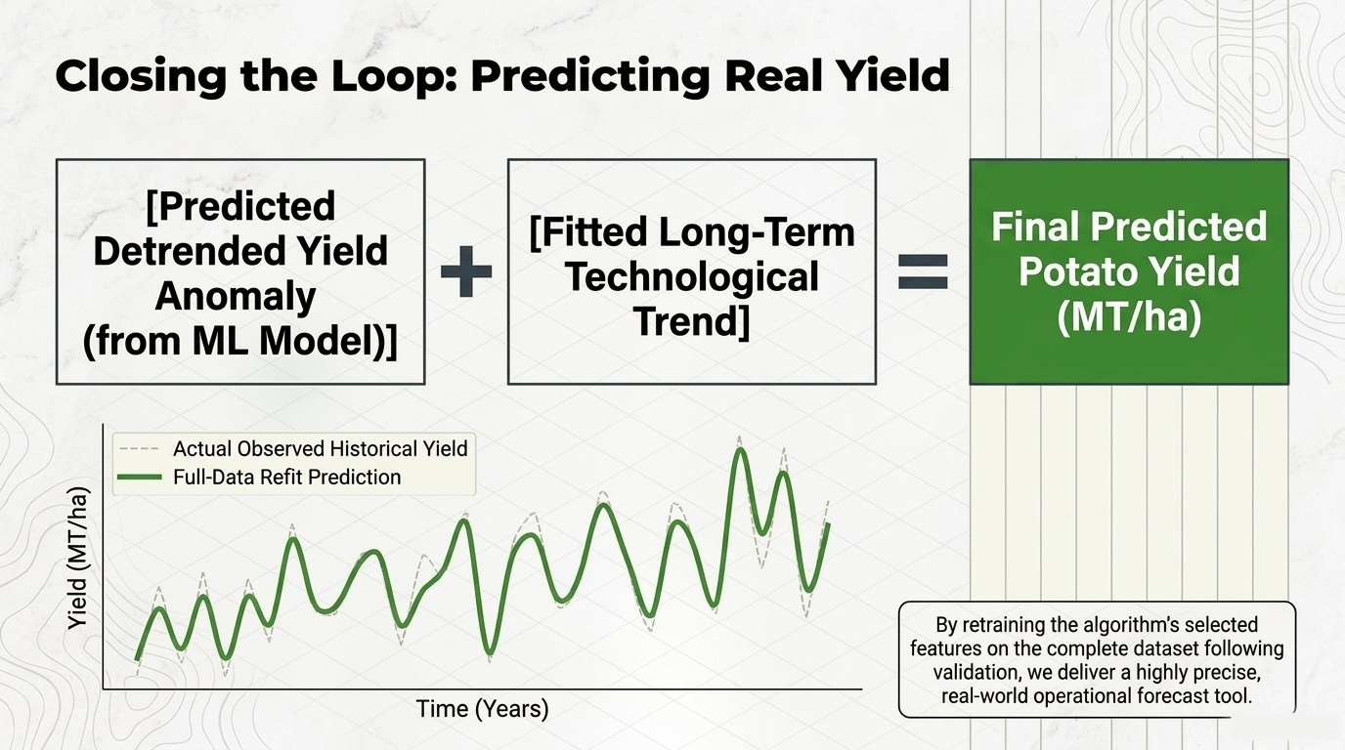

Slide 24
THANK YOU
“Our sincere thanks to Dr. V.B.Vaidya and Dr. Manoj Lunagaria, for their guidance and support throughout this project”

