Slide 1
College Cents Track - Your Personal Expense Tracker
GLA University
CEA Department
April 16,2024

Slide 2
Introduction
A refined system to efficiently manage his/her expenses with ease.
Tracking expenses daily can really help us save a lot of money.
Stay in control and achieve your goal.
The project is motivated by the universal need for a user-friendly tool to empower individuals to manage their spending and savings effectively.

Slide 3
Objectives
To know where the money is going.
To spend only on priorities.
To save money for pre-defined expenses.
To plan on your future investments.

Slide 4
Problem Statement
At the end of the month we start to have a money crisis.
Lack of proper planning of our income
A person has to keep a log in a diary or on a computer.
All the calculations need to be done by the user.
Overload to rely on the daily entry of the expenditure.

Slide 5
Technology Used
Front-end
HTML(Hypertext Markup Language)
CSS(Cascading Style Sheets)
JavaScript
Back-end
React.js
Node.js
Express.js
MongoDB

Slide 6

System Architecture
Landing page of the College Cents .

Slide 7
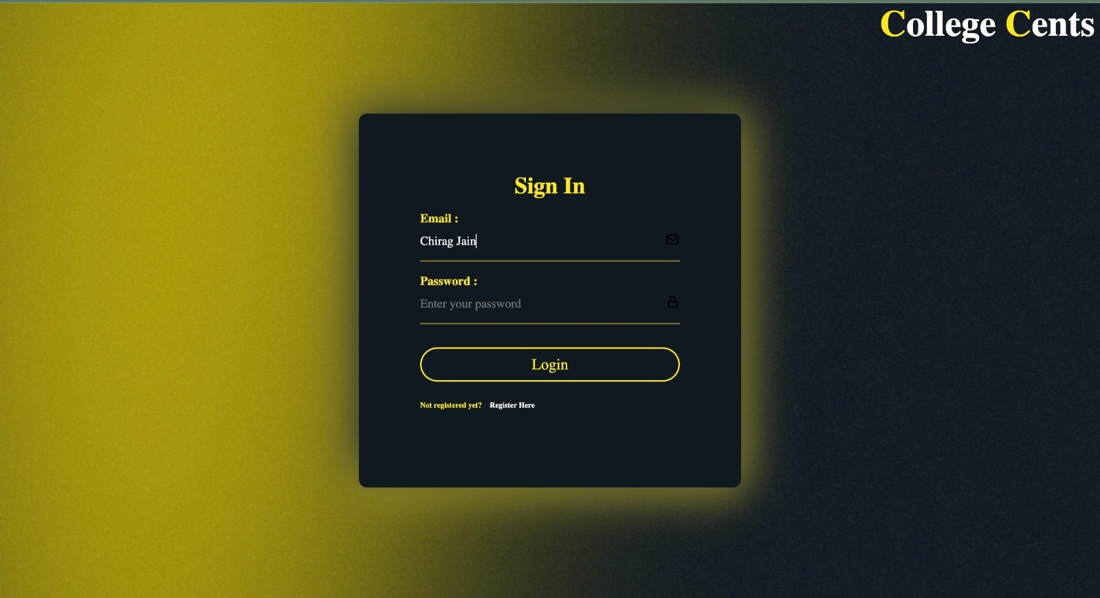
This snapshot shows the Login Page , after logging in you will be redirected to your personal expense tracker.

Slide 8
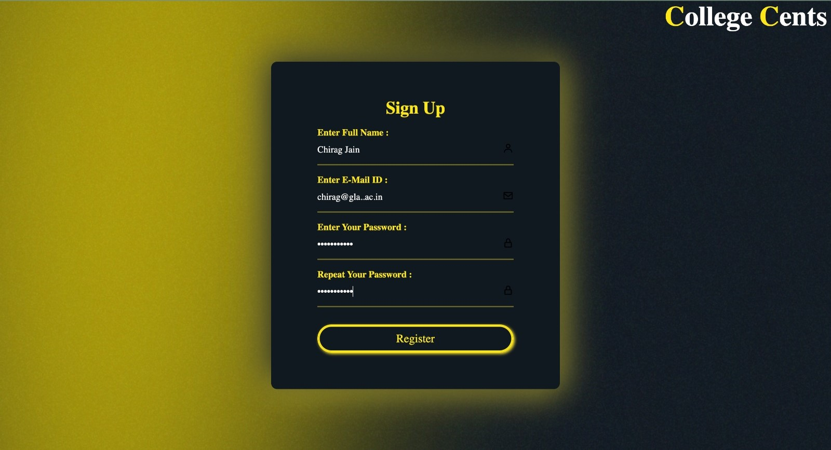
If you are not a registered user then you have to register first then go to login page to go to expense tracker.

Slide 9
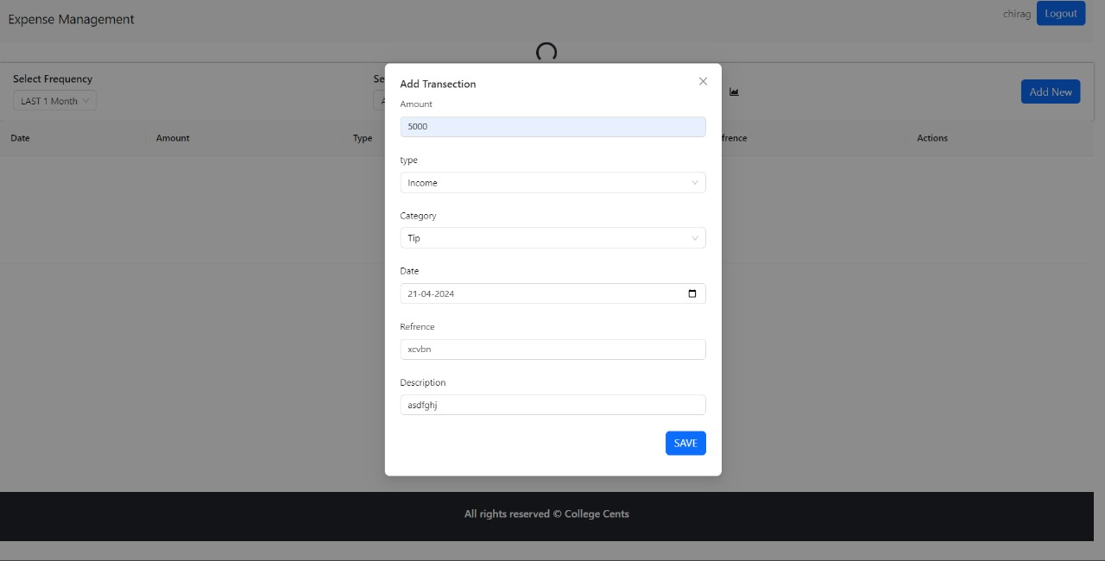
This snapshot shows the Tracker page where you can enter your income/expense category, amount, date then click on save to store the data.

Slide 10
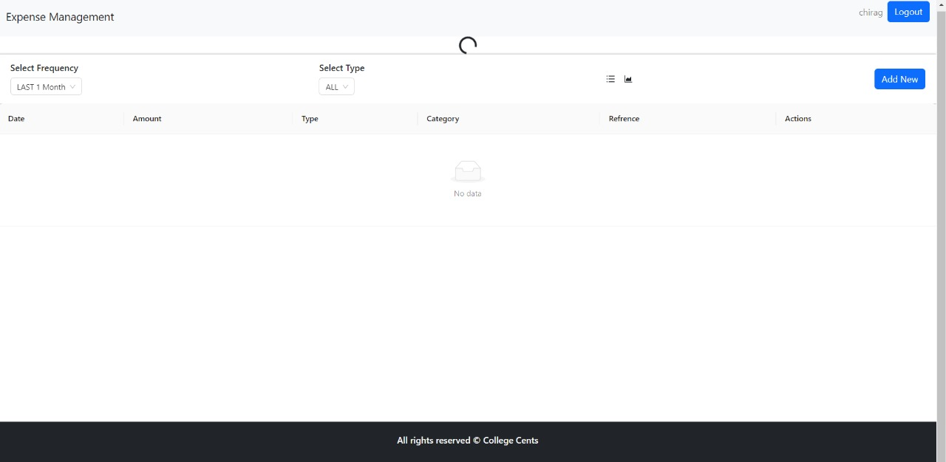
This snapshot shows the Analysis Page where we will show you the records of your Expenses and Income and also the analysis of Income in form of Bar Graph and Pie Charts.

Slide 11
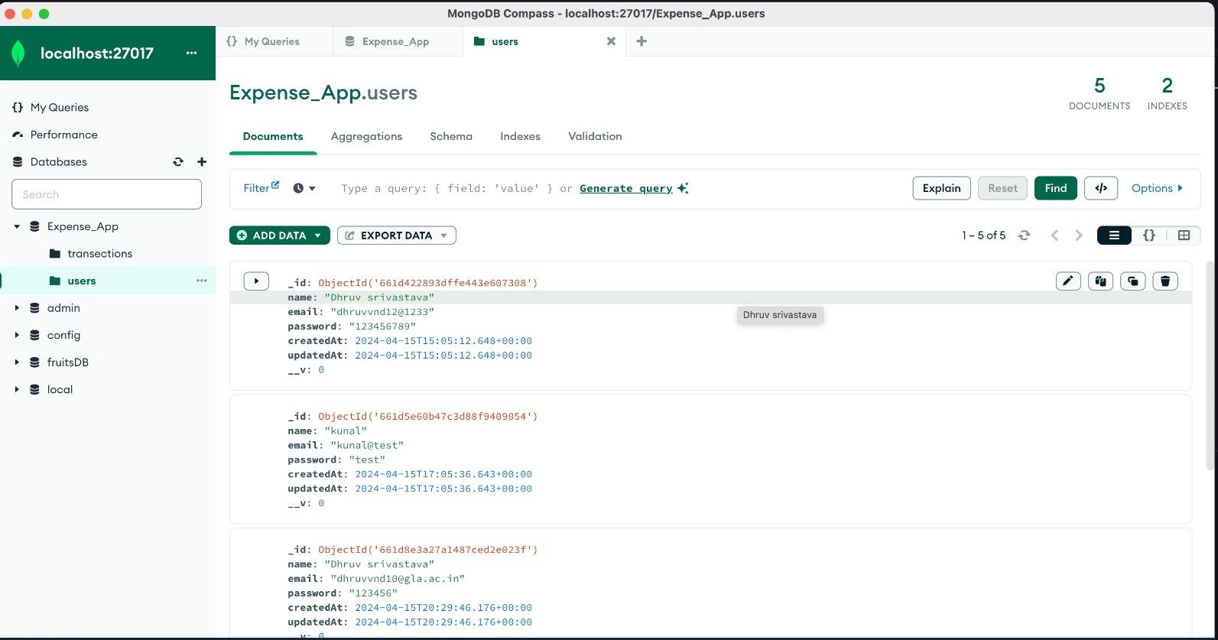
This snapshot shows the MongoDB Database where you can see all the user credentials stored inside it , which can be used to login inside the personalised tracker.

Slide 12
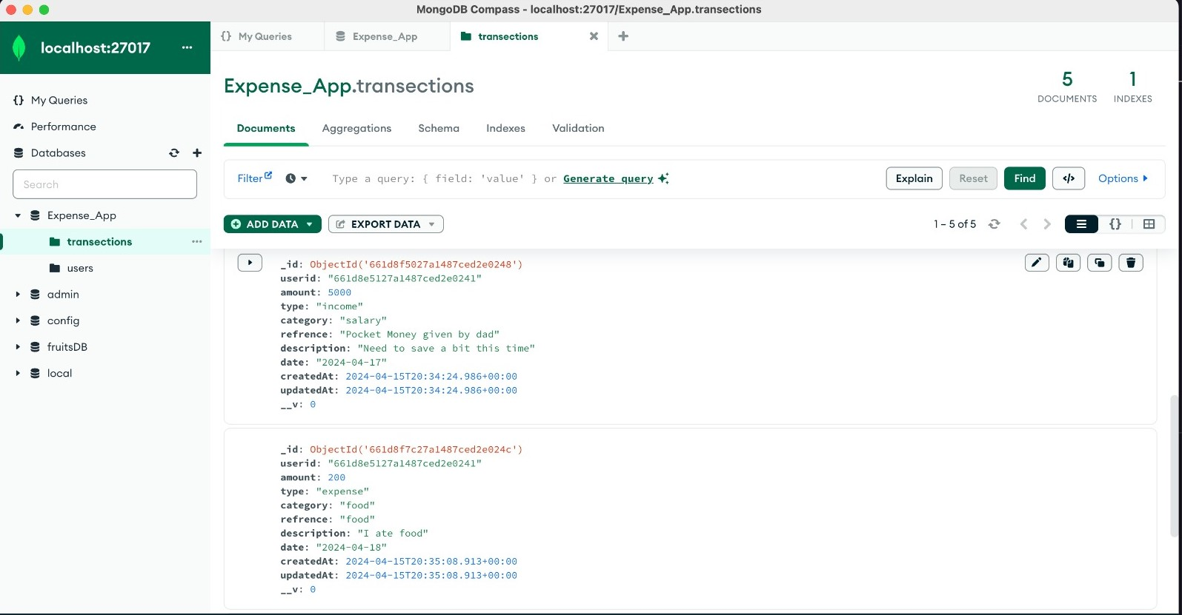
This Snapshot shows the MongoDB Database where all the transactions created a by user can be seen .

Slide 13
Features
User Authentication:
Secure login and signup processes.
Password hashing for enhanced security.
Expense Management:
Add, update, and delete expenses.
Categorize expenses and add tags for better organization.

Slide 14
Future Work
Mobile Application Development:
Consider developing a mobile application version of the expense tracker to cater to users who prefer on-the-go accessibility.
Machine Learning for Expense Predictions:
Implement machine learning algorithms to analyze spending patterns and provide users with predictions and insights.
Cross-Platform Compatibility:
Ensure compatibility with a wider range of devices and platforms, catering to different user preferences.

Slide 15


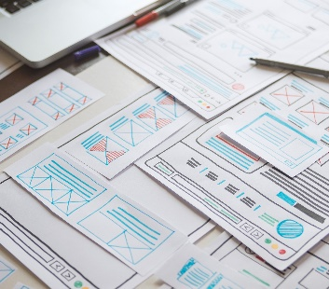

Conclusion
We assure you that this will help users to manage the cost of their daily expenses.
Helpful for the people who are frustrated with the daily budget management.
Help in managing money.
Preserve the record of their daily cost.
Overcome wastage of money.

Slide 16



Thank You

