Slide 1
PROJECT ON UNDER WATER MONITORING SYSTEM
MADE BY: DHRUV GOEL &
DIVYANSH LAKHERA

Slide 2
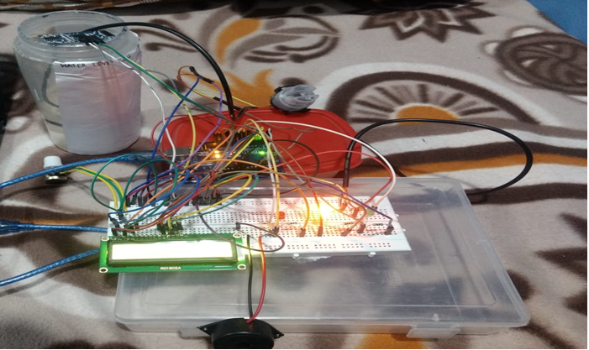
OBJECTIVE OF PROJECT
The main objective of the project is to know about the underwater monitoring system.

Slide 3
APPARATUS AND SENSORS USED
Arduino uno board
Breadboard
Lcd display(16 x 2) and a rotatry potentiometer
Led’s (red, yellow, green)
Resistors(three of 100 ohm, one of 4.7 k ohm, one of 200 ohm)
Jumpers(male to male and male to female)
Buzzer(1)
Ultrasonic sensor
Water-proof temperature sensor( DS18B20)
Turbididy sensor
Wi-fi module(ESP8266-01)

Slide 4
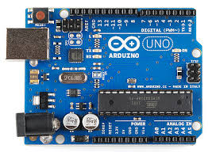
ARDUINO UNO
Arduino is an open-source electronics platform based on easy-to-
use hardware and software.
Arduino boards are able to read inputs –
light on a sensor, a finger on a button,
turn it into an output - activating a motor,
turning on an LED, publishing something online.
You can tell your board what to do by sending a set of instructions
to the microcontroller on the board.
To do so you use the Arduino programming language (based
on Wiring), and the Arduino Software (IDE), based on Processing.

Slide 5
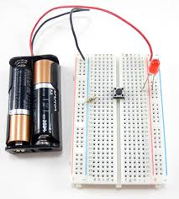
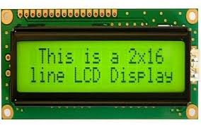
BREADBOARD
A breadboard is a solderless device for temporary prototype with
electronics and test circuit designs.
Most electronic components in electronic circuits can be
interconnected by inserting their leads or terminals into the holes and
then making connections through wires where appropriate.
LCD DISPLAY(16 X 2)
LCD (Liquid Crystal Display) screen is an electronic display module
and find a wide range of applications.
A16x2 LCD means it can display 16 characters per
line and there are 2 such lines.

Slide 6
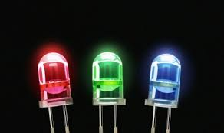
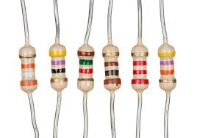
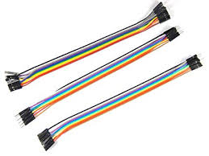
LED’S
A light-emitting diode is a semiconductor light
source that emits light when current flows through it.
RESISTORS
A resistor is a passive two-terminal electrical
component that implements electrical resistance
as a circuit element.
JUMPER WIRES
A jumper wire is an electrical wire with a connector
or pin at each end (or sometimes without them – simply
"tinned"), which is normally used to interconnect the components
of a breadboard .

Slide 7
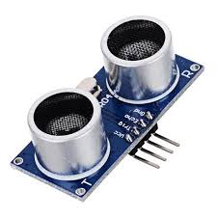
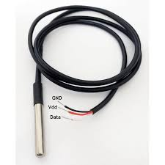
ULTRASONIC SENSOR
Ultrasonic sensors measure distance by using ultrasonic waves.
The sensor head emits an ultrasonic wave and receives
the wave reflected back from the target.
Ultrasonic Sensors measure the distance to the target
by measuring the time between the emission and reception.
WATER-PROOF TEMPERATURE SENSOR(DS18B20)
One-wire temperature sensors like the DS18B20
are devices that can measure temperature with a
minimal amount of hardware and wiring.
These sensors use a digital protocol to send accurate
temperature readings directly to board without the need
of an analog to digital converter.

Slide 8
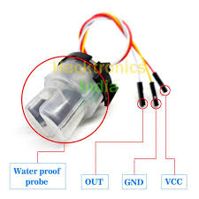
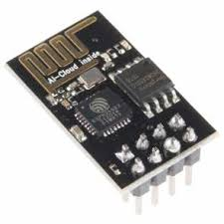
TURBIDITY SENSOR
Turbidity sensors measure the amount of light
that is scattered by the suspended solids in water.
As the amount of total suspended solids (TSS) in
water increases, the water's turbidity level
(and cloudiness or haziness) increases.
WI-FI MODULE(ESP8266)
The ESP8266 Wi-Fi Module is a self contained
SOC with integrated TCP/IP protocol stack that can give
any microcontroller access to your Wi-Fi network.
The ESP8266 is capable of either hosting an application
or offloading all Wi-Fi networking functions from
another application processor.

Slide 9
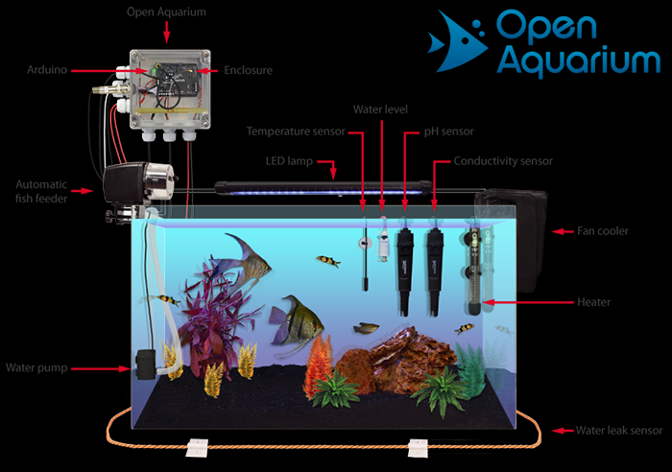
APPLICATIONS
We can use underwater monitoring system in aquariums, swimming pools, water tanks in our homes, etc.

Slide 10
THANK YOU

