Slide 1

Topic-Site-to-Site VPN on AWS
This presentation will guide you through the process of setting up a site-to-site VPN connection on AWS using the AWS Management Console. We'll cover the essential steps involved in creating a secure and reliable connection between your on-premises network and your AWS resources. We'll provide clear and concise instructions based on the official AWS documentation, ensuring a seamless and efficient implementation.
This was the group project during my internship at Jovac cloud computing.
Member were Dhruv , Naman and Satvik

Slide 2
Step-by-Step Guide to Setting Up a Site-to-Site VPN on AWS
1. Create a Customer Gateway
2. Create a Virtual Private Gateway
3. Create a VPN Connection
This is where you bring together the Customer Gateway and the Virtual Private Gateway to create a secure and reliable VPN connection.
The Customer Gateway represents your on-premises network. You'll need to configure the public IP address of your gateway, along with other essential details like the routing type.
The Virtual Private Gateway (VPG) serves as your AWS gateway. This gateway will connect to your customer gateway, establishing the VPN tunnel.

Slide 3

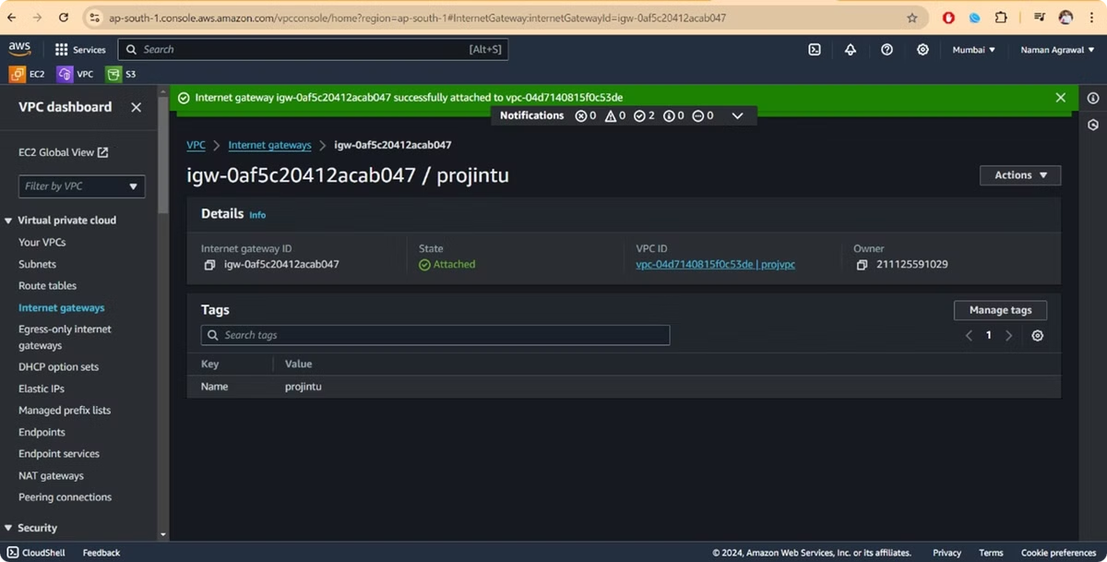
Step 1: Create a Customer Gateway
1
Log in to the AWS Management Console.
2
Navigate to the VPC Dashboard.
3
Select Customer Gateways from the left-hand menu.
4
Click Create Customer Gateway.

Slide 4

Provide Customer Gateway Information
Name tag
IP Address
A descriptive name for your customer gateway (e.g., OnPremCustomerGateway).
The static public IP address of your on-premises gateway (e.g., 203.0.113.1).
Routing
BGP ASN (if Dynamic)
Choose Static for static routing or Dynamic for BGP routing.
Provide the BGP ASN for your on-premises gateway.

Slide 5
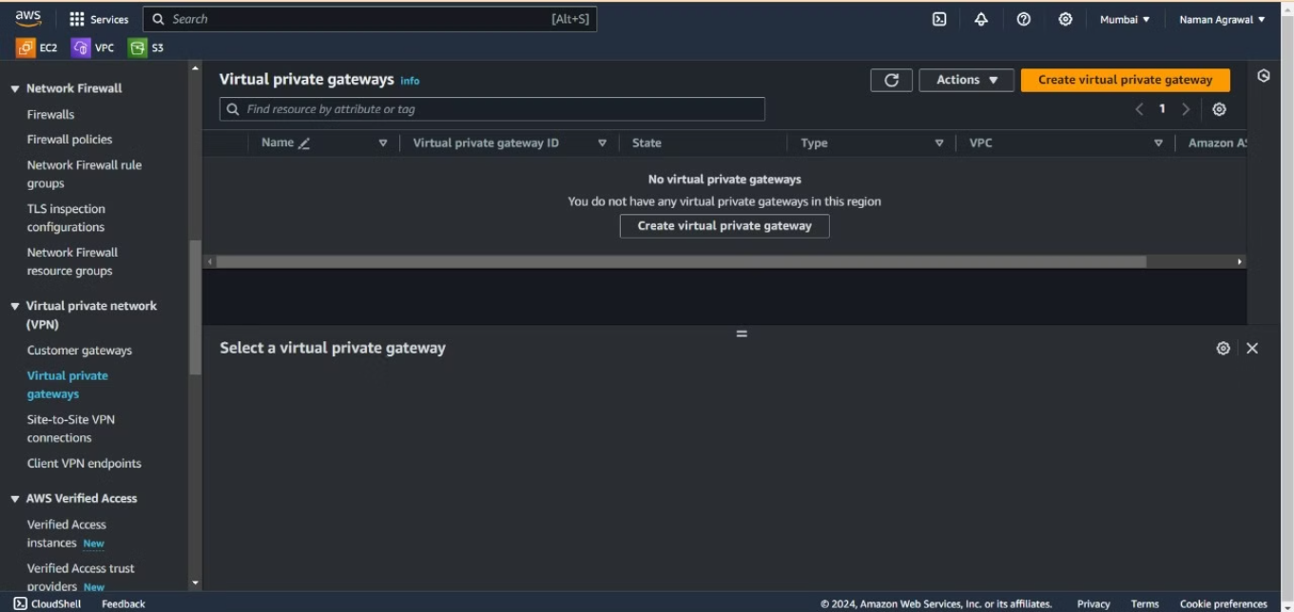
Step 2: Create a Virtual Private Gateway
1
From the VPC Dashboard select Virtual Private Gateways.
2
Click Create Virtual Private Gateway.
3
Provide a name and select the ASN.
4
Click Create Virtual Private Gateway.
5
Attach the Virtual Private Gateway to your VPC.

Slide 6
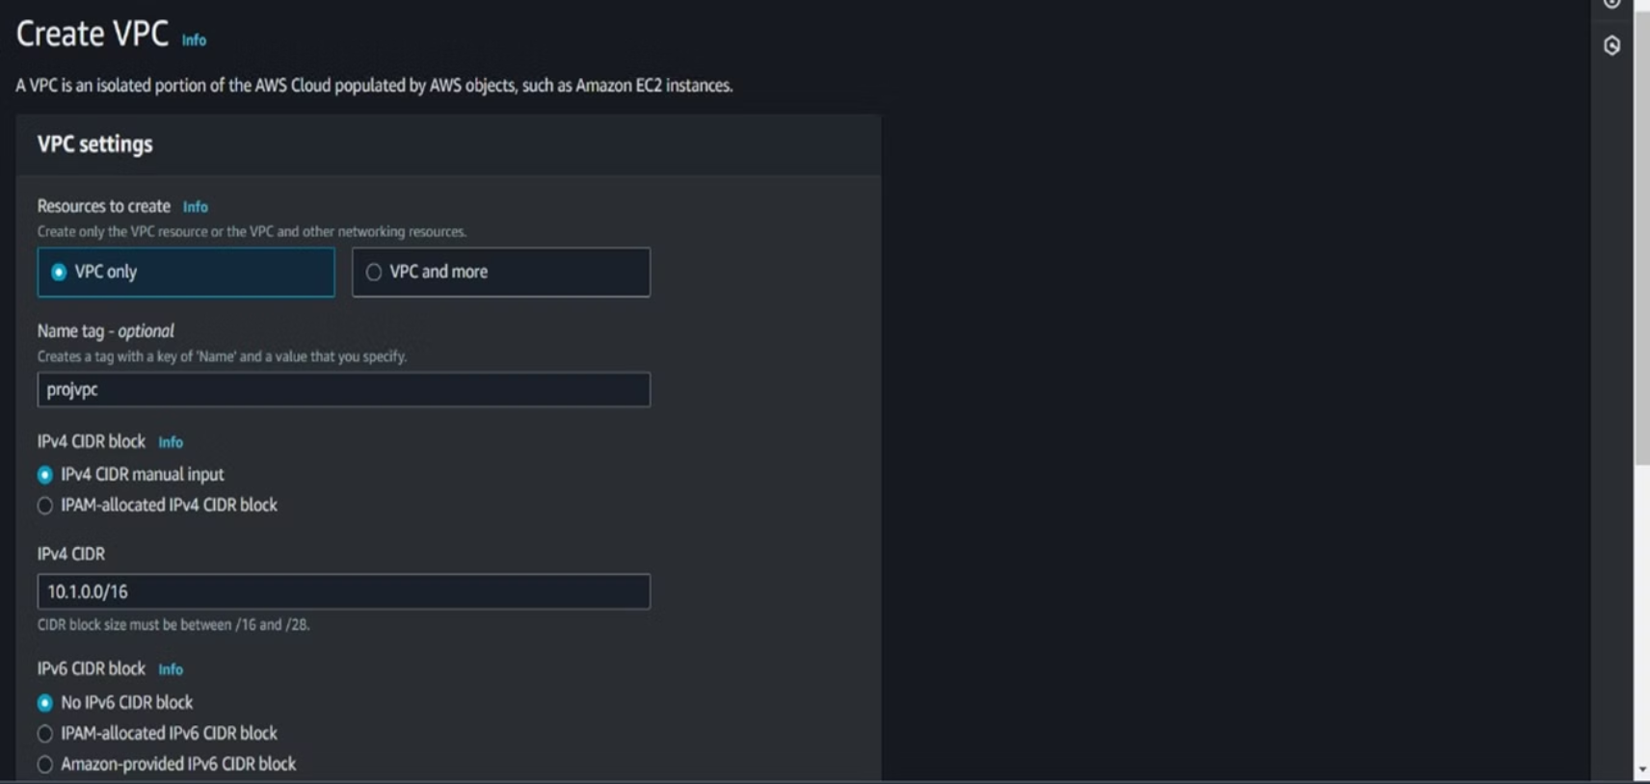

Slide 7



Attach Virtual Private Gateway to Your VPC
Network Connectivity
Enhanced Security
Performance Optimization
The VPG acts as the bridge between your AWS resources and your on-premises network, enabling seamless communication.
The VPN connection provides a secure and encrypted tunnel for data transfer, protecting your data from unauthorized access.
The VPN connection can help reduce latency and improve the overall performance of your applications, allowing you to access your AWS resources efficiently.

Slide 8
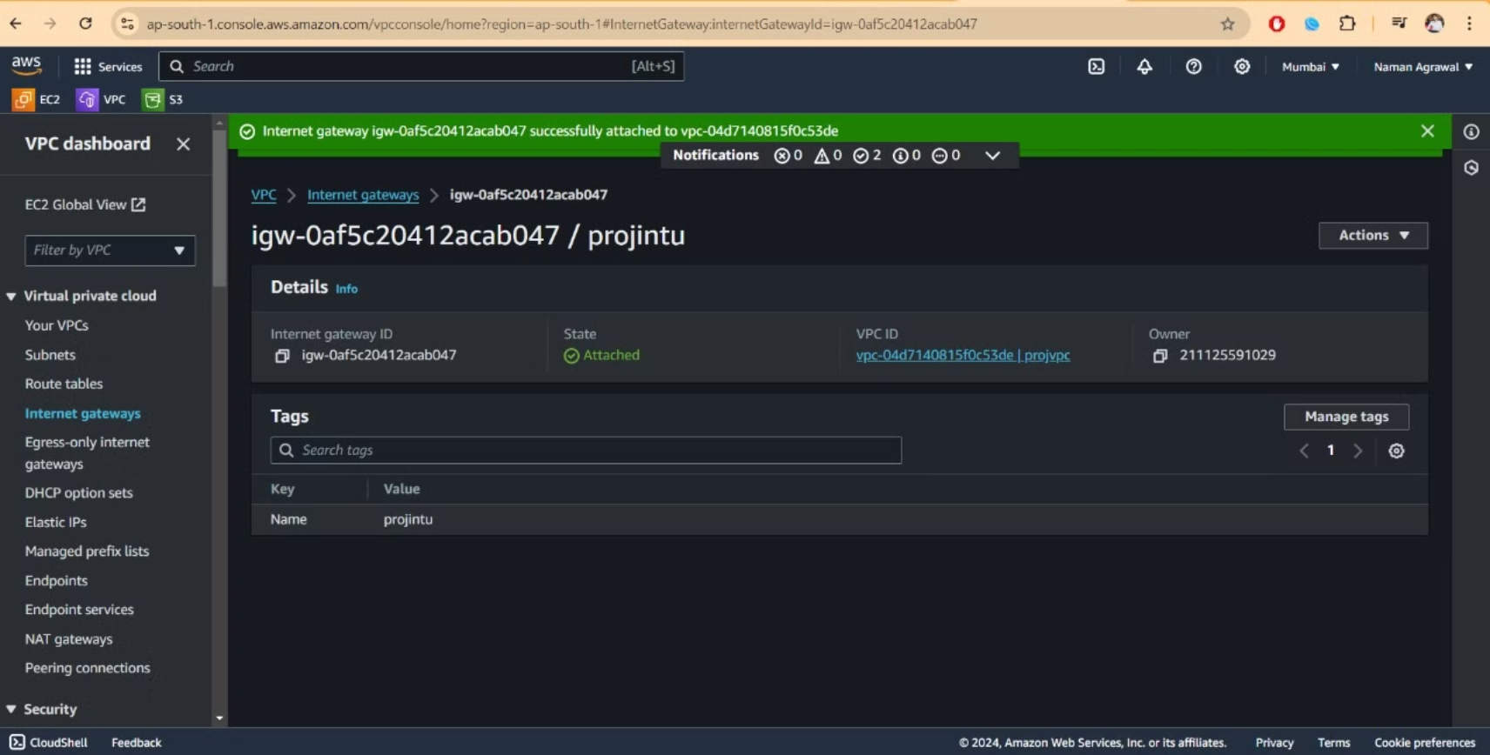

Slide 9
Step 3: VPN Connection Configuration
Name tag
Target Gateway Type
Virtual Private Gateway
Customer Gateway
A descriptive name for your VPN connection (e.g., MySiteToSiteVPN).
Select Virtual Private Gateway.
Select the customer gateway you created.
Select the virtual private gateway you created.

Slide 10
Step 4: Download the VPN Configuration
Once the VPN connection is created select it from the VPN Connections list.
Click Download Configuration.
Choose your vendor and platform (e.g., Cisco ASA, Juniper, etc.).
Download the configuration file.

Slide 11
Step 5: Configure Your On-Premises Gateway
Use the downloaded configuration file to configure your on-premises VPN device. This file contains the necessary settings and commands for the VPN connection.
Follow the specific instructions in the configuration file for your device type.
Ensure that your on-premises firewall allows traffic over the ports and protocols used by the VPN (typically UDP 500 and 4500 for IPsec).

Slide 12
Step 6: Update Route Tables
From the VPC Dashboard select Route Tables from the left-hand menu.
Choose the route table associated with the subnet(s) that need to communicate over the VPN.
Click Routes then Edit routes.
Add a route for the on-premises network:
Destination: The CIDR block of your on-premises network (e.g., 192.168.1.0/24).
Target: Select Virtual Private Gateway and choose the gateway you created.
Click Save routes.

Slide 13
Step 7: Verify the Connection
Check the status of the VPN connection in the AWS Management Console:
Go to VPN Connections.
Select your VPN connection and verify that both tunnels show UP.
Perform connectivity tests:
From an instance in your VPC try to ping a device on your on-premises network.
From a device on your on-premises network try to ping an instance in your VPC.
Troubleshoot if necessary:
Check security group rules and network ACLs in your VPC to ensure they allow the necessary traffic.
Verify that your on-premises firewall rules allow traffic to and from the VPC.
Review the logs on your on-premises VPN device for any errors.

Slide 14




Security Best Practices
1
Use Strong Passwords
2
Implement Multi-Factor Authentication
3
Enable Encryption
4
Regularly Update Security Patches
A well-configured site-to-site VPN connection can provide a secure and reliable connection, but it's crucial to follow security best practices to mitigate potential risks.

Slide 15
Next Steps and Conclusion
After successfully setting up your site-to-site VPN connection, ensure you test the connectivity and verify that you can access your AWS resources from your on-premises network.
This presentation provided a detailed overview of the key steps involved in creating a secure and reliable site-to-site VPN connection on AWS. By following these steps, you can establish a secure communication channel between your on-premises network and your AWS resources.

