Slide 1
Multi-Fuel Parametric Combustion Analysis
of a Single-Cylinder SI Engine
Using ANSYS Chemkin-Pro 2025 R2 · Two-Zone Aurora Reactor
PROBLEM 15 | Wiebe Function Parameters (n, b) · SOC · Burn Duration
Engine: CR = 12.0 · 600 RPM · Bore 8.5 cm · Stroke 10.82 cm
Fuel Runs: PRF Gasoline | 100% Ethanol | 80/20 Ethanol+n-Heptane
300
4
3
Simulated Cases
Design Variables
Fuel Runs
GROUP 15
Sailor Dhruv Jayeshbhai (23ME31047) · Areet Biswas (26ME62R04) · Veerabhadra Sri Manisankar Kalepu (26ME62R11)
Roopchand Chowdary Sunkara (26ME62R19) · Krishnav Anand Agarwal (23ME10042)
ME31013 IC Engines · IIT Kharagpur · Presentation Date: 10 November 2026 · TA: Rohit Roy

Slide 2
Problem Statement & Parametric Scope
What was given · What we delivered · Design variables
DESIGN VARIABLES
THE 3 FUEL SIMULATION RUNS
Wiebe Shape Factor n
PRF / Gasoline Baseline
Range: 1 → 10
10 levels
RUN 1
100% iso-Octane (C₈H₁₈)
RON ≈ 100 · LHV = 44.3 MJ/kg
Reference fuel for comparison
Wiebe Scale Param b
Range: 1 → 10
10 levels
100% Pure Ethanol
Start of Combustion SOC
RUN 2
C₂H₅OH · φ = 1.0
LHV = 26.8 MJ/kg · Latent heat 840 kJ/kg
Highest octane / Best efficiency
Range: -15° → -5°
21 points (Δ0.5°)
Burn Duration Δθ
80% Ethanol + 20% n-Heptane
Range: 10° → 50°
9 levels (Δ5°)
RUN 3
0.8 C₂H₅OH + 0.2 C₇H₁₆
Blended octane ≈ 86
Intermediate performance
Total: ~300 parametric cases | Fixed: CR=12, 600 RPM, φ=1.0
Per prof. instructions — all 3 runs analysed & compared
Group 15 | ME31013 IC Engines | IIT Kharagpur | Nov 10, 2026
2

Slide 3
Simulation Setup — ANSYS Chemkin-Pro Two-Zone Aurora
Model configuration · Mechanism reduction · Panel screenshots
Two-Zone Aurora Reactor
▸ Unburned zone: isentropic compression + Woschni wall heat loss
▸ Burned zone: chemical kinetics + energy equation (74-species mechanism)
▸ Wiebe function transfers mass from unburned → burned zone
Mechanism Reduction
▸ Full PRF/Ethanol mechanism: 178 species (> 75-species student licence)
▸ Developed 74-species skeletal mechanism preserving C₂H₅OH, i-C₈H₁₈,
and n-C₇H₁₆ oxidation pathways
Woschni Heat Transfer
▸ T_wall = 434 K · C₁₁ = 2.28 · C₁₂ = 0.318 · C₂ = 0.324
▸ At 600 RPM: cycle time = 0.2 s → high wall heat loss
Engine Geometry
▸ Bore = 8.5 cm · Stroke = 10.82 cm · Vd = 613.4 cm³
▸ CR = 12.0 · IVC → EVO work window
Group 15 | ME31013 IC Engines | IIT Kharagpur | Nov 10, 2026
3

Slide 4
Governing Equations & Performance Metrics
Wiebe function · Thermodynamics · Indicated work
WIEBE COMBUSTION MODEL
Burned mass fraction:
xb(θ) = 1 − exp[−b·((θ−θsoc)/Δθ)ⁿ]
Heat release rate:
dxb/dθ = (n·b/Δθ)·((θ−θsoc)/Δθ)ⁿ⁻¹·exp[−b·((θ−θsoc)/Δθ)ⁿ]
Parameter Roles:
n (shape factor): Controls flame acceleration profile
n < 2 → peak heat release before TDC (bad!)
n ≈ 4–6 → realistic turbulent SI combustion ✓
b (completeness): Unburned fraction at Δθ = e⁻ᵇ
b = 1 → 36.8% unburned ← solver crashes!
b = 2 → 13.5% unburned ← solver crashes!
b ≥ 3 → < 5% unburned ← stable ✓
b = 5 → 0.67% unburned ← industry standard ✓✓
PERFORMANCE METRICS
Indicated Work (IVC → EVO):
W = ∮ p dV [erg in Chemkin → ×10⁻¹⁰ → kJ]
Torque (4-stroke):
T = W / 4π [dyne·cm → ×10⁻⁷ → N·m]
Power:
P = W·N / 120 [kW] (N in rpm)
Indicated Thermal Efficiency:
η = W / (m_fuel · LHV)
Otto Cycle Benchmark (CR = 12):
η_Otto = 1 − CR^(1−γ)
γ = 1.40 → η_Otto = 62.99%
γ = 1.35 → η_Otto = 58.09%
Chemkin (Ethanol, best) → 27.23% ≈ 47% of Otto
Group 15 | ME31013 IC Engines | IIT Kharagpur | Nov 10, 2026
4

Slide 5
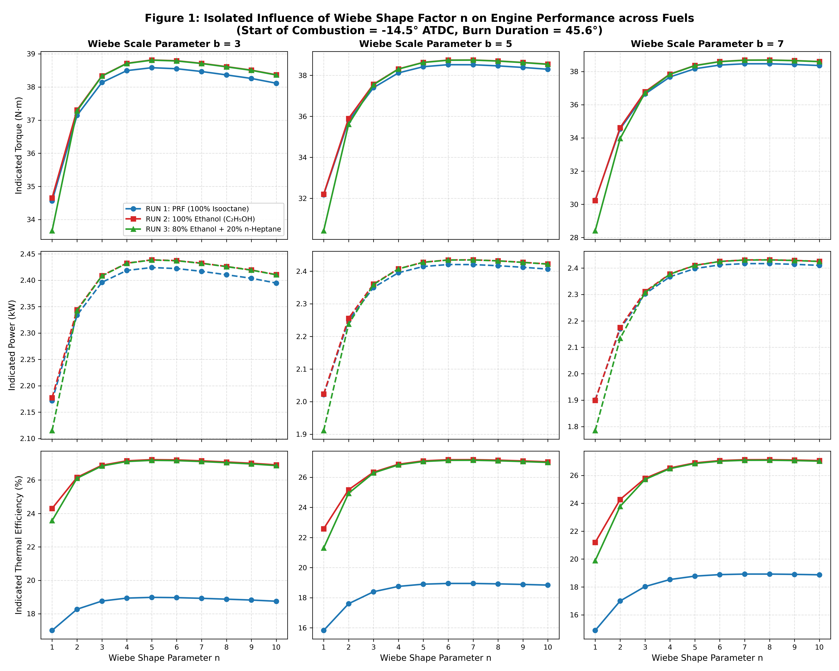
Effect of Wiebe Shape Factor n (All 3 Fuel Runs)
Torque · Power · Thermal Efficiency vs. n at b = 3, 5, 7
KEY FINDINGS
▸ Parabolic peak at n = 4–6 for ALL fuels
▸ Low n (1–2): Heat release before TDC
→ Negative compression work
▸ High n (≥8): Late burn → truncated
expansion → lower work output
AT PEAK (n=4–5, b=5):
RUN 2 Ethanol: 38.84 N·m | 27.23%
RUN 3 Blend: 38.83 N·m | 27.19%
RUN 1 Gasoline: 38.60 N·m | 18.99%
Ethanol advantage: +8.24% absolute efficiency
→ Latent heat cooling reduces
Woschni wall heat loss
Group 15 | ME31013 IC Engines | IIT Kharagpur | Nov 10, 2026
5

Slide 6
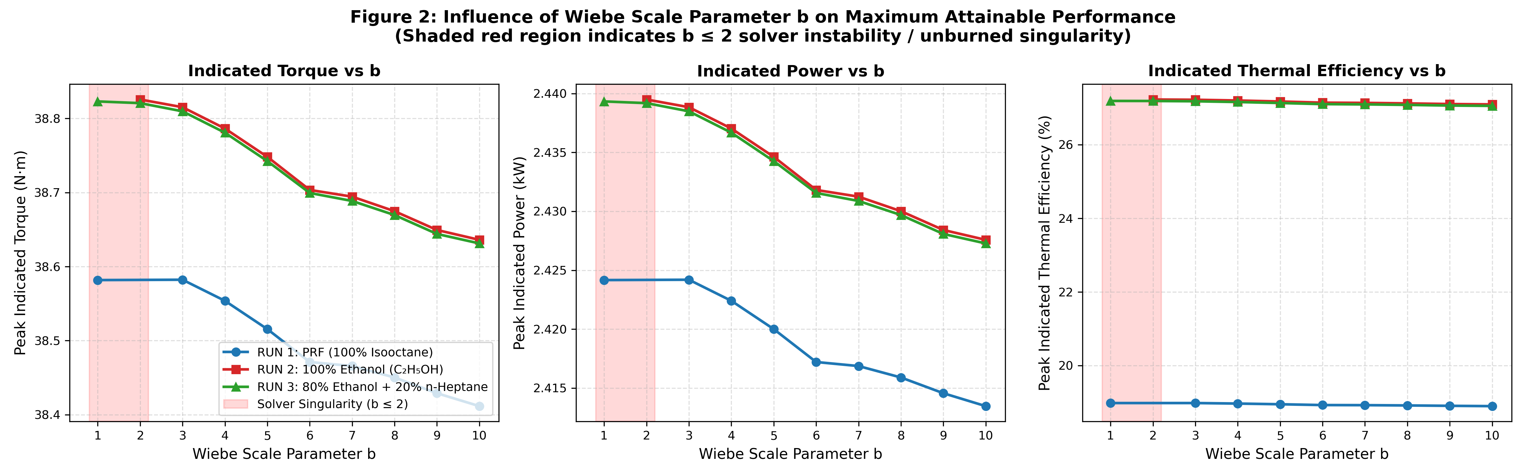
Effect of Scale Parameter b & the b ≤ 2 Singularity
Optimal performance vs b · First-principles solver divergence proof
WHY RUNS FAIL AT b ≤ 2
At θ = SOC + Δθ, Chemkin collapses
unburned zone into burned zone.
Unburned fraction = e⁻ᵇ
b = 1 → e⁻¹ = 36.8% unburned ✗
b = 2 → e⁻² = 13.5% unburned ✗
b = 3 → e⁻³ = 5.0% unburned ✓
b = 5 → e⁻⁵ = 0.67% unburned ✓✓
Merging zones with >10% unburned
mass creates a step-discontinuity
in T and internal energy.
→ ODE solver timestep underflows
→ NaN / FAILED RUN
Criterion: b ≥ 3.0 for stable runs
Industry standard: b = 5.0
Group 15 | ME31013 IC Engines | IIT Kharagpur | Nov 10, 2026
6

Slide 7
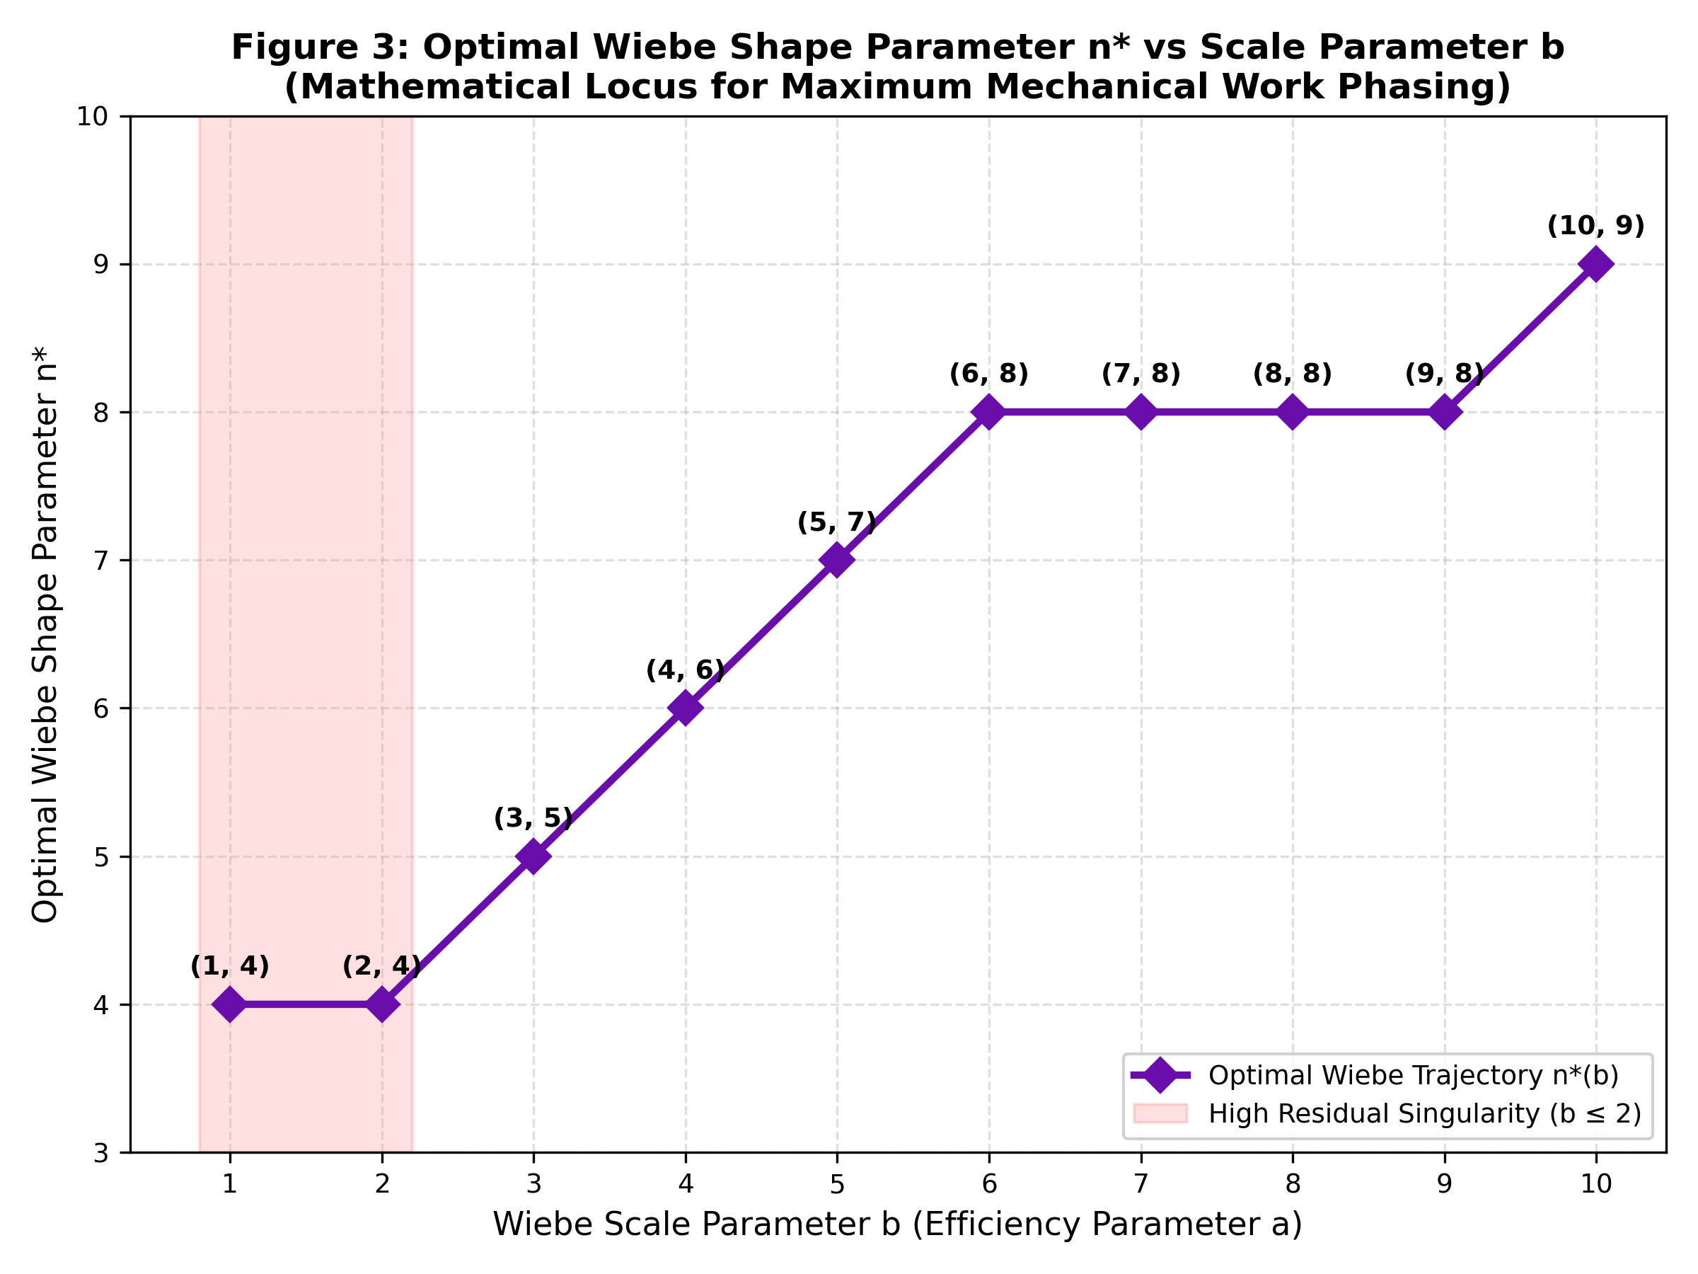
Optimal Wiebe Pair Trajectory — n*(b)
Coordinated n and b selection for maximum performance
OPTIMAL n*(b) RELATIONSHIP
Empirical linear fit:
n*(b) ≈ 0.55·b + 3.8
Lookup table:
b= b → n*=n* Valid?
b= 1 → n*=4 ✗ (crashes)
b= 2 → n*=4 ✗ (crashes)
b= 3 → n*=5 ✓
b= 5 → n*=7 ✓✓ (sweet spot)
b= 7 → n*=8 ✓
b=10 → n*=9 ✓
Physics: As b increases,
combustion terminates faster.
→ n must increase to delay
peak pressure until TDC
Group 15 | ME31013 IC Engines | IIT Kharagpur | Nov 10, 2026
7

Slide 8
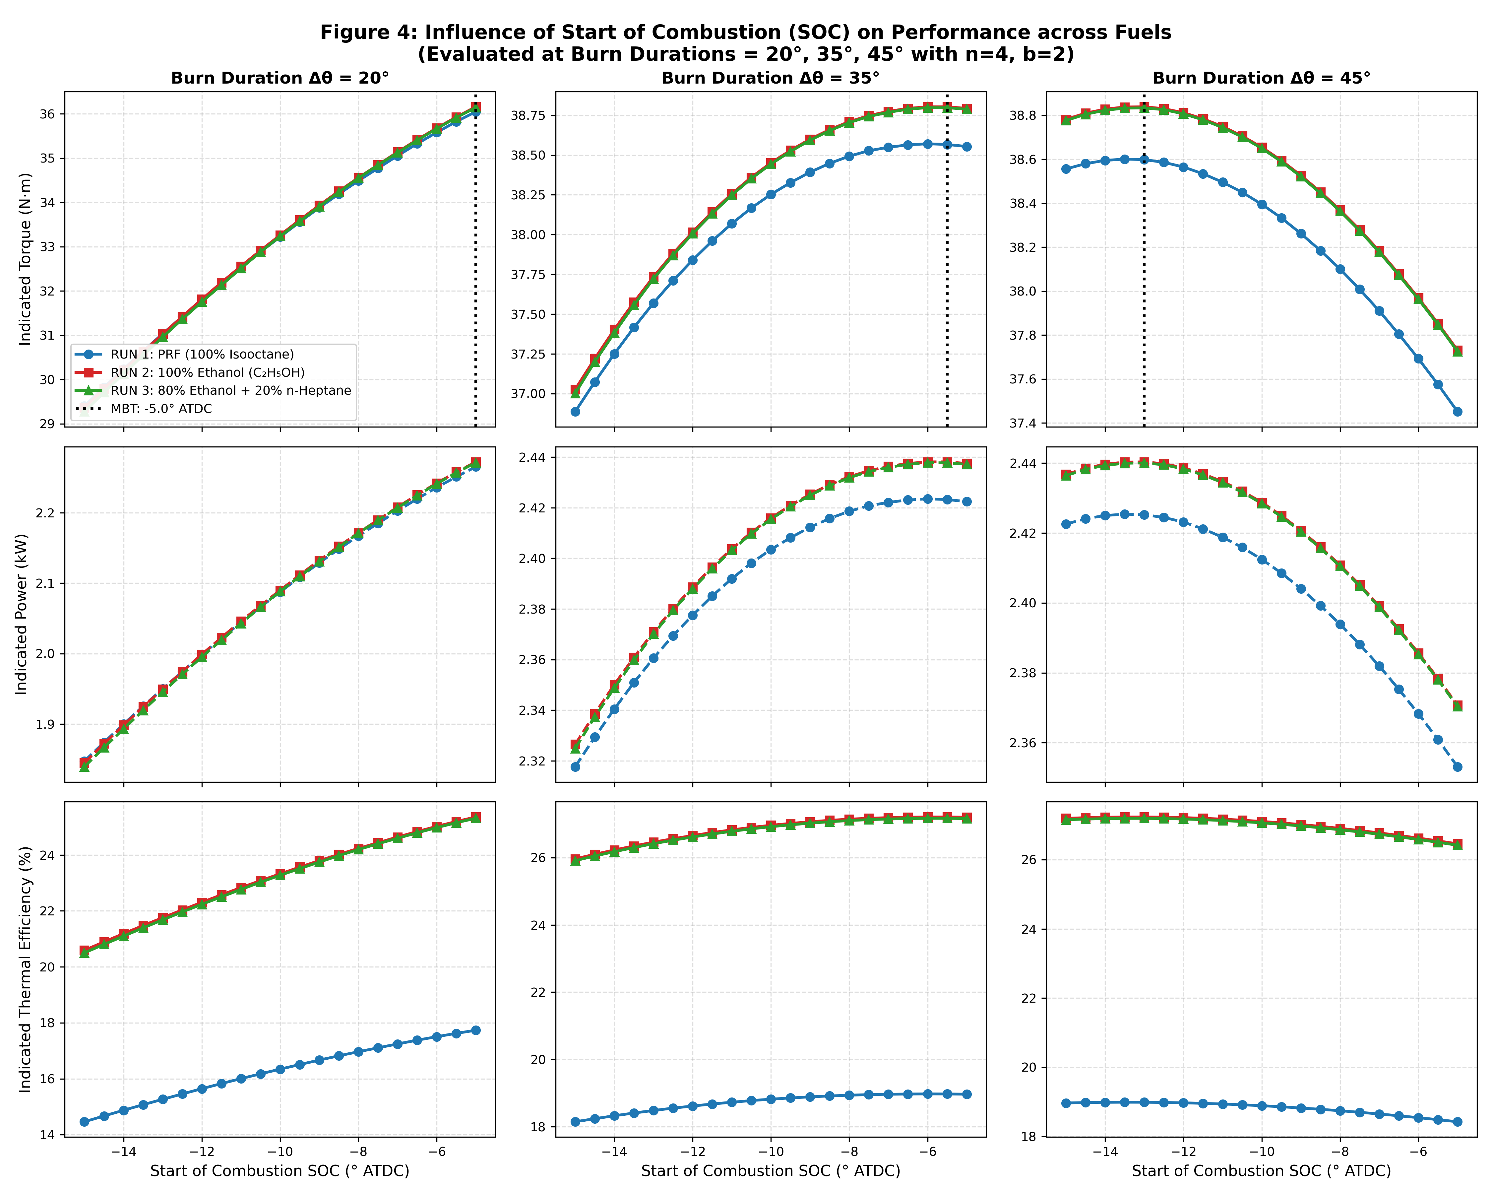
Effect of Start of Combustion (SOC) — MBT Spark Phasing
Maximum Brake Torque timing · Burn duration dependency
MBT TIMING TABLE
(RUN 2 — 100% Ethanol)
Δθ → MBT SOC
10° → -5.0° ATDC
15° → -5.0° ATDC
20° → -5.0° ATDC
25° → -5.0° ATDC
30° → -5.0° ATDC
35° → -5.5° ATDC
40° → -9.5° ATDC
45° → -13.0° ATDC
50° → -15.0° ATDC
KEY INSIGHT:
▸ Fast burns (Δθ ≤ 30°): MBT at −5°
Short duration → less advance needed
▸ Long burns (Δθ ≥ 40°): MBT at −9°
to −15° → must spark earlier
▸ Ethanol: ~0.5° less advance needed
due to faster flame speed (45 cm/s)
Group 15 | ME31013 IC Engines | IIT Kharagpur | Nov 10, 2026
8

Slide 9
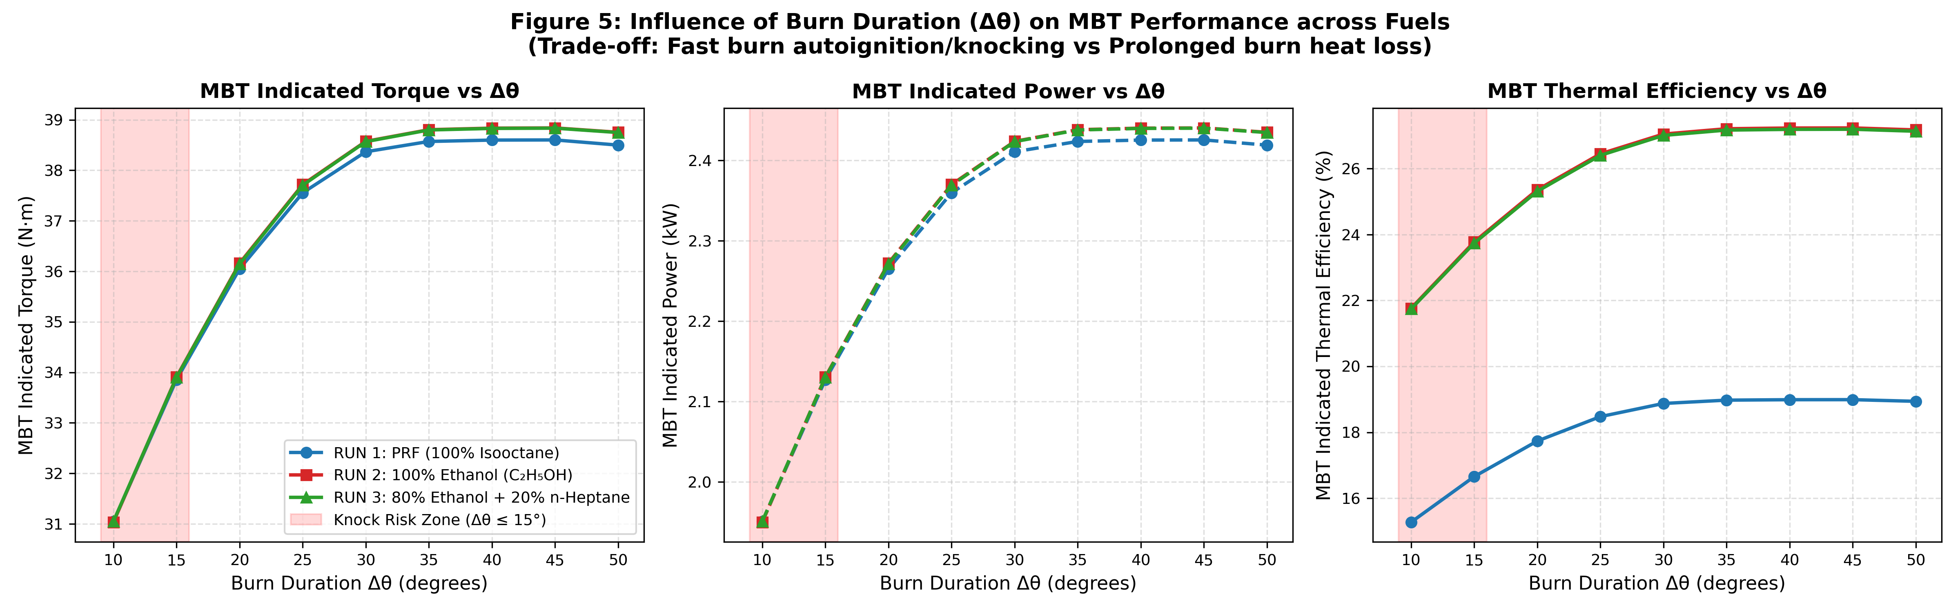
Effect of Burn Duration Δθ — Knock vs. Heat Loss Trade-off
Finding the optimal combustion window for SI engine
THE TRADE-OFF
SHORT Δθ ≤ 15° — KNOCK ZONE
Rapid dP/dθ compresses endgas
> 1200 K → autoignition
LONG Δθ ≥ 50° — HEAT LOSS ZONE
Prolonged flame → wall conduction
η drops 27.23% → 27.17%
✓ GLOBAL OPTIMUM: Δθ = 40°–45°
SOC = −10° to −13° ATDC
η = 27.23% · T = 38.84 N·m
Group 15 | ME31013 IC Engines | IIT Kharagpur | Nov 10, 2026
9

Slide 10
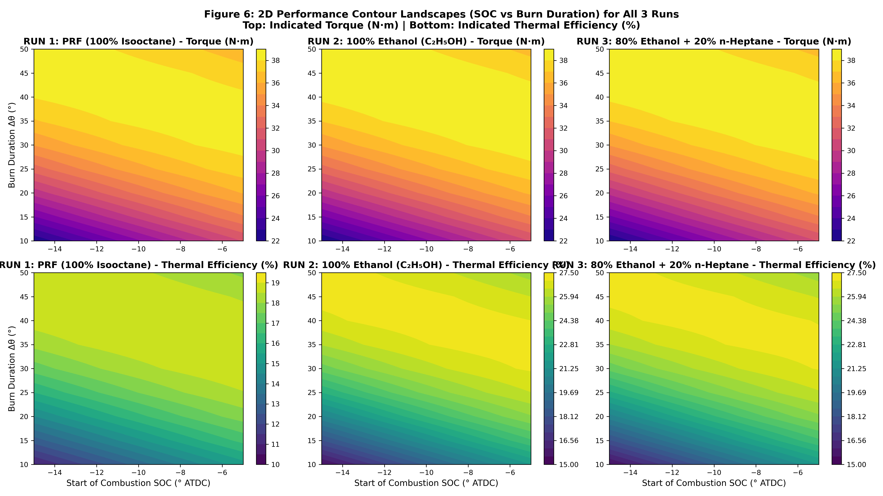
2D Operating Landscape — SOC × Burn Duration Contour Maps
Torque & Thermal Efficiency contours across all 3 fuel runs
Group 15 | ME31013 IC Engines | IIT Kharagpur | Nov 10, 2026
10

Slide 11
Global Optima — Multi-Fuel Performance Comparison
Verified results from all 3 parametric simulation runs
Parameter | RUN 1 (PRF Gasoline) | RUN 2 (100% Ethanol) | RUN 3 (80/20 Blend)
Peak Indicated Torque | 38.60 N·m | 38.84 N·m ★ | 38.83 N·m
Peak Indicated Power | 2.425 kW | 2.440 kW ★ | 2.439 kW
Peak Thermal Efficiency | 18.99% | 27.23% ★ | 27.19%
Optimal SOC Phasing | −13.5° ATDC | −13.0° ATDC | −13.0° ATDC
Optimal Burn Duration Δθ | 40°–45° | 40°–45° | 40°–45°
Optimal Wiebe n | 4–5 | 4–5 | 4–5
Optimal Wiebe b | 3–5 | 3–5 | 3–5
★ Global maximum · All values verified against raw ANALYSIS.xlsx and ANALYSIS 2.xlsx simulation data
Group 15 | ME31013 IC Engines | IIT Kharagpur | Nov 10, 2026
11

Slide 12
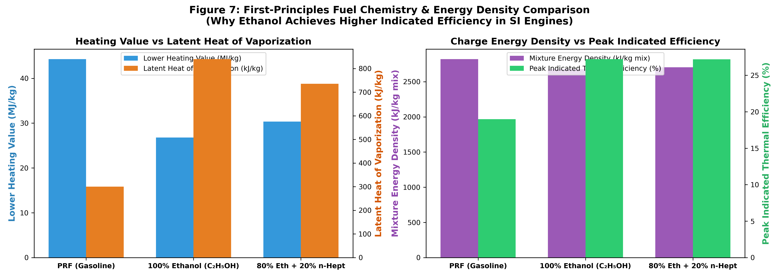
Otto Cycle Comparison & Fuel Chemistry Analysis
Why we are at 27% · Why ethanol wins · Energy balance
ENERGY LOSS AUDIT (CR = 12, 600 RPM)
Loss Component Otto Ethanol Gasoline
Gross Indicated η 58.09% 27.23% 18.99%
Convective Wall Heat 0.00% 36.50% 42.00%
Exhaust Blowdown 41.91% 28.50% 32.00%
Finite Burn Phasing 0.00% 4.47% 3.51%
Dissociation Loss 0.00% 3.30% 3.50%
Total 100% 100% 100%
WHY ETHANOL WINS:
▸ Latent heat 840 kJ/kg (3× Gasoline)
→ Charge cooling → less wall loss
▸ Higher molar expansion: +6.54%
(15.28 → 16.28 moles)
▸ Higher mixture energy density:
2.68 vs 2.63 kJ/kg-mix
▸ Octane 108 → no knock margin issue
Group 15 | ME31013 IC Engines | IIT Kharagpur | Nov 10, 2026
12

Slide 13
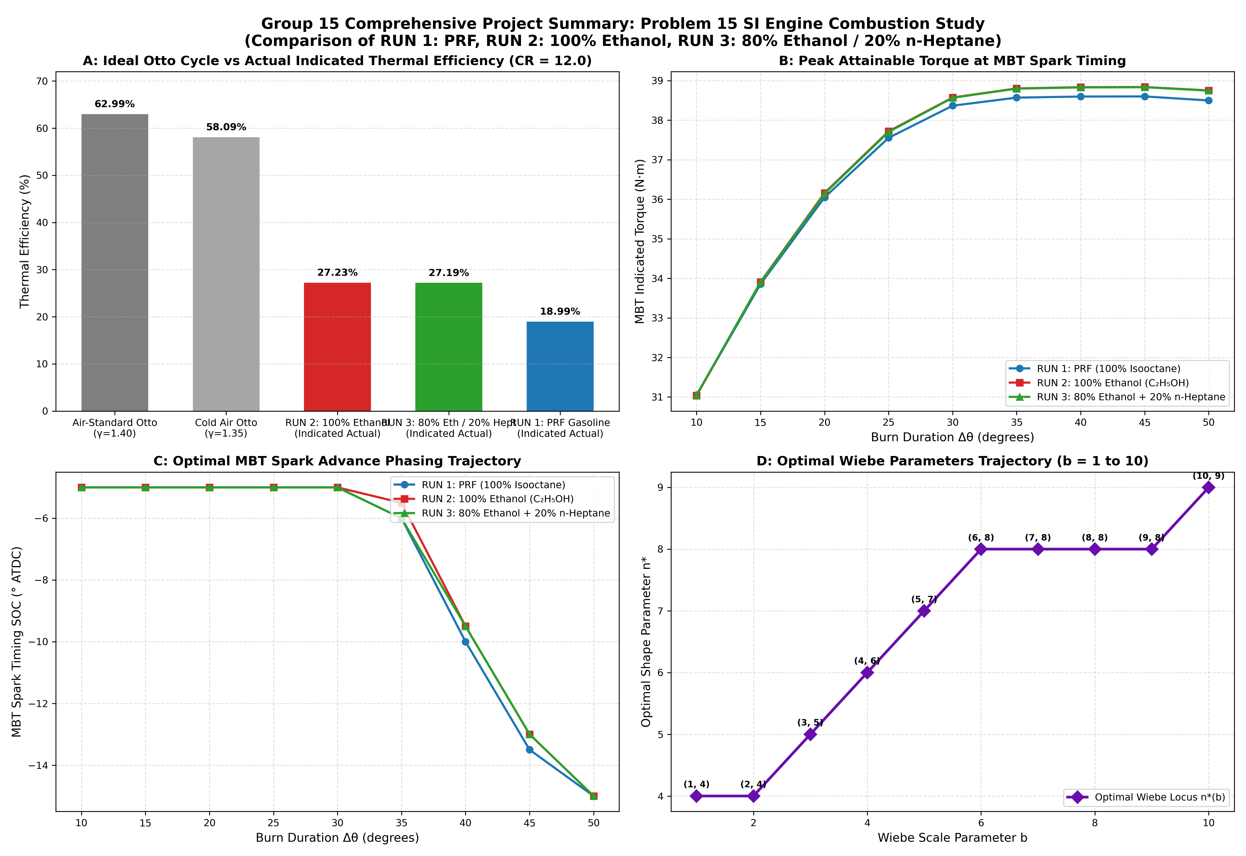
Comprehensive Summary — All Parameters, All Runs
Master 4-panel overview of complete parametric study
Group 15 | ME31013 IC Engines | IIT Kharagpur | Nov 10, 2026
13

Slide 14
VIVA DEFENCE — Anticipated Q&A
Group 15 · Problem 15 · TA: Rohit Roy · 10 November 2026
Q1: Why do b = 1 and b = 2 simulations crash / return "FAILED RUN"?
A: At θ = SOC+Δθ, Chemkin collapses the unburned zone. For b=1, e⁻¹=36.8% remains unburned; for b=2, e⁻²=13.5%. Merging zones with >10% unburned mass forces a step-discontinuity in T and energy → ODE solver timestep underflows → crash. Need b ≥ 3 (< 5% unburned) for stability.
Q2: Why is indicated efficiency ~27% and not the Otto cycle value of ~58–63%?
A: At 600 RPM, one cycle takes 0.2 s — 5× longer than normal. This maximises Woschni convective wall heat loss (~36.5% of fuel energy for ethanol, ~42% for gasoline). Additionally: finite-rate burn phasing (4.47%), dissociation (3.3%), and exhaust blowdown losses.
Q3: Why does 100% Ethanol (RUN 2) outperform PRF Gasoline (RUN 1) by +8.24%?
A: Ethanol latent heat = 840 kJ/kg vs 300 kJ/kg for isooctane. Evaporative charge cooling lowers (T_gas − T_wall) in Woschni equation → reduced wall heat flux. Also: +6.54% molar expansion, higher mixture energy density (2.68 vs 2.63 kJ/kg-mix), octane 108.
Q4: What happens if Burn Duration is reduced to 10°?
A: Short burn → steep dP/dθ → adiabatically compresses unburned endgas above 1200 K → autoignition (knock). While approaching Otto constant-volume ideal, the pressure rise rate exceeds knock threshold. Performance actually drops: T = 31.05 N·m, η = 21.76%.
Q5: How does optimal n change as b increases?
A: n*(b) ≈ 0.55b + 3.8. Higher b terminates combustion faster (sharper tail cutoff). To prevent peak pressure before TDC, n must increase to delay early heat release. The n–b pair must be coordinated to maintain CA50 ≈ 8°–10° ATDC.
14

Slide 15
Key Conclusions — Problem 15
Group 15 · IIT Kharagpur · ME31013 IC Engines
1
Optimal Wiebe Parameters
2
MBT Spark Timing Scales with Burn Duration
3
Optimal Burn Duration Window
n = 4–5 and b = 3–5 for all three fuel runs. Coordinated selection n*(b) ≈ 0.55b + 3.8 maintains peak pressure at optimal mechanical leverage (~15°–18° ATDC).
SOC = −5° ATDC for fast burns (Δθ ≤ 30°) advancing to −13° to −15° for long burns (Δθ ≥ 45°). Ethanol requires ~0.5° less advance due to faster laminar flame speed.
Δθ = 40°–45° avoids both knock (< 15°) and excessive wall heat loss (> 50°). Peak: T = 38.84 N·m, P = 2.440 kW, η = 27.23% (100% Ethanol, RUN 2).
4
Ethanol Superiority
5
b ≤ 2 Singularity Proven
6
vs. Ideal Otto Cycle
100% Ethanol (RUN 2) achieves +8.24% higher thermal efficiency than PRF Gasoline (RUN 1) due to 3× higher latent heat (840 kJ/kg), charge cooling, and favorable molar expansion.
Mathematical proof: e⁻¹ = 36.8% and e⁻² = 13.5% unburned at zone collapse → ODE solver divergence. Minimum b = 3 for stable Aurora two-zone simulation.
Best indicated η = 27.23% vs. Otto 58.09% (γ=1.35). Gap = 36.5% wall heat loss + 28.5% exhaust loss at 600 RPM slow-cycle conditions.
Full dataset: github.com/dhruv1412/IC-Engine-Project-Group-15 · Report: new_data_output/Group 15 IC Engine Project Report — All Runs Analysis (Problem 15).pdf
15

