Slide 1
OpticFable
“A picture is worth a thousand words”
Dhruv Verma
March 15th 2019

Slide 2
Part 1: Image Captioning

Slide 3

Datasets
Flickr8K:
Training set (6,000 images), Val set (1,000 images), Test dataset (1,000 images).
Approx 5 captions describing each image
Reshaped to 224 x 224 pixel images
Notes:
Convert all words to lowercase.
Remove all punctuation.
Remove all words that are one character or less in length (e.g. ‘a’).
Remove all words with numbers in them.

Slide 4
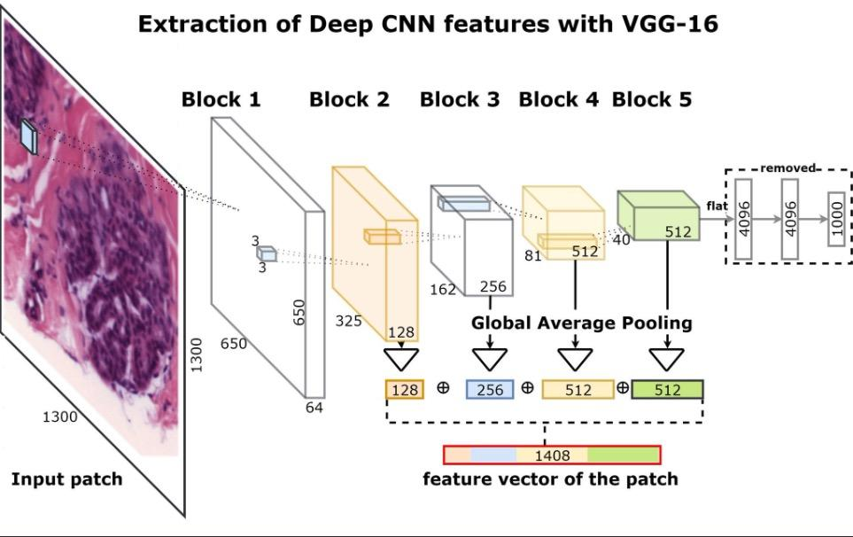
Models
Photo Feature Extractor
16-layer VGG model pre-trained on the ImageNet dataset.
Pre-process photos using VGG model (without the output layer)
Extracted features predicted by this model as input.

Slide 5
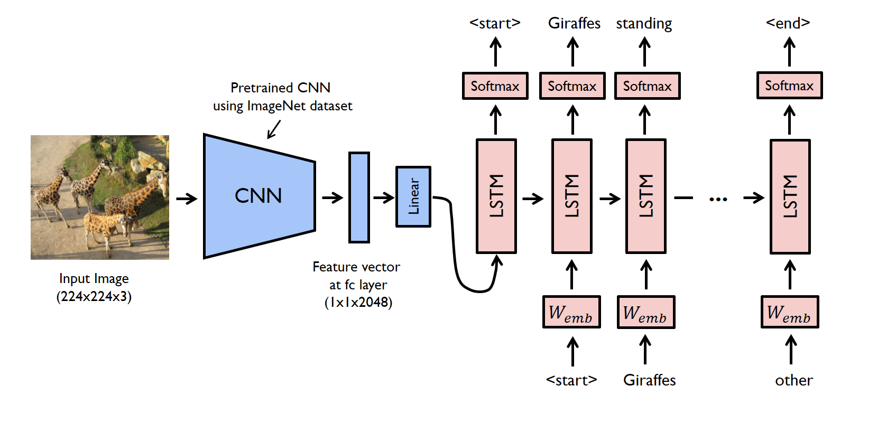
Models
Sequence Processor
Word embedding layer for handling text input
Followed by a Long Short-Term Memory (LSTM) recurrent neural network layer.

Slide 6
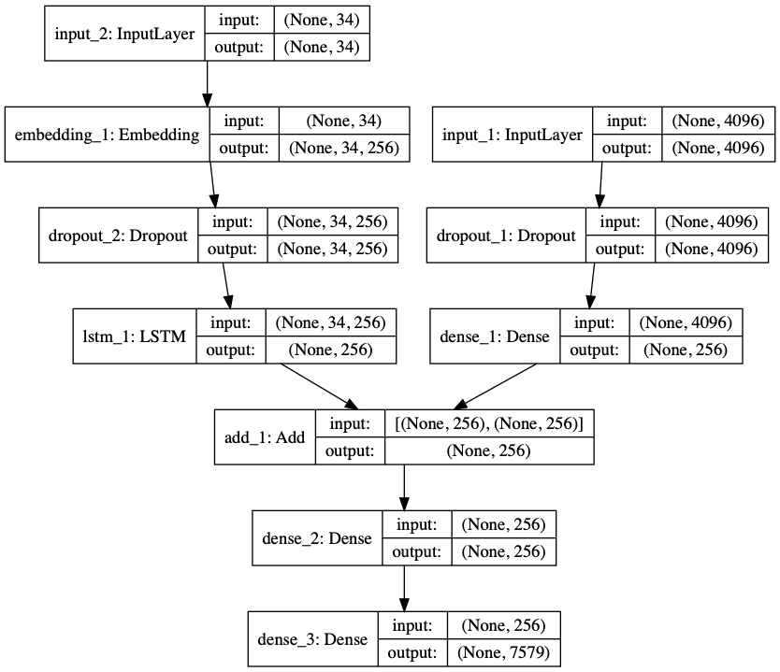
Models
Decoder (Merge model)
Both feature extractor and sequence processor output a fixed-length vector.
These are merged together and processed by a Dense layer to make a final prediction.
Notes:
The merge model combines both the encoded form of the image input with the encoded form of the text description generated so far.
The combination of these two encoded inputs is then used by a very simple decoder model to generate the next word in the sequence. The role of the recurrent neural network is to encode input rather than generate output.
Iteration 1 input: image vector + “startseq”

Slide 7
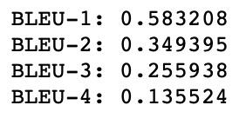
Evaluation: BLEU Score
Bilingual Evaluation Understudy Score, (BLEU), is a metric for evaluating a generated sentence to a reference sentence
Calculate BLEU scores for 1, 2, 3 and 4 cumulative n-grams.
Ideal (Marc Tanti et al.):
BLEU-1 = 0.6, BLEU-2 = 0.413, BLEU-3 = 0.273,
BLEU-4 = 0.178
Notes:
Counting matching n-grams in the generated text to n-grams in the reference text, where 1-gram or unigram would be each token and a bigram comparison would be each word pair.
Score close to 1.0 is better, a score closer to zero is worse.

Slide 8
Optimizations
Precompute image feature vectors for entire image dataset to use for training
Use data generator to batch train

Slide 9
Part 2: Language Model

Slide 10
GPT-2 (Generative Pre-training Transformer)
Generalized unsupervised language model
Smaller version released (117m parameters vs 1.5B parameters)
Trained on 8 million Web pages collected by crawling qualified outbound links from Reddit. 50GB of text data
No official custom training/ fine-tuning
Notes:
Predict the next word, given all of the previous words within some text. It adapts to the style and content of the conditioning text. This allows the user to generate realistic and coherent continuations about a topic of their choosing

Slide 11
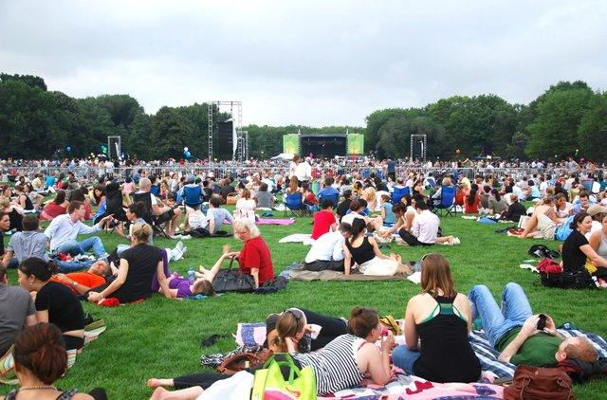
A crowd of people having a picnic in the park, and it was clear to everyone that the people there were all in the mood for something to eat. Everyone wanted to grab a plate of fries. There were also people cheering as they were pulled from the parking lot and into the park.
The park's first big event happened in September. As many as 250 people gathered outside of the park, and it was a great show for the park. It was also the first time in history that there had been more people than the number of people in a park. More people than when the entire first year of the park was under 100 people. There was a lot of excitement, and the crowds were so large that it was hard to see the area around the park.
As well, there will be a new theme park to be created next year, bringing in some new fans to join the park.

Slide 12
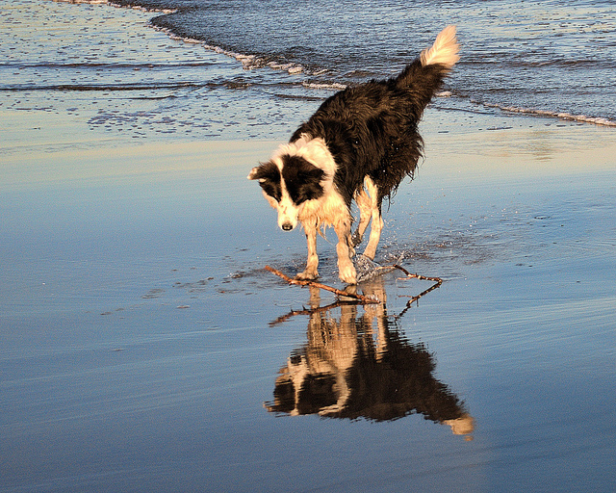
Black and white dog jumps into water. The problem is that not even a single dog is allowed to use a water bottle. "We don't even have a policy on a dog being allowed to use a bottle in public water parks," said Bob Kornacki, a veterinarian with the National Park Service.
But in the case of the black dogs, the local police have had to intervene.
"In a city like Chicago where there are over 100 schools with 100,000 students, we have to be involved. I'm sure it's a very difficult scenario for the police department to make," said Kornacki.
While the black dogs of Chicago are being handled by the city's police department, they are not allowed back at the park.

Slide 13
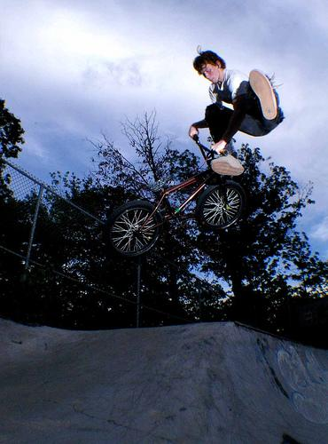
Person jumping off of bike in the game of the season, but he's a bit of a different kind of person than he could have been.
He's very, very good at basketball. He's very good at basketball on defense. He's very good at basketball on offense. He's very good at basketball on special teams. He's very good at basketball on special teams. He's very good at basketball on defense. He's very good at basketball on special teams.
He's a very smart guy.

Slide 14
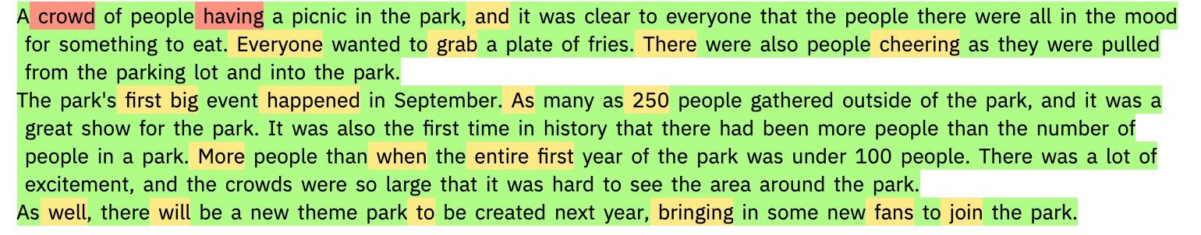
Fake Text Detector (GLTR)
Each text is analyzed by how likely each word would be the predicted word given the context to the left.
If the actual used word would be in the Top 10 predicted words the background is colored green, for Top 100 in yellow, Top 1000 red, otherwise violet.

Slide 15
Further Work
Use attention mechanism for image captioning model
Use COCO dataset
Use pre-trained word vectors for image captioning LSTM
Retrain GPT2/ other language model on literary genres
More hyper parameter tuning (learning rate, batch size, dropout rate, batch normalization etc.).
Deploy model

