Slide 1
Elements of Electrical and Electronics Engineering
FY BTech

Slide 2

Syllabus Modules
D.C Circuits
A. C. Circuits
Basic Electronic Devices and applications
Electrical machines
https://somaiya0-my.sharepoint.com/:v:/g/personal/sangeetakulkarni_somaiya_edu/EUsKvLjkvj9Ds7A3aE26fWgBnN-A2fGcNMshz72xKWT2Gw

Slide 3
D.C.Circuits
D.C. Vs A.C.
Direct current
Alternating current

Slide 4
D.C.Circuits
Course outcome:
Analyze resistive networks excited by DC sources using various network theorems

Slide 5
Basic Laws / theorem:
  Ohm’s law
  Kirchhoff’s Voltage and current laws (KVL and KCL)
  Mesh Analysis
  Node Analysis
  Superposition theorem
  Thevenin’s Theorem
  Norton’s Theorem
  Maximum power transfer theorem

Slide 6
D.C.Circuits- Basic Elements
Voltage sources-basic network element which supplies energy to the networks
Independent voltage source-
An independent voltage source is a two terminal network element that establishes a specified voltage across its terminals. The value of this voltage at any instant is independent of the value or direction of the current that flows through it. Can be constant value or time dependant value.
Independent Current source-

Slide 7
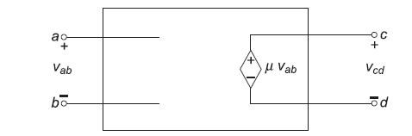
D.C.Circuits- Basic Elements
Dependent source:
If the voltage or current of a source depends in turn upon some other voltage or current
Voltage controlled voltage source( VCVS)-
Voltage gain

Slide 8
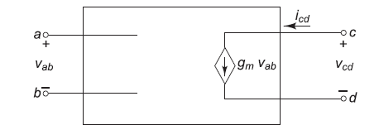
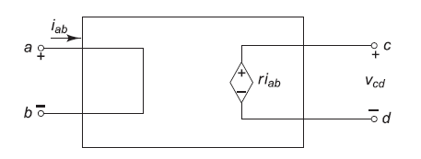
D.C.Circuits- Basic Elements
2. Voltage controlled Current source( VCCS)- Transconductance
3. Current controlled Voltage source( CCVS)- mutual resistance

Slide 9
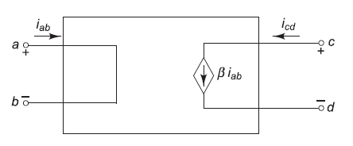
D.C.Circuits- Basic Elements
.
4. Current controlled Current source( CCCS)- Current gain

Slide 10
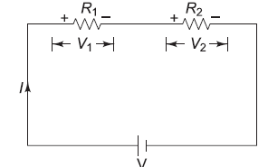
D.C.Circuits- Basics
.
Ohm’s Law- V=I * R
Resistances in series R= R1+R2+R3+…….

Slide 11
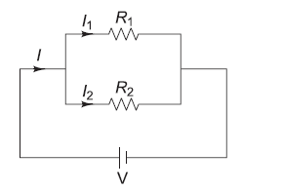
D.C.Circuits- Basic Elements
.Resistances in parallel
(1/R)= (1/R1)+(1/R2) OR R= (R1R2)/ (R1+R2)

Slide 13
If 5 resistors of 5Ω each are connected in parallel, Effective resistance is ------
If n resistors of R Ω each are connected in parallel, Effective resistance is ------

Slide 14
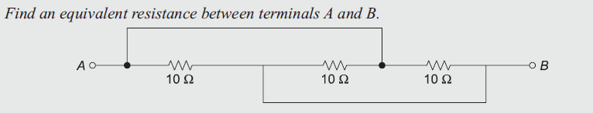
D.C.Circuits- Basic Elements
.

Slide 16
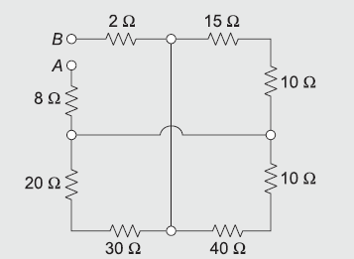
D.C.Circuits- Basic Elements
.
Find the equivalent resistance between terminals A and B.

Slide 17
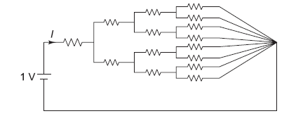
D.C.Circuits- Basic Elements
.
Value of current I if all resistances of
1 Ω each

Slide 18
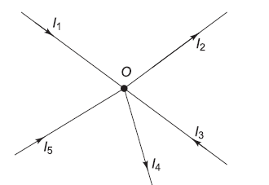
D.C.Circuits- Basic Elements
KVL and KCL- (Kirchhoff’s voltage and current laws )
  The algebraic sum of currents meeting at a junction or node in an electric circuit is zero.
At node O
I1-I2+I3-I4+I5=0
(Assuming incoming currents positive and outgoing negative)

Slide 19


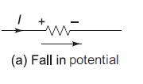
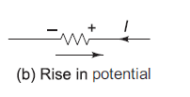
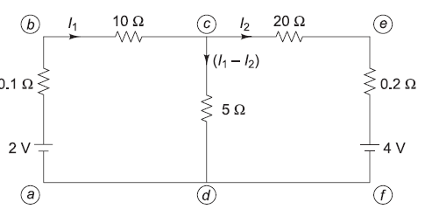
D.C.Circuits- Basic Elements
.
Kirchhoff’s Voltage Law (KVL) - The algebraic sum of all the voltages in any closed circuit or mesh or loop is zero.
Sign convention:

Slide 20
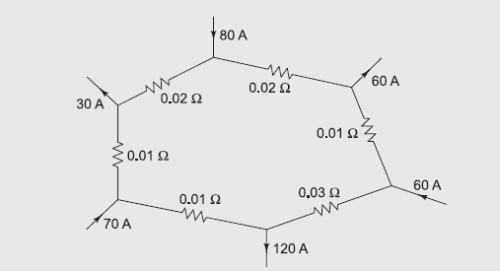
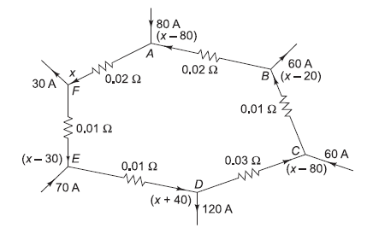
Find currents in all branches of circuit

Slide 21
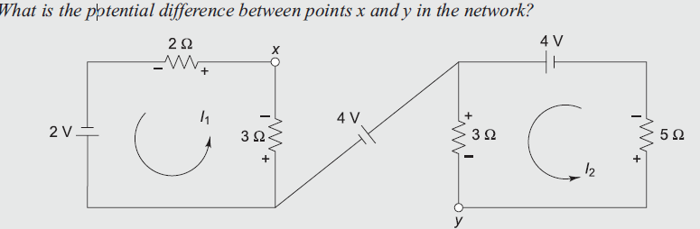
D.C.Circuits- KCL/KVL
.

Slide 22
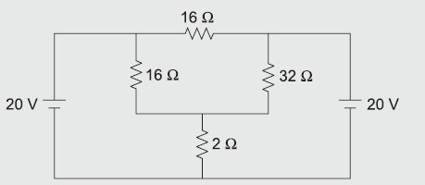
D.C.Circuits- KCL/KVL
.
Find the value of current flowing through the 2 ohm resistor.

Slide 23
D.C.Circuits- Basic Elements
.

Slide 24
D.C.Circuits- Basic Elements
.

Slide 25
D.C.Circuits- Basic Elements
.

Slide 26
D.C.Circuits- Basic Elements
.

