Slide 1

Face Recognition Based Attendance System
Presentation by:
Bhavin Kuwar
Dhruv Thummar
Neel Patel
Vivek Mewada

Slide 2
ABSTRACT
Taking Attendance manually and maintaining is difficult process , especially for large group of students. We are developing a system to overcome the drawbacks like cost, fake attendance, accuracy, intrusiveness.
In this project, we propose a system that takes the attendance of students during classroom lecture automatically using face recognition.
We propose a method for estimating the attendance precisely using all the results of face recognition obtained by continuous observation, improves the performance.
The enrolment of the students is a onetime process and their face will be stored in the database. Students can have their own roll number as student id which will be unique for each student.

Slide 3
Problem definition
The traditional manual methods of monitoring students attendance in lectures are tedious as the calling attendance in classrooms for analysis.
The use of clickers, ID cards swiping and manually writing down names on a sheet of paper as a method to track students attendance.
This is time consuming and prone to inaccuracies as some students in classroom can often respond for their absent colleagues, rendering this method ineffective in tracking the students’ class attendance.
This is not in any way to criticize the various methods used for student attendance, but to build a system that will detect the number of faces present in a classroom as well as recognizing them.

Slide 4

DEMERITS
Physical State.
Time Consuming.
More Manpower.
Difficult to Maintain.
Forgery Chances.

Slide 5

Proposed System
1.Detect Face in Image
Face recognition is one of the method of automatic attendance which is accurate and time saving.
In this we have four steps:
a) Detect Face In Image
b) Normalize Facial landmarks
c) Extract Facial Features
d) Recognize Face Image
4. Recognize Face Image
2. Normalize Facial Landmark
3. Extract Facial Features

Slide 6
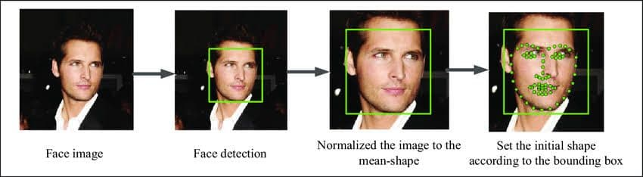
Proposed System – Continue…
a.) Detect Face in Image :-
Is to detect image in real time and to keep tracking of the same image.
b.) Normalize Facial Landmarks :-
Detecting facial landmarks :
Step 1: Localize the face in the image.
Step 2: Detect the key facial structures on the face.

Slide 7
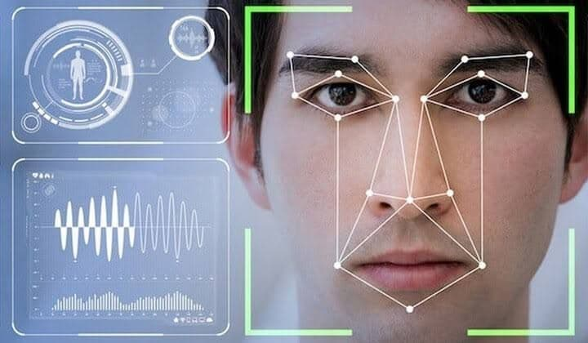
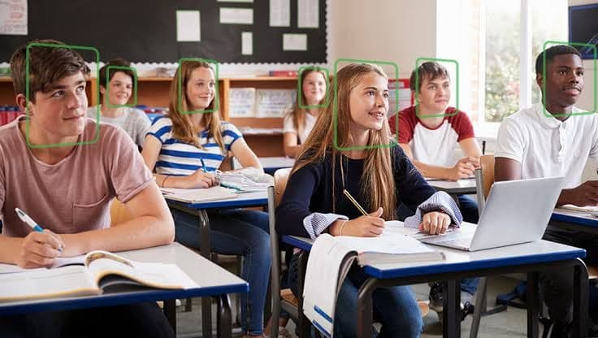
Proposed System – Continue…
c.) Extract Facial Features :-
Facial feature extraction is the process of extracting face component features like eyes, nose, mouth, etc from human face image.
d.) Recognize Face Image :-
A facial recognition system is a technology capable of identifying or a verifying person from a digital image or a video frame from a video source.

Slide 8

MERITS
Automated time tracking system.
Labour cost savings.
Tighter security & Intruder Tracking.
Environment Savvy.
Ease of integration

Slide 9
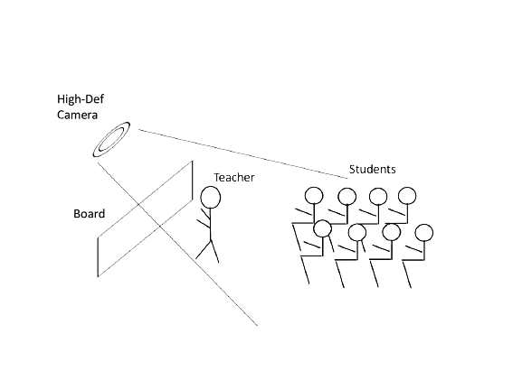
How It’s Work ?

Slide 10
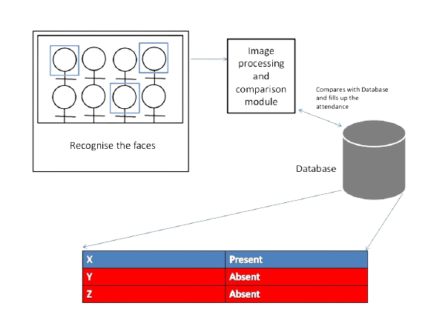
Continue…

Slide 11

Roles of actors…
What’s the role of Faculty ?
Take Attendance

Slide 12
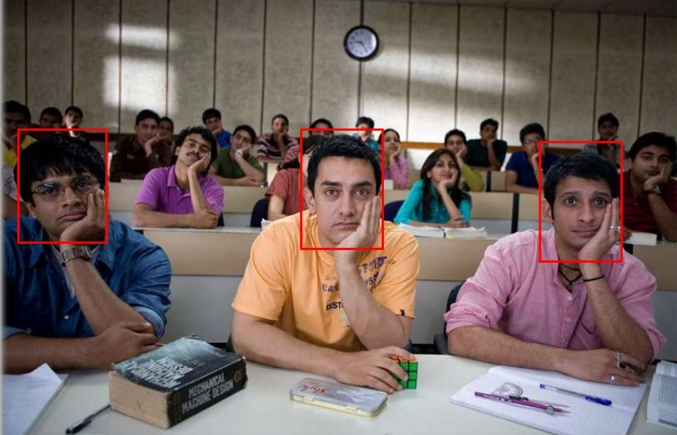
What’s the role of Student’s ?

Slide 13





Project Prerequisites
Software Requirements
IDE
Libraries
Jupyter Notebook

Slide 14



Project Prerequisites – Continue…
Hardware Requirements
WEB Camera.
GPU for faster video processing.
Secondary memory to store images.

Slide 15
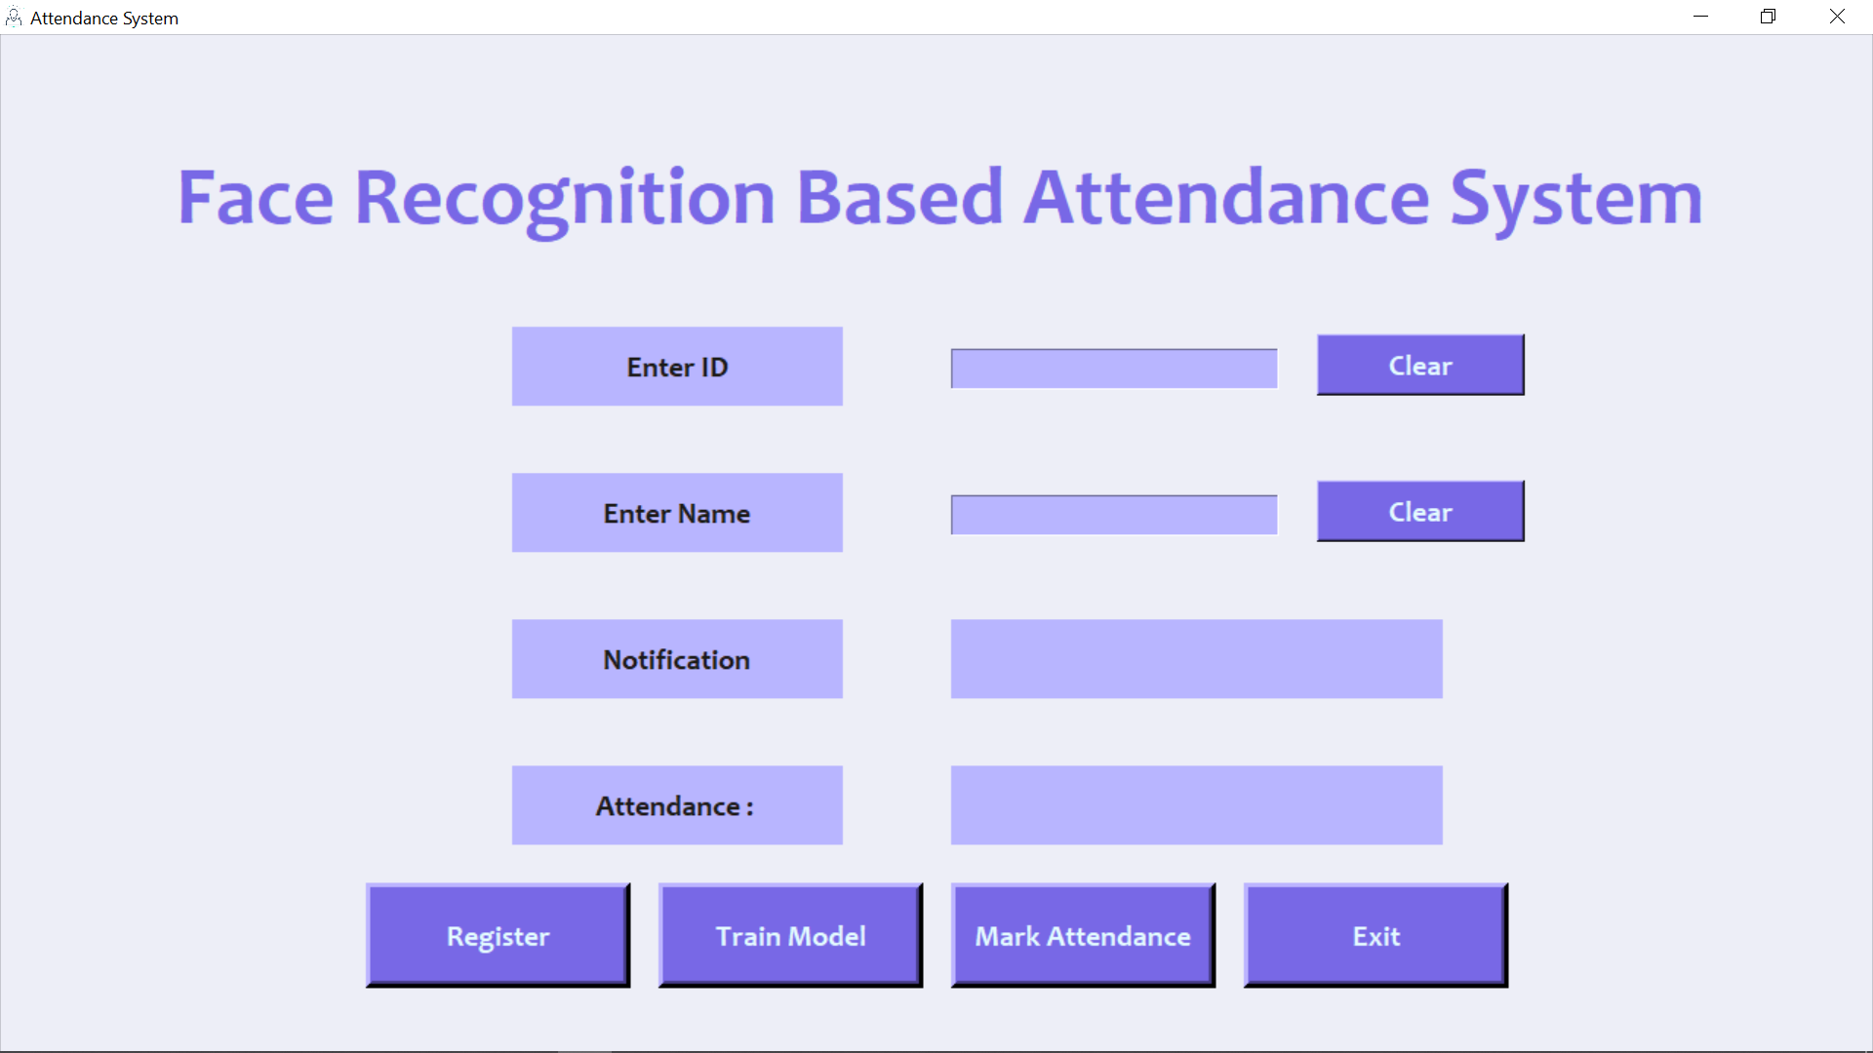
Graphical User Interface

Slide 16
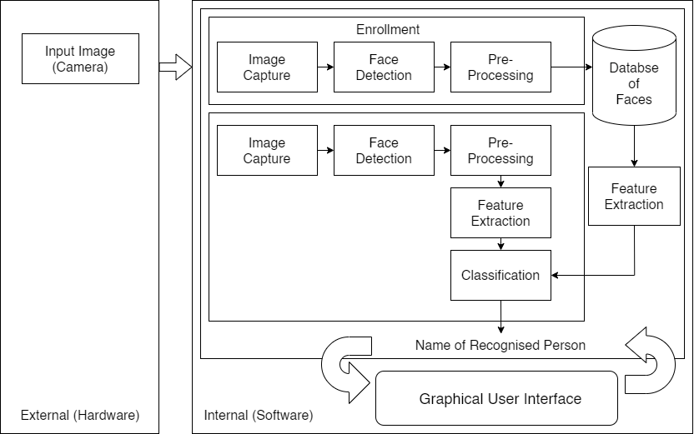
System architecture

Slide 17
UML Diagrams
Activity diagram
Data flow diagram
Use case diagram
ER diagram
Sequence diagram

Slide 18
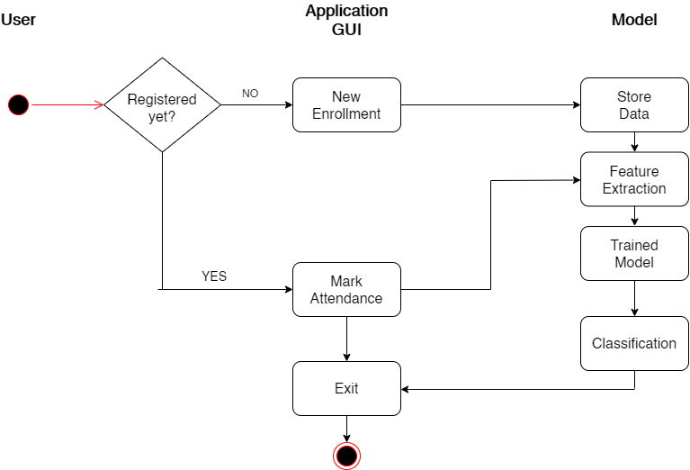
Activity Diagram

Slide 19
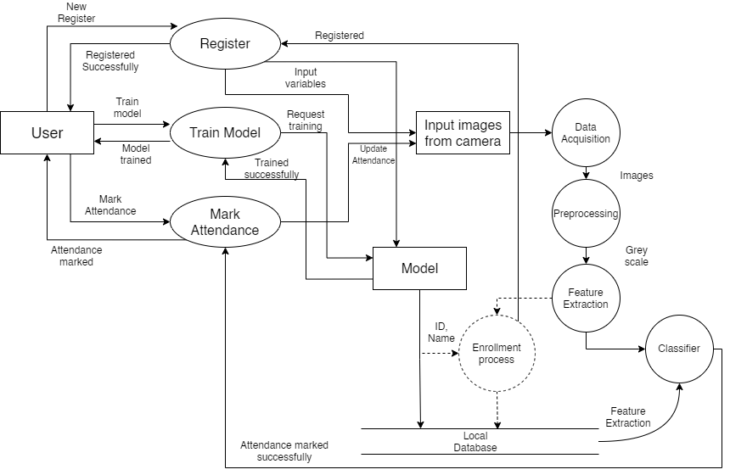
Data flow Diagram

Slide 20
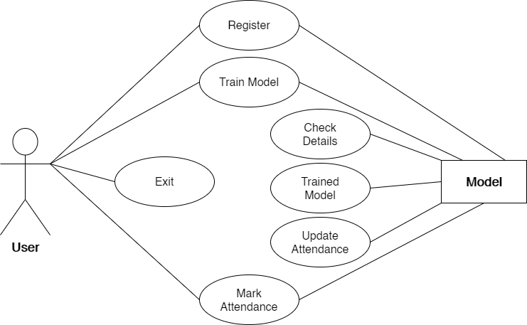
Use Case Diagram

Slide 21
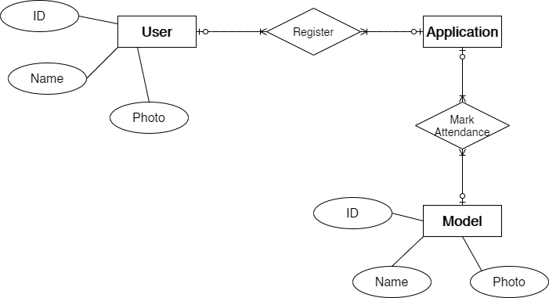
E.R. Diagram

Slide 22
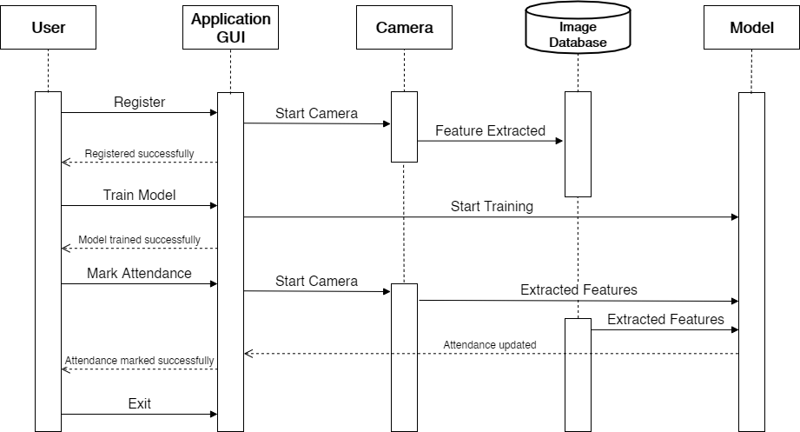
Sequence Diagram

Slide 23
Future Enhancements
Automated Attendance System can be implemented in larger areas like in a seminar hall where it helps in sensing the presence of many people.
Sometimes the poor lighting condition of the classroom may affect image quality which indirectly degrades system performance, this can be overcome in the latter stage by improving the quality of the video or by using some algorithms.

Slide 24
Conclusion
Thus, the aim of this project is to capture the video of the students, convert it into frames, and relate it with the database to ensure their presence or absence, mark attendance to the particular student to maintain the record.
Thus, it can be concluded from the above discussion that a reliable, secure, fast and an efficient system has been developed replacing a manual and unreliable system.

Slide 25
Thank You…

