Slide 1
Software Group Project-1(IT266)
Name: Dhruv Prajapati
Id:22IT126
Project Name: Data Analysis

Slide 2
Compare the sales and orders using single chart

Slide 3
Who purchased more-men or women in 2022?

Slide 4
What is different order status in 2022?

Slide 5
List top 5 states contributing to the sales?

Slide 6
Relation between age and gender based on number of orders

Slide 7
Which channel is contributing to maximum sales?

Slide 8
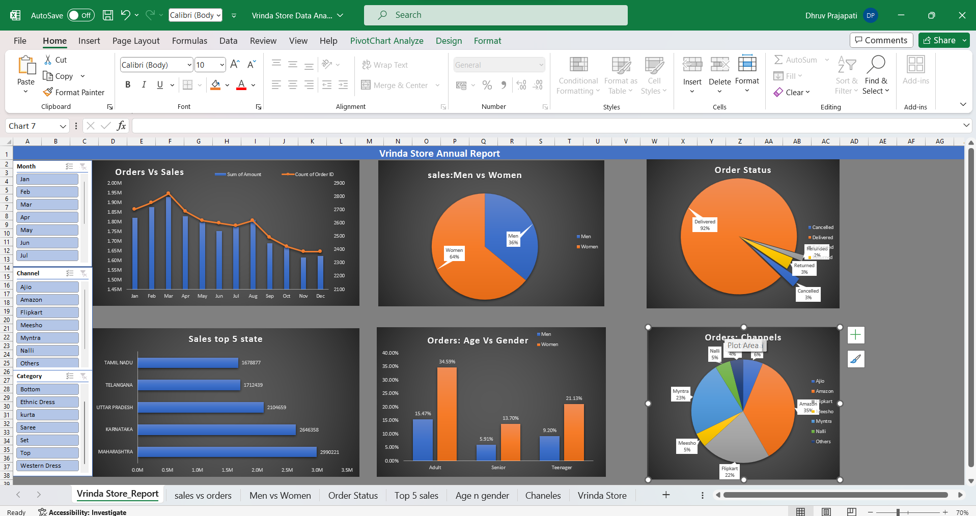

Slide 9
So We can conclude that:
Women are more likely to buy compared to men (~65%)
Maharashtra, Karnataka and Uttar Pradesh are the top 3 states (~35%)
Adult age group (30-49 yrs) is max contributing (~50%)
Amazon, Flipkart and Myntra channels are max contributing (~80%)
To improve Vrinda store sales:
Target women customers of age group (30-49 yrs) living in Maharashtra, Karnataka and Uttar Pradesh by showing ads/offers/coupons available on Amazon, Flipkart and Myntra.

Slide 10
Reference
I use data base on Kaggle: https://www.kaggle.com/datasets/anshika2301/vrinda-store-data-analysis?resource=download

Slide 11
Thank you

