Slide 1
TASK ALLOCATION USING BIPARTITE GRAPH
GROUP MEMBERS
U19CS008- KRINA PATEL
U19CS009- BRIJESH ROHIT
U19CS015- DHRUV GANDHI
U19CS038 – SUMIT SHETTY

Slide 2
Problem Description
There are N tasks and M machines.
Each machine can only accomplish one task and each task can be assigned to only one machine.
Not all tasks can be completed by all machines, which is decided by range of machine up to which it can perform and this is the input/property value of machines.
A task is also measured by a input/property value, which can be less than or equal to machine's range to which it is allocated.
We have to find an allocation in which maximum tasks are completed and maximum utilization of machines if found.

Slide 3
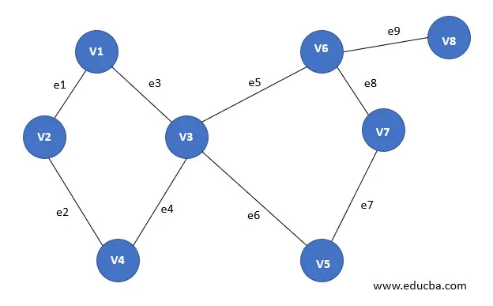
Introduction to graph.
A graph (V, E) is a set of vertices V1, V2…Vn and set of edges E = E1, E2,….En.
Here, each distinct edge can identify using the unordered pair of vertices (Vi, Vj).
2 vertices Vi and Vj are said to be adjacent if there is an edge whose endpoints are Vi and Vj. Thus E is said to be a connect of Vi and Vj.
In the example shown in figure, circles represent vertices, while blue lines connecting the circles represent edges.

Slide 4
Order of the graph = The number of vertices in the graph. Size of the graph = The number of edges in the graph. Degree of a vertex of a graph = Number of edges incident to the vertex.
There are many types of graphs categorized based on number of nodes, number of edges, degree of vertices, type of connection/edge(loop), direction of edges, labelled edges etc.
We in particular are interested in Bipartite Graphs, which holds our solution to Task Allocation problem easily.

Slide 5
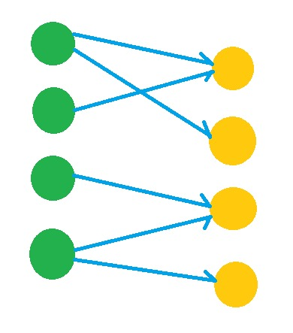


What is bipartite graph?
$$L$$
$$R$$
A Bipartite Graph is a graph whose vertices can be divided into two independent sets L and R such that every edge (u, v) either connect a vertex from L to R or a vertex from R to L.
→ In other words, for every edge (u, v) either u ∈ L and v ∈ L. We can also say that no edge exists that connect vertices of the same set.

Slide 6
Matching is a Bipartite Graph is a set of edges chosen in such a way that no two edges share an endpoint. Given an undirected Graph G = (V, E), a Matching is a subset of edge M ⊆ E such that for all vertices v ∈ V, at most one edge of M is incident on v.
A Maximum matching is a matching of maximum cardinality, that is, a matching M such that for any matching M', we have |M|>|M’|.

Slide 7
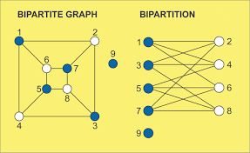
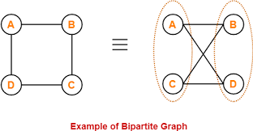


EXAMPLE OF BIPARTITE GRAPH:
$$1$$
$$2$$

Slide 8
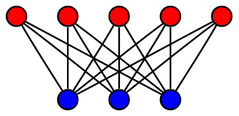
COMPLETE BIPARTITE GRAPH:
A complete bipartite graph is a bipartite graph in which each vertex in the first set is joined to every single vertex in the second set. The complete bipartite graph is denoted by Kx,y where the graph G contains x vertices in the first set and y vertices in the second set.
A complete bipartite graph can have an isolated point as condition is in splitting, but condition like no edges between two sets are possible.

Slide 9
Input/Output and Matching
Inputs are integral arrays, one specifying the value/property of task, one for machine capacity and one specifying compatibility property from set of tasks to the set of machines compatible to process the task. Output is the number specifying maximum number of tasks which can be processed after allocation in single go at that instance of time.
A matching M is a set of pairwise non-adjacent edges of a graph (in other words, no more than one edge from the set should be incident to any vertex of the graph M). The cardinality of a matching is the number of edges in it. The maximum (or largest) matching is a matching whose cardinality is maximum among all possible matchings in a given graph. All those vertices that have an adjacent edge from the matching (i.e., which have degree exactly one in the subgraph formed by M) are called saturated by this matching.

Slide 10
An alternating path is a path in which the edges alternately belong / do not belong to the matching.
An augmenting path is an alternating path whose initial and final vertices are unsaturated, i.e., they do not belong in the matching.
A maximal matching is a matching to which no more edges can be added without increasing the degree of one of the nodes to two; it is a local maximum. A maximum matching is a matching with the largest possible number of edges; it is globally optimal (This is the solution we want).
A matching M is maximum if there is no augmenting path relative to the matching M.

Slide 11
SIMPLE EXPLANATION WITH EXAMPLE
A simple explanation to this can be found in example of assigning hotel rooms which are available. Initially we consider all rooms are vacant and to simplify the explanation we assume each room has a unique distinct capacity to accommodate and are denoted by numbers such as 4,5,6 meaning room no 4 can accommodate at most 4 people.
Suppose many families comes to reside in the hotel at the same time. Here the algorithm is in best use.
Say we have 4 families with strength of 3,8,5,9 and rooms with number 4,10,7,9. These are the inputs as discussed above and compatibility is decided automatically here, which is the property/value of room and family strength. If the same order is followed, i.e., f3, f8, f5, f9 for families and r4, r10, r7, r9 for rooms than STEPS ARE:

Slide 12
1) Starting with f3 compatible with all rooms, we first try to accommodate it in r4, where is empty so we initially mark it as assigned to f3.
[f3-->r4].
2)Then we go for f8 compatible with r10 and r9, which will first try for r10 which is empty so family f8 is marked there.
[f8-->r10].
3)Then we have f5 compatible with r10, r7 and r9, which will first try for r10 which is already accommodated so f8 is unmarked and f5 is marked for it.
[f8-->?], [f5-->r10].
4)Then f8 is compatible with r9 so it checks if it is accommodated or not, which is empty so it is marked there.
[f8-->r9].
5)Then we have f9 which is compatible with r10 and r9, first it will try for r10 which is marked for f5, so f5 is unmarked first and f9 is marked for r10.
[f5-->?], [f9-->r10].
6)Now f5 is compatible with r7 and r9. So according to order it will first search for r7, which is not marked yet for anyone so it is marked for f5.
[f5-->r7]

Slide 13
So finally,
[f3-->r4].
[f8-->r9].
[f9-->r10].
[f5-->r7]
That’s how the algorithm works.
At last, this is how we can accommodate all the 4 families in respective 5 rooms.
If in the end no rooms are found for any family that means that family is not accepted or in other words considering task allocation example that task will be not be completed in this cycle or allotment.

Slide 14
Finding a maximum bipartite matching
L
R
Allocated
Visit
1
1
1
1
2
2
2
2
1
1
3
4
3
3
3
4
4
4
4

Slide 15
Algorithm
bipartiteMatch(u, visited, assign)
Input: Starting node, visited list to keep track, assign the list to assign node with another node.
Output − Returns true when a matching for vertex u is possible.
Begin
for all vertex v, which are adjacent with u, do
if v is not visited, then
mark v as visited
if v is not assigned, or bipartiteMatch(assign[v], visited, assign) is true, then
assign[v] = u
return true
done
return false
End

Slide 16
maxMatch(graph) Input − The given graph. Output − The maximum number of the match.
Begin
initially no vertex is assigned
count = 0
for all applicant u in M, do
make all node as unvisited
if bipartiteMatch(u, visited, assign), then
increase count by 1
done
End

Slide 17
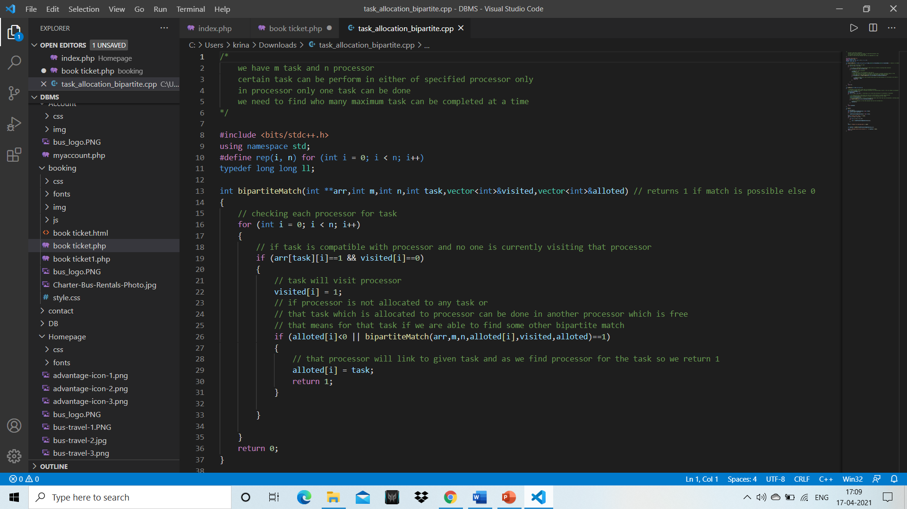

Slide 18


Slide 19
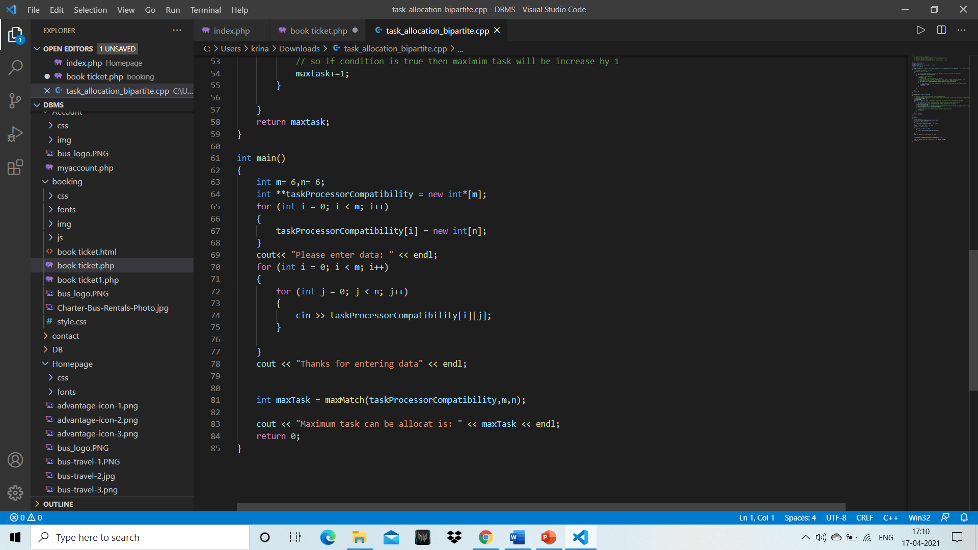

Slide 20
TIME COMPLEXITY ANALYSIS:
ALGORITHM (bipartiteMatch) | Cost
Begin for all vertex v, which are adjacent with u, do if v is not visited, then mark v as visited If v is not assigned or bipartiteMatch(assign[v], visited, assign) is true, then assign[v] = u return true done return false End | E * O(1) E * O(1) E * O(1)*T(n-1) E * O(1) E * O(1) E * O(1)
TOTAL COST = E*O(1)*5 + E * O(1)*T(n-1) = a*T(n-1) + b | θ(n)

Slide 21
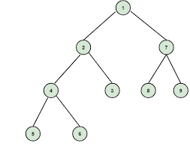
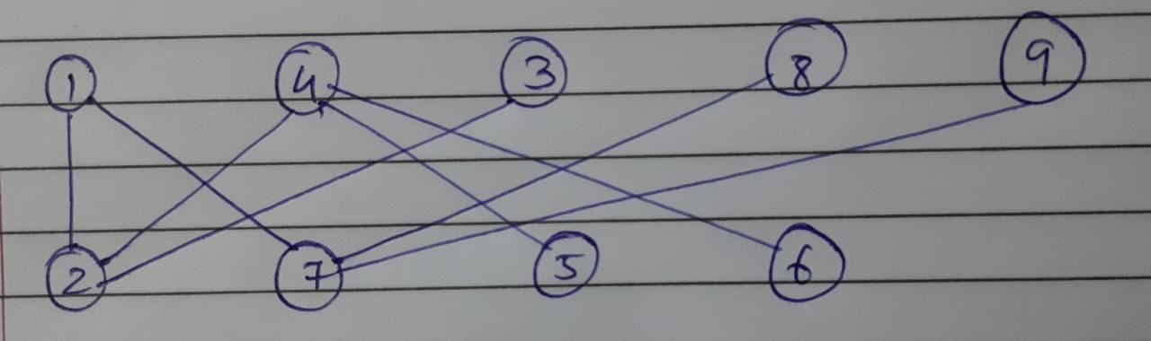
If we write accurately
T = O(V+E)
where N = number of machines
and M = number of tasks,
So over all
T = O(N*M)
bipartite(u)
if u not visited
marks visited
check assigned or bipartite(V)

Slide 22
ALGORITHM (maxMatch) | COST
Begin initially no vertex is assigned count = 0 for all applicant u in M, do make all node as unvisited if bipartiteMatch(u, visited, assign) is true increase count by 1 done End | c1 M*c2+1 M*c3 M*T`(E) M*c4
TOTAL COST | T = O(N*M*M)
M = number of vertices in tasks.
So T` = c1 + M*c2+1 + M*c3 + M*T + M*c4
= M*(c2 + c3 + c4 + T) + 1 + c1
= O(N*M)*M + b
Over all Time complexity = O(N*M*M)

Slide 23
SPACE COMPLEXITY ANALYSIS:
Since we are not constructing any graph and using array visited, array assigned, both of which contains members as many as number of vertices, so overall space complexity is :
S(V) = O(N), which are number of tasks or
S(V) = O(V), asymptotically both will be same.
We get overall Space complexity = O(V).

Slide 24
EXECUTIVE SUMMARY
There are N tasks and M machines.
Each machine can only accomplish one task and each task can be assigned to only one machine.
Not all tasks can be completed by all machines, which is decided by range of machine up to which it can perform and this is the input/property value of machines.
A task is also measured by an input/property value, which can be less than or equal to machine's range to which it is allocated.
We have to find an allocation in which maximum tasks are completed and maximum utilization of machines is found.
THE END
THANK YOU!

