Slide 1
TASK ALLOCATION USING BIPARTITE GRAPH
GROUP MEMBERS
U19CS008- KRINA PATEL
U19CS009- BRIJESH ROHIT
U19CS015- DHRUV GANDHI
U19CS038 – SUMIT SHETTY

Slide 2
Problem Description
There are N tasks and M machines.
Each machine can only accomplish one task and each task can be assigned to only one machine.
Not all tasks can be completed by all machines, which is decided by range of machine up to which it can perform and this is the input/property value of machines.
A task is also measured by a input/property value, which can be less than or equal to machine's range to which it is allocated.
We have to find an allocation in which maximum tasks are completed and maximum utilization of machines if found.

Slide 3
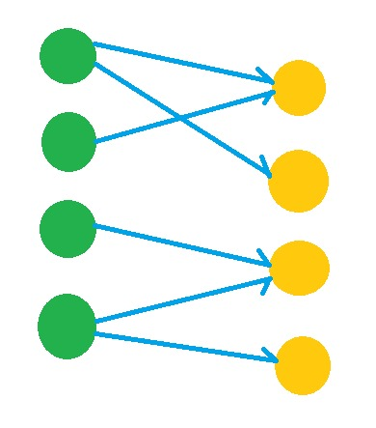


What is bipartite graph?
$$L$$
$$R$$
A Bipartite Graph is a graph whose vertices can be divided into two independent sets L and R such that every edge (u, v) either connect a vertex from L to R or a vertex from R to L.
→ In other words, for every edge (u, v) either u ∈ L and v ∈ L. We can also say that no edge exists that connect vertices of the same set.

Slide 4
Matching is a Bipartite Graph is a set of edges chosen in such a way that no two edges share an endpoint. Given an undirected Graph G = (V, E), a Matching is a subset of edge M ⊆ E such that for all vertices v ∈ V, at most one edge of M is incident on v.
A Maximum matching is a matching of maximum cardinality, that is, a matching M such that for any matching M', we have |M|>|M'|.

Slide 5
Finding a maximum bipartite matching
L
R
Allocated
Visit
1
1
1
1
2
2
2
2
1
1
3
4
3
3
3
4
4
4
4

Slide 6
Algorithm
bipartiteMatch(u, visited, assign)
Input: Starting node, visited list to keep track, assign the list to assign node with another node.
Output − Returns true when a matching for vertex u is possible.
Begin
for all vertex v, which are adjacent with u, do
if v is not visited, then
mark v as visited
if v is not assigned, or bipartiteMatch(assign[v], visited, assign) is true, then
assign[v] = u
return true
done
return false
End

Slide 7
maxMatch(graph) Input − The given graph. Output − The maximum number of the match.
Begin
initially no vertex is assigned
count = 0
for all applicant u in M, do
make all node as unvisited
if bipartiteMatch(u, visited, assign), then
increase count by 1
done
End

