Slide 1

Dbms project
Tehsildar management system

Slide 2
Made by Prabhjot Singh : 21CSB0A43 Dhruv Patel : 21CS0BA41 B.tech CSE-A (2021-2025)
SUBMITED TO DR. T. Ramakrishnudu Department of Computer Science and Engineering, National Institute of Technology, Warangal

Slide 3
CONTENTS
PROBLEM STATEMENT
ER MODEL
ER MODEL EXPLAINATION
RELATIONAL SCHEMA
FUNCTIONAL DEPENDENCIES

Slide 4
PROBLEM STATEMENT
The Tehsildar is the most important government functionary in the Taluk. He is immediately subordinate to the Assistant Commissioner.
The Tahsildar is responsible for the collection of land revenue and seeing that the village Accountants and Revenue inspectors in his charge work efficiently and keep the village records up-to-date. Managing the data related to this administrative unit is a very crucial part of running the tehsil. So we need an efficient database to manage this data.

Slide 5
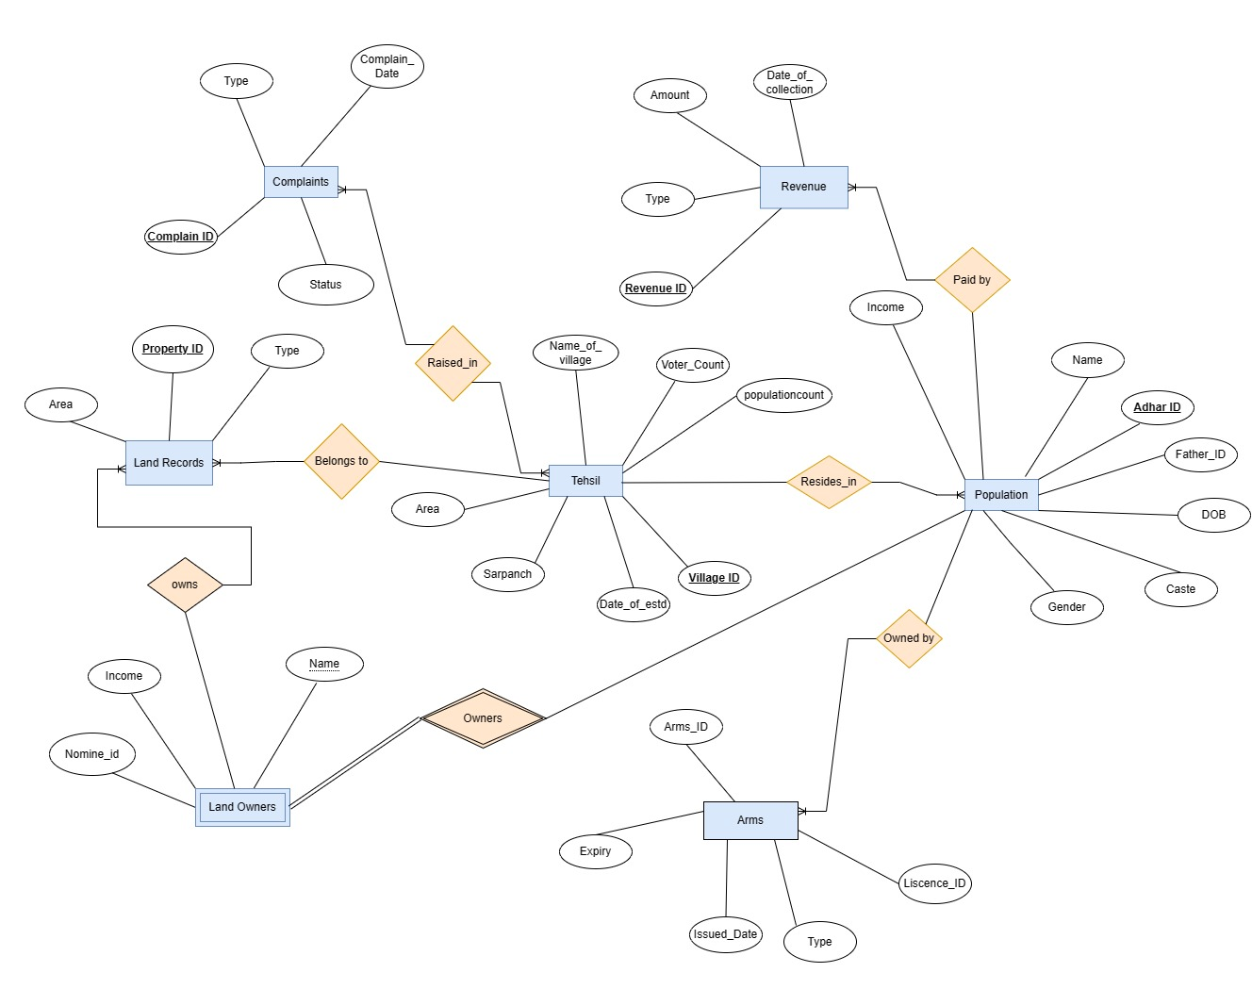
ER(ENTITY RELATIONSHIP) MODEL:

Slide 6
ER MODEL EXPLAINATION :
• Tehsil----<Belongs_to>----Land records:
In this Belongs_to relation is one to many type of relation as there can be more than one Land plots
in a village of a tehsil but vice versa doesn’t work.
• Tehsil----<Resides_in>----Population:
In this Resides_in relation is a one to many type of relation as A village has a large number of people living in it,
but a person cannot have more than one residential addresses.
• Population----<Owned_by>----Arms:
In this Owned_by relation is a one to many type of relation as people can have more than one weapon but a
weapon cannot be owned by more than one person.

Slide 7
ER MODEL EXPLAINATION :
• Population----<Paid_by>----revenue:
In this Paid_by relation is a one to many type of relation as A person might be paying taxes to the
state in more than one ways.
• Tehsil----<Raised_in>----Complaints:
This is many to many relationships because a type of complain can be issued by more than one villages and there would also be the case in which people issued same complaints
• Land owners----<owns>----Land records
Here the Owns relation is a one to many type of relation as a person can own a number of properties.

Slide 8
ER MODEL EXPLAINATION :
• Land owners----<Owners>----Population
Here Land owners is a Weak Entity as it doesn’t have a primary key of its own. The relation hers is
one to one

Slide 9
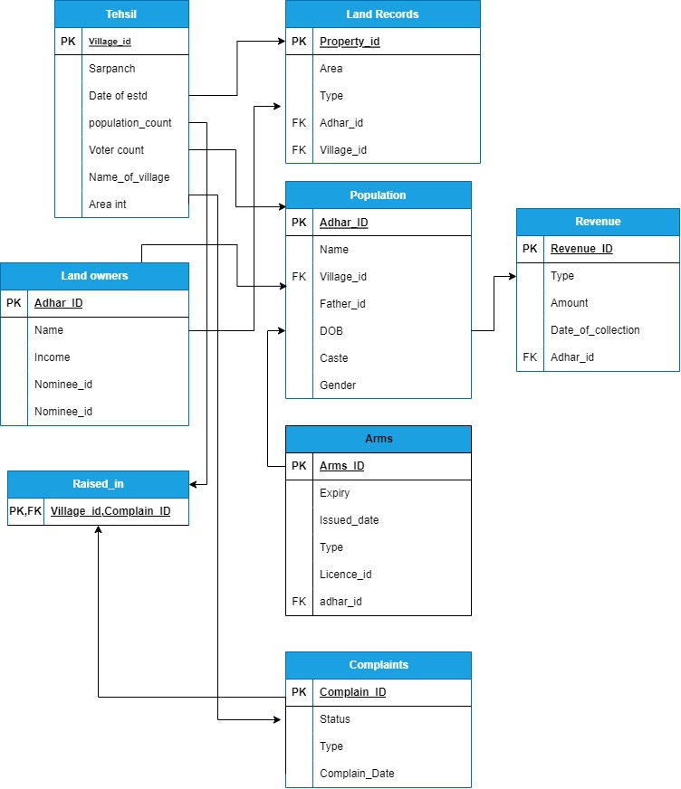
RELATIONAL SCHEMA:

Slide 10
FUNCTIONAL DEPENDENCIES :
Village_id-> {Area,Name_of_village,voter_count,Populationcount,Date_of_estd,Sarpanch}
Adhar_id-> {Name,Father_id,DOB,Caste,Gender,Income}
Revenue_id -> {Tye,Amount,Date_of_collection}
Arms_id -> {Expiry,Issued_date,Type,Licence_id}
Adhar_id -> {Name,Income,Nominee_id}
Property_id -> {Area,Type}
Complain_id -> {status,type,Complain_date}

