Slide 1
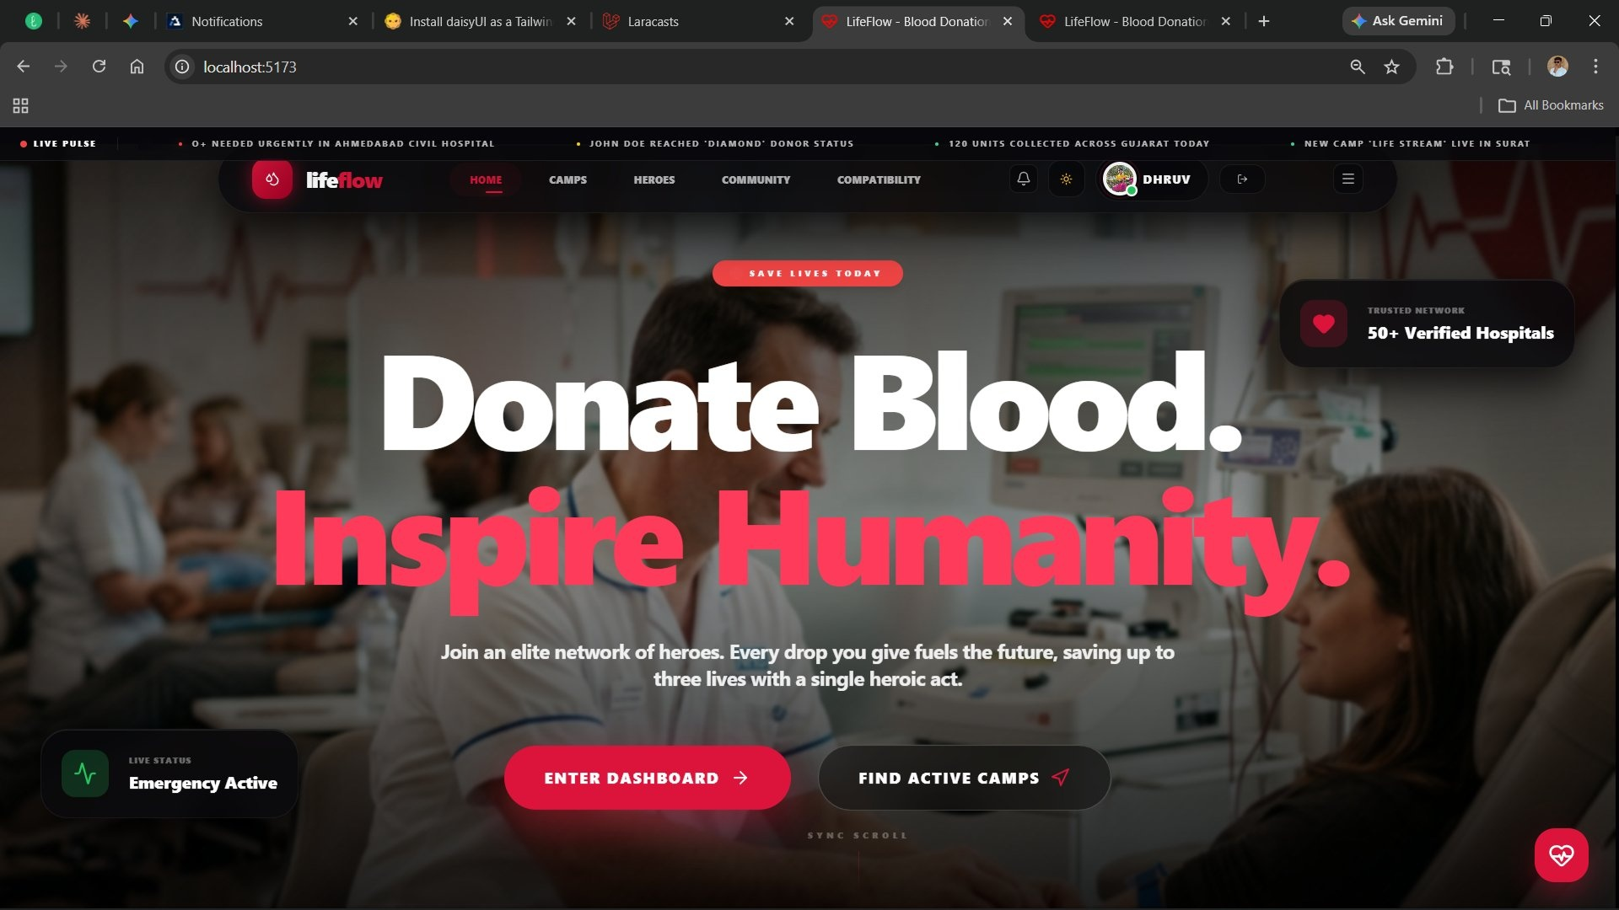
❤
LifeFlow
Give the
Gift of
Life.
50+
3
8+
19
Hospitals
User Roles
Blood Types
Features
A Smart Blood Donation Platform
React
Node.js
MySQL
JWT
Final Year Project · College Submission · 2025–2026
NEW
AI Chat
Compatibility
Maps
Dhruv Solanki
Govind Desai
Enrollment: 23001102031
Enrollment: 23001102022

Slide 2
PROJECT OVERVIEW
LifeFlow — Blood Donation Platform
🩸 THE PROBLEM
✅ OUR SOLUTION
Blood shortages are a critical healthcare crisis. Patients in emergencies struggle to find compatible donors in time. Existing systems lack real-time coordination, gamification, and smart matching.
LifeFlow is a full-stack web platform connecting donors, recipients, hospitals and organizations — featuring real-time inventory, interactive maps, AI chat, gamified rewards, blood compatibility checker, and a complete admin panel.
3
17
8
9+
50+
User Roles
Key Features
Blood Types
Camps
Hospitals
Real-time Tracking
Emergency Requests
Gamified Rewards
AI Chatbot
Community Hub

Slide 3
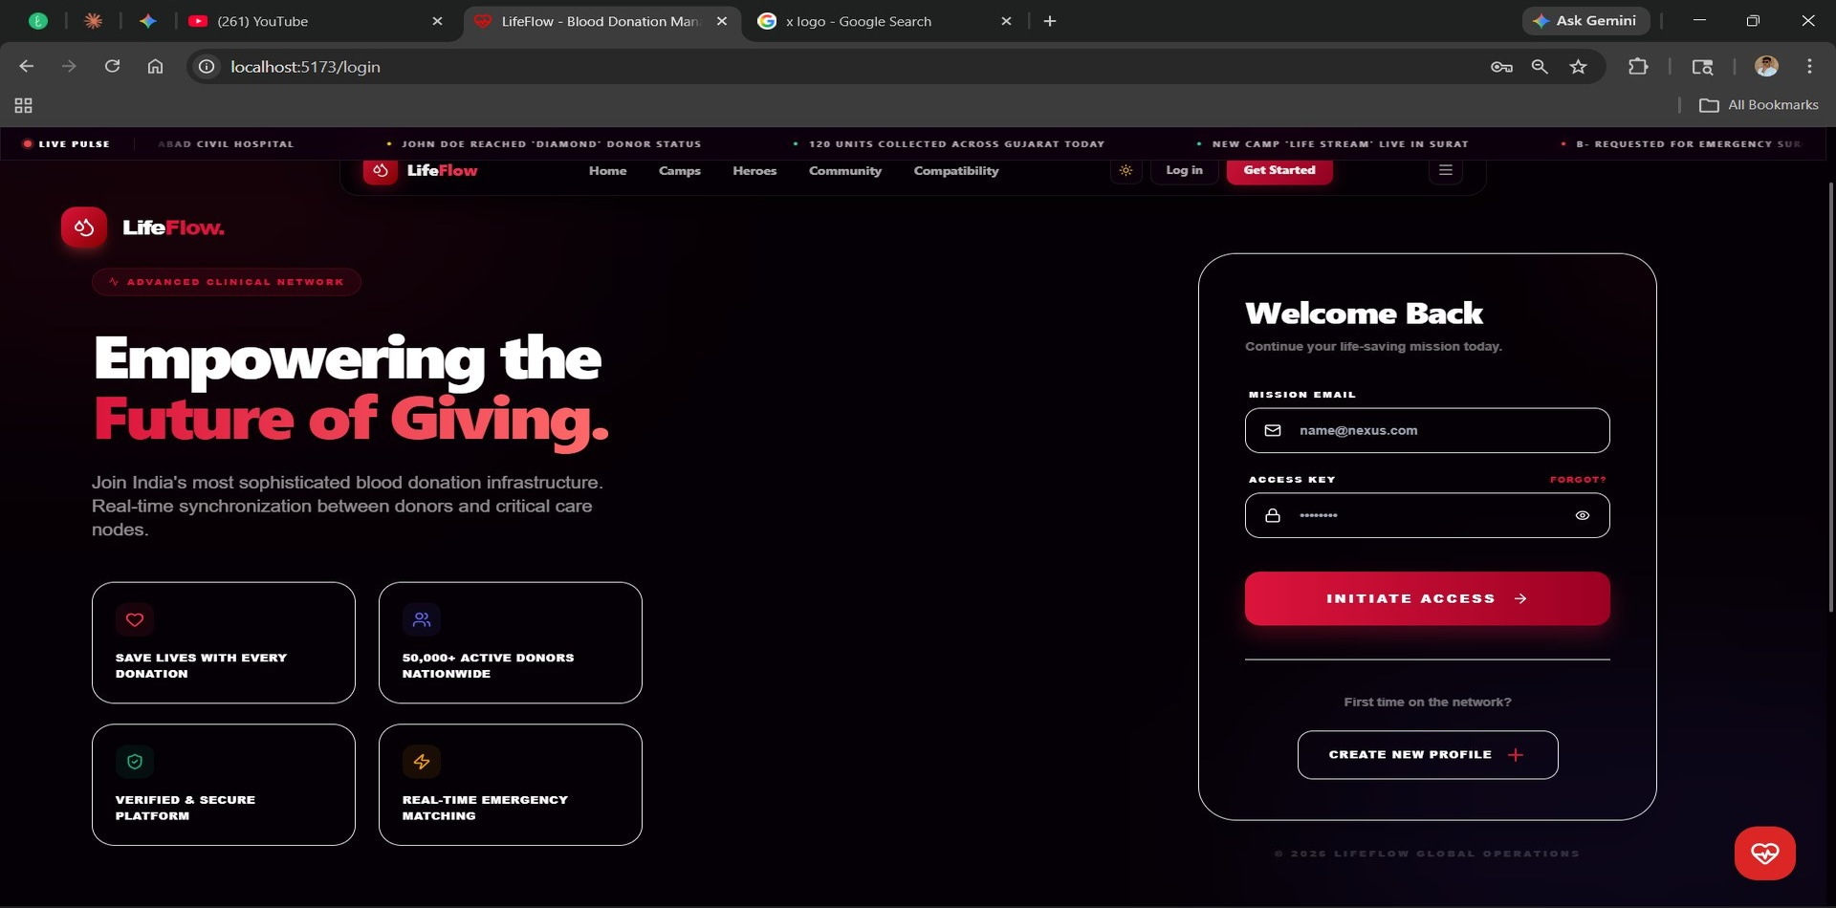
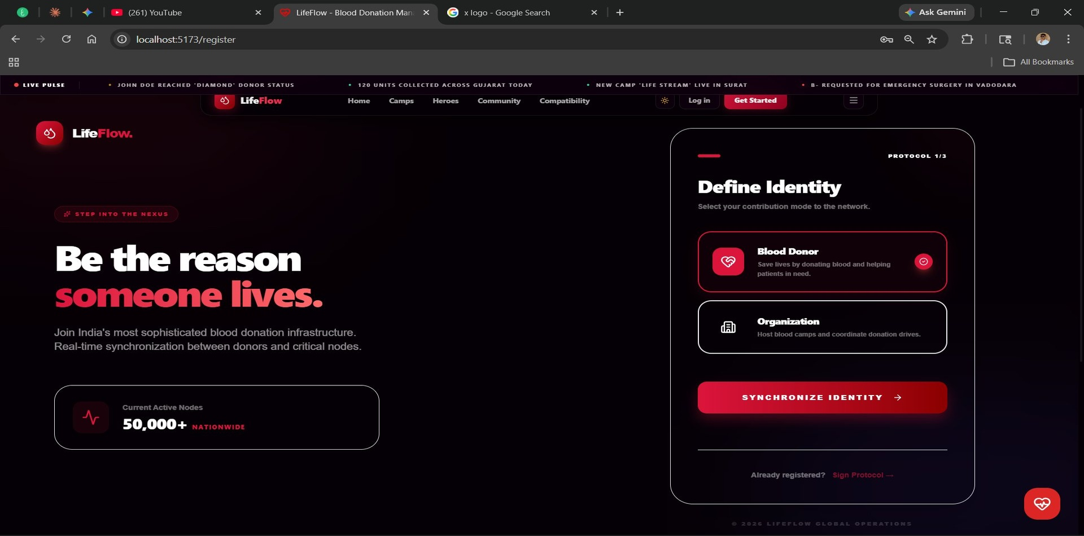
AUTHENTICATION
Access Sanctuary — Login & Registration
🔐 Login — Access Sanctuary
📝 Register — New Recruit
▸ Secure email + password keycode
▸ Choose: User/Donor or Organization
▸ Google OAuth one-click login
▸ Enter blood group, age & secure keycode
▸ Role-based dashboard routing
▸ Complete Enrollment → instant access

Slide 4
HOME PAGE
Donate Blood. Inspire Humanity.
📢 Live Ticker
Real-time alerts — units collected, new camps, emergency blood requests city-wise
🏥 50+ Verified Hospitals
Trusted network badge displayed prominently in the hero section
🚨 Live Status — Emergency Active
Real-time emergency indicator showing active blood emergencies
🌟 Community & Notifications
New Community tab + notification bell + profile avatar in navbar

Slide 5
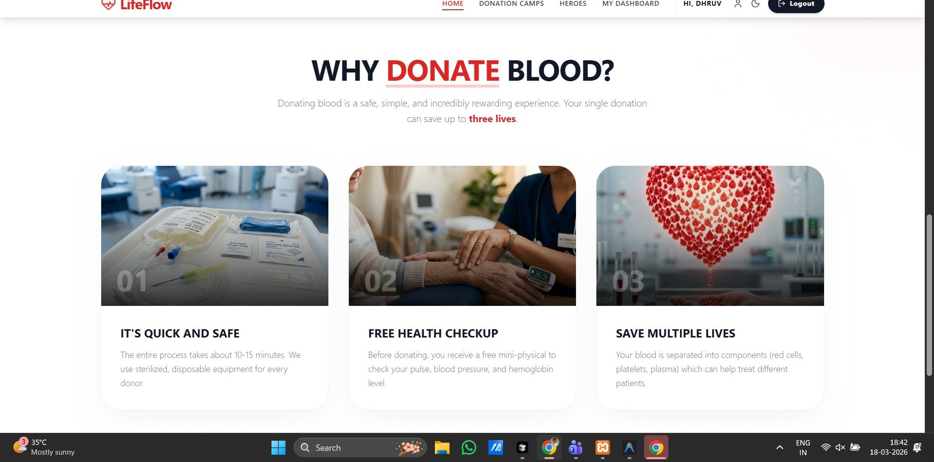
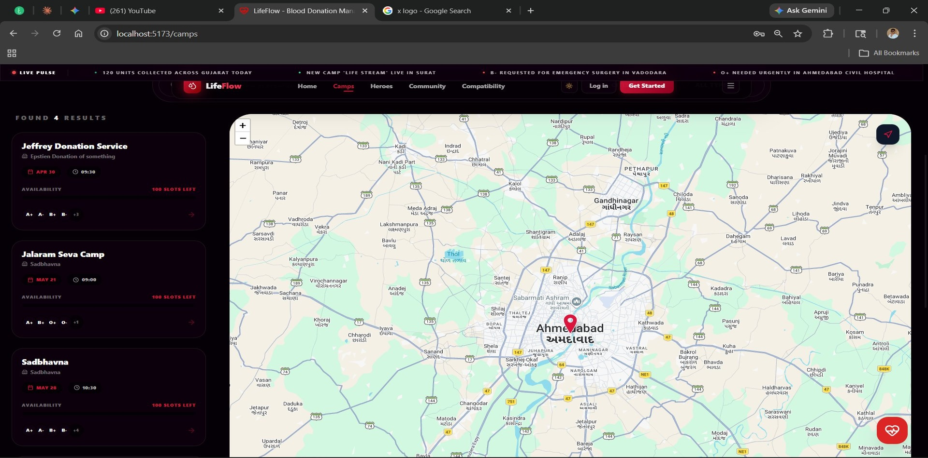
INFORMATIONAL & DISCOVERY
Why Donate Blood? & Donation Camps
Why Donate Blood?
Donation Camps — Live Map
⚡ Quick & Safe — Only 10-15 mins
🗺️ Interactive Leaflet.js map
💊 Free Health Checkup included
🔍 Search by name, hospital or city
❤️ One donation saves up to 3 lives
📅 Slot availability counter in real-time

Slide 6
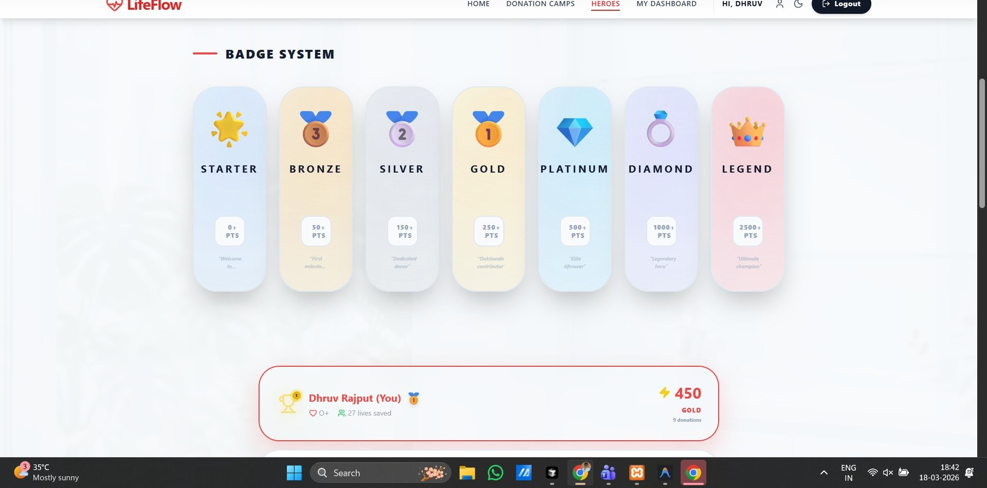
HEROES MODULE
Gamified Badge System — 7 Tiers
STARTER
0+ pts
BRONZE
50+ pts
SILVER
150+ pts
GOLD
250+ pts
PLATINUM
500+ pts
DIAMOND
1000+ pts
LEGEND
2500+ pts
🏆 Earn XP with every donation
Climb tiers · Unlock achievements · Top the leaderboard

Slide 7
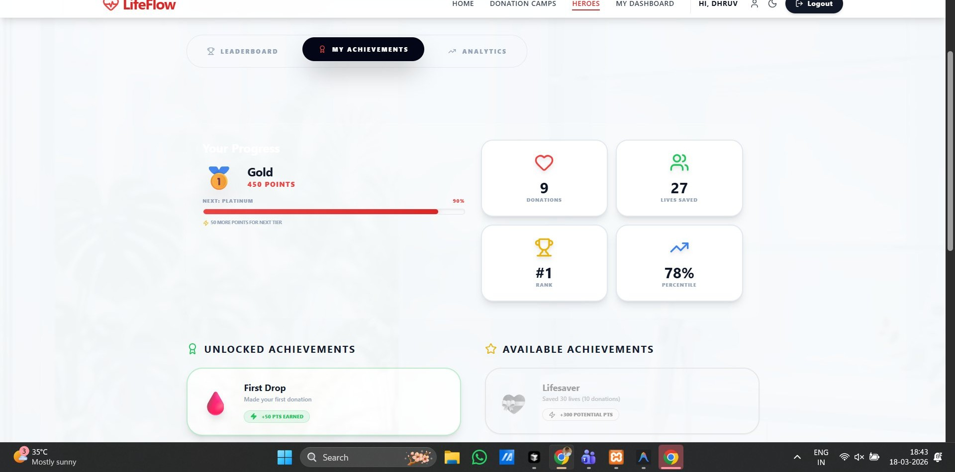
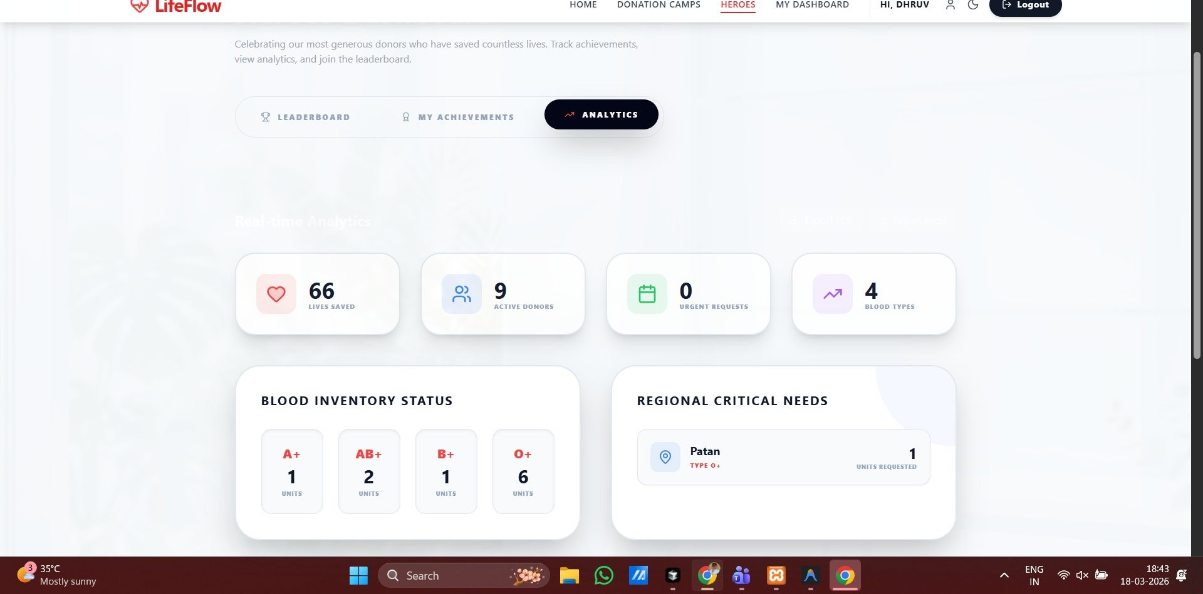
DONOR STATS
My Achievements & Analytics Dashboard
My Achievements
Blood Analytics
🏅 Gold rank — 450 XP points
🩸 Live blood group inventory (A+, B+, O+…)
❤️ 9 Donations · 27 Lives saved
👥 Active donors count · Urgent request alerts
📊 #1 Rank · Top 78 percentile
🗺️ Regional critical needs per city
🔓 Unlocked: First Drop badge
📈 Real-time supply & demand tracking

Slide 8
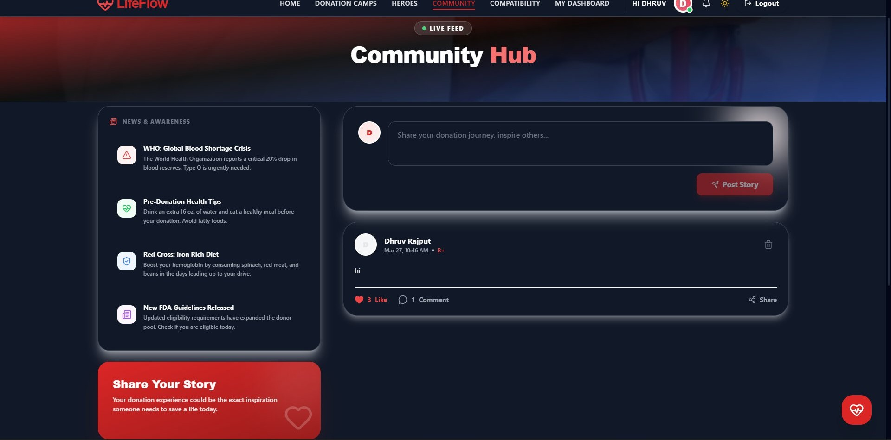
COMMUNITY MODULE
✨ NEW FEATURE
Community Hub — Live Feed & Stories
📰 News & Awareness Panel
4 live articles — WHO blood shortage alerts, pre-donation health tips, Red Cross iron diet guide & FDA guidelines
✍️ Share Your Story
Donors post their donation journey to inspire others — with blood group tag, likes, comments & share
❤️ Like · Comment · Share
Full social interaction on each post — 3 likes, 1 comment shown live on Dhruv Rajput's post
📡 Live Feed Badge
💬 Why Community Matters:
Donor stories inspire others to donate. A single post saying 'I saved 3 lives today' can motivate hundreds of new donors to register and act.
Real-time community feed labelled LIVE FEED — always shows the latest donor stories first

Slide 9
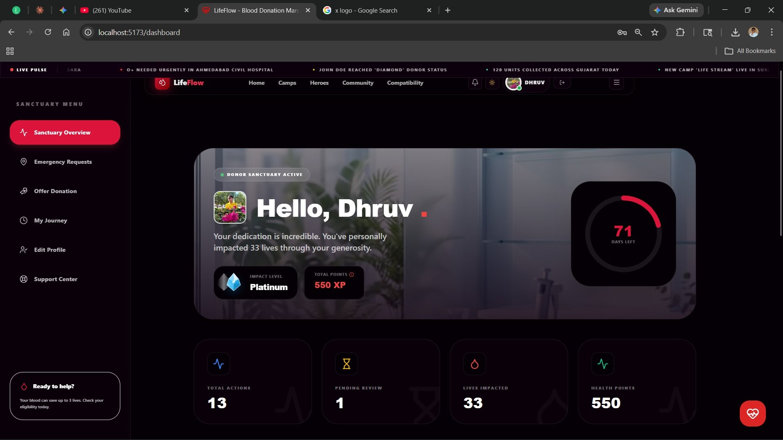
DONOR DASHBOARD
Sanctuary Overview — Personal Command Center
👤 Personalised Greeting
Hello message with impact level, total XP & lives saved count
📊 4 Live Stats
Total actions · Pending review · Lives impacted · Health points
🚨 Emergency Requests
Submit urgent blood needs for a patient instantly
🩸 Offer Donation
Join active verified donation sessions near you
🗺️ My Journey
Complete medical timeline of all past donation events

Slide 10
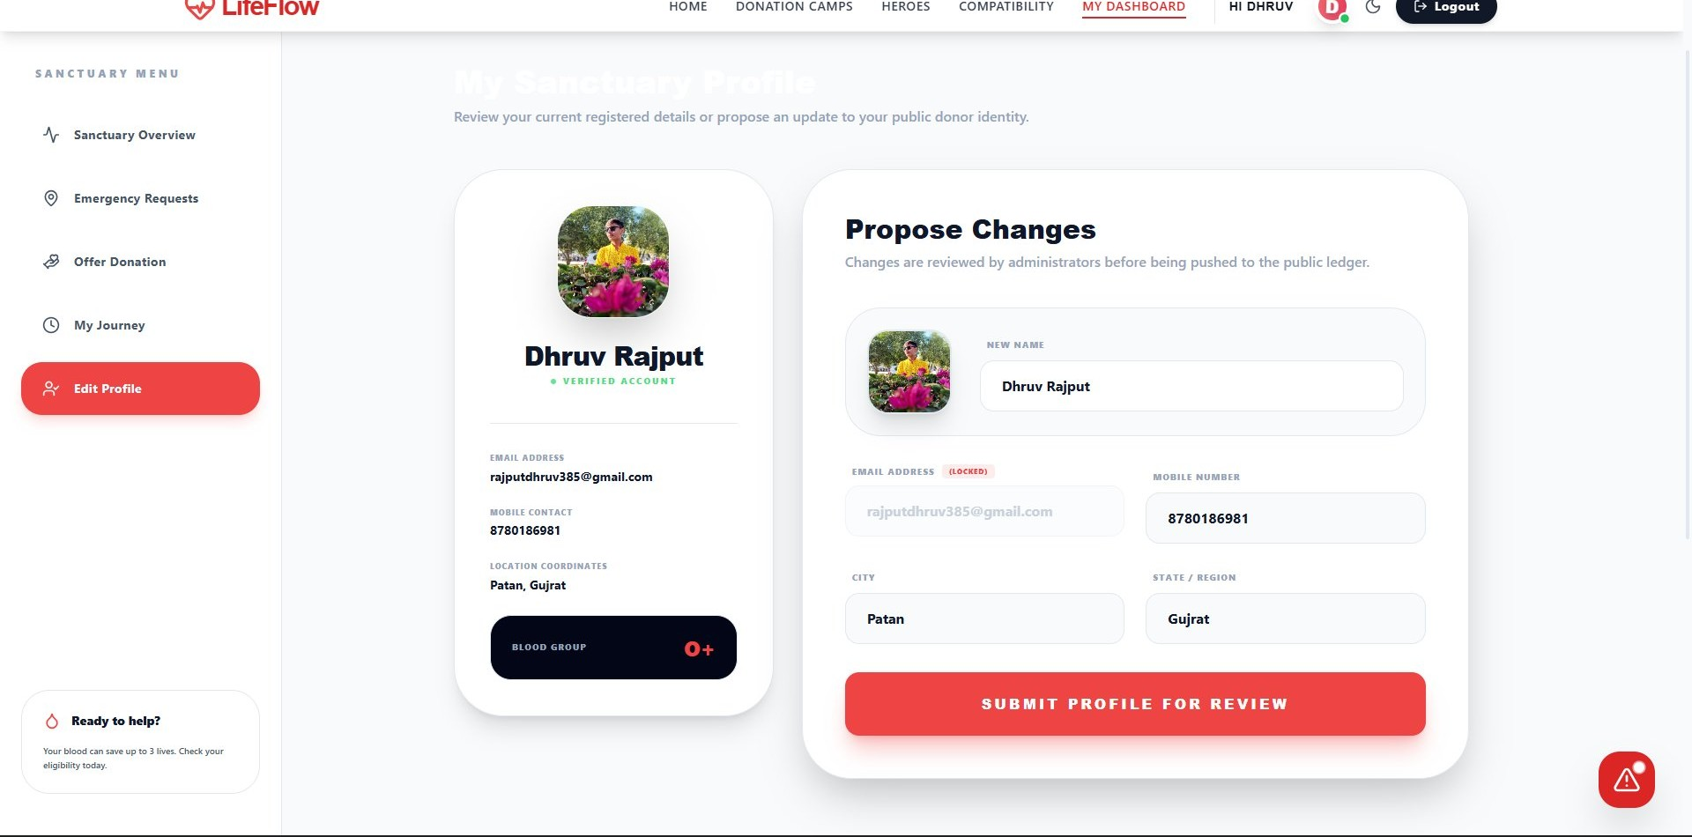
DONOR PROFILE MODULE
✨ NEW FEATURE
My Community Profile — View & Edit
👤 Donor Identity Card
Displays profile photo, full name, Verified Account badge, email, mobile, city & blood group in a clean card
✏️ Propose Profile Changes
Donors can propose updates to their name, photo, mobile number, city and state — reviewed by admin before going live
🔒 Email Locked by System
Email address is locked and cannot be changed to maintain account integrity and prevent misuse
📋 Submit for Admin Review
Every donor profile is publicly verified with a Verified Account badge. Blood group is prominently displayed so hospitals and admins can identify compatible donors instantly in an emergency.
All profile change requests are sent to the admin pipeline — changes only reflect after approval to keep data verified

Slide 11
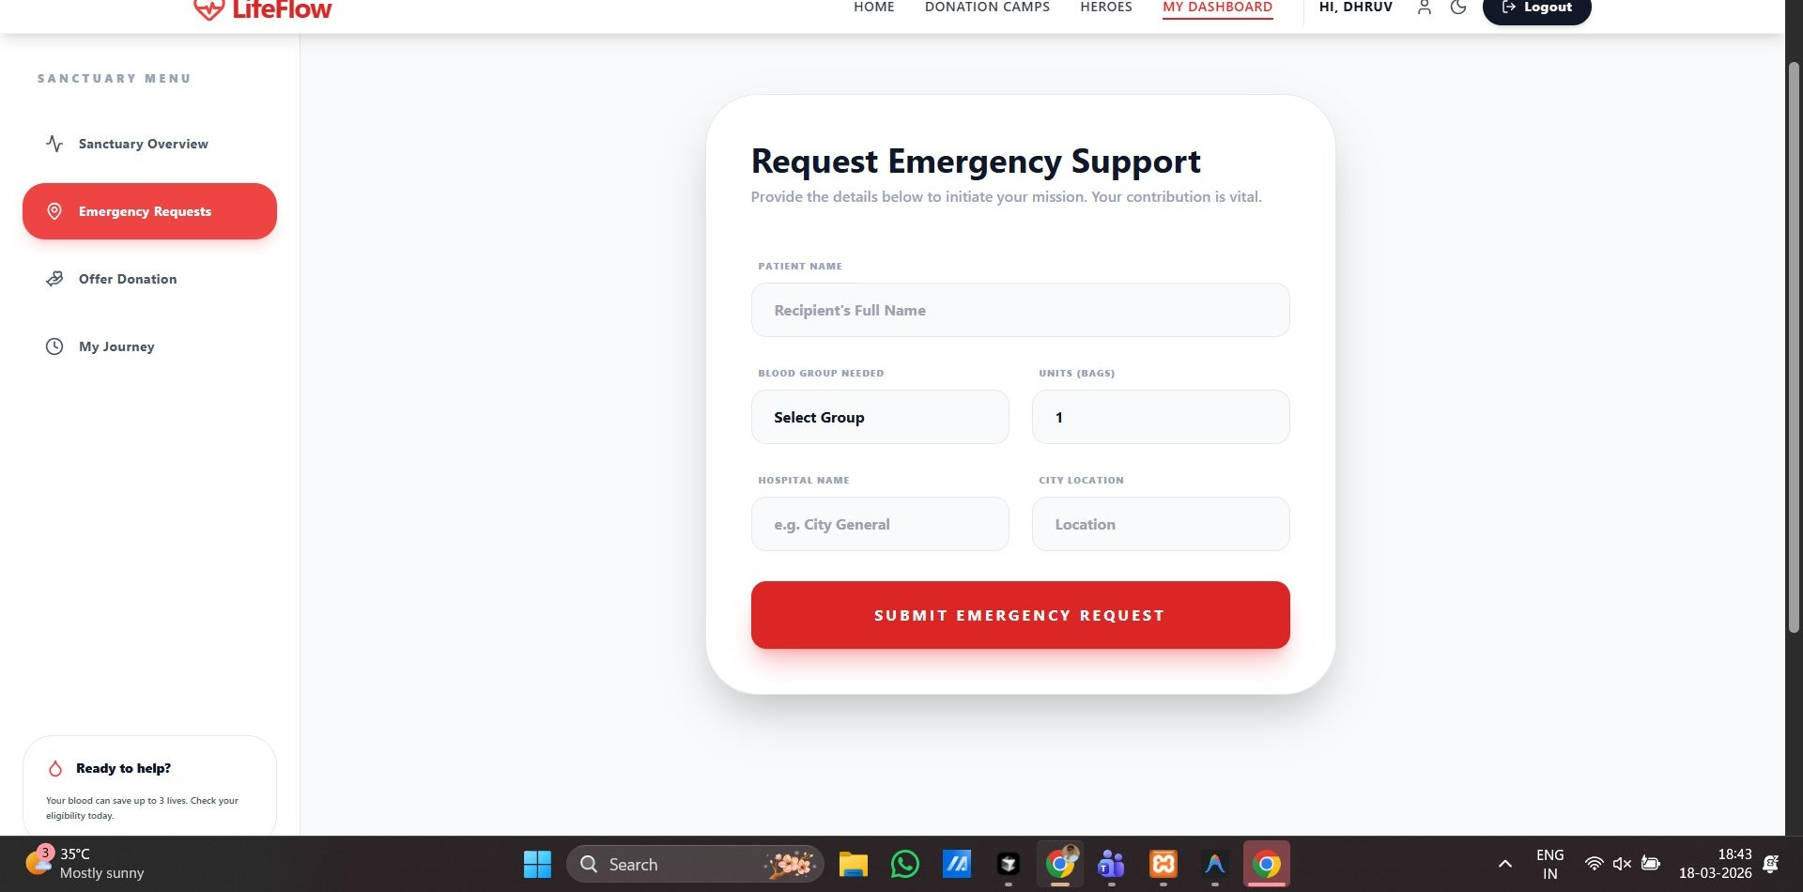
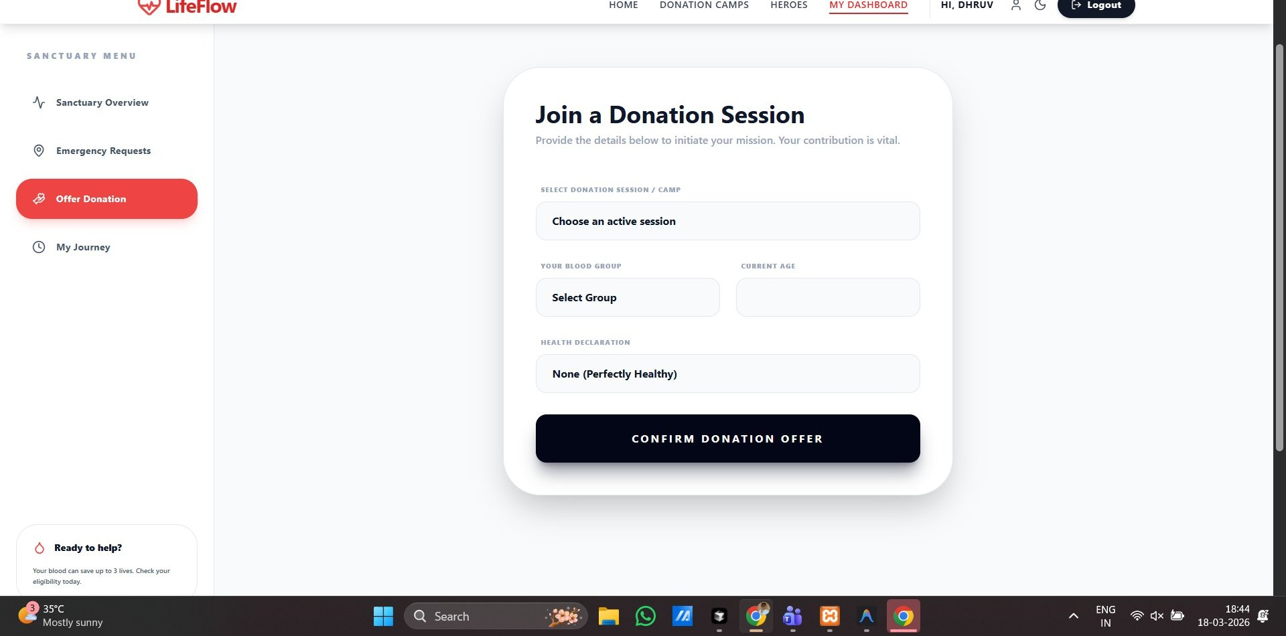
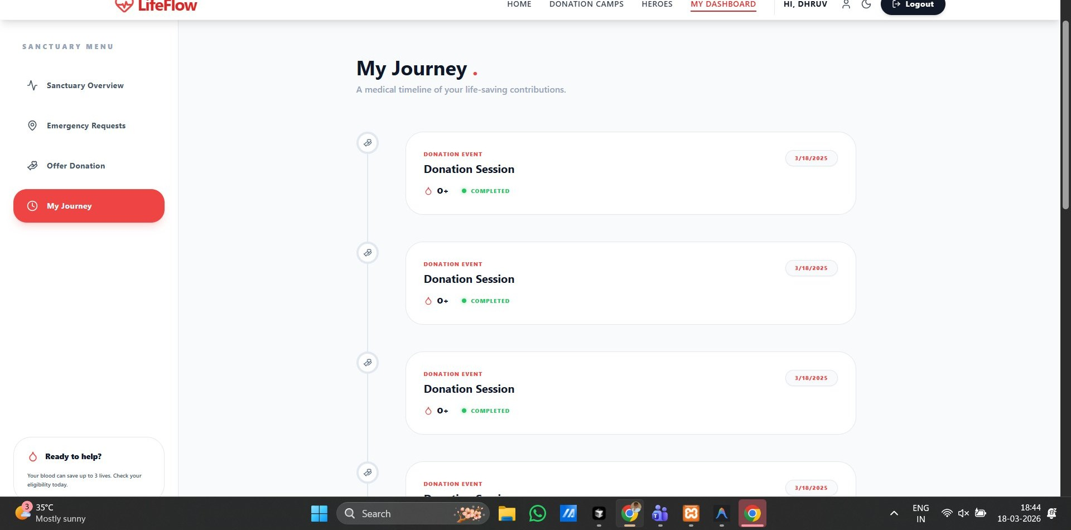
DONOR ACTIONS
Emergency Request · Offer Donation · My Journey
Emergency Request
Offer Donation
My Journey
Submit urgent blood needs — patient name, blood group, units, hospital & city location
Join active camp sessions — select blood group, current age & health declaration
Medical timeline of every donation event with blood type & completion status
💡 All donor actions are tracked, reviewed by admin, and rewarded with XP points to climb the Heroes leaderboard.

Slide 12
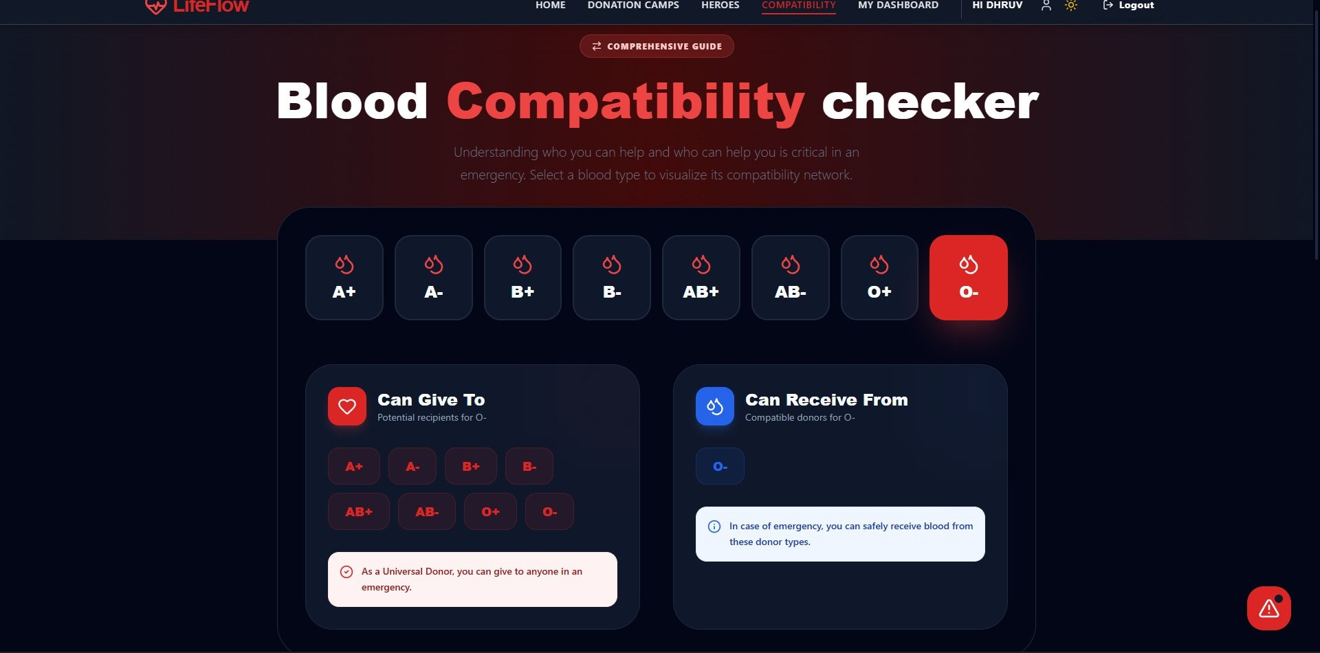
NEW FEATURE · COMPATIBILITY MODULE
✨ NEW PAGE
Blood Compatibility Checker
🩸 8 Blood Group Buttons
Select any blood group (A+, A-, B+, B-, AB+, AB-, O+, O-) with one click — active group highlighted in red
✅ Can Give To
Shows all compatible recipient blood types instantly with colour-coded badges
📥 Can Receive From
Shows which donor types are compatible for the selected blood group
⚠️ Universal Donor Alert
💡 Why this matters:
Special info card: O- identified as Universal Donor with emergency note
In emergencies, knowing blood compatibility instantly can be the difference between life and death. This tool educates donors and medical staff with zero friction.

Slide 13
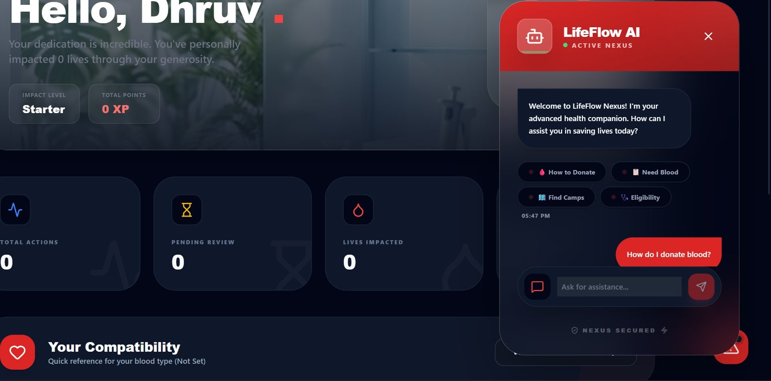
NEW FEATURE · AI MODULE
✨ NEW FEATURE
LifeFlow AI — Intelligent Health Companion
🤖 LifeFlow AI — Active Nexus
Always-available AI companion embedded in the donor dashboard sidebar
💬 Natural Language Chat
Donors type questions; the AI responds with contextual blood donation guidance
⚡ One-tap Quick Actions
4 pre-built action buttons: How to Donate · Need Blood · Find Camps · Eligibility
🔒 Nexus Secured
Quick-action buttons inside the chat:
All AI sessions are secured with end-to-end encryption labelled 'NEXUS SECURED'
🩸 How to Donate
📋 Need Blood
🏕️ Find Camps
✅ Eligibility

Slide 14
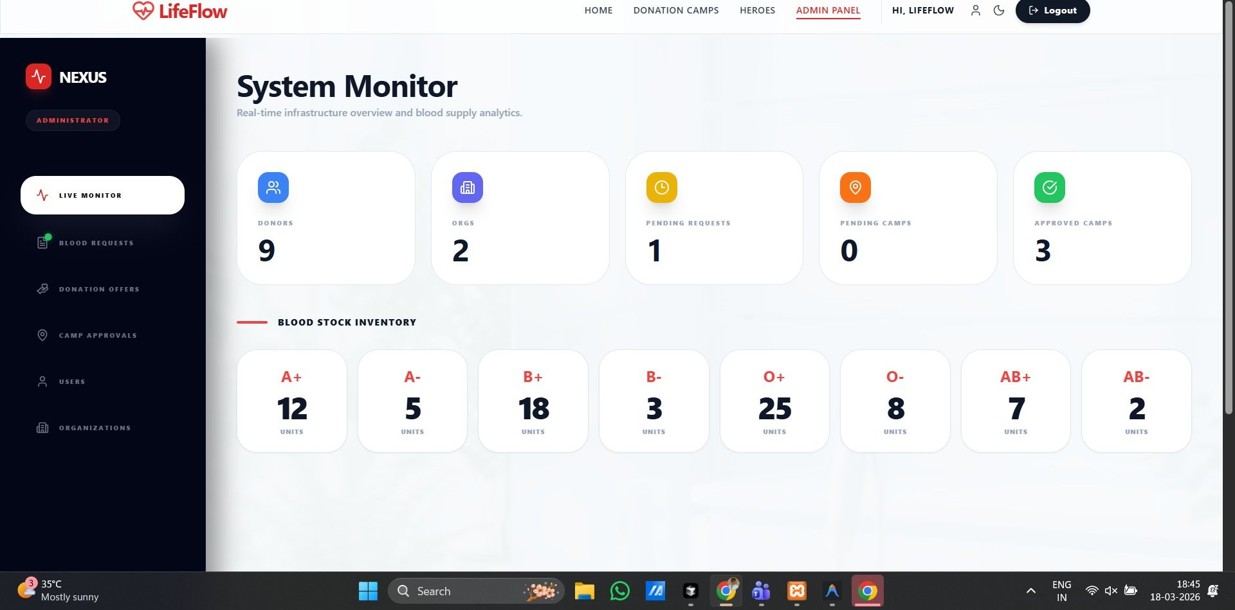
NEXUS — ADMIN PANEL
NEXUS — ADMIN PANEL
System Monitor & Control Center
System Monitor & Control Center
📊 Live Monitor
Real-time overview: donors, orgs, pending requests & approved camps
🩸 Blood Requests
Approve or dismiss hospital blood requests with blood type info
🏕️ Camp Approvals
Review and approve camp submissions from organisations
👥 User Registry
Full directory of all registered donors with blood group details
🏢 Organisations
Manage partner clinics and verified donation centres

Slide 15
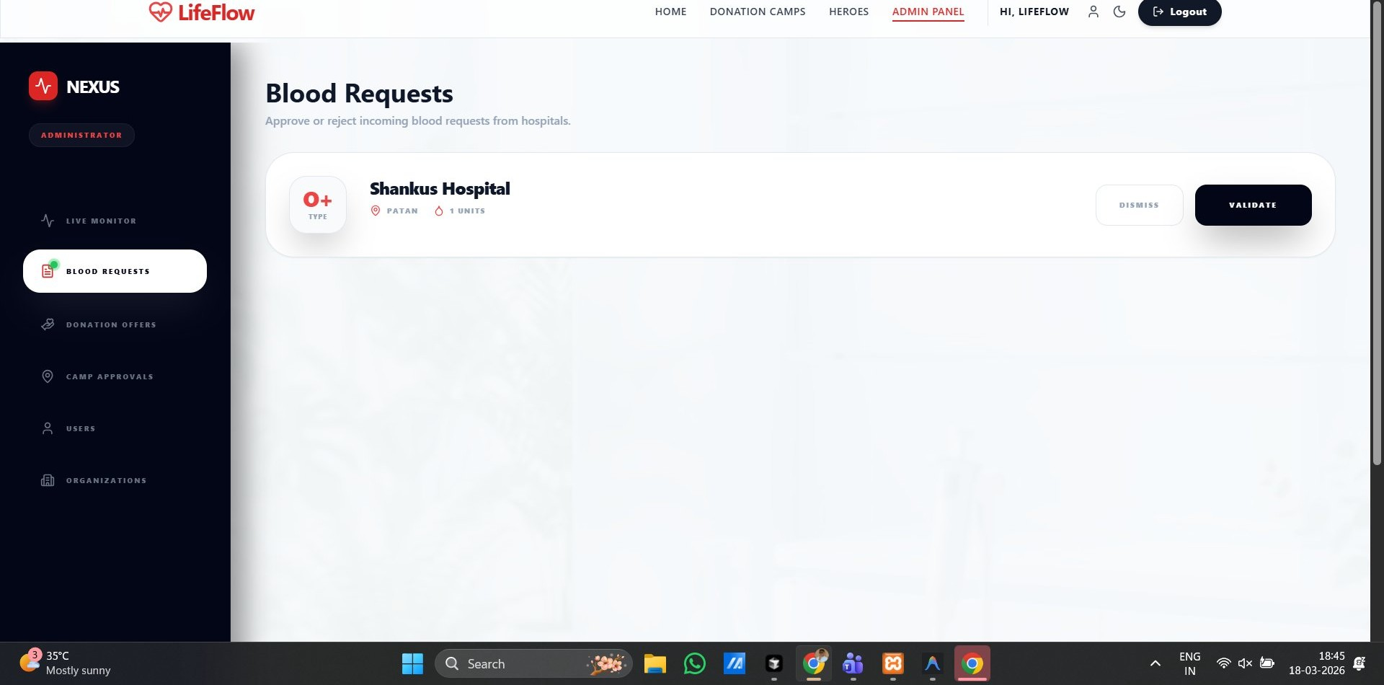
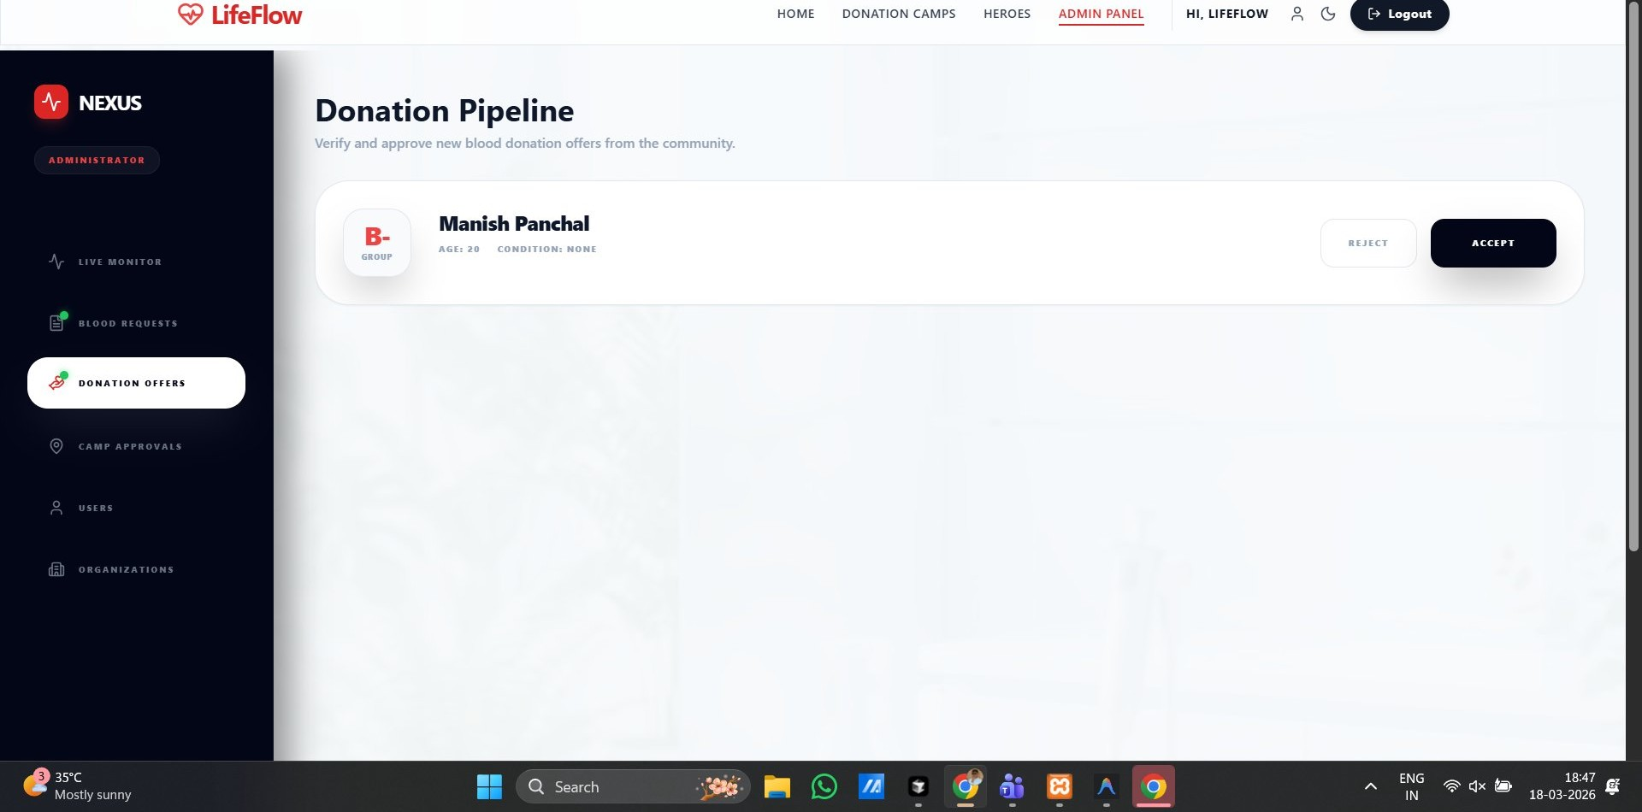
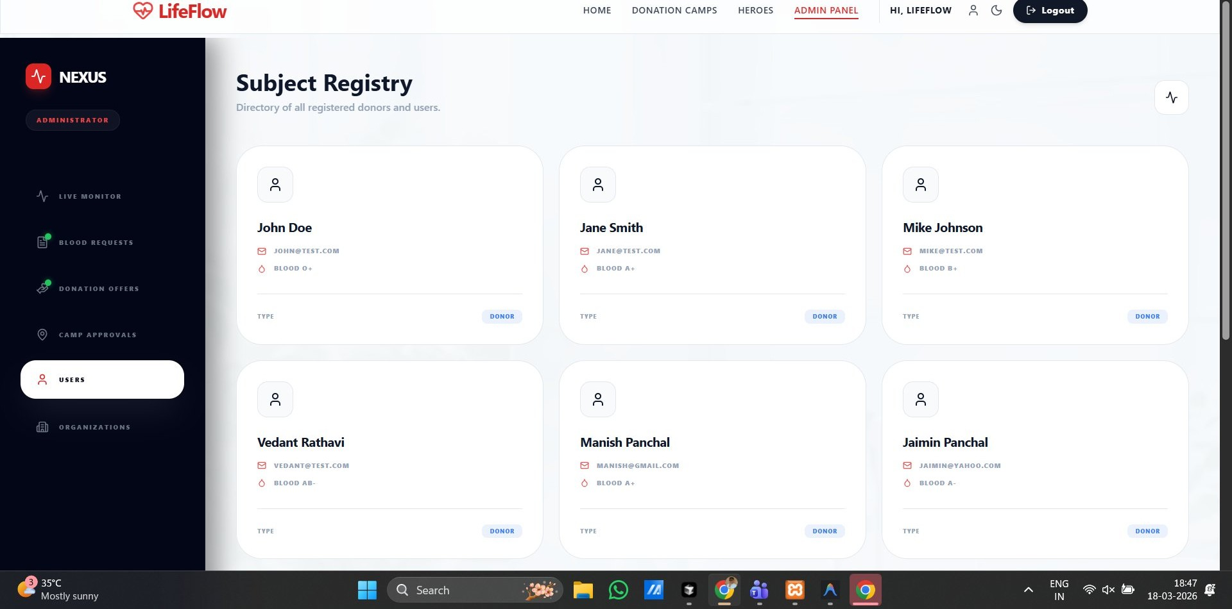
ADMIN PANEL — DETAILS
Blood Requests · Donation Pipeline · Subject Registry
Blood Requests
Donation Pipeline
Subject Registry
Approve or reject incoming hospital requests — shows blood type, units needed & hospital location
Verify donation offers from community donors — one-click Accept or Reject
Complete donor directory with name, email, blood group and donor type badges
⚙️ Admin Nexus gives complete system control — approve/reject requests, manage users, monitor blood supply and oversee all organisations from one central panel.

Slide 16
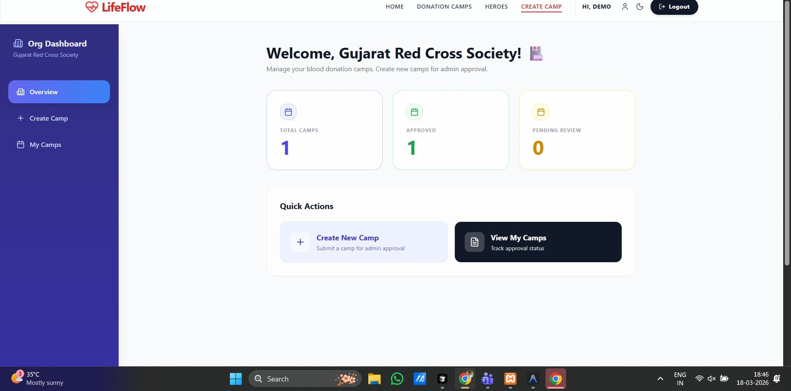
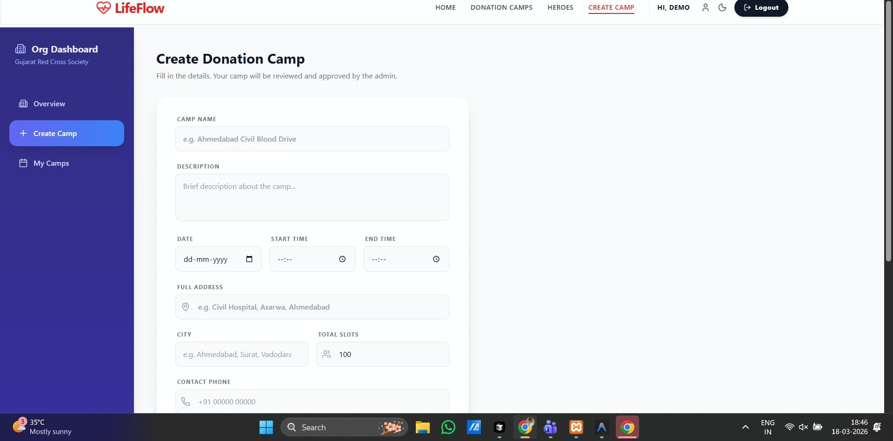
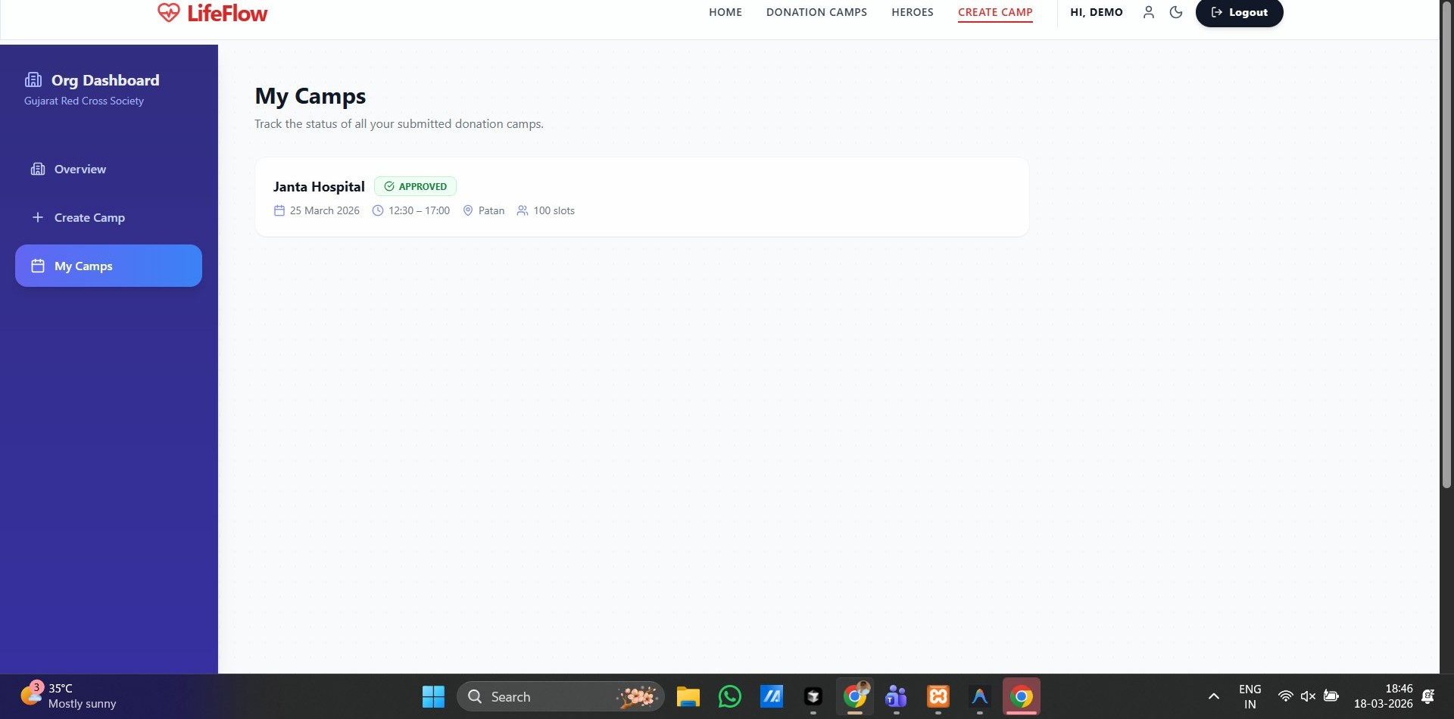
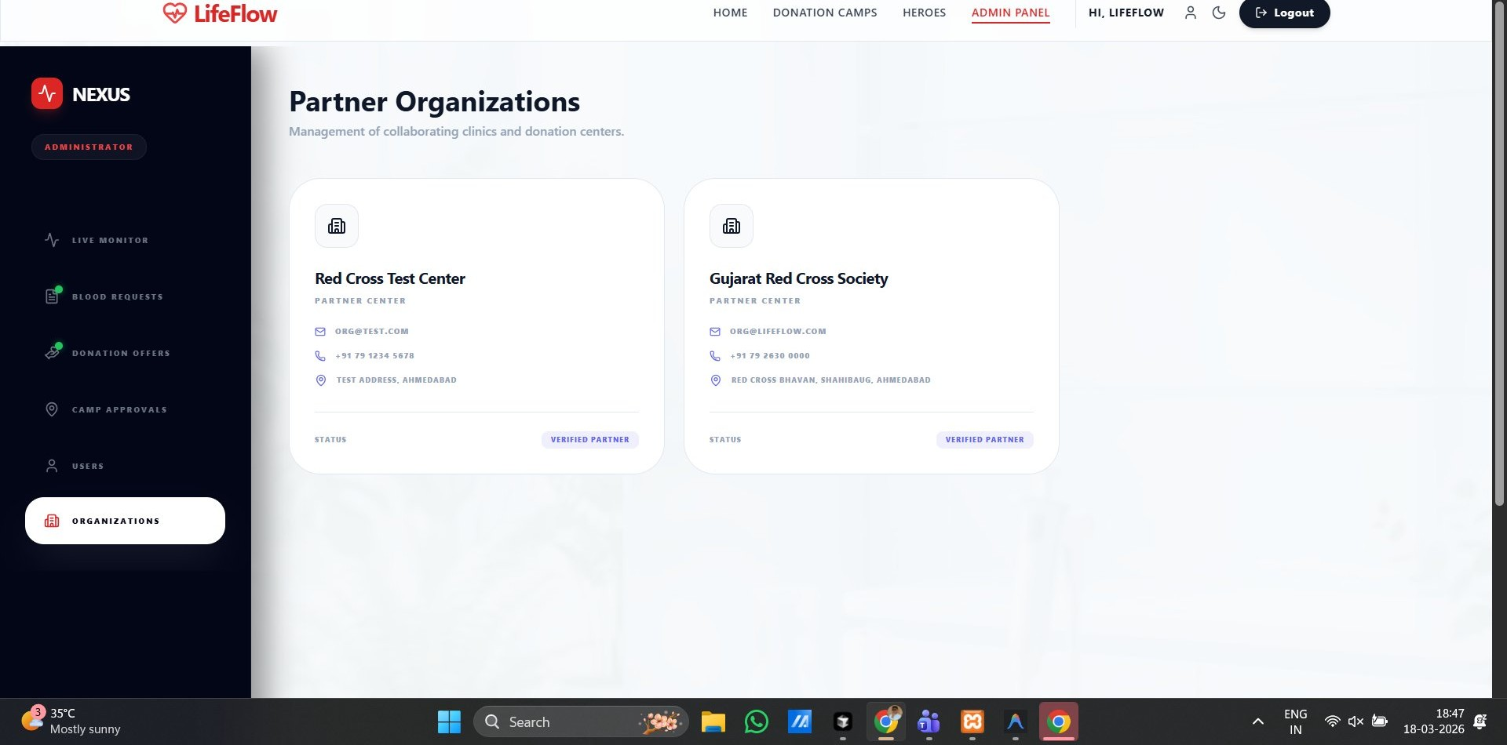
ORGANISATION PORTAL
Org Dashboard, Camp Creation & Management
Org Dashboard
Create Donation Camp
My Camps
Welcome screen · Total/Approved/Pending camps · Quick actions panel
Camp name · Description · Date/Time · Address · Slots · Blood types · Phone
Track all submitted camps — view APPROVED badge, schedule & slot count
Partner Organisations — Verified clinics & donation centers visible to Admin

Slide 17
TECHNOLOGY STACK
Built With Modern Technologies
Frontend
Backend
Database
Tools & Libraries
React 19
Node.js
MySQL
Vite Build Tool
Tailwind CSS
Express.js v5
Sequelize ORM
Zustand State
Framer Motion
REST API
Prisma Schema
Axios HTTP Client
Leaflet + React-Leaflet
JWT + Bcrypt
mysql2 Driver
React Router v7

Slide 18
COMPLETE FEATURE SET
Everything LifeFlow Offers — 19 Features
🏠 Smart Homepage
🗺️ Camp Finder Map
🩺 Why Donate
🏆 7-Tier Badges
Hero · live ticker · hospital trust badge
9+ verified camps · filters · slot counter
Education section with 3 key reasons
Starter → Legend gamification with XP
📊 Donor Analytics
🚨 Emergency System
🩸 Donation Offers
📅 My Journey
Stats · rank · percentile · achievements
Urgent requests routed to admin approval
Join sessions with health declaration
Full donation history timeline
🔐 Auth System
⚙️ Admin Nexus
🏢 Org Portal
NEW
🔬 Compatibility
OAuth + email · role-based routing
Monitor · blood stock · pipeline approvals
Create & track camps · approval status
Blood type checker — give/receive network
NEW
NEW
NEW
🤖 AI Chatbot
👤 Donor Profile
💬 Community Hub
🌙 Dark/Light Mode
LifeFlow Nexus AI health companion
View & edit verified donor identity card
Live feed · donor stories · news & awareness
Full theme toggle throughout
📱 Responsive Design
🔒 Nexus Secured
🏅 Leaderboard
Mobile · tablet · desktop ready
End-to-end secure AI sessions
Community heroes ranking system

Slide 19
❤️
Thank You!
Every Drop Counts. Every Hero Matters.
❤ LifeFlow
⚙️ React + Node.js
🎓 2025–2026
Blood Donation Platform
Full-Stack Web App
Final Year Project

