Slide 1
Sales Performance & Profitability Analysis
2014–2017 · Executive Business Intelligence Review
Tools Used:
Power BI
DAX
Data Visualization
Business Analytics
Dataset:
https://www.kaggle.com/datasets/ahmedmohamedibrahim1/sales-dataset
DATA-DRIVEN STRATEGY
PERFORMANCE INTELLIGENCE

Slide 2
SLIDE 1 · EXECUTIVE OVERVIEW
How Did the Business Perform Overall?
Across four years, the business generated strong revenue, maintained healthy profitability, and served a substantial customer base — establishing a solid foundation for continued growth.
$2.30M
$286.4K
Total Sales
Total Profit
Revenue generated across all years
Net profit accumulated
12.47%
5K
Profit Margin
Total Orders
Overall margin efficiency
Transactions processed
38K
15.62%
Units Sold
Avg Discount
Total quantity across categories
Mean discount applied per order

Slide 3
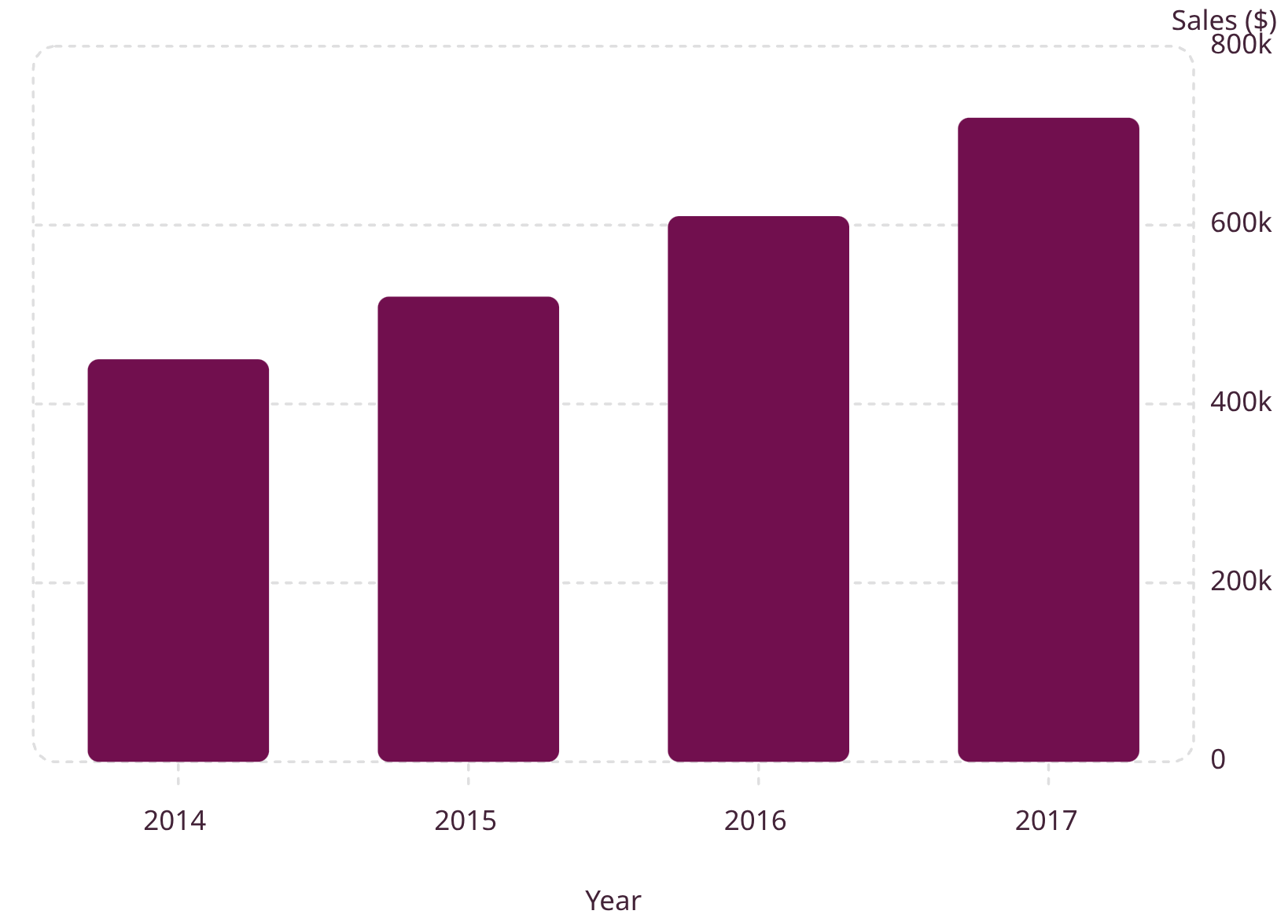

SLIDE 2 · SALES PERFORMANCE
How Has Revenue Evolved Over Time?
Steady Revenue Growth
Sales increased consistently year-over-year, reflecting successful market expansion and growing customer demand. 2017 delivered the strongest performance, reaching the peak of the four-year period.
Key Takeaway: The business achieved its strongest sales performance in 2017, demonstrating sustained momentum.

Slide 4
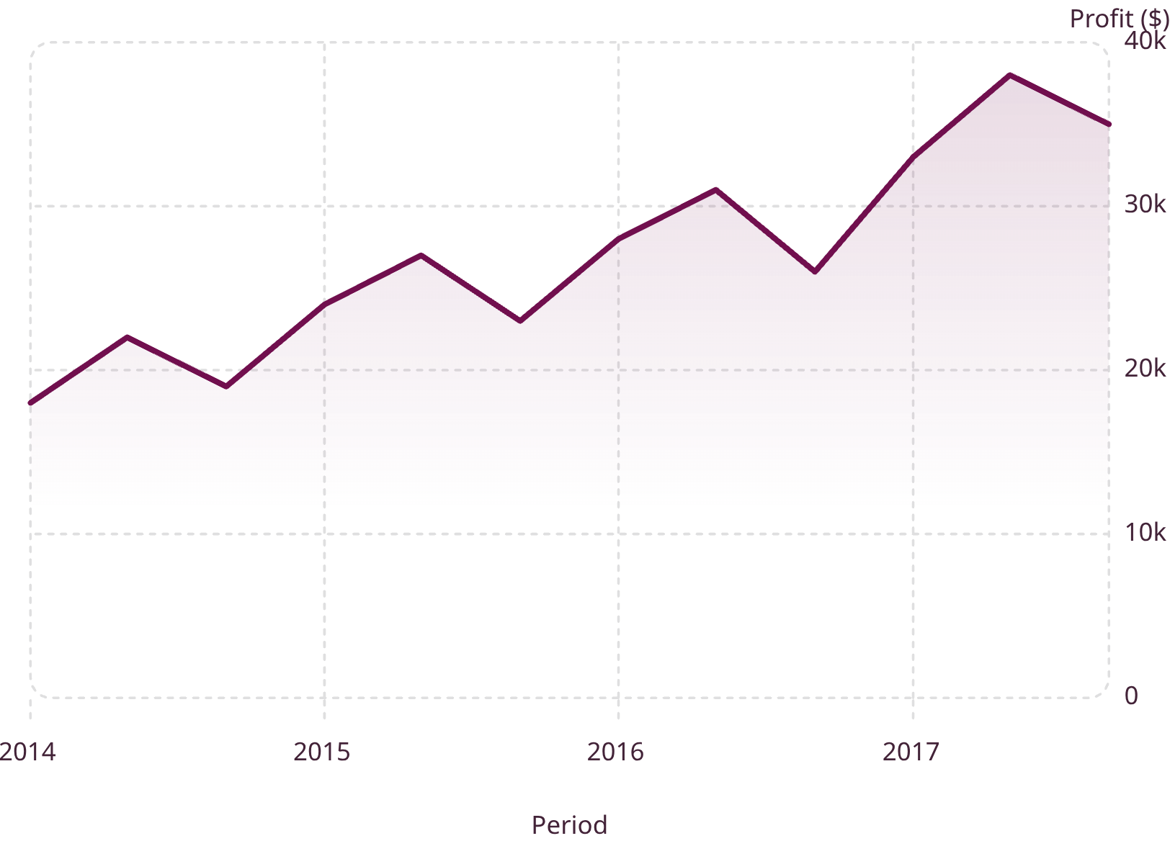

SLIDE 3 · PROFIT PERFORMANCE
Is Revenue Growth Translating Into Profit?
Healthy Profitability Throughout
Despite periodic fluctuations, profitability remained consistently positive and trended upward alongside revenue growth. Seasonal patterns are evident, with peaks typically occurring in mid-year periods.
Key Takeaway: The company maintained healthy profitability while scaling sales operations across all four years.

Slide 5
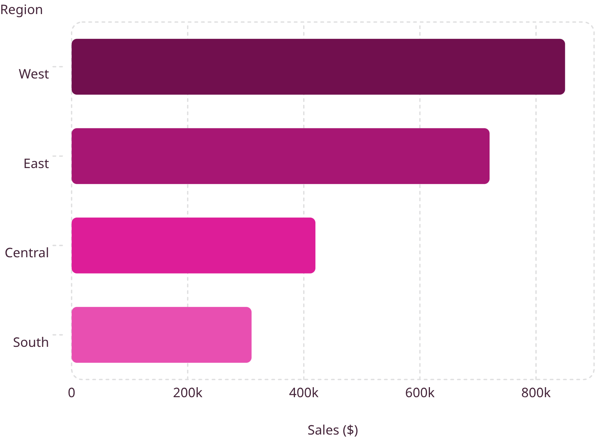

SLIDE 4 · REGIONAL PERFORMANCE
Which Regions Drive Business Success?
Concentrated Regional Performance
Revenue generation is heavily concentrated in the West and East regions, which together account for the majority of total sales. The South region remains significantly underdeveloped.
West: Largest revenue contributor
East: Strong secondary market
Central: Moderate performance
South: Untapped growth potential
Executive Insight: Regional diversification can reduce dependency on top-performing markets and unlock new revenue streams.

Slide 6
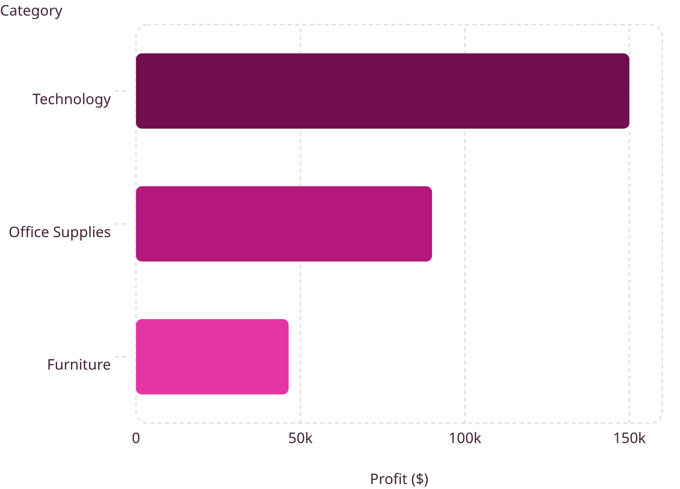

SLIDE 5 · PRODUCT PERFORMANCE
Which Product Categories Generate the Most Value?
Technology Leads Profitability
Technology is the dominant profit driver, contributing the highest profitability across all categories. Office Supplies delivers solid mid-tier returns. Furniture generates revenue but contributes significantly less profit relative to its sales volume.
Technology: Primary profit engine
Office Supplies: Consistent contributor
Furniture: Margin improvement needed
Key Takeaway: Not all sales generate equal business value — category-level margin analysis is essential.

Slide 7

SLIDE 6 · CONNECTING THE STORY
From Revenue to Business Value Creation
Business success follows a clear value chain — from top-line sales growth through to product-level profitability and regional contribution.
Regional Contribution
Product Profitability
Sales Growth
Profit Growth
Strong sales growth is underpinned by profitable product categories — led by Technology — and concentrated regional performance in the West and East. Understanding each link in this chain enables targeted strategic decisions.

Slide 8
SLIDE 7 · KEY BUSINESS INSIGHTS
Five Insights That Define Performance
$2.30M in Total Sales
2017 Peak Performance
West Region Dominance
Generated $286.4K profit at a 12.47% margin across 5K orders.
The strongest sales year, capping four years of consistent revenue growth.
The largest revenue contributor, with East as a strong secondary market.
Technology Leads Profit
15.62% Avg Discount
The highest-profit category and primary driver of overall business value.
Supports sales volume but may constrain overall margin efficiency.

Slide 9
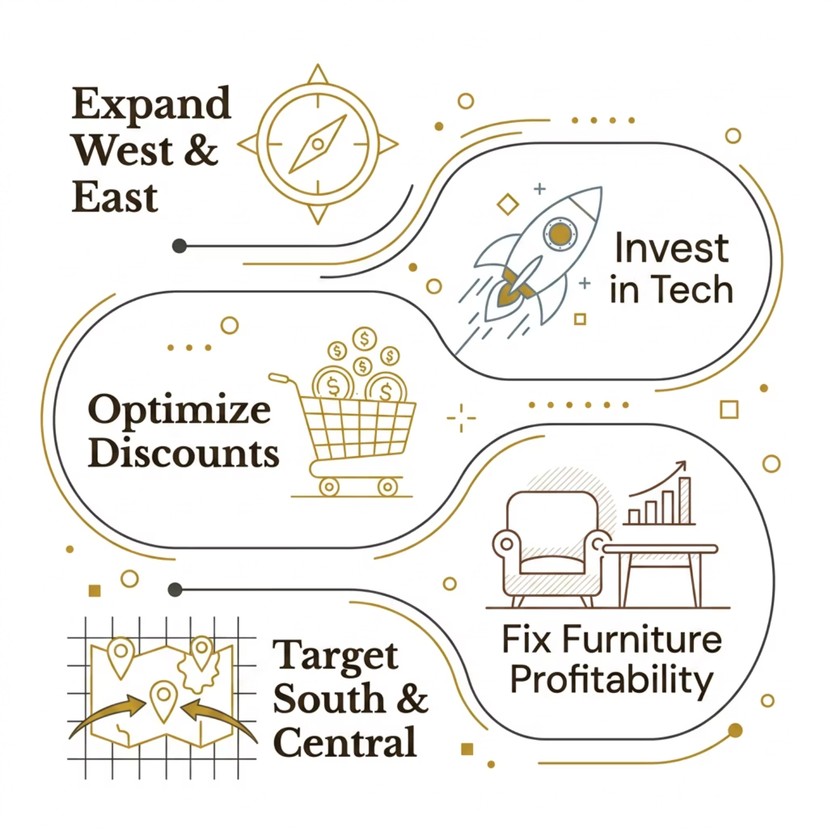
SLIDE 8 · STRATEGIC RECOMMENDATIONS
What Should Management Do Next?
A Focused Growth Agenda
Management should prioritize high-margin categories, optimize promotional spend, and activate underperforming regions to unlock the next phase of profitable growth.
Replicate winning regional strategies
Deepen Technology category investment
Rationalize discount structures
Address Furniture margin gaps
Develop South and Central markets

Slide 10
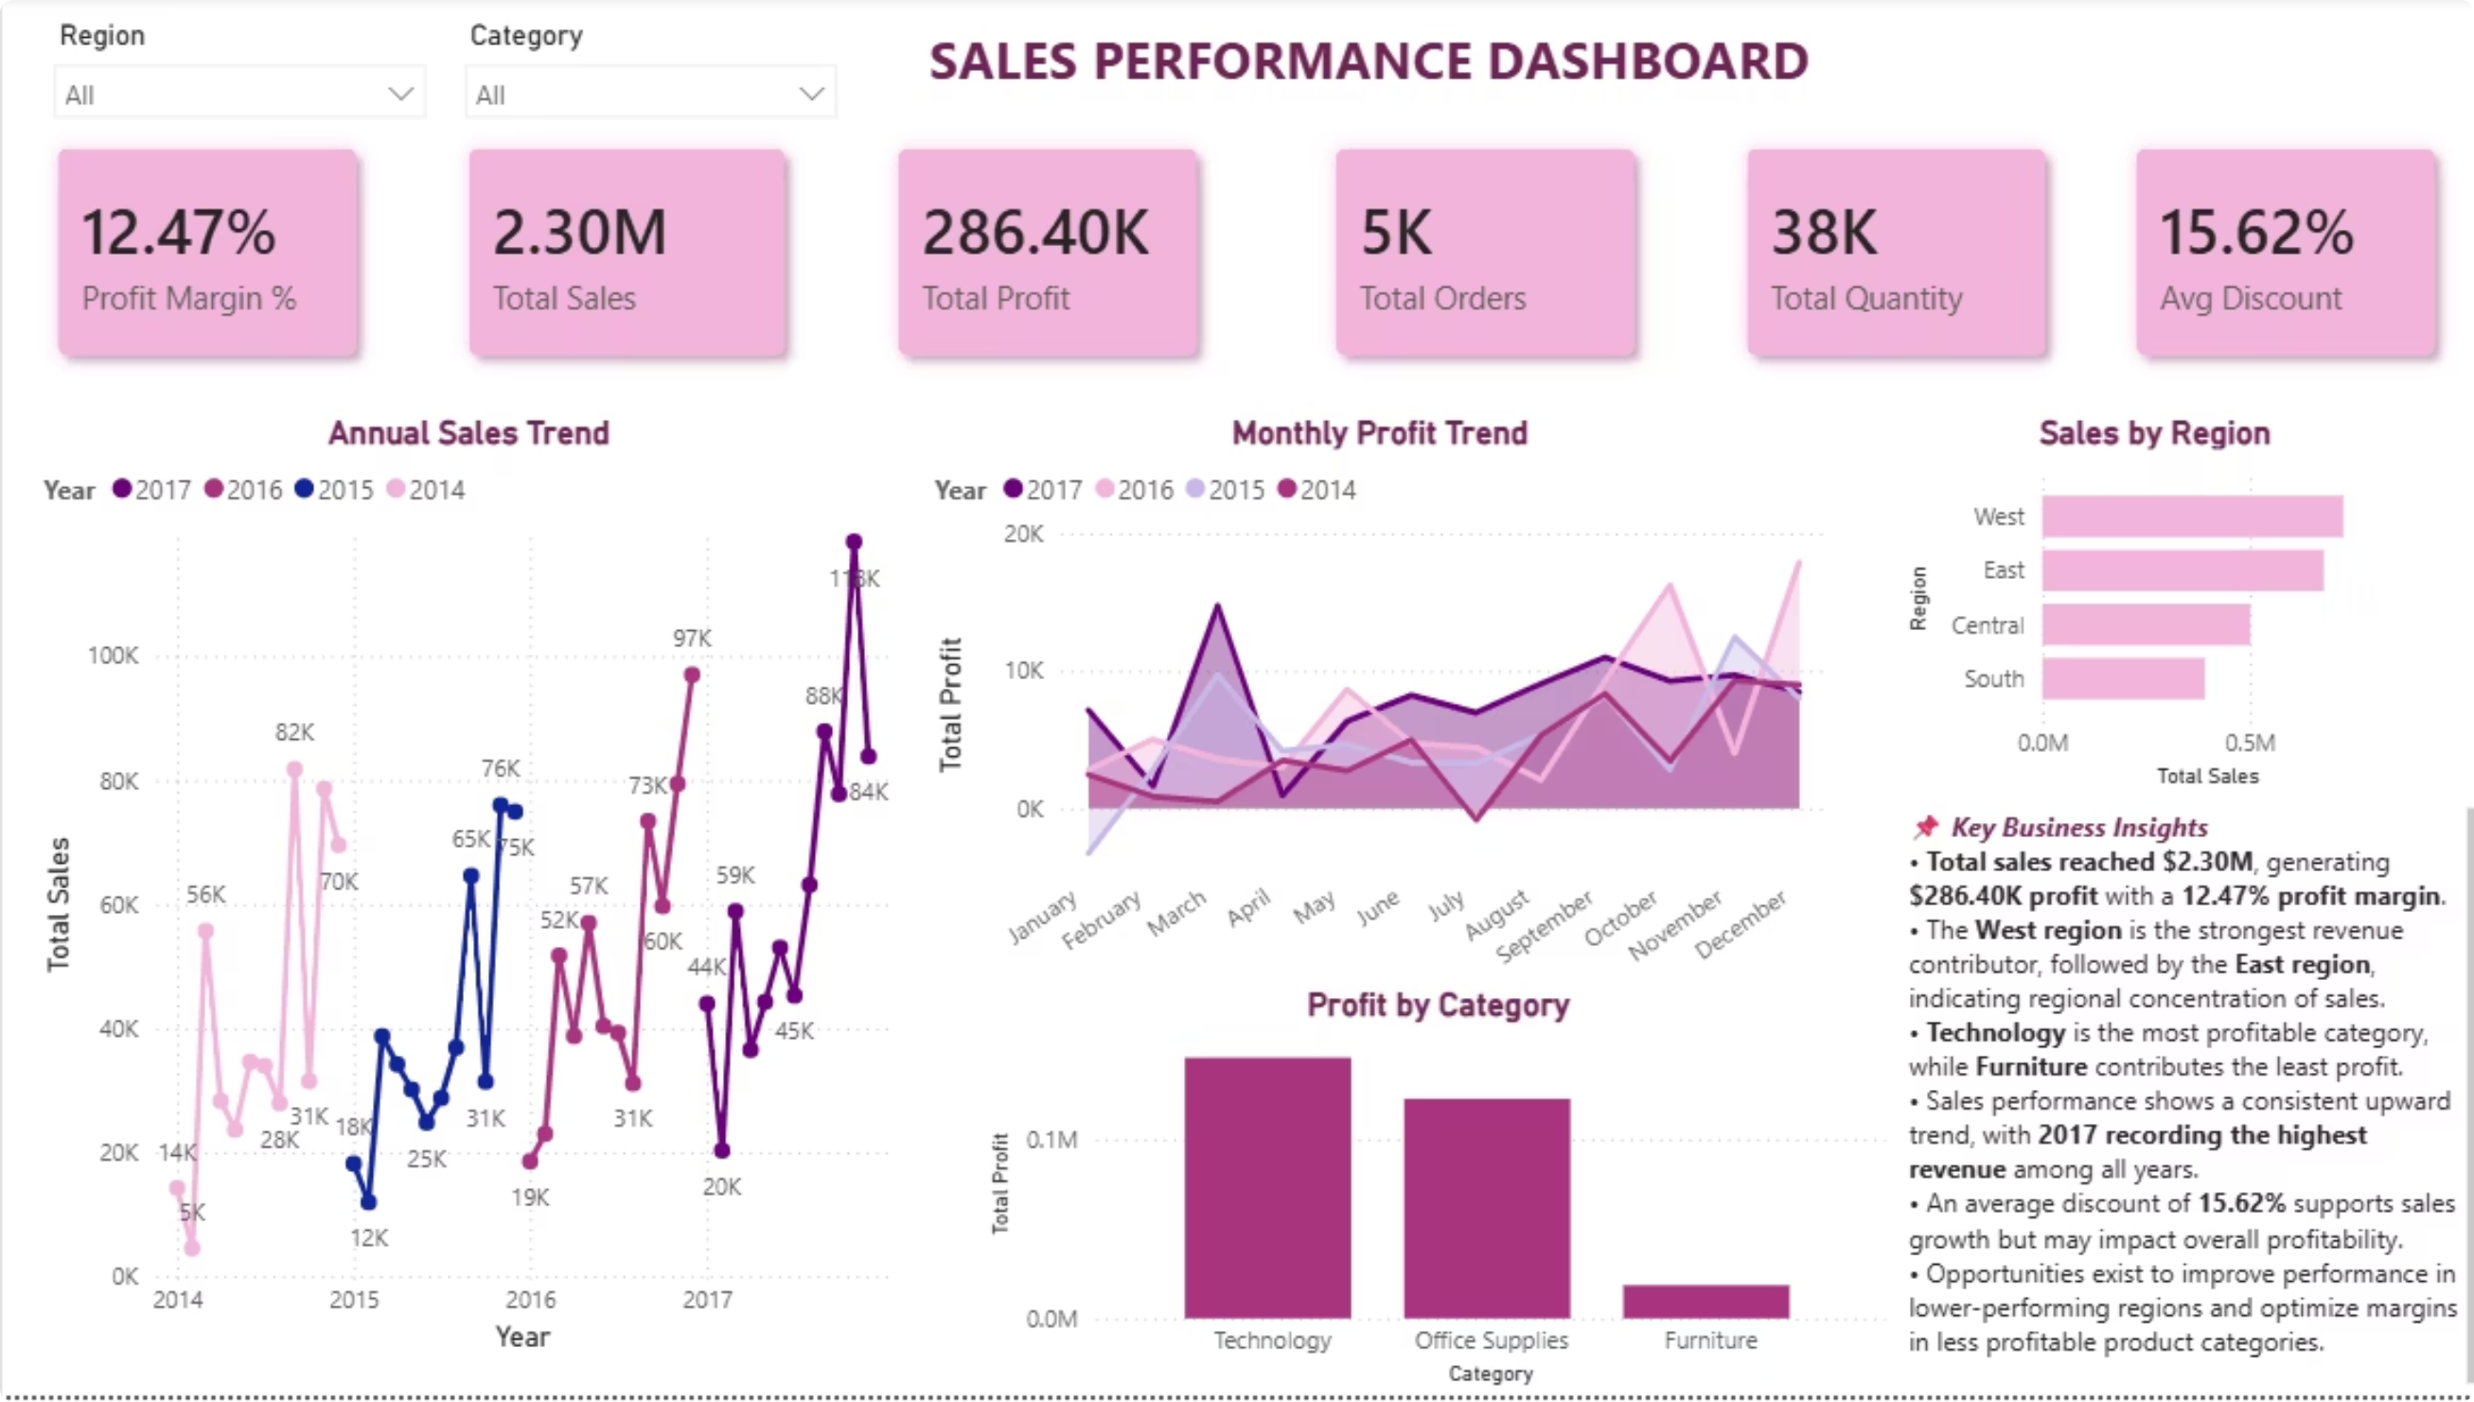
Conclusion
The 2014–2017 analysis demonstrates that business growth is driven by strong sales performance, profitable product categories, and high-performing regions. Interactive dashboarding enables stakeholders to monitor performance, identify opportunities, and make data-driven decisions with confidence.
"Transforming sales data into actionable business intelligence for smarter business decisions."

