Slide 1

SMART INDIA HACKATHON 2026
COAST
When GPS dies, you coast on sensors.
Problem Statement ID – 26168
Problem Statement Title – AI-ML based Intelligent Dead Reckoning system for seamless navigation
Theme – Space Technology
PS Category – Software
Team ID – TEAM ID
Team Name – TEAM NAME

Slide 2
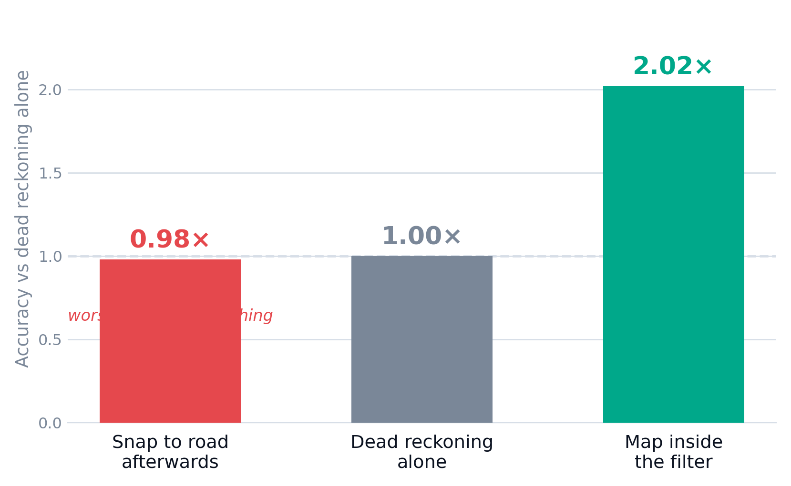
COAST — NAVIGATION THAT SURVIVES THE TUNNEL
TEAM NAME
Everyone tries to fix this with a better sensor. We measured that instinct — and it is wrong.
01 Given a perfect, zero-error gyroscope, dead reckoning still fails 55% of 60-second segments. The bottleneck was never sensor quality — it is that nothing stops the estimate leaving the road.
02 So we changed what the filter is allowed to believe. Its state is not a free position (x, y); it is (which road edge, how far along it). Off-road is not representable, so lateral error cannot accumulate.
03 This only works in the loop. Snapping a finished track to the nearest road scores 0.98× — worse than doing nothing. Same map, opposite architecture.
04 Runs on the phone already in the vehicle. No OBD-II, no dongle, no network — the map database is offline OpenStreetMap, as the problem statement specifies.
2.02×
lower median position error
55%
a perfect gyro still fails
98×
the 200 Hz edge requirement
Measured on 43 real GNSS outages from IO-VNBD, scored against vehicle CAN-bus ground truth.

Slide 3
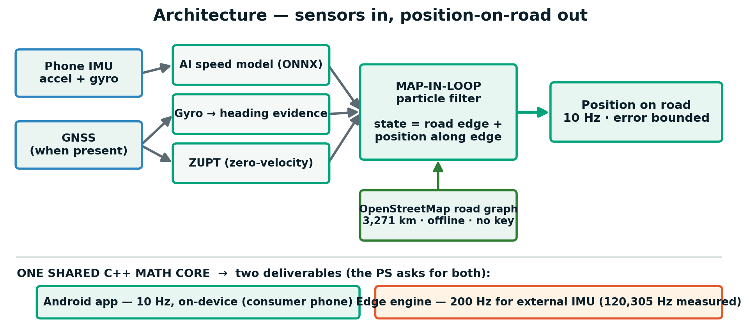
TECHNICAL APPROACH
TEAM NAME
COAST-VNet-1 — our speed model
96,086 parameters · 392 KB ONNX · runs on the phone. A frequency-decoupled CNN-GRU: the low band goes through a GRU as vehicle motion, the high band through a conv stack as road and engine vibration — the exact noise the problem statement names.
Trained leave-file-out on IO-VNBD, labelled from the vehicle CAN bus rather than phone GNSS, so it never learns to imitate a noisy fix.
The estimation pipeline
Align pitch/roll from gravity; mount yaw estimated on the move
Filter gravity removed, then vibration split from motion
Predict COAST-VNet-1 speed + gyro yaw + compass, ZUPT at rest
Constrain particle filter over the OSM road graph, with NHC
Fuse GNSS re-acquired in 100 ms, both directions
Stack
Kotlin · Jetpack Compose · ONNX Runtime Mobile · MapLibre + OpenStreetMap (no API key, no billing) · shared C++ core → phone, WASM and a headless edge daemon · PyTorch for training.
Why a particle filter, not a Kalman filter
At a junction the belief is genuinely multi-modal — you may be on either road. A single Gaussian must collapse that to one answer exactly when the ambiguity matters most. Particles carry both hypotheses until the motion resolves them.

Slide 4
FEASIBILITY AND VIABILITY
TEAM NAME
Feasible because it needs nothing that does not already exist
Extra hardware None — any phone with an IMU
Map licence / API key None — OpenStreetMap, offline
Network at runtime None — inference is on-device
Cloud infrastructure None — zero marginal cost per user
User account None — no identity is collected
Risks, and what we did about them
Heading drift is the hard part
We proved a perfect gyro is not enough (55% still fail), which is why the map is in the loop rather than a better sensor.
Consumer IMUs are noisy and biased
Gravity removed before integration; vibration separated from motion in the model; zero-velocity updates at rest.
Phone mount varies
Gravity-axis canonicalisation cut mount-swap degradation by ~63% in ablation. Yaw-to-vehicle remains our open problem, and we say so.
We do not yet meet the <10% drift bar
We are at 16.8% against a 27.6% baseline — roughly half the gap closed, with a measured route to the rest.
Our uncertainty estimate is not trustworthy
It correlates −0.23 with real error, so we hide it rather than show a number we cannot stand behind.
Scales in three directions
→ Device — one C++ core runs 10 Hz on a phone and 19,682 Hz headless in its worst measured configuration, 98× the 200 Hz edge requirement.
→ Geography — OpenStreetMap covers the planet. Adding a city is a data step, not an engineering one.
→ Domain — the constraint is a plug-in. The algorithm never knew it was a road; a rail track or a shipping channel is another implementation.

Slide 5
IMPACT AND BENEFITS
TEAM NAME
The vehicles nobody built a fallback for
Premium cars ship with wheel-connected inertial navigation. Trucks, older cars and India's two-wheeler fleet do not — they rely entirely on the phone on the dashboard. That is who this is for.
Benefits
Social
Navigation continuity is a safety function. It should not require a data plan, a subscription, or a car expensive enough to have inertial navigation fitted at the factory.
Economic
Zero marginal cost per user. No map licensing, no cloud bill, no per-query fee — so the consumer app can stay free while the core is licensed to OEMs and fleet operators.
Environmental
Zero additional hardware manufactured, and therefore zero additional e-waste. It runs on phones people already own, and on old ones — the model is 392 KB.
Strategic
Positioning that depends on no satellite signal keeps working while a constellation is being rebuilt or deliberately denied. It complements NavIC rather than competing with it.
1.96 crore
two-wheelers sold in India, FY2024-25
4.6×
two-wheelers per passenger vehicle
₹0
marginal cost per additional user
Sales figures: SIAM, 15 April 2025.
Where it matters most
› Everyday navigation — the turn you miss because the dot froze
› Emergency response — an ambulance in an underpass, when dispatch needs it most
› Logistics & quick commerce — continuity through tunnels and multi-level warehouses
› Sovereignty — GNSS can be jammed; an inertial + map solution cannot be

Slide 6
RESEARCH AND REFERENCES
TEAM NAME
Dataset
IO-VNBD — Inertial and Odometry Benchmark Dataset for ground vehicle positioning. Onyekpe et al. github.com/onyekpeu/IO-VNBD
All results below are leave-file-out on this corpus, labelled from the vehicle CAN bus at 10 Hz — never from phone GNSS.
Foundational work we build on
· Newson & Krumm (2009) — Hidden Markov map matching. Their algorithm; we implement and cite it, adapted for dead-reckoned rather than GNSS input.
· Brossard et al. — AI-IMU dead reckoning (invariant EKF, vehicle DR).
· Herath et al. RoNIN · Liu et al. TLIO · TinyOdom — the neural inertial odometry line COAST-VNet-1 belongs to.
· EqNIO (ICLR 2025) — gravity-axis equivariance; our mount canonicalisation follows this idea.
Our own measured results
Every figure in this deck is re-derived from a committed results file by tools/verify_claims.py, which fails the build if a slide states a number no measurement produced.
Map-in-loop vs dead reckoning 2.02× lower median error
Post-hoc road snapping (control) 0.98× — worse than nothing
Perfect-gyro ablation still fails 55% of segments
Median drift, free DR → COAST 27.6% → 16.8%
Heading channel, gyro → compass 16.9% → 7.2%
GNSS+INS fusion 1.07× — a wash, reported as such
Edge engine, worst configuration 19,682 Hz = 98× the requirement
GNSS ⇄ dead-reckoning handover 100 ms, both directions
We publish our negative results alongside our wins. A record that contains only successes is one nobody should trust.

