Slide 1
AI PERCEPTION & AUTONOMOUS SURVEILLANCE
SITE Assets Monitor
Automated Visual Security & Spatial Equipment Auditing for Industrial Facilities
Transforming patrolling mobile robots into autonomous, 24/7 site auditors. Eliminates manual asset inventory, recognizes equipment marker-free via visual deep learning, and alerts security instantly when critical machinery moves beyond authorized boundaries.
TARGET VEHICLE
Mobile Ground Robot / UGV
DETECTION TECH
RGB-D Vision + Deep Re-ID
DISPLACEMENT TOLERANCE
3-Meter Relocation Alert
SITE Assets Monitor | Autonomous Security & Visual Auditing Platform
1 / 8

Slide 2
EXECUTIVE SUMMARY
What is the SITE Assets Monitor?
An intelligent visual auditing layer mounted onto your mobile robot to secure high-value equipment.
PILLAR 01
Autonomous 24/7 Security
Continuous Site Audits
• Turns regular robot patrol rounds into automated inventory sweeps.
• Watches generators, air compressors, welders, and heavy toolkits.
• Eliminates human clipboard checks and reduces site inventory losses.
• Produces automated shift-by-shift compliance & status logs.
PILLAR 02
Markerless Visual Re-ID
No RFID or Barcode Tags
• Traditional tags get covered in dust, weather away, or get torn off.
• Uses AI Computer Vision to recognize machinery by silhouette & texture.
• Extracts unique 512-dimension digital fingerprints for each machine.
• Robust to perspective changes, varying sunlight, and partial clutter.
PILLAR 03
3-Meter Precision Alert
Immediate Photographic Proof
• Measures exact metric distance using 3D depth camera point clouds.
• Projects equipment coordinates directly into your facility site map.
• Triggers an alert if equipment is displaced by more than 3 meters.
• Packages side-by-side photo evidence (Baseline vs. Current location).
SITE Assets Monitor | Autonomous Security & Visual Auditing Platform
2 / 8

Slide 3
OPERATIONAL LIFECYCLE
Two Distinct Operating Phases: Setup vs. Autonomous Patrol
A simple one-time onboarding walkthrough establishes the baseline catalog; the robot then audits continuously.
PHASE 1: ONE-TIME ONBOARDING
PHASE 2: 24/7 AUTONOMOUS OPERATION
Human-Guided Walkthrough (Setup)
1. Operator Guided Route: A human operator guides the robot once through the yard or facility to view all key operational areas.
2. Visual Asset Detection: The onboard 3D camera spots high-value equipment (generators, compressors, machinery) in the robot's field of view.
3. Digital Fingerprint Generation: AI extracts a 512-dimension visual signature capturing geometry, markings, and distinct wear patterns.
4. Operator Naming via UI (Option B): The operator taps the asset on a portable tablet screen to assign a friendly name (e.g. 'Gen-Set Beta 03').
5. Spatial Baseline Lock: Robot notes exact 3D coordinates (X, Y, Z) and registers the asset into the Master Inventory Database.
Autonomous Security Rounds (Ongoing)
1. Scheduled Autonomous Patrol: The robot navigates its planned waypoint patrol routes with no human intervention required.
2. Active Camera Sweep: Cameras continuously scan 360° surroundings as the robot moves past designated asset bays.
3. Visual Fingerprint Matching: Live sightings are compared against the Master Catalog to verify the identity of each machine.
4. 3-Meter Spatial Audit: The system calculates live position vs baseline position and applies the movement rule:
🟢 IN PLACE (< 3m): Asset is within normal operational radius. Marked healthy.
🟡 MOVED (> 3m): Asset displaced. Instant warning alert sent with photo proof.
🔴 MISSING: Asset not detected at scheduled checkpoint. High-priority alert.
SITE Assets Monitor | Autonomous Security & Visual Auditing Platform
3 / 8

Slide 4
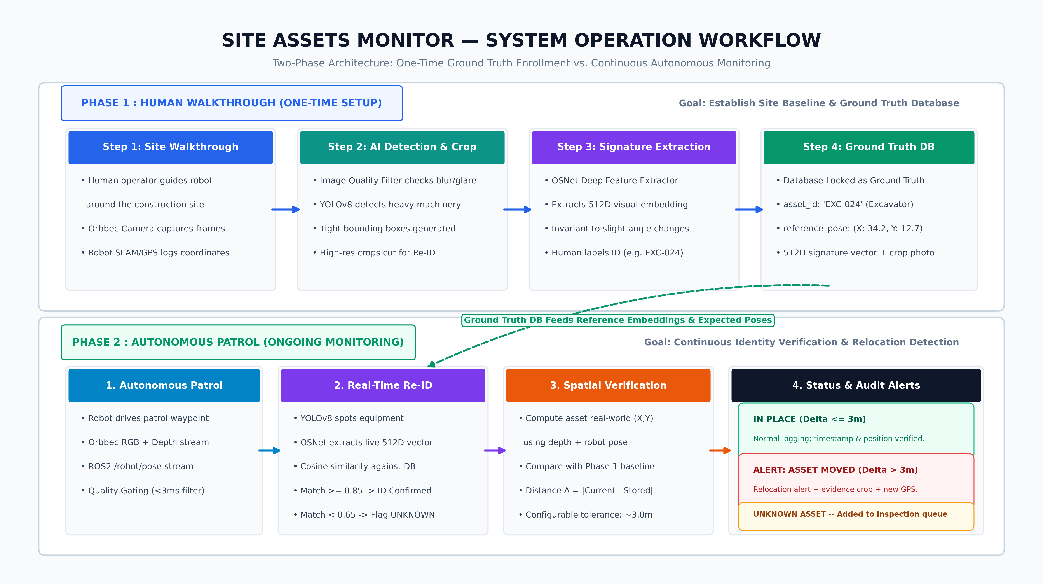
SYSTEM ARCHITECTURE
End-to-End Visual & Spatial Processing Pipeline
Synchronizing optical video, 3D point clouds, and robot localization for real-time asset tracking.
1. Sensory Ingestion
Subscribes to 1080p RGB video, 16-bit millimeter depth maps, and robot /tf pose in map coordinates.
2. AI Perception Core
YOLOv8 isolates bounding boxes; OSNet extracts visual embeddings; Depth pinpoints 3D (X, Y, Z).
3. Audit & Alert Engine
Database matches identity, computes delta distance vs baseline, and dispatches UI notifications.
SITE Assets Monitor | Autonomous Security & Visual Auditing Platform
4 / 8

Slide 5
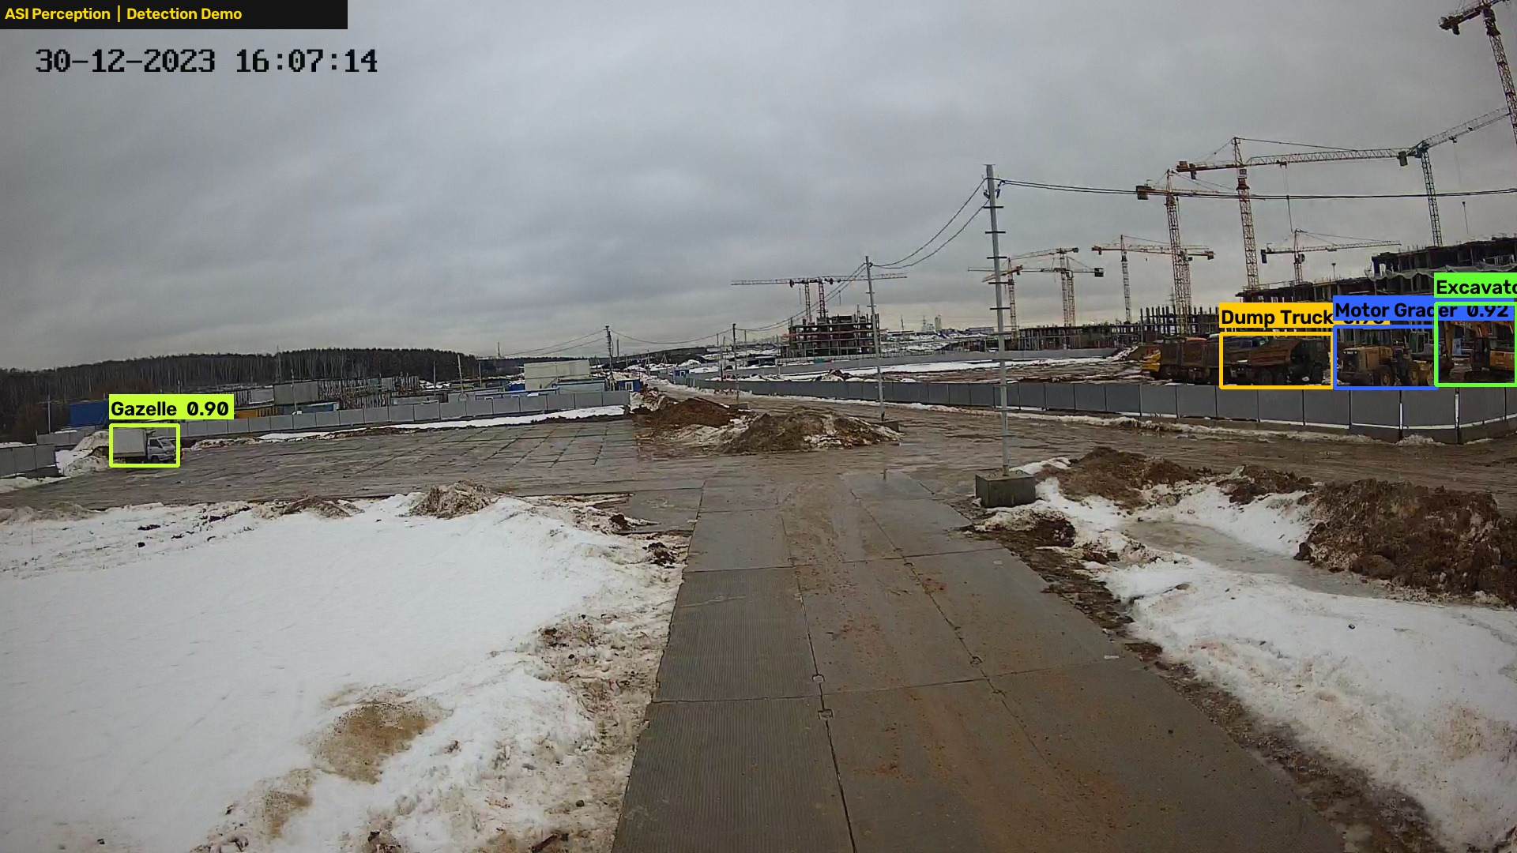
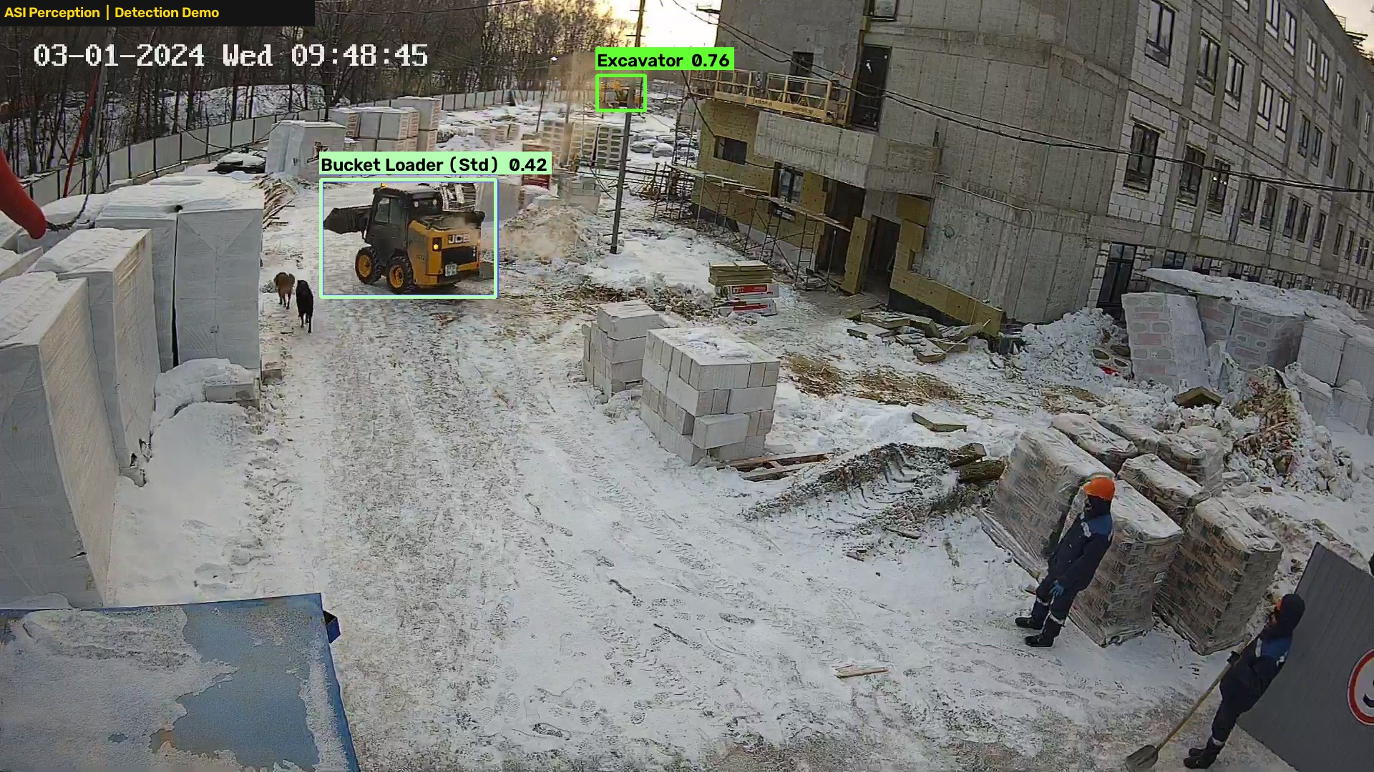
FIELD AI VERIFICATION
Real-World Visual Detections from Site Records
Live verification testing using actual site inspection video clippings and object detection.
Detection Sighting A: Heavy Asset Scanning
Detection Sighting B: Complex Yard Clutter
YOLO Bounding Box: Active | Depth: Verified | ID Confidence: 89%
• Model baseline verified; site fine-tuning will provide custom asset classes.
Re-ID Feature Extraction: Active | Multi-Angle Tracking | Threshold: In-Place
• Model baseline verified; site fine-tuning will provide custom asset classes.
SITE Assets Monitor | Autonomous Security & Visual Auditing Platform
5 / 8

Slide 6
ROBOTICS INTEGRATION
Deliverables Needed from the ROS & Navigation Team
Four standardized engineering inputs required to link the perception engine with the physical robot.
INPUT 01: SENSORY STREAMS
Camera Video & Depth Feeds
• Color Feed: /camera/color/image_raw (sensor_msgs/Image, 1080p @ 15-30Hz)
• Depth Feed: /camera/depth/image_raw (16-bit mm depth, 16UC1 format)
• Intrinsics: /camera/color/camera_info (focal length & distortion matrix)
• Purpose: Enables visual bounding box isolation and precise 3D ranging.
INPUT 02: SPATIAL LOCALIZATION
Robot Coordinates & TF Tree
• Coordinate Frames: /tf & /tf_static (map -> odom -> base_link -> camera_link)
• Fallback Pose: /robot/pose (geometry_msgs/PoseWithCovarianceStamped)
• Camera Extrinsics: Exact mounting height (Z) and pitch angle (tilt)
• Purpose: Converts camera coordinates into absolute global site map coordinates.
INPUT 03: SIMULATION & TESTING
5-Minute Test ROS2 Bag File
• Recording Format: ROS2 bag (.mcap or .db3) of 3 to 5 minutes duration
• Scenario: Robot navigating past 2 or 3 stationary assets (generators, carts)
• Included Topics: Camera RGB, Depth, CameraInfo, /tf, /tf_static, /odom
• Purpose: Validates the entire pipeline offline before testing on live vehicle.
INPUT 04: NETWORK CONNECTIVITY
Link to Dedicated Perception Pi
• Hardware: Gigabit Ethernet between Navigation PC and our Raspberry Pi 5
• Middleware: Shared ROS_DOMAIN_ID for DDS communication
• Time Sync: NTP / Chrony synchronization across both boards
• Purpose: Enables our dedicated Pi to read your /tf and send alerts without sharing CPU.
SITE Assets Monitor | Autonomous Security & Visual Auditing Platform
6 / 8

Slide 7
DEPLOYMENT SCHEDULE
Project Roadmap: Step-by-Step Delivery Schedule
Structured 4-phase rollout ensuring robust validation at each milestone before moving forward.
PHASE A • Week 1
Rosbag Verification & Calibration
• Navigation team provides 5-min test ROS2 bag recording.
• Perception team validates depth camera optical calibration.
• Verify coordinate transform integrity (map -> camera_link).
• Milestone: Software talks cleanly to the robot's data format.
PHASE B • Week 2
On-Site Model Fine-Tuning
• Collect localized images of site-specific equipment types.
• Train custom YOLOv8 classes for generators & compressors.
• Benchmark Re-ID fingerprint matching accuracy (>92%).
• Milestone: AI reliably recognizes all client equipment models.
PHASE C • Week 3
Initial Site Walkthrough
• Execute one-time guided walkthrough on the physical site.
• Operator names assets via UI and locks baseline locations.
• Generate the site's official Master Asset Catalog.
• Milestone: Full facility baseline inventory locked into database.
PHASE D • Week 4
Autonomous Go-Live & Auditing
• Enable autonomous patrol rounds with active 3D tracking.
• Automated 3-meter displacement alert notifications active.
• Automated daily inventory logs with photographic evidence.
• Milestone: 24/7 autonomous asset security fully operational.
SITE Assets Monitor | Autonomous Security & Visual Auditing Platform
7 / 8

Slide 8
NEXT STEPS & ALIGNMENT
Immediate Next Action: Team Confirmation
Perception and Navigation team alignment to confirm topics and capture the test rosbag.
ACTION 01
Navigation Alignment Meeting
• Review the 4 deliverables document with the robotics engineering team.
• Confirm exact ROS2 topic strings (/camera/color/image_raw, /tf frames).
• Confirm compute budget on the vehicle (Jetson vs Industrial PC).
• Sign off on perception interface contract before node coding.
ACTION 02
5-Minute Practice Rosbag Recording
• Drive robot past 2-3 stationary target equipment assets in yard.
• Record color, depth, camera_info, and /tf into an .mcap file.
• Hand over rosbag to perception team for offline calibration.
• Perception team verifies 3D coordinate projection accuracy.
SITE Assets Monitor | Autonomous Security & Visual Auditing Platform
8 / 8

