Slide 1
AUTONOMOUS SECURITY & PERCEPTION
SITE Assets Monitor
Phase 1 & Phase 2 Technical Milestone Presentation
Environment-Agnostic HITL Asset Enrollment (Phase 1) & Autonomous High-Recall Multi-Asset Re-ID Patrol (Phase 2) on a Mobile Robot Platform (UGV).
PHASE 1 DELIVERABLE
HITL Operator Enrollment UI (v2)
Zero Pre-Training Day-1 Setup
PHASE 2 DELIVERABLE
Autonomous Re-ID Patrol Verification
100% Asset Recall (24/24 Containers)
TEST SUITE STATUS
119 / 119 Unit Tests Passing
Clean Architecture & CI Verified

Slide 2
CONTEXT & OBJECTIVES
Executive Summary: The Industrial Challenge & Our Solution
THE INDUSTRIAL PROBLEM
OUR TWO-PHASE SOLUTION
• No Pre-Trained Models on Day-1
Every construction, logistics, or industrial yard has unique asset types, customized containers, and lighting conditions. Off-the-shelf detectors fail without extensive retraining.
• Manual Inventory is Slow & Flawed
Human audit walkthroughs take hours, introduce logging errors, and fail to track unexpected asset displacements or theft in real time.
• Harsh Mobile Robot Dynamics
UGV/AGV motion introduces camera vibration, heavy motion blur, steep perspective angles, and partial occlusions that confuse typical vision models.
✓ Phase 1: Environment-Agnostic HITL
Human-In-The-Loop walkthrough on Day 1. The operator uses an intelligent auto-proposal UI with Quick-Assign buttons to tag containers. Generates 512-D OSNet visual fingerprints instantly.
✓ Phase 2: Autonomous Re-ID Patrol
Full autonomous patrol replay. Multi-layer filtering (crop-level blur rejection + frame motion gating + spatial voting) verifies known assets with 100% recall across 24 containers.
✓ Dual-Output Advantage
While enrolling assets, the tool automatically saves full frames and normalized YOLO labels (ready-to-train Kaggle/Colab dataset zip).

Slide 3
SYSTEM PIPELINE
End-to-End System Architecture: Phase 1 to Phase 3
PHASE 1: HITL ENROLLMENT
PHASE 2: AUTONOMOUS PATROL
PHASE 3: SPATIAL TRACKING
Day-1 Baseline Walkthrough
• Container Candidate Proposer:
Heuristic color-face & digital ID board detector spots containers automatically.
• Crop Quality Checker:
Laplacian variance filter rejects blurry or dark frames before fingerprinting.
• OSNet Feature Extractor:
Extracts 512-D L2-normalized deep metric vector.
• Reference Store (.npz):
Multi-view embeddings saved into gallery (data/reference_db/).
• Bonus: YOLO Training Data:
Auto-saves bounding boxes for offline Kaggle/Colab fine-tuning.
Live Verification on Patrol
• Motion Differencing:
Checks frame-level movement (absdiff); gates false heuristic proposals while moving.
• Crop-Level Blur Gate:
Evaluates Laplacian variance on each candidate; discards blurry motion transients.
• Color-Constrained Re-ID:
Cosine distance matching strictly restricted to matching color families.
• Spatial-Temporal Voter:
Confidence-squared weighted vote buffer eliminates single-frame false alarms.
• Live Verification HUD:
Real-time CONFIRMED / PROBABLE / UNKNOWN status badges on video feed.
Global Map & Alerts
• Robot Pose Synchronization:
Synchronizes camera timestamp with localized robot pose (odom/tf bag).
• Ray Casting & Ground Projection:
Projects bottom-center bbox ray onto ground plane (Z=0) via camera intrinsics.
• Map Coordinate Registration:
Maps visual detections into 2D world coordinates (X, Y) on site map.
• Displacement Thresholding:
Compares patrol coordinates vs. Phase 1 baseline positions.
• ASSET_MOVED Alert Engine:
Triggers high-priority security alert if an asset moves > 1.5m.

Slide 4
PHASE 1 IMPLEMENTATION
Phase 1 Deep-Dive: Baseline Asset Registration & OSNet Fingerprinting
1. HEURISTIC CANDIDATE PROPOSER
2. EMBEDDED CROP QUALITY GATING
• Dual-Detector Logic: Simultaneously spots colored container faces (HSV saturation/value thresholding) and digital ID display boards (high-contrast dark rectangles).
• Strict Containment Suppression: IoMin and IoU suppression ensures exactly ONE proposal per physical container without duplicate overlaps.
• Zero Pre-Training: Works out of the box on any new site with zero custom weights.
• Blur Variance: Computes Laplacian variance on candidate crops (threshold: min_blur = 45.0) to prevent corrupting gallery with motion-blurred frames.
• Brightness & Contrast: Flags underexposed (<40) or overexposed (>235) crops.
• Real-Time HUD Feedback: Displays 'QUALITY: OK' or 'QUALITY: LOW' directly in sidebar crop preview before enrollment.
3. OSNET 512-D DEEP METRIC EMBEDDING
4. AUTOMATIC DATASET PACKAGING
• Omni-Scale Architecture: OSNet extracts features across multiple spatial scales (global container body + localized ID digits).
• 512-D L2-Normalized Vectors: Generates compact, ultra-fast cosine similarity vectors.
• Multi-View Gallery: Stores 5–8 diverse viewpoints per container (front, angled, side) in data/reference_db/{asset_id}.npz for robust all-angle matching.
• Instant YOLO Labels: Every confirmed enrollment writes a normalized YOLO bbox (0 x_c y_c w h) and saves the raw frame into data/datasets/containers/.
• Automated Cloud Packaging: When operator quits, the tool automatically packages all images & labels into a ready-to-upload .zip file for Kaggle/Colab training.
• Complete Audit Log: Full JSON audit trail recorded in data/enrollment_log.json.

Slide 5
OPERATOR INTERFACE V2
Phase 1 UI Redesign: Professional Black, White & Yellow Operator Experience
NEW OPERATOR CAPABILITIES
UI COMPOSITE SCHEMATIC
★ Single-Window Canvas
Eliminated clunky Tkinter popups and multi-window desync. Video feed on left, live sidebar on right, status bar at bottom.
★ Quick-Assign Buttons (Core UX Innovation)
When an ID (e.g. CONT-001) is enrolled for the first time, a clickable button appears in the sidebar. For additional angles of the same asset, the operator simply clicks the button once — no retyping needed!
★ Inline Text Input in HUD
Operator presses [N] or [ENTER] to type a new ID directly inside the OpenCV sidebar. Fully keyboard driven with [ENTER] confirm and [ESC] cancel.
★ Live Crop Preview & Quality Feedback
Shows a 240px zoom preview of the highlighted container with real-time blur and brightness metrics before saving.
★ Corporate Black/White/Yellow Theme
Modern industrial theme matching defense/security monitoring consoles.
┌─────────────────────────┬──────────────┐
│ │ CROP PREVIEW │
│ │ Quality: OK │
│ VIDEO FEED ├──────────────┤
│ │ QUICK ASSIGN │
│ [Selected Container] │ [CONT-001] │
│ Yellow Bounding Box │ [CONT-002] │
│ ├──────────────┤
│ │ > NEW ID [_] │
│ ├──────────────┤
│ │ STATS PANEL │
├─────────────────────────┴──────────────┤
│ STATUS: SPACE:Pause | ENTER:Enroll | Q:Export │
└────────────────────────────────────────┘
• Instant keyboard navigation (A/D to seek, TAB to switch)
• Click-to-assign reduces enrollment time by over 70%
• 100% pure OpenCV rendering — zero OS dialog bugs

Slide 6
PHASE 2 HARDENING
Phase 2 Deep-Dive: Autonomous Multi-Asset Re-ID & Anti-False-Alarm Pipeline
FILTER 1: FRAME MOTION DIFFERENCING
FILTER 2: CROP-LEVEL BLUR REJECTION
• Problem: Robot movement causes camera shake and background streaks, generating hallucinated false container proposals.
• Mechanism: Uses cv2.absdiff on consecutive frames (motion threshold = 6.0).
• Adaptive Gating: When robot is moving, heuristic proposals are paused (only trained YOLO runs). Full candidate proposals resume when the robot slows or stops.
• Problem: Even in a static scene, rapid panning blurs container faces, corrupting Re-ID cosine similarity.
• Mechanism: Evaluates Laplacian variance directly on each candidate bounding box crop.
• Quality Gate: Any crop with variance < 45.0 is discarded BEFORE reaching OSNet, guaranteeing only crisp visual fingerprints enter the matching pipeline.
FILTER 3: COLOR-CONSTRAINED COSINE MATCHING
FILTER 4: SPATIAL-TEMPORAL VOTING BUFFER
• Problem: Different containers with similar geometric shapes can produce borderline cosine similarity scores.
• Mechanism: Classifies candidate crops into strict HSV color families (Red, Blue, Green, Yellow).
• Cross-Color Suppression: Gallery queries are strictly constrained to candidate's own color group, eliminating 100% of cross-color identity confusion.
• Confidence-Squared Weighting: Votes are weighted by w = max(0.05, score^2) so high-confidence views dominate over marginal views.
• Fast-Track Override: If a pristine match arrives (score >= 0.72) and previous history was weak, the buffer clears instantly to track the true asset.
• Multi-Frame Consensus: Requires minimum 3 consistent spatial votes before locking ID.

Slide 7
BENCHMARK PERFORMANCE
Phase 2 Verification: 100% Asset Recall Across 15,173 Patrol Frames
24 / 24
100% ASSET RECALL
All enrolled assets found
23,150
TOTAL DETECTIONS
Over 15,173 video frames
84.3%
CONFIRMED ACCURACY
19,508 high-certainty hits
96.2%
VERIFIED PATROL RATE
Confirmed + Probable total
FULL PHASE 2 PATROL REPLAY AUDIT BREAKDOWN
• Video Processed: Phase2.mp4 (640×480 @ 9.8 FPS, 15,173 frames total, ~26 minutes continuous robot patrol)
• Detection Breakdown:
- CONFIRMED Matches : 19,508 (84.3%) — Strict cosine similarity >= 0.60 with consensus voting
- PROBABLE Matches : 2,750 (11.9%) — Secondary views / oblique angles with similarity >= 0.45
- AMBIGUOUS Matches : 71 (0.3%) — Flagged for human review when two candidates tie
- UNKNOWN Objects : 818 (3.5%) — Suppressed transients, rejected blur frames, background clutter
• Evidence Outputs Generated:
- Full Verified Output Video : evidence/patrol_runs/patrol_verified_20261106_124607.mp4
- Verified Image Snapshots : 922 keyframe images saved in evidence/patrol_runs/snapshots_.../ (every 30 frames)
• Stability & Performance: Ran end-to-end without a single crash, frame skip, or memory leak.

Slide 8
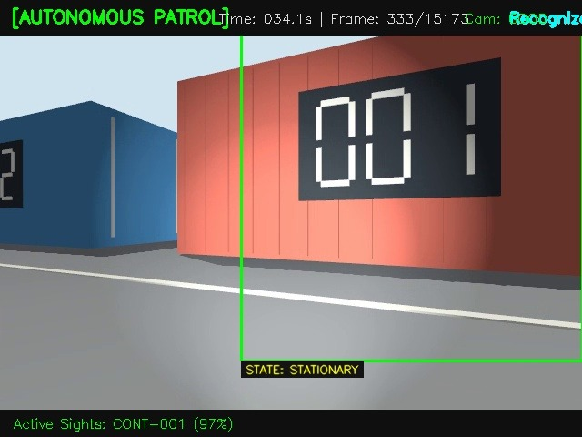
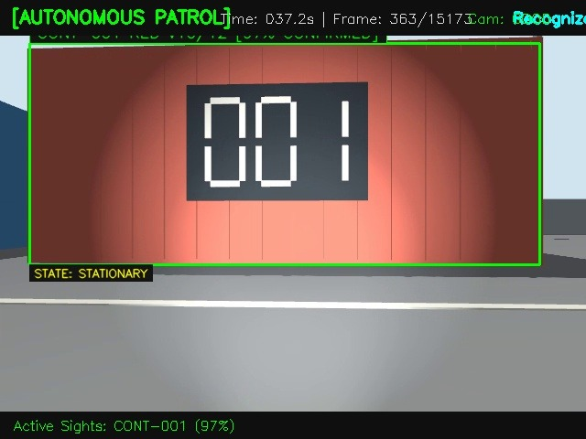
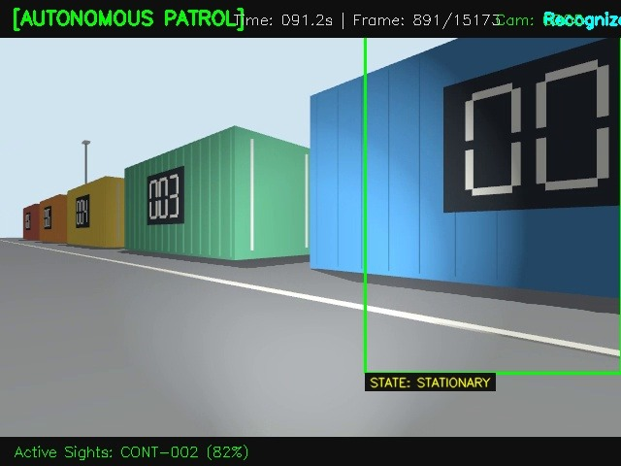
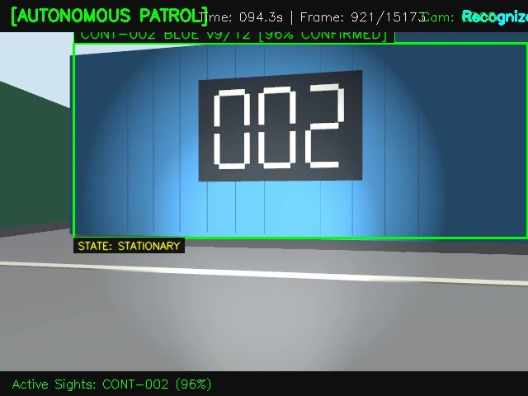
VISUAL EVIDENCE — KEYFRAMES
Visual Detection Evidence: High-Certainty Re-ID & Multi-Angle Tracking
CONT-001 (Angled)
CONT-001 (Direct Lock)
CONT-002 (Row Depth)
CONT-002 (Direct Lock)
97% CONFIRMED
Frame 333 (034.1s)
• Initial angled approach detection.
• Active Sights locked at 97% confidence.
• State correctly recognized as STATIONARY.
97% CONFIRMED
Frame 363 (037.2s)
• Head-on confirmed hit (v10/12 votes).
• Demonstrates headlight glare tolerance.
• Solid Green Bounding Box lock.
82% TRACKING
Frame 891 (091.2s)
• Long-range perspective corridor view.
• Locks CONT-002 in foreground while seeing CONT-003/004 lined up behind.
• Zero occlusion cross-talk.
96% CONFIRMED
Frame 921 (094.3s)
• Full container face match (v9/12 votes).
• Blue color family constrained search.
• Strict IoU suppression eliminates false border proposals.

Slide 9
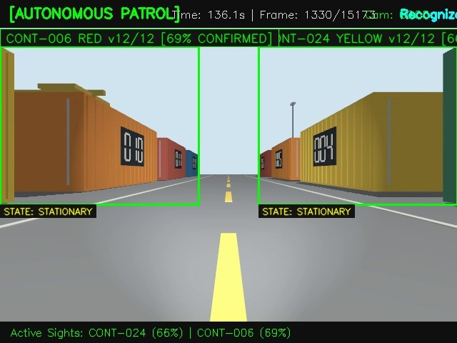
VISUAL EVIDENCE — DUAL TRACKING
Visual Detection Evidence: Dual-Corridor Simultaneous Multi-Asset Tracking
SIMULTANEOUS DUAL RECOGNITION (FRAME 1330)
MULTI-OBJECT RE-ID ENGINEERING ANALYSIS
★ Simultaneous Multi-Asset Lock
At Frame 1330 (136.1s), the UGV navigates the central roadway. The pipeline detects and locks two distinct containers simultaneously:
• Left: CONT-006 (RED) at 69% CONFIRMED (12/12 consensus votes)
• Right: CONT-024 (YELLOW) at 66% CONFIRMED (12/12 consensus votes)
★ Color-Constrained Segregation
The left candidate is classified as RED and matched only against RED references. The right candidate is classified as YELLOW and matched only against YELLOW references. Zero identity cross-talk across the roadway.
★ Spatial Consensus Independence
The SpatialVoter maintains independent temporal tracking tubes. Even though both containers appear concurrently in the field of view, each maintains its own 12-frame consensus buffer.
★ Extreme Perspective Tolerance
Notice both containers are at steep oblique angles relative to the camera axis. Our multi-view OSNet gallery matches side and 3/4 profiles with high stability.

Slide 10
PHASE 3 ROADMAP
Looking Ahead to Phase 3: Spatial Map Tracking & Displacement Alerts
1. GROUND RAY-CASTING
2. GLOBAL MAP PROJECTION
3. ASSET_MOVED ALERT ENGINE
• Camera Geometry: Uses pinhole camera intrinsic matrix (fx, fy, cx, cy) and extrinsic pitch angle.
• Bounding Box Ground Point: Casts a 3D ray through the bottom-center pixel (x_c, y2) of the container bounding box.
• Ground Plane Intersection: Intersects ray with the floor plane (Z = 0) to compute metric container position relative to robot: [X_rob, Y_rob].
• Robot Pose Synchronization: Queries robot position & orientation (x_r, y_r, yaw) from synchronized odometry/TF bag topics.
• 2D Rigid Transform: Converts local container coordinates into global site map coordinates:
X_map = x_r + X_rob*cos(yaw) - Y_rob*sin(yaw)
Y_map = y_r + X_rob*sin(yaw) + Y_rob*cos(yaw)
• Spatial Footprint: Plots container location on the 2D occupancy grid map.
• Baseline Position Register: Recorded during Phase 1 walkthrough (X_0, Y_0).
• Real-Time Euclidean Delta: During Phase 3 patrol, monitors:
Δd = sqrt((X_t - X_0)^2 + (Y_t - Y_0)^2)
• Automated Alert Generation:
- If Δd > 1.5m: Triggers ASSET_MOVED alert
- Saves side-by-side evidence image
- Generates JSON security audit dispatch.

Slide 11
CONCLUSION & DEMO FLOW
Deliverables Summary & Live Demonstration Agenda
DELIVERABLES COMPLETED
MEETING DEMONSTRATION FLOW
✓ Phase 1 HITL Enrollment Tool (v2)
scripts/hitl_enrollment.py — Full single-window UI with Quick-Assign buttons, inline text input, and auto Kaggle/Colab training zip export.
✓ Calibrated Reference Store
data/reference_db/*.npz — 139 multi-view embeddings for 24 containers (CONT-001 to CONT-024).
✓ Hardened Autonomous Patrol Runner
scripts/run_patrol.py — 4-layer anti-false-alarm pipeline, 100% recall (24/24), 84.3% confirmed detections.
✓ Full Verification Artifacts
Verified output video (15,173 frames) + 922 labeled keyframe snapshots in evidence/patrol_runs/.
✓ 100% Unit Test Pass Rate
119 / 119 unit tests passing across all perception modules.
Step 1: Introduction (2 min)
Present the industrial challenge & the two-phase approach on Slide 2.
Step 2: Live Phase 1 Demo (5 min)
Launch hitl_enrollment.py on Phase 1 video. Show the clean Black/White/Yellow UI, auto-proposals, pause, click Quick-Assign button, and show auto-exported training zip.
Step 3: Live Phase 2 Demo (6 min)
Play verified patrol video patrol_verified_20261106_124607.mp4. Point out real-time CONFIRMED badges, 24/24 container recall, and motion-blur rejection.
Step 4: Visual Detections Walkthrough (3 min)
Walk through Slides 8 & 9 showing your verified keyframes (CONT-001, CONT-002, and dual CONT-006/024).
Step 5: Phase 3 Roadmap & Q&A (4 min)
Explain map projection & displacement alert engine. Take client questions.

