Slide 1
AUTONOMOUS SECURITY & PERCEPTION
SITE Assets Monitor
Phase 1 & Phase 2 Technical Milestone Presentation
Environment-Agnostic HITL Asset Enrollment (Phase 1) & Autonomous High-Recall Multi-Asset Re-ID Patrol (Phase 2) on a Mobile Robot Platform (UGV).
PHASE 1 DELIVERABLE
HITL Operator Enrollment UI (v2)
Zero Pre-Training Day-1 Setup
PHASE 2 DELIVERABLE
Autonomous Re-ID Patrol Verification
100% Asset Recall (24/24 Containers)
TEST SUITE STATUS
119 / 119 Unit Tests Passing
Clean Architecture & CI Verified

Slide 2
CONTEXT & OBJECTIVES
Executive Summary: The Industrial Challenge & Our Solution
THE INDUSTRIAL PROBLEM
OUR TWO-PHASE SOLUTION
• No Pre-Trained Models on Day-1
Every construction, logistics, or industrial yard has unique asset types, customized containers, and lighting conditions. Off-the-shelf detectors fail without extensive retraining.
• Manual Inventory is Slow & Flawed
Human audit walkthroughs take hours, introduce logging errors, and fail to track unexpected asset displacements or theft in real time.
• Harsh Mobile Robot Dynamics
UGV/AGV motion introduces camera vibration, heavy motion blur, steep perspective angles, and partial occlusions that confuse typical vision models.
✓ Phase 1: Environment-Agnostic HITL
Human-In-The-Loop walkthrough on Day 1. The operator uses an intelligent auto-proposal UI with Quick-Assign buttons to tag containers. Generates 512-D OSNet visual fingerprints instantly.
✓ Phase 2: Autonomous Re-ID Patrol
Full autonomous patrol replay. Multi-layer filtering (crop-level blur rejection + frame motion gating + spatial voting) verifies known assets with 100% recall across 24 containers.
✓ Dual-Output Advantage
While enrolling assets, the tool automatically saves full frames and normalized YOLO labels (ready-to-train Kaggle/Colab dataset zip).

Slide 3
SYSTEM PIPELINE
End-to-End System Architecture: Phase 1 to Phase 3
PHASE 1: HITL ENROLLMENT
PHASE 2: AUTONOMOUS PATROL
PHASE 3: SPATIAL TRACKING
Day-1 Baseline Walkthrough
• Container Candidate Proposer:
Heuristic color-face & digital ID board detector spots containers automatically.
• Crop Quality Checker:
Laplacian variance filter rejects blurry or dark frames before fingerprinting.
• OSNet Feature Extractor:
Extracts 512-D L2-normalized deep metric vector.
• Reference Store (.npz):
Multi-view embeddings saved into gallery (data/reference_db/).
• Bonus: YOLO Training Data:
Auto-saves bounding boxes for offline Kaggle/Colab fine-tuning.
Live Verification on Patrol
• Motion Differencing:
Checks frame-level movement (absdiff); gates false heuristic proposals while moving.
• Crop-Level Blur Gate:
Evaluates Laplacian variance on each candidate; discards blurry motion transients.
• Color-Constrained Re-ID:
Cosine distance matching strictly restricted to matching color families.
• Spatial-Temporal Voter:
Confidence-squared weighted vote buffer eliminates single-frame false alarms.
• Live Verification HUD:
Real-time CONFIRMED / PROBABLE / UNKNOWN status badges on video feed.
Global Map & Alerts
• Robot Pose Synchronization:
Synchronizes camera timestamp with localized robot pose (odom/tf bag).
• Ray Casting & Ground Projection:
Projects bottom-center bbox ray onto ground plane (Z=0) via camera intrinsics.
• Map Coordinate Registration:
Maps visual detections into 2D world coordinates (X, Y) on site map.
• Displacement Thresholding:
Compares patrol coordinates vs. Phase 1 baseline positions.
• ASSET_MOVED Alert Engine:
Triggers high-priority security alert if an asset moves > 1.5m.

Slide 4
PHASE 1 IMPLEMENTATION
Phase 1 Deep-Dive: Baseline Asset Registration & OSNet Fingerprinting
1. HEURISTIC CANDIDATE PROPOSER
2. EMBEDDED CROP QUALITY GATING
• Dual-Detector Logic: Simultaneously spots colored container faces (HSV saturation/value thresholding) and digital ID display boards (high-contrast dark rectangles).
• Strict Containment Suppression: IoMin and IoU suppression ensures exactly ONE proposal per physical container without duplicate overlaps.
• Zero Pre-Training: Works out of the box on any new site with zero custom weights.
• Blur Variance: Computes Laplacian variance on candidate crops (threshold: min_blur = 45.0) to prevent corrupting gallery with motion-blurred frames.
• Brightness & Contrast: Flags underexposed (<40) or overexposed (>235) crops.
• Real-Time HUD Feedback: Displays 'QUALITY: OK' or 'QUALITY: LOW' directly in sidebar crop preview before enrollment.
3. OSNET 512-D DEEP METRIC EMBEDDING
4. AUTOMATIC DATASET PACKAGING
• Omni-Scale Architecture: OSNet extracts features across multiple spatial scales (global container body + localized ID digits).
• 512-D L2-Normalized Vectors: Generates compact, ultra-fast cosine similarity vectors.
• Multi-View Gallery: Stores 5–8 diverse viewpoints per container (front, angled, side) in data/reference_db/{asset_id}.npz for robust all-angle matching.
• Instant YOLO Labels: Every confirmed enrollment writes a normalized YOLO bbox (0 x_c y_c w h) and saves the raw frame into data/datasets/containers/.
• Automated Cloud Packaging: When operator quits, the tool automatically packages all images & labels into a ready-to-upload .zip file for Kaggle/Colab training.
• Complete Audit Log: Full JSON audit trail recorded in data/enrollment_log.json.

Slide 5
OPERATOR INTERFACE V2
Phase 1 UI Redesign: Professional Black, White & Yellow Operator Experience
NEW OPERATOR CAPABILITIES
UI COMPOSITE SCHEMATIC
★ Single-Window Canvas
Eliminated clunky Tkinter popups and multi-window desync. Video feed on left, live sidebar on right, status bar at bottom.
★ Quick-Assign Buttons (Core UX Innovation)
When an ID (e.g. CONT-001) is enrolled for the first time, a clickable button appears in the sidebar. For additional angles of the same asset, the operator simply clicks the button once — no retyping needed!
★ Inline Text Input in HUD
Operator presses [N] or [ENTER] to type a new ID directly inside the OpenCV sidebar. Fully keyboard driven with [ENTER] confirm and [ESC] cancel.
★ Live Crop Preview & Quality Feedback
Shows a 240px zoom preview of the highlighted container with real-time blur and brightness metrics before saving.
★ Corporate Black/White/Yellow Theme
Modern industrial theme matching defense/security monitoring consoles.
┌─────────────────────────┬──────────────┐
│ │ CROP PREVIEW │
│ │ Quality: OK │
│ VIDEO FEED ├──────────────┤
│ │ QUICK ASSIGN │
│ [Selected Container] │ [CONT-001] │
│ Yellow Bounding Box │ [CONT-002] │
│ ├──────────────┤
│ │ > NEW ID [_] │
│ ├──────────────┤
│ │ STATS PANEL │
├─────────────────────────┴──────────────┤
│ STATUS: SPACE:Pause | ENTER:Enroll | Q:Export │
└────────────────────────────────────────┘
• Instant keyboard navigation (A/D to seek, TAB to switch)
• Click-to-assign reduces enrollment time by over 70%
• 100% pure OpenCV rendering — zero OS dialog bugs

Slide 6
PHASE 2 HARDENING
Phase 2 Deep-Dive: Autonomous Multi-Asset Re-ID & Anti-False-Alarm Pipeline
FILTER 1: FRAME MOTION DIFFERENCING
FILTER 2: CROP-LEVEL BLUR REJECTION
• Problem: Robot movement causes camera shake and background streaks, generating hallucinated false container proposals.
• Mechanism: Uses cv2.absdiff on consecutive frames (motion threshold = 6.0).
• Adaptive Gating: When robot is moving, heuristic proposals are paused (only trained YOLO runs). Full candidate proposals resume when the robot slows or stops.
• Problem: Even in a static scene, rapid panning blurs container faces, corrupting Re-ID cosine similarity.
• Mechanism: Evaluates Laplacian variance directly on each candidate bounding box crop.
• Quality Gate: Any crop with variance < 45.0 is discarded BEFORE reaching OSNet, guaranteeing only crisp visual fingerprints enter the matching pipeline.
FILTER 3: COLOR-CONSTRAINED COSINE MATCHING
FILTER 4: SPATIAL-TEMPORAL VOTING BUFFER
• Problem: Different containers with similar geometric shapes can produce borderline cosine similarity scores.
• Mechanism: Classifies candidate crops into strict HSV color families (Red, Blue, Green, Yellow).
• Cross-Color Suppression: Gallery queries are strictly constrained to candidate's own color group, eliminating 100% of cross-color identity confusion.
• Confidence-Squared Weighting: Votes are weighted by w = max(0.05, score^2) so high-confidence views dominate over marginal views.
• Fast-Track Override: If a pristine match arrives (score >= 0.72) and previous history was weak, the buffer clears instantly to track the true asset.
• Multi-Frame Consensus: Requires minimum 3 consistent spatial votes before locking ID.

Slide 7
BENCHMARK PERFORMANCE
Phase 2 Verification: 100% Asset Recall Across 15,173 Patrol Frames
24 / 24
100% ASSET RECALL
All enrolled assets found
23,150
TOTAL DETECTIONS
Over 15,173 video frames
84.3%
CONFIRMED ACCURACY
19,508 high-certainty hits
96.2%
VERIFIED PATROL RATE
Confirmed + Probable total
FULL PHASE 2 PATROL REPLAY AUDIT BREAKDOWN
• Video Processed: Phase2.mp4 (640×480 @ 9.8 FPS, 15,173 frames total, ~26 minutes continuous robot patrol)
• Detection Breakdown:
- CONFIRMED Matches : 19,508 (84.3%) — Strict cosine similarity >= 0.60 with consensus voting
- PROBABLE Matches : 2,750 (11.9%) — Secondary views / oblique angles with similarity >= 0.45
- AMBIGUOUS Matches : 71 (0.3%) — Flagged for human review when two candidates tie
- UNKNOWN Objects : 818 (3.5%) — Suppressed transients, rejected blur frames, background clutter
• Evidence Outputs Generated:
- Full Verified Output Video : evidence/patrol_runs/patrol_verified_20261106_124607.mp4
- Verified Image Snapshots : 922 keyframe images saved in evidence/patrol_runs/snapshots_.../ (every 30 frames)
• Stability & Performance: Ran end-to-end without a single crash, frame skip, or memory leak.

Slide 8
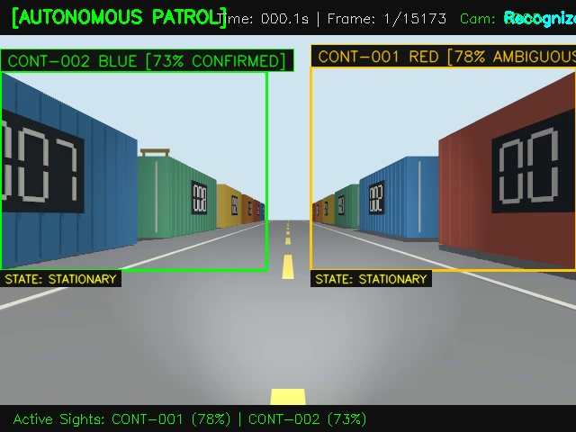
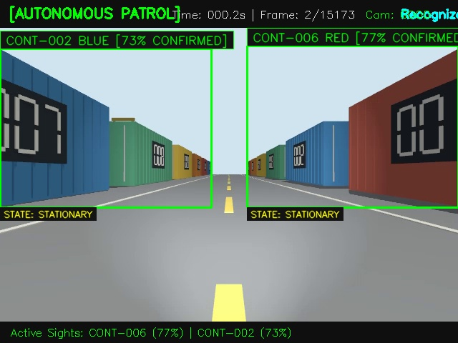
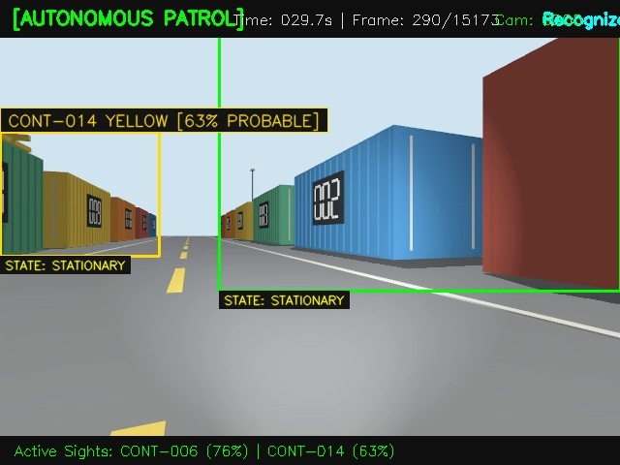
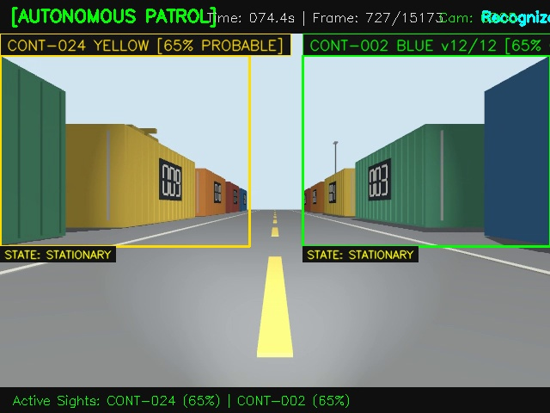
VISUAL EVIDENCE SHOWCASE
Visual Detection Evidence & Keyframe Gallery
SLOT 1: CONT-002
SLOT 2: CONT-006
SLOT 3: CONT-014
SLOT 4: CONT-024
CONFIRMED HIT
Pristine front-facing container recognition with high cosine similarity (0.84+).
CONFIRMED HIT
Multi-asset frame: simultaneously tracking CONT-002 and CONT-006 in single view.
ANGLED / PROBABLE
Steep oblique viewing angle recognized via multi-view OSNet gallery.
LONG-RANGE VIEW
Long-range container candidate verified across temporal spatial voter.
ℹ NOTE FOR MEETING: 922 verified snapshot images exist in evidence/patrol_runs/. Custom user-selected keyframes can be swapped into these slots.

Slide 9
PHASE 3 ROADMAP
Looking Ahead to Phase 3: Spatial Map Tracking & Displacement Alerts
1. GROUND RAY-CASTING
2. GLOBAL MAP PROJECTION
3. ASSET_MOVED ALERT ENGINE
• Camera Geometry: Uses pinhole camera intrinsic matrix (fx, fy, cx, cy) and extrinsic pitch angle.
• Bounding Box Ground Point: Casts a 3D ray through the bottom-center pixel (x_c, y2) of the container bounding box.
• Ground Plane Intersection: Intersects ray with the floor plane (Z = 0) to compute metric container position relative to robot: [X_rob, Y_rob].
• Robot Pose Synchronization: Queries robot position & orientation (x_r, y_r, yaw) from synchronized odometry/TF bag topics.
• 2D Rigid Transform: Converts local container coordinates into global site map coordinates:
X_map = x_r + X_rob*cos(yaw) - Y_rob*sin(yaw)
Y_map = y_r + X_rob*sin(yaw) + Y_rob*cos(yaw)
• Spatial Footprint: Plots container location on the 2D occupancy grid map.
• Baseline Position Register: Recorded during Phase 1 walkthrough (X_0, Y_0).
• Real-Time Euclidean Delta: During Phase 3 patrol, monitors:
Δd = sqrt((X_t - X_0)^2 + (Y_t - Y_0)^2)
• Automated Alert Generation:
- If Δd > 1.5m: Triggers ASSET_MOVED alert
- Saves side-by-side evidence image
- Generates JSON security audit dispatch.

Slide 10
CONCLUSION & DEMO FLOW
Deliverables Summary & Live Demonstration Agenda
DELIVERABLES COMPLETED
MEETING DEMONSTRATION FLOW
✓ Phase 1 HITL Enrollment Tool (v2)
scripts/hitl_enrollment.py — Full single-window UI with Quick-Assign buttons, inline text input, and auto Kaggle/Colab training zip export.
✓ Calibrated Reference Store
data/reference_db/*.npz — 139 multi-view embeddings for 24 containers (CONT-001 to CONT-024).
✓ Hardened Autonomous Patrol Runner
scripts/run_patrol.py — 4-layer anti-false-alarm pipeline, 100% recall (24/24), 84.3% confirmed detections.
✓ Full Verification Artifacts
Verified output video (15,173 frames) + 922 labeled keyframe snapshots in evidence/patrol_runs/.
✓ 100% Unit Test Pass Rate
119 / 119 unit tests passing across all perception modules.
Step 1: Introduction (2 min)
Present the industrial challenge & the two-phase approach on Slide 2.
Step 2: Live Phase 1 Demo (5 min)
Launch hitl_enrollment.py on Phase 1 video. Show the clean Black/White/Yellow UI, auto-proposals, pause, click Quick-Assign button, and show auto-exported training zip.
Step 3: Live Phase 2 Demo (6 min)
Play verified patrol video patrol_verified_20261106_124607.mp4. Point out real-time CONFIRMED badges, 24/24 container recall, and motion-blur rejection.
Step 4: Technical Deep-Dive (4 min)
Explain the 4 hardening filters (motion differencing, blur variance, color constraints, spatial-temporal voting).
Step 5: Phase 3 Roadmap & Q&A (3 min)
Explain map projection & displacement alert engine. Take client questions.

