Slide 1



Predict the fare amount of future rides using regression analysis
Group members:- Dhruva Rakesh B
Sumedh Bansod
PG-DBDA IACSD

Slide 2
Contents
Description
Acknowledgement
Objective
Strategic Plan of Action
Project Outcomes & Conclusions
PG-DBDA IACSD

Slide 3
Description
The project is about on world's largest taxi company Uber inc. In this project, we're looking to predict the fare for their future transactional cases. Uber delivers service to lakhs of customers daily. Now it becomes really important to manage their data properly to come up with new business ideas to get best results. Eventually, it becomes really important to estimate the fare prices accurately.
The dataset contains the following fields:
key - a unique identifier for each trip
fare_amount - the cost of each trip in USD
pickup_datetime - date and time when the meter was engaged
passenger_count - the number of passengers in the vehicle (driver entered value)
pickup_longitude - the longitude where the meter was engaged
pickup_latitude - the latitude where the meter was engaged
dropoff_longitude - the longitude where the meter was disengaged
dropoff_latitude - the latitude where the meter was disengaged
PG-DBDA IACSD

Slide 4
Acknowledgement
The dataset is referred from Uber having 2,00,000 rows
Objective
Understand the Dataset & cleanup (if required).
Build Regression models to predict the fare price of Uber ride.
Also evaluate the models & compare their respective scores like R2, RMSE, etc.
PG-DBDA IACSD

Slide 5
Strategic Plan of Action
We aim to solve the problem statement by creating a plan of action, Here are some of the necessary steps:
Data Exploration
Exploratory Data Analysis (EDA)
Data Pre-processing
Data Manipulation
Feature Selection/Extraction
Predictive Modelling
Stractegic Plan of Action:
PG-DBDA IACSD

Slide 6
Data Exploration
Importing the basic librarires
pandas
numpy
matplotlib
seaborn
geopy
scikit-learn
Importing the dataset
Check for empty elements
Checking the data type all columns
Checking number of unique rows in each feature
Checking Stats of all columns
PG-DBDA IACSD

Slide 7
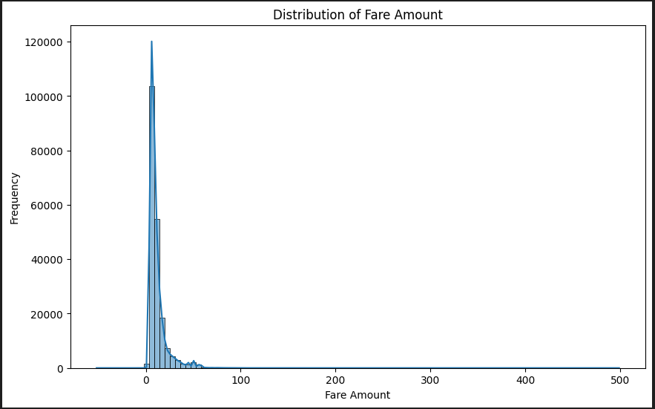
Exploratory Data Analysis (EDA)
Analyzing the distribution of the target variable using histogram
PG-DBDA IACSD

Slide 8
Extracting feature from existing columns
From column pickup_datetime
Hour
Day
Month
Year
Dayofweek
From column pickup_longitude, pickup_latitude, dropoff_longitude, dropoff_latitude
Distance_km
PG-DBDA IACSD

Slide 9
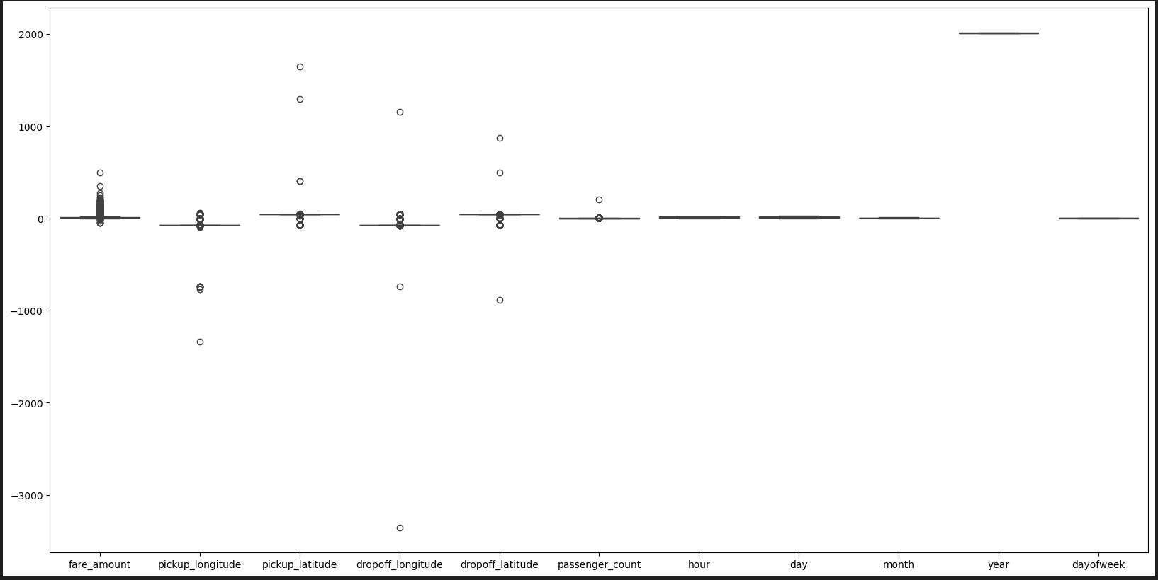
Handling outliers by IQR method and imputing them
PG-DBDA IACSD

Slide 10
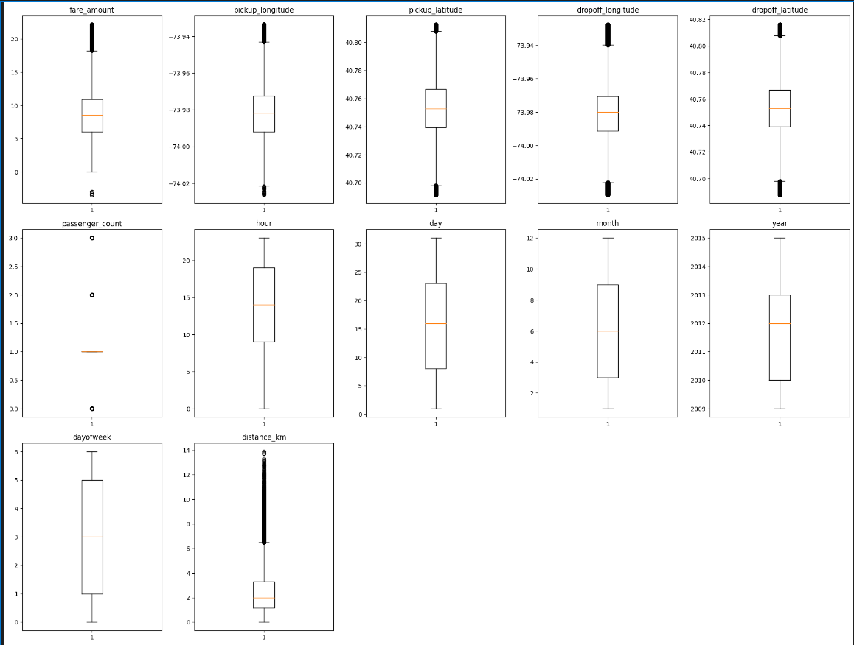
Boxplot visualization of all the columns
PG-DBDA IACSD

Slide 11
Data Pre-processing
Removal of any Duplicate rows (if any)
Find and imputation of outliers
Check for null values and removing them (if any)
Check for shape of new dataset
PG-DBDA IACSD

Slide 12
Data Manipulation
Data Standardization
fare_amount | pickup_longitude | pickup_latitude | dropoff_longitude | dropoff_latitude | passenger_count | hour | day | month | year | dayofweek | distance_km
count | 1.999940e+05 | 1.999940e+05 | 1.999940e+05 | 1.999940e+05 | 1.999940e+05 | 1.999940e+05 | 1.999940e+05 | 1.999940e+05 | 1.999940e+05 | 1.999940e+05 | 1.999940e+05 | 1.999940e+05
mean | -1.662720e-16 | -3.507839e-13 | -3.557581e-14 | 5.503967e-13 | 6.915089e-14 | 9.955002e-17 | -4.618666e-18 | -4.902892e-17 | 5.950974e-18 | 1.065509e-14 | -2.526055e-17 | -1.114164e-16
std | 1.000003e+00 | 1.000003e+00 | 1.000003e+00 | 1.000003e+00 | 1.000003e+00 | 1.000003e+00 | 1.000003e+00 | 1.000003e+00 | 1.000003e+00 | 1.000003e+00 | 1.000003e+00 | 1.000003e+00
min | -2.246531e+00 | -2.837650e+00 | -2.926672e+00 | -2.919839e+00 | -2.888328e+00 | -2.353120e+00 | -2.070669e+00 | -1.692663e+00 | -1.535898e+00 | -1.477294e+00 | -1.565732e+00 | -1.370892e+00
25% | -7.324725e-01 | -6.516136e-01 | -6.500822e-01 | -6.555717e-01 | -6.035633e-01 | -4.437430e-01 | -6.893416e-01 | -8.868988e-01 | -9.543233e-01 | -9.386011e-01 | -1.052109e+00 | -7.220174e-01
50% | -1.016149e-01 | -3.530719e-03 | -1.135324e-02 | 5.115368e-03 | 1.448833e-02 | -4.437430e-01 | 7.806271e-02 | 3.397433e-02 | -8.196091e-02 | 1.387850e-01 | -2.486519e-02 | -2.631766e-01
75% | 5.040084e-01 | 5.938429e-01 | 6.566445e-01 | 5.585131e-01 | 6.156822e-01 | -4.437430e-01 | 8.454670e-01 | 8.397383e-01 | 7.904015e-01 | 6.774780e-01 | 1.002379e+00 | 4.759883e-01
max | 3.355485e+00 | 3.066076e+00 | 2.845428e+00 | 3.106174e+00 | 2.816890e+00 | 3.375011e+00 | 1.459390e+00 | 1.760611e+00 | 1.662764e+00 | 1.754864e+00 | 1.516001e+00 | 6.430729e+00
Splitting the data into traning and testing sets
PG-DBDA IACSD

Slide 13
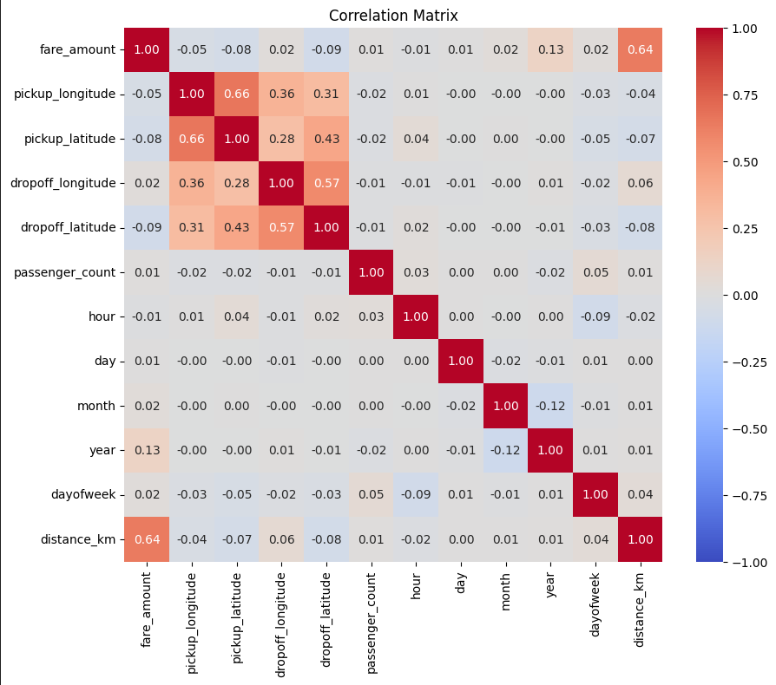
Feature Selection/Extraction
Correlation Analysis
PG-DBDA IACSD

Slide 14
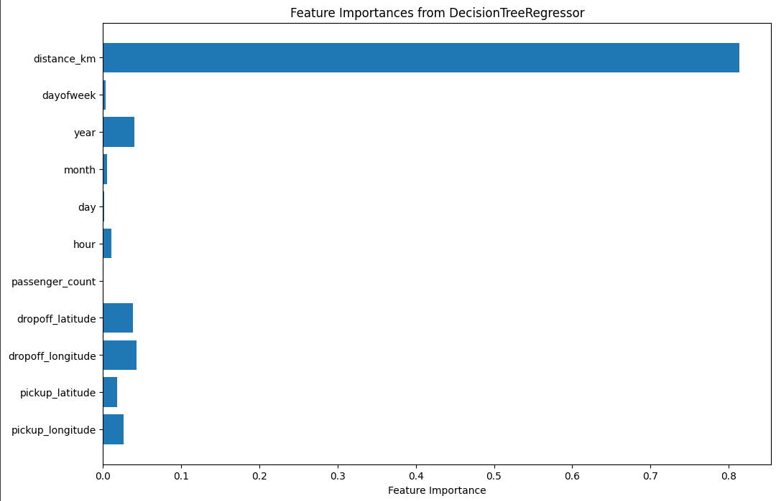
Feature Selection/Extraction using rfe and DecisionTreeRegressor
PG-DBDA IACSD

Slide 15
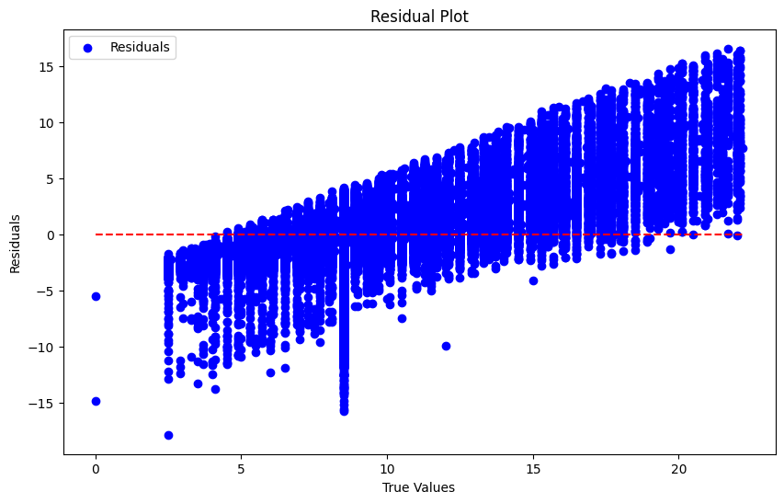
Predictive Modelling
Linear Regression Algorithm
Mean Squared Error: 8.864337475947181
Mean Absolute Error: 2.110808383916388
R-squared: 0.436491398786778
Coefficient: -0.07769621707518337
Intercept: -315.7246250314859
PG-DBDA IACSD

Slide 16
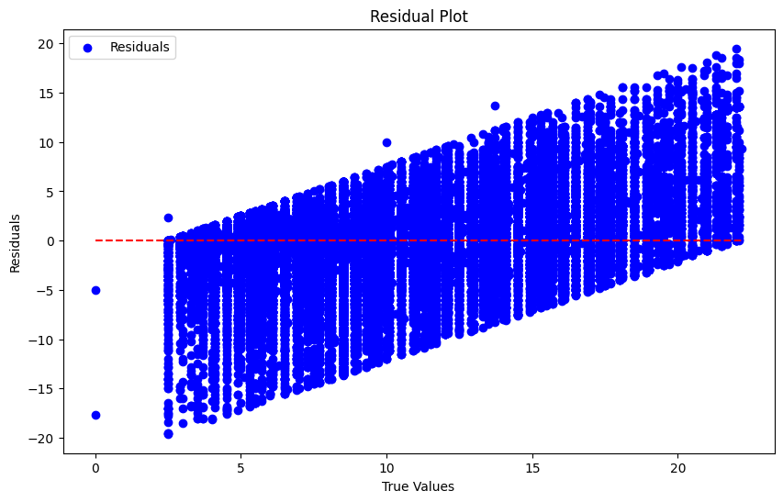
Decision Tree Algorithm
Mean Squared Error: 12.570475008657551
Mean Absolute Error: 2.2849781940810123
R-squared: 0.2008911204097089
PG-DBDA IACSD

Slide 17
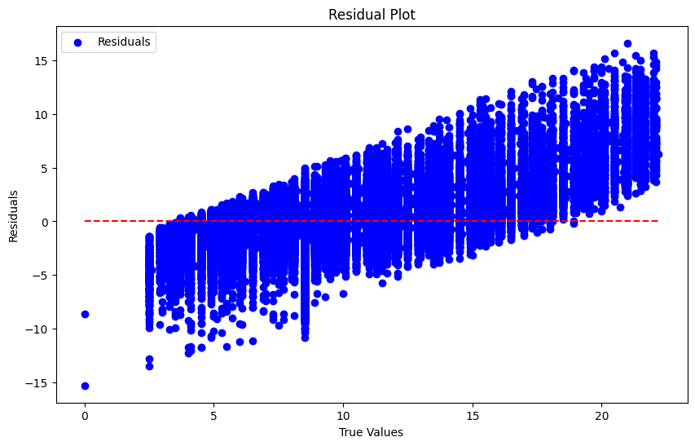
Random Forest Algorithm
Mean Squared Error: 6.036710342063817
Mean Absolute Error: 1.6492517917560534
R-squared: 0.6162445067083498
PG-DBDA IACSD

Slide 18
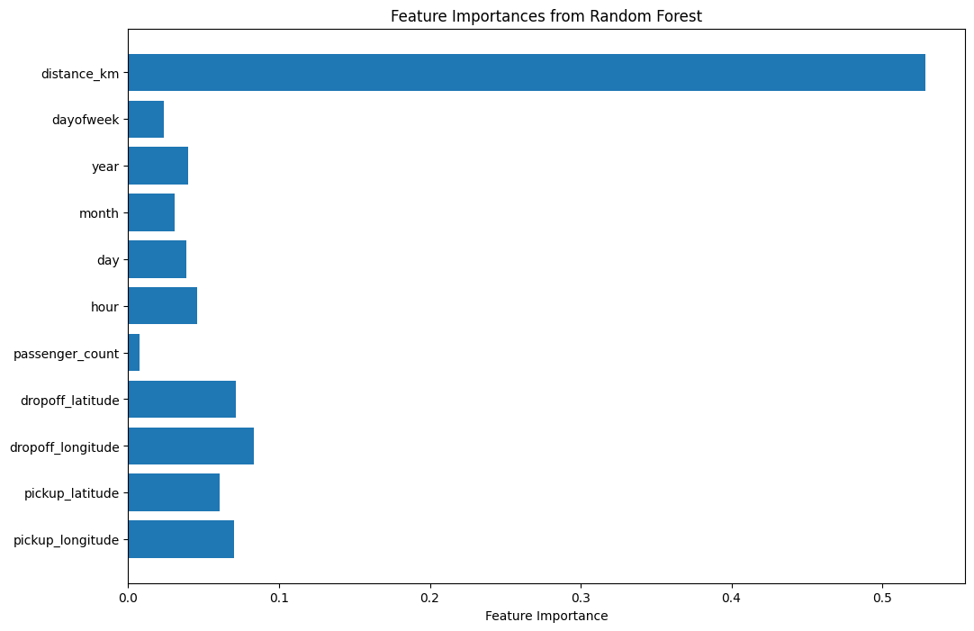
PG-DBDA IACSD

Slide 19
PG-DBDA IACSD

Slide 20
Conclusions
Here are some of the key outcomes of the project:
The Dataset was large enough totaling 2,00,000 rows samples
Visualizing the distribution of data & their relationships, helped us to get some insights on the feature-set.
The features had high multicollinearity, hence in Feature Extraction step, we shortlisted the appropriate features using Decision tree
Testing multiple algorithms with default as well as fine tuned hyperparamters gave us some understanding for various models performance on this specific dataset.
While, Random Forest Regression Algorithm with n_estimators=100 was the best choice.
PG-DBDA IACSD

