Slide 1

Iterative Quantization: A Procrustean Approach to Learning Binary Codes
Yunchao Gong and Svetlana Lazebnik (CVPR 2011)
Presented by Relja Arandjelović
University of Oxford
21st September 2011

Slide 2
Objective
Construct similarity-preserving binary codes for high-dimensional data
Requirements:
Similar data mapped to similar binary strings (small Hamming distance)
Short codes – small memory footprint
Efficient learning algorithm

Slide 3
Related work
Start with PCA for dimensionality reduction and then encode
Problem: Higher-variance directions carry more information, using the same number of bits for each direction yields poor performance
Spectral Hashing (SH): Assign more bits to more relevant directions
Semi-supervised hashing (SSH): Relax orthogonality constraints of PCA
Jégou et al.: Apply a random orthogonal transformation to the PCA-projected data (already does better than SH and SSH)
This work: Apply an orthogonal transformation which directly minimizes the quantization error

Slide 4
Notation
n data points,
d dimensionality
c binary code length
Data points form data matrix
Assume data is zero-centred
Binary code matrix:
For each bit k binary encoding defined by
Encoding process:

Slide 5


Approach (unsupervised code learning)
Apply PCA for dimensionality reduction, find to maximize:
Keep top c eigenvectors of the data covariance matrix to obtain , projected data is
Note that if is an optimal solution then is also optimal for any orthogonal matrix
Key idea: Find to minimize the quantization loss:
nc and V are fixed so this is equivalent to maximizing ( ) :

Slide 6
Optimization: Iterative quantization (ITQ)
Start with R being a random orthogonal matrix
Minimize the quantization loss by alternating steps:
Fix R and update B:
Achieved by
Fix B and update R:
Classic Orthogonal Procrustes problem, for fixed B solution:
Compute SVD of as and set

Slide 7
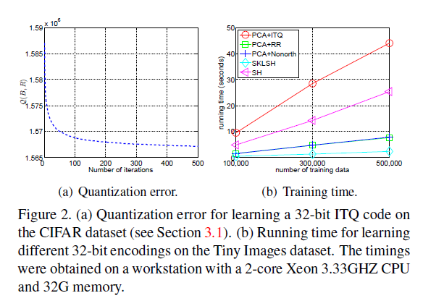
Optimization (cont’d)

Slide 8
Supervised codebook learning
ITQ can be used with any orthogonal basis projection method
Straight forward to apply to Canonical Correlation Analysis (CCA): obtain W from CCA, everything else is the same

Slide 9
Evaluation procedure
CIFAR dataset:
64,800 images
11 classes: airplane, automobile, bird, boat, cat, deer, dog, frog, horse, ship, truck
manually supplied ground truth (i.e. “clean”)
Tiny Images:
580,000 images, includes the CIFAR dataset
Ground truth is “noisy” – images associated with 388 internet search keywords
Image representation:
All images are 32x32
Descriptor: 320-dimensional grayscale GIST
Evaluate code sizes up to 256 bits

Slide 10
Evaluation: unsupervised code learning
Baselines:
LSH: W is a Gaussian random matrix
PCA-Direct: W is the matrix of top c PCA directions
PCA-RR: R is a random orthogonal matrix (i.e. starting point for ITQ)
SH: Spectral hashing
SKLSH: Random feature mapping for approximating shift-invariant kernels
PCA-Nonorth: Non-orthogonal relaxation of PCA
Note: LSH and SKLSH are data-independent, all others use PCA

Slide 11
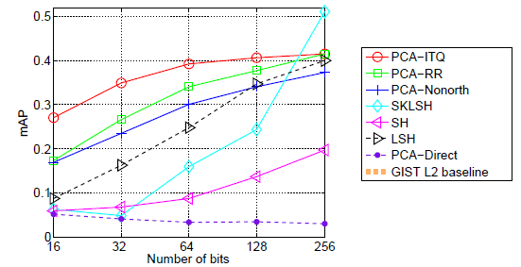
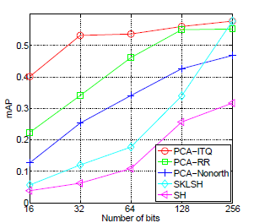
Results: unsupervised code learning
Nearest neighbour search using Euclidean neighbours as ground truth
Largest gain for small codes, random projection and data-independent methods work well for larger codes
CIFAR
Tiny Image

Slide 12
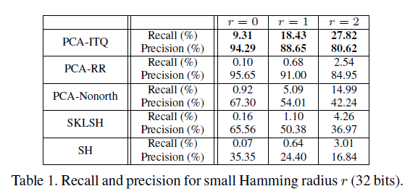
Results: unsupervised code learning
Nearest neighbour search using Euclidean neighbours as ground truth

Slide 13
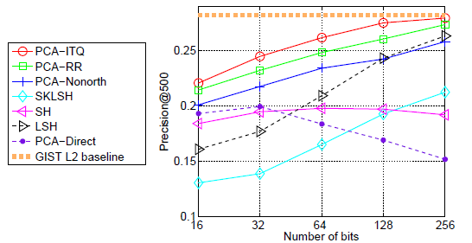
Results: unsupervised code learning
Retrieval performance using class labels as ground truth
CIFAR

Slide 14
Evaluation: supervised code learning
“Clean” scenario: train on clean CIFAR labels
“Noisy” scenario: train on Tiny Images (disjoint from CIFAR)
Baselines:
Unsupervised PCA-ITQ
Uncompressed CCA
SSH-ITQ:
Perform SSH: modulate the data covariance matrix with a n x n matrix S where S_{ij} is 1 if x_{i} and x_{j} have equal labels and 0 otherwise
Obtain W from the eigendecomposition of
Perform ITQ on top

Slide 15
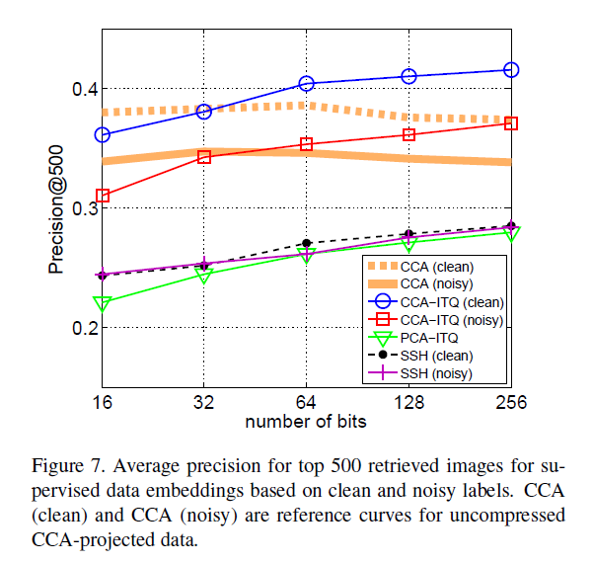
Results: supervised code learning
Interestingly after 32 bits CCA-ITQ outperforms uncompressed CCA

Slide 16
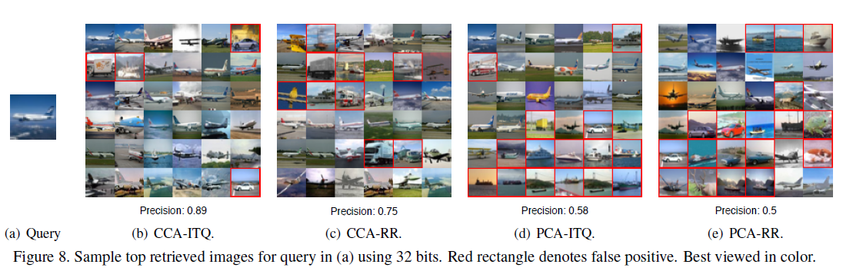
Qualitative Results

