Slide 1
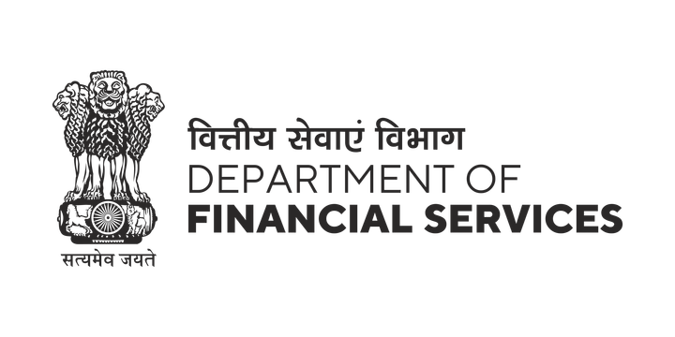
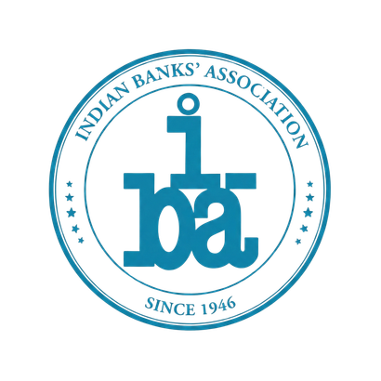


RBI · iDEA 2.0 · PROBLEM STATEMENT: INTERNAL & PRIVILEGED-USER FRAUD
HAWK-EYE
An AI Early-Warning System for Internal & Privileged-User Fraud
Protecting the bank's money, its licence, and its trust — every privileged action watched, scored, and explained; a person always decides.
SAVES MONEY
RBI-COMPLIANT
BUILT ON-PREM · SOVEREIGN
EXPLAINABLE & FAIR
Team NINEAGENTS — Dhruv Agrawal · Tanishq Vyas · Hanzala Saify · Aditya Dubey SVKM's NMIMS
github.com/dhruvagrawal27/hawk-eye

Slide 2
THE EXPOSURE ON YOUR BOOKS
The fastest-growing loss is the one nobody is watching
Bank fraud has exploded — and public-sector banks carry most of it.
₹25,667 cr
+194%
~12 months
of FY25 bank fraud was borne by public-sector banks
jump in fraud value in a single year (₹12,230 cr → ₹36,014 cr)
that insider fraud runs, on average, before anyone notices
₹33,148 cr — over 92% of it — came from loans & advances: the instruments only privileged staff can originate or modify.
Caught by luck, not by systems
This is Union Bank's largest blind spot
Insider fraud is most often found by a tip-off — not by a control. Banking is the most-affected sector worldwide. When it is actively monitored, detection time roughly halves.
A merged Finacle core, ~8,000+ branches and thousands of privileged users — DBAs, treasury & SWIFT operators, makers, checkers, loan officers — each holding the keys to core banking, treasury and loan systems.
HAWK-EYE · Team NINEAGENTS · SVKM's NMIMS · for Union Bank of India · RBI iDEA 2.0
2 / 11

Slide 3
WHY NOW
Now a supervised duty — and a chance to lead
Watching your own privileged staff has moved from good practice to a supervised obligation.
The opportunity
THE RBI MANDATE (2024–2026)
Fraud Risk Management Directions, 2024
Red-Flagged-Account lifecycle, staff-accountability on a 6-month clock, and a fair hearing before anyone is named (Supreme Court, SBI v. Rajesh Agarwal).
▸ Turn a duty into a showcase
Be the PSB that meets the mandate with a modern, home-grown AI system — a natural centrepiece for the Global Fintech Fest.
FREE-AI framework, 2025 + Model-Risk draft, 2026
AI models used in the bank are now a regulated, inspectable asset — governance, explainability and a kill-switch expected.
▸ Protect the licence & the trust
Cyber-Security Framework + IS Audit
Demonstrable, inspection-ready controls reduce regulatory risk and protect the bank's reputation with customers and the Board.
Privileged access, segregation of duties and log integrity are directly inspected.
▸ Lead, don't follow
Reporting duties
No global vendor offers an on-prem, India-sovereign, insider-focused, RBI-native system. This is open ground.
FMR returns, Central Fraud Registry and CRILC (₹3 cr / 7-day / 180-day) all apply to staff fraud.
HAWK-EYE · Team NINEAGENTS · SVKM's NMIMS · for Union Bank of India · RBI iDEA 2.0
3 / 11

Slide 4
WHAT HAWK-EYE IS
In one sentence — and it never touches your money
It watches every action a privileged employee takes, gives each one a 0–100 risk score, explains why in plain English, and places the risky few in front of an officer.
It never blocks a payment and never brands anyone a fraudster — a human always decides.
Watches the right people
Learns what 'normal' looks like
Explains every alert
Improves as it runs
DBAs, sysadmins, SWIFT/treasury operators, makers & checkers, loan officers, IAM/PAM admins — across core banking, treasury, loans and customer data.
For each person, compared with their peers — so it flags the genuinely unusual (odd hours, bulk downloads, self-granted access, sudden approvals) not the merely busy.
Plain-English reasons, the contributing signals, and a connection map — an officer understands it in seconds; a regulator can audit it.
Every officer's decision teaches the system, so accuracy rises and false alarms fall the longer the bank uses it.
HAWK-EYE · Team NINEAGENTS · SVKM's NMIMS · for Union Bank of India · RBI iDEA 2.0
4 / 11

Slide 5
HOW IT WORKS
Seven checks, one score — for every action
Each action passes through layered checks; the results combine into a single, calibrated score.
1
2
3
4
5
6
7
Standardise
Hard rules
Behaviour
Learned patterns
Sequence
Connections
One score
every action becomes one common record
known red-flags & two-person breaches
is this unusual for this person vs peers?
does it resemble past known fraud?
is the order & timing of actions odd?
collusion rings & shell-vendor links
0–100, with the reasons why
REAL-TIME LANE: the everyday privileged action is scored in seconds — the moment it happens.
SLOW-BURN LANE: quieter schemes (ghost vendors, ghost payroll, loan collusion) build up over weeks — and feed RBI's Early-Warning reporting.
The result is always one ranked alert per person — with the reasons attached — so officers are guided, never buried.
HAWK-EYE · Team NINEAGENTS · SVKM's NMIMS · for Union Bank of India · RBI iDEA 2.0
5 / 11

Slide 6
WHAT YOUR OFFICER SEES
The whole story on one screen
Hawk-Eye · Investigator Console · Alert alr-3d7e22
Analyst view
Why this was flagged
The connection map
87
New payee → huge payment, fast
A brand-new beneficiary was paid ₹48 lakh just 27 minutes after being created.
HIGH RISK
Maker
Checker
Done in the dead of night
EMP-7f3a (name hidden)
02:14 AM — far outside this officer's and their team's normal hours.
Ops Maker · Trade Finance Branch BR-219 · 7 yrs tenure
New payee ₹48L
The same two people, every time
Maker–checker ring · RNG-12
Exposure
₹48,00,000
Maker and checker approve only each other — an isolated pair (a possible ring).
Confirm fraud
Not fraud
Plain-English summary written by the AI assistant.
An officer decides — never auto-blocks.
HAWK-EYE · Team NINEAGENTS · SVKM's NMIMS · for Union Bank of India · RBI iDEA 2.0
6 / 11

Slide 7
COMPLIANCE & TRUST
Every RBI box ticked — inspection-ready
The system is designed to sit inside the regulatory machinery, not bolted on after.
WHAT THE REGULATOR EXPECTS
HOW HAWK-EYE DELIVERS IT
A fair hearing before anyone is named (natural justice)
Alerts only flag & evidence; a person decides after due process. Never auto-classifies.
✓
Red-Flagged-Account lifecycle, FMR & Central Fraud Registry
Case workflow with the 7-day / 180-day clocks and one-click regulator-ready reports.
✓
Staff-accountability on a 6-month clock
Built-in examination workflow and a tamper-proof record of who did what, and when.
✓
AI model governance (FREE-AI / Model-Risk)
Model register, explainability on every alert, fairness tests, and a kill-switch.
✓
Data stays in India, on the bank's own premises
Runs in your data centre; nothing leaves. Personal identities are masked by default.
✓
Watch the watchers
Every view and every unmasking is written to a permanent, tamper-evident audit log.
✓
HAWK-EYE · Team NINEAGENTS · SVKM's NMIMS · for Union Bank of India · RBI iDEA 2.0
7 / 11

Slide 8
THE BUSINESS CASE
One prevented fraud pays for years of the system
This is a cost-avoidance investment with a fast, conservative payback.
Months → minutes
~8× return
₹10 L – ₹3 cr / year
Time to spot a digitally-visible insider scheme — collapsing the ~12-month window.
Conservative value vs. cost — and it still pays back if you halve every assumption.
All-in cost by bank size — a fraction of a single prevented insider fraud.
Where the value comes from
The simple logic for the Board
▸ Fraud loss avoided — earlier detection means smaller losses and faster recovery.
Public-sector banks lost ₹25,667 cr to fraud last year.
Stopping even one significant insider case funds Hawk-Eye for years.
Everything else — compliance, trust, prestige — is upside.
▸ Lower regulatory & reputational risk — inspection-ready controls, fewer surprises.
▸ Analyst time saved — one ranked alert per person, not a flood of false alarms.
▸ Faster, defensible decisions — every alert already carries its evidence.
HAWK-EYE · Team NINEAGENTS · SVKM's NMIMS · for Union Bank of India · RBI iDEA 2.0
8 / 11

Slide 9
ENTERPRISE-GRADE & SOVEREIGN
Built like a bank system — and fully sovereign
BUILT FOR YOUR SCALE
SECURE & SOVEREIGN
PROVEN, NOT A CONCEPT
• Handles the volume of ~8,000+ branches and thousands of privileged users.
• On-premise, inside your data centre — India-resident by design.
• A complete working system — built, tested and ready to pilot.
• Modern streaming core — scores actions the moment they happen.
• Encrypted throughout; secrets in a hardware vault; access strictly role-based.
• Connects to Finacle, SWIFT/treasury, privileged-access and HR systems.
• Runs one ranked alert per person, so investigators are never overwhelmed.
• The AI assistant runs in a secure enclave — even the model provider can't read the data.
• A low-risk pilot runs first on synthetic data — zero exposure of real records.
HAWK-EYE · Team NINEAGENTS · SVKM's NMIMS · for Union Bank of India · RBI iDEA 2.0
9 / 11

Slide 10
THE STRATEGIC CASE
A first-of-its-kind sovereign AI fraud shield
The global fraud giants — Feedzai, Featurespace (now Visa), NICE Actimize — are built for customer transaction fraud. None offers an on-prem, India-sovereign, insider-focused, RBI-native system.
That gap is the opportunity — and it is Union Bank's to take first.
A regulator showcase
A trust dividend
A sovereign asset
Meet the 2024–26 mandates with a modern, explainable, home-grown system — a natural flagship to present to RBI and at the Global Fintech Fest.
Visible, fair, auditable protection of the bank's own integrity — reassuring the Board, the regulator, staff and customers alike.
Indian-built, India-resident, and owned by the bank — no dependence on a foreign vendor for a core-risk capability.
“Catch more, far earlier, with far less effort — defensibly.” That is the whole promise, in one line.
HAWK-EYE · Team NINEAGENTS · SVKM's NMIMS · for Union Bank of India · RBI iDEA 2.0
10 / 11

Slide 11
THE PATH FORWARD
A low-risk pilot — with a clear next step
1
Pilot on synthetic data
2
Watch the highest-risk surface
3
Expand & report
Prove the system end-to-end with zero exposure of real records — weeks, not months.
Turn on the most sensitive privileged systems first — treasury, SWIFT, entitlements.
Add collusion & slow-burn detection; wire the RBI Early-Warning & FMR reporting.
What we ask of the Board: approve a scoped pilot on the bank's highest-risk privileged systems.
Honest & alert-only, it complements your audit, controls and culture — it never replaces them.
Thank you.
Team NINEAGENTS · github.com/dhruvagrawal27/hawk-eye
HAWK-EYE · Team NINEAGENTS · SVKM's NMIMS · for Union Bank of India · RBI iDEA 2.0
11 / 11

