Slide 1
Parallel Simulation of Microplastic Dispersion Using Ocean Current Data
Methodology Presentation
OpenMP-parallel Lagrangian particle advection, evaluated against a matched serial baseline
Patil Rigved Ramesh (241IT052), Batti Akbarali Abbasali (241IT014),
Dhruv Agrawal (241IT026), Salim Moh (241IT068)
Department of Information Technology
National Institute of Technology Karnataka, Surathkal
Passive particles carried by a double-gyre current field
Notes:
Good morning. Our project is a parallel simulation of how microplastic particles spread in the ocean, driven by ocean current data. Each particle is a passive tracer, meaning it just follows the current. Since particles never interact with each other, the update loop is naturally parallel. We parallelise it with OpenMP and compare it against a matched serial baseline. The figure on the right is the synthetic double-gyre flow we use for correctness checks. In this presentation we cover the datasets, the methodology block diagram, how our approach differs from existing solutions, and how we plan to evaluate it.

Slide 2
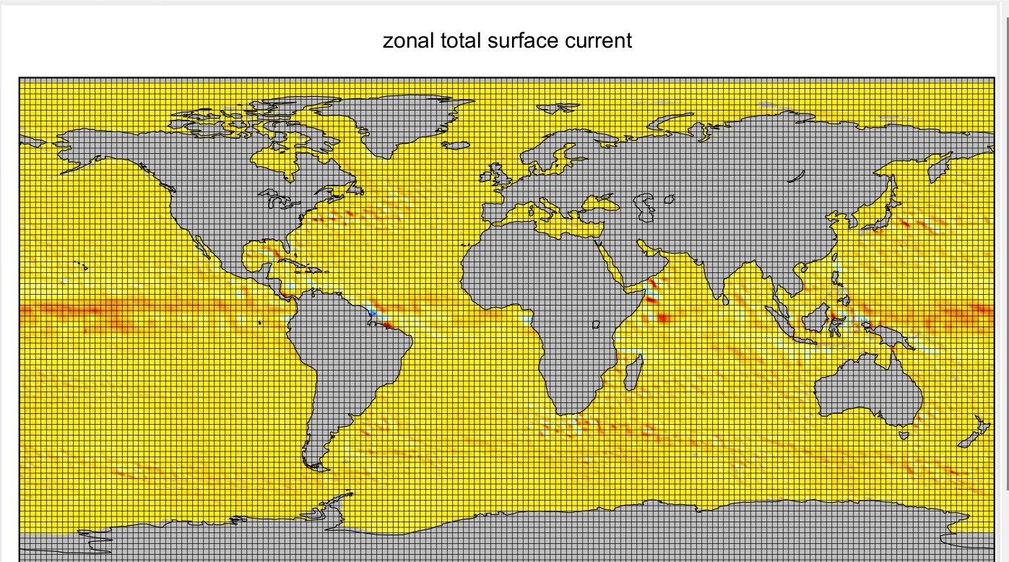
Dataset: OSCAR Ocean Surface Currents
Full name
Ocean Surface Current Analyses Real-time (OSCAR) Surface Currents, Near Real Time 0.25° (Version 2.0)
Source
NASA PO.DAAC (JPL), produced by Earth & Space Research (ESR)
File format
NetCDF, extension .nc
File layout
One file per day, e.g. oscar_currents_nrt_20261006.nc
Global 0.25° grid over the zonal current u (OSCAR NRT, 6 Oct 2026)
Variables
u (zonal) and v (meridional) total surface current, m s⁻¹
Meaning
Daily mean current over the top 30 m of the ocean
Notes:
The real-data runs use OSCAR, Ocean Surface Current Analyses Real-time, near-real-time product, version 2.0 at 0.25 degrees. It is distributed by NASA PO.DAAC and produced by Earth and Space Research. Data come as NetCDF files with the .nc extension, one file per day. Each holds the zonal current u and meridional current v in metres per second, averaged over the top 30 m. The map shows the global 0.25 degree grid over the u field.

Slide 3
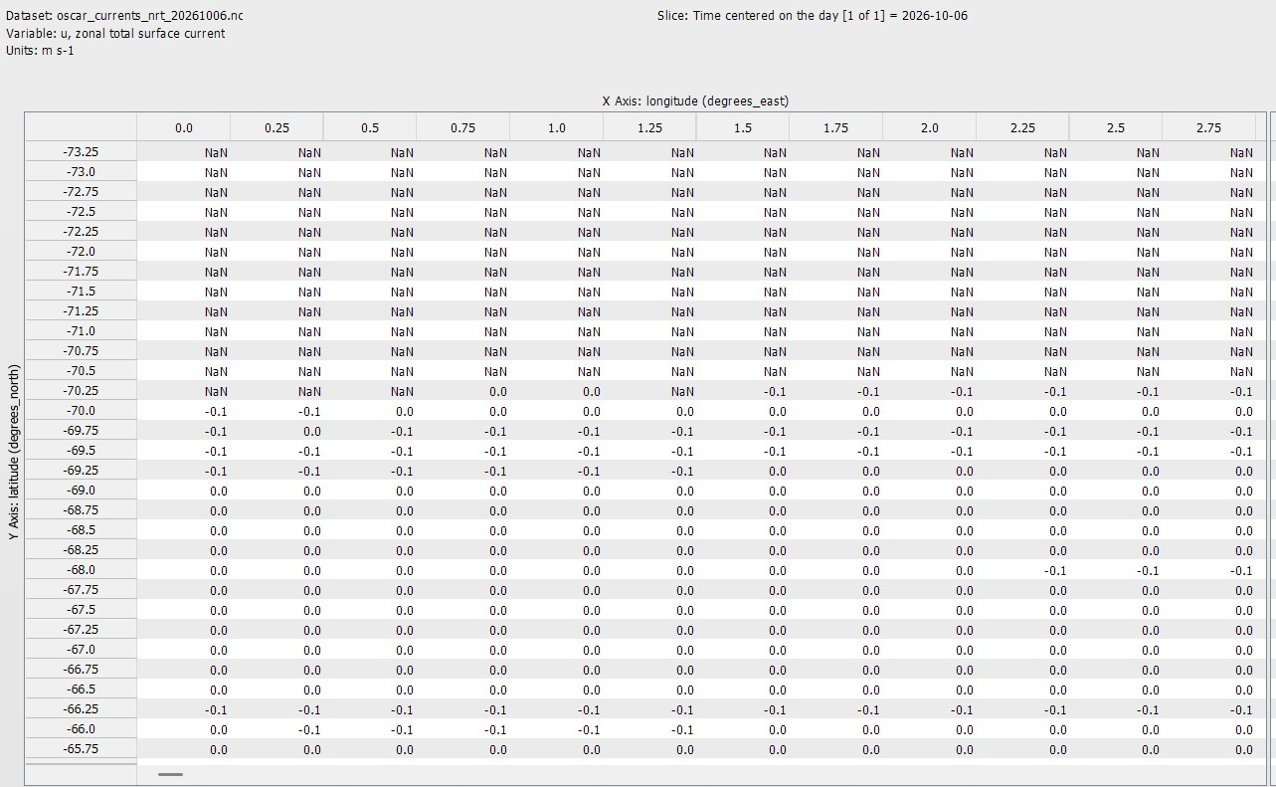
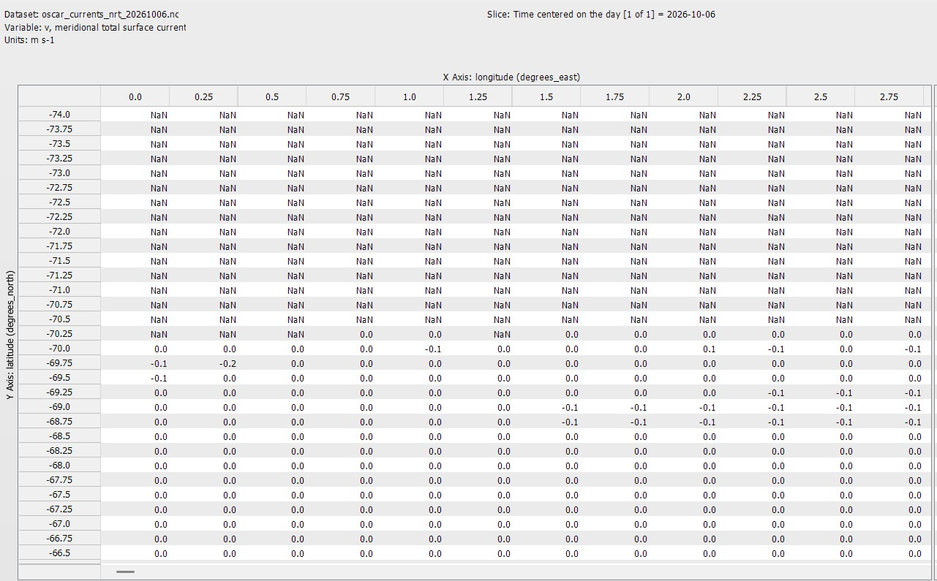
Dataset: Grid, Size and Velocity Fields
u: zonal current (m s⁻¹), NaN over land and ice
v: meridional current (m s⁻¹)
1440 × 719
grid points, 0.25° × 0.25°
2,105 days
1 Jan 2021 – 6 Oct 2026
≈ 8.3 MB
one day (u + v, float32)
≈ 17.4 GB
all days, uncompressed
Instances: particles, P = 10⁴ to 5×10⁶ per run, released from the same fixed points in every run.
Notes:
Each daily field is 1440 by 719 points at 0.25 by 0.25 degrees, about 1.04 million cells per variable. u and v in float32 give roughly 8.3 MB per day. From 1 January 2021 to 6 October 2026 there are 2,105 daily files, about 17.4 GB uncompressed. The array views show u and v values; NaN marks land and ice. The particles are the instances, from ten thousand to five million per run.

Slide 4
Methodology Block Diagram
A. Setup (before timing)
Current-field data
Synthetic double-gyre, OSCAR, HYCOM
Custom NetCDF loader
(u, v) grids kept as contiguous arrays
Particle setup
Fixed release points, SoA position arrays
B. Per-timestep advection loop at time t_{k} (the timed kernel)
Per particle, on every thread in parallel; no locks (grid is read-only)
Step 1
Load time slices
bracketing [t_{k}, t_{k+1}]
Step 2
Split particle array
over OpenMP threads
Step 3
Interpolate velocity
bilinear in space,
linear in time
Step 4
Integrate position
RK4, fixed step
Step 5
Boundary check
land mask, then store
×4 RK4 stages
advance to t_{k+1} and repeat until the end time
C. Evaluation
Serial baseline
Same Steps 3–5 code on one thread: the correctness check and timing reference
Measure and compare
Wall-clock time, per-thread busy time, particle throughput,
cache misses and bandwidth (perf stat), position drift vs. serial
Notes:
This slide shows the whole method. Row A is the setup, which happens before any timing. The current-field data is read through our own small NetCDF loader into contiguous arrays, and the particles are placed at fixed release points in a structure-of-arrays layout. Row B is the kernel that we actually time. At each timestep, Step 1 picks the two time slices that bracket the current time, so the temporal interpolation is well defined. Step 2 gives each OpenMP thread a chunk of the particle array. Steps 3 to 5 then run for each particle. Step 3 finds the velocity using bilinear interpolation in space and linear interpolation in time. Step 4 advances the position using fourth-order Runge-Kutta, and it calls back into Step 3 for each of the four stages. Step 5 applies the land-mask rule and stores the new position. The current grid is read-only and particles never interact, so the threads do not need any locks. After that the loop moves to the next timestep. Row C is the evaluation. The same code run on one thread is our serial baseline, and we compare timing, hardware counters and particle positions against it.

Slide 5
How This Differs from Existing Solutions
 | Serial advection the usual starting point | Framework-based tracking typical general-purpose tools | Our approach OpenMP advection kernel
Execution | One core; runtime grows linearly with particle count | Kernel sits inside a larger simulation framework | All cores; particles are split across threads with no locks
Scheduling | Not applicable | Usually fixed by the tool | We compare static, dynamic and guided
Data layout | Whatever the code happens to use | Usually fixed by the tool | We compare SoA and AoS
What gets measured | Only total runtime | Kernel time mixed with I/O and framework overhead | The kernel alone, plus cache misses, bandwidth and drift vs. serial
Net effect: the algorithm is O(P·T) and nothing in it scales worse than linearly, so any scaling limit we see can be traced to memory bandwidth and cache behaviour.
Notes:
The template asks how our methodology is different from existing solutions. Compared with plain serial advection, the difference is simple: we use all the cores, and since particles are independent we can do this without any locks. Compared with particle tracking done inside a general-purpose simulation framework, the difference is in what we can measure. We use our own small loader and time the advection kernel by itself, so framework overhead does not get mixed into the numbers. We also treat the scheduling policy and the memory layout as things to test, not fixed choices: static, dynamic and guided scheduling, and structure-of-arrays against array-of-structs. The middle column is a general description of typical tools and is not a claim about any specific one. Since the algorithm is linear in particles and timesteps, any limit on scaling can be put down to memory bandwidth and cache behaviour.

Slide 6
Evaluation Metrics and Expected Analysis
Research question | Metric | How we measure it
RQ1: Speedup and efficiency | S(N) = T_{serial} / T_{parallel}(N), E(N) = S(N) / N | Median wall-clock time of 5 runs, for each particle count
RQ2: Compute vs. memory bound | Arithmetic intensity vs. roofline model | Cross-checked with cache-miss rate and bandwidth use
RQ3: Scheduling and layout | Per-thread busy-time variance | Static, dynamic, guided × SoA, AoS at fixed P and N
RQ4: Physical fidelity | Position drift vs. serial baseline | Plus a visual comparison of accumulation-zone maps
Expected analysis
Near-linear speedup up to a moderate thread count.
Efficiency should drop soonest on the coarse, calm N. Pacific Gyre (bandwidth limit) and hold longest on Gulf Stream and Agulhas.
Dynamic or guided scheduling should help mainly near coasts, where land-mask checks make the work uneven.
If speedup flattens early everywhere, that is still a result: memory bandwidth, not thread count, is the bottleneck.
Are these metrics good enough?
Performance: speedup and efficiency show how well it scales; the roofline model and perf counters show why it stops.
Correctness: drift against the serial run confirms that parallelising did not change the physics.
Fairness: 2 warm-ups, median of 5 timed runs, pinned threads, identical release points.
Limit: accumulation maps are compared by eye, so that part is qualitative.
Notes:
Our evaluation follows the four research questions, with one group of metrics for each. For RQ1 we compute speedup and parallel efficiency from the median wall-clock time of five runs, for thread counts from 1 to 16 and particle counts from ten thousand to five million. For RQ2 we estimate the arithmetic intensity of the kernel and place it on the roofline model of the platform, and we cross-check this with the measured cache-miss rate and memory bandwidth. For RQ3 we compare the variance in per-thread busy time across the three scheduling policies and the two data layouts. For RQ4 we measure how far the parallel trajectories drift from the serial ones and compare the accumulation-zone maps. We expect near-linear speedup up to a moderate thread count. Efficiency should drop first on the coarse, calm North Pacific Gyre, because there is less arithmetic per byte moved, and it should hold longer on the high-resolution, eddy-rich regions. Are the metrics good enough? For performance we think yes: speedup tells us how much we gain, and the roofline and counters tell us why it stops. For correctness, drift is a direct check. One limitation is that the accumulation maps are compared visually, so that part is qualitative. If speedup flattens early everywhere, we will report that as a finding about memory bandwidth.

