Slide 1
Data Mining Final Project
Janki Patel
Dhruval Patel
Samantha Newkirk

Slide 2
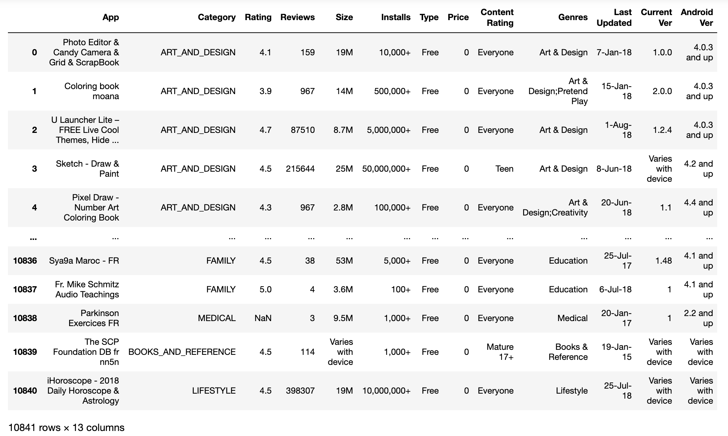
Dataset
Name: Google Play Store
Source: Kaggle
Features:
App
Category
Rating
Reviews
Size
Installs
Type
Price
Content Ratings
Genres
Last Updated
Current Version
Android Version

Slide 3
Motivation
Too many applications in the play store
What category apps are most popular or downloaded?
What is the average rating that an app can have?
Are paid apps any better than free apps?
Who are the target audience?

Slide 4
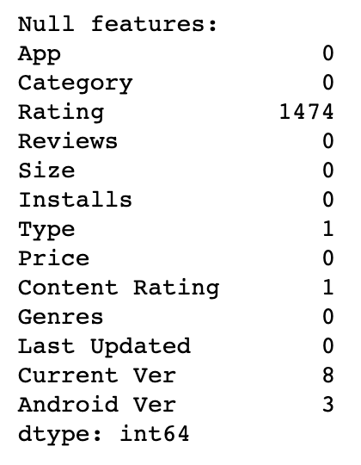
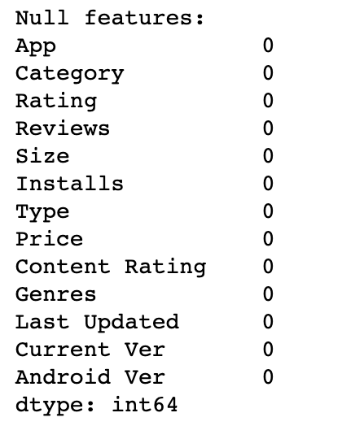
Pre-Processing
Null/NaN
Before
After
Rating: Mean method (4.2)
Type: Drop/Delete
Content Rating: Drop/Delete
Current Ver: Drop/Delete
Android Ver: Drop/Delete

Slide 5
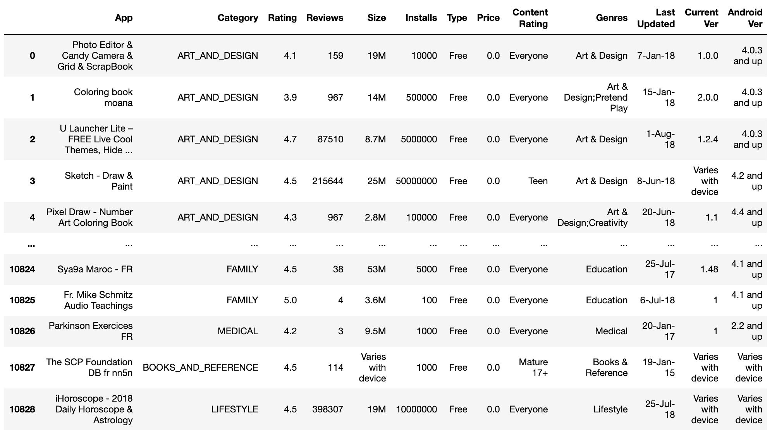
Pre-Processing
Install, Price

Slide 6
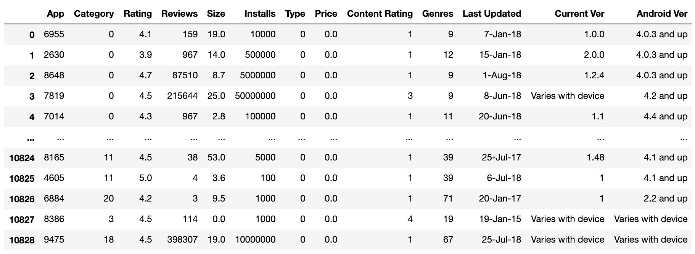
Pre-Processing
App, Category, Genres

Slide 7
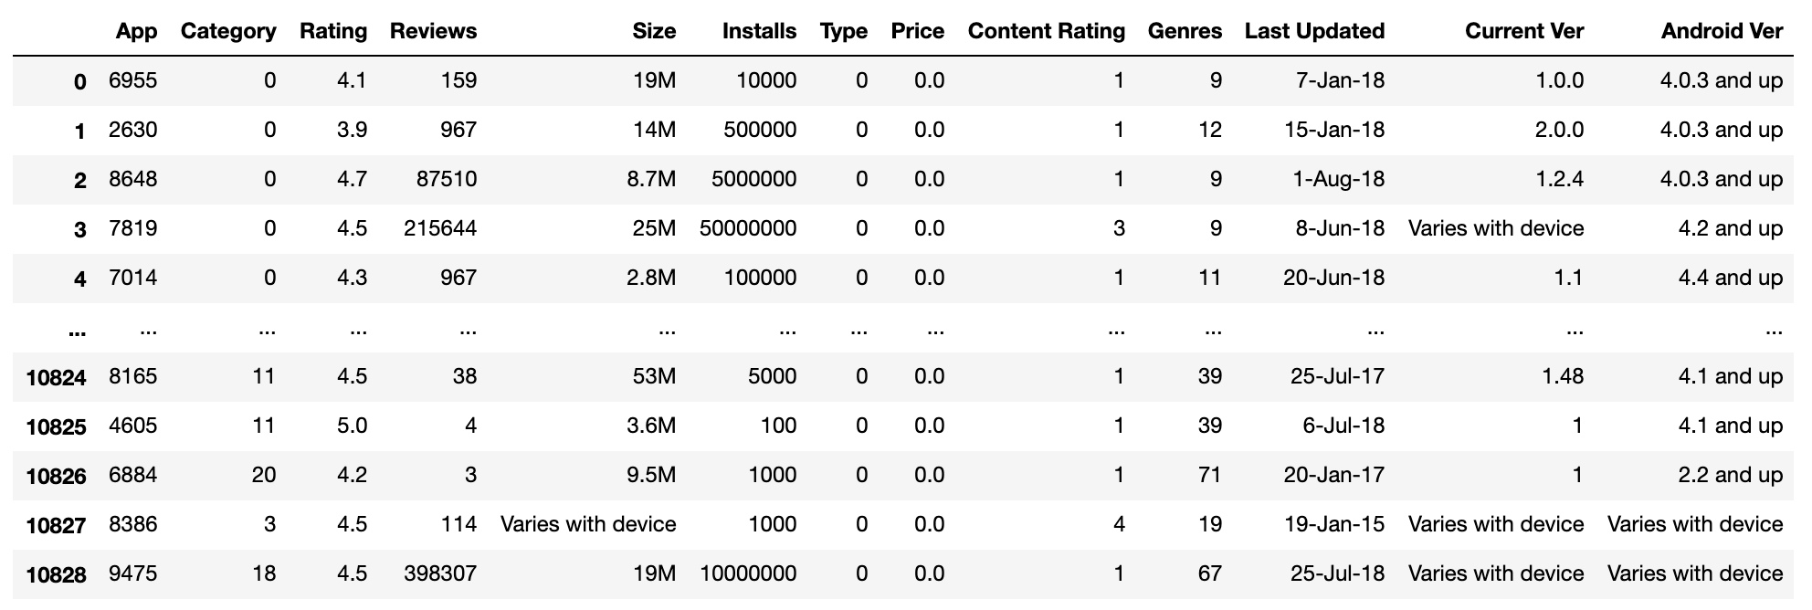
Pre-Processing
Content Rating, Type

Slide 8
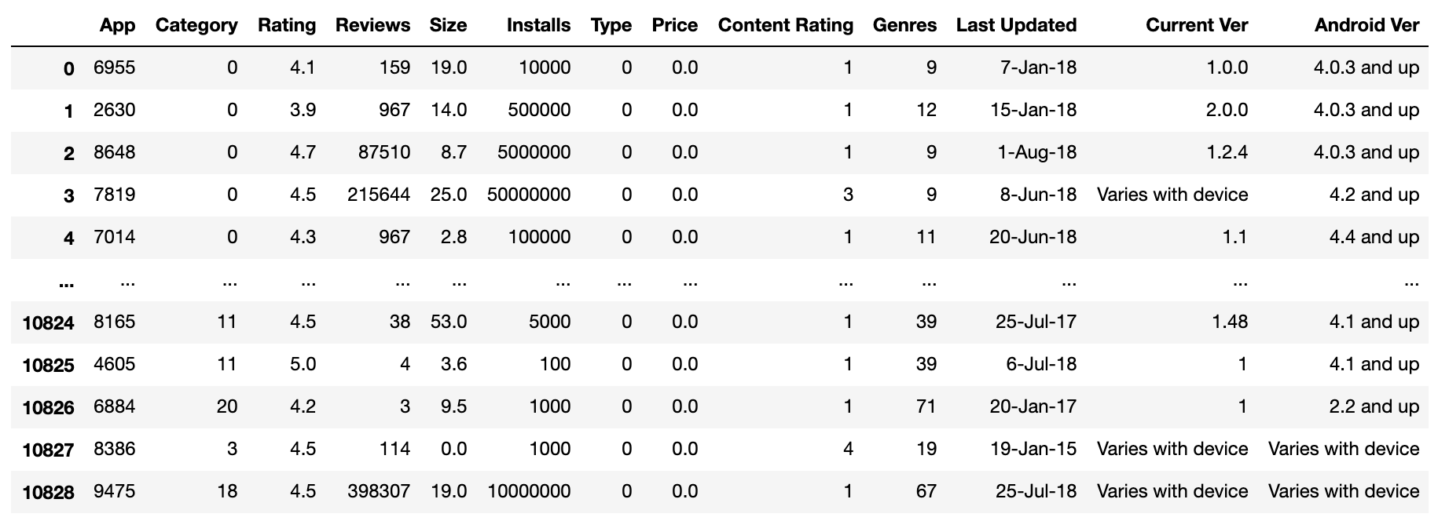
Pre-Processing
Size, Review

Slide 9
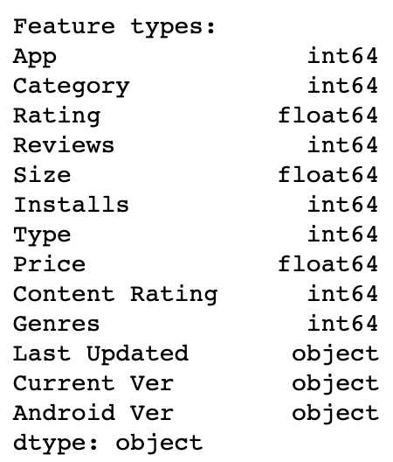
Pre-Processing
Completed (Clean Data)

Slide 10
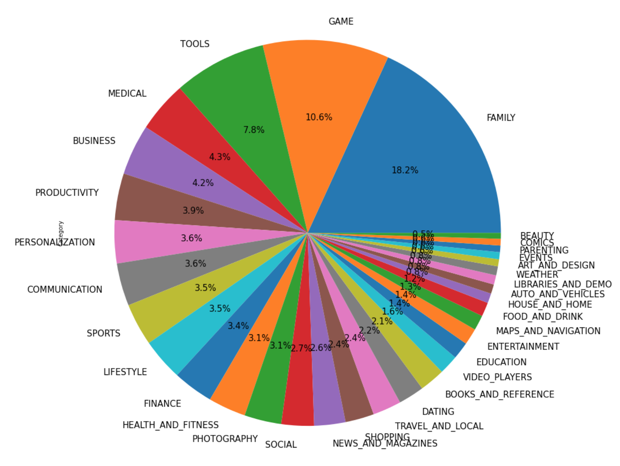
Visualization
Graph: Pie
Feature Visualizing: Category
How it helps us?

Slide 11
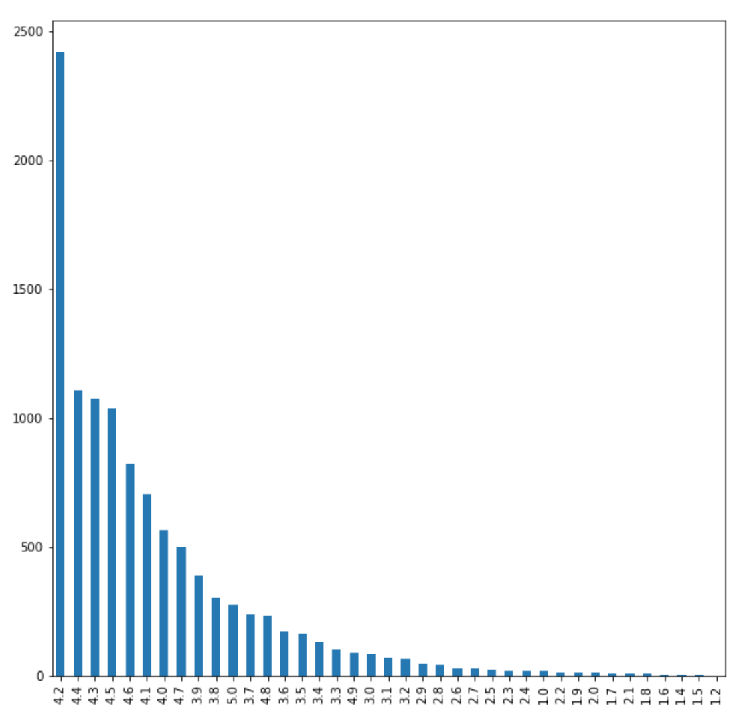
Visualization
Graph: Bar
Feature Visualizing: Ratings
How it helps us?

Slide 12
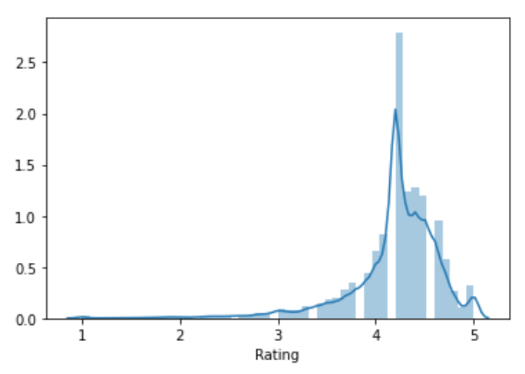
Visualization
Graph: Distribution Plot
Feature Visualizing: Ratings
How it helps us?

Slide 13
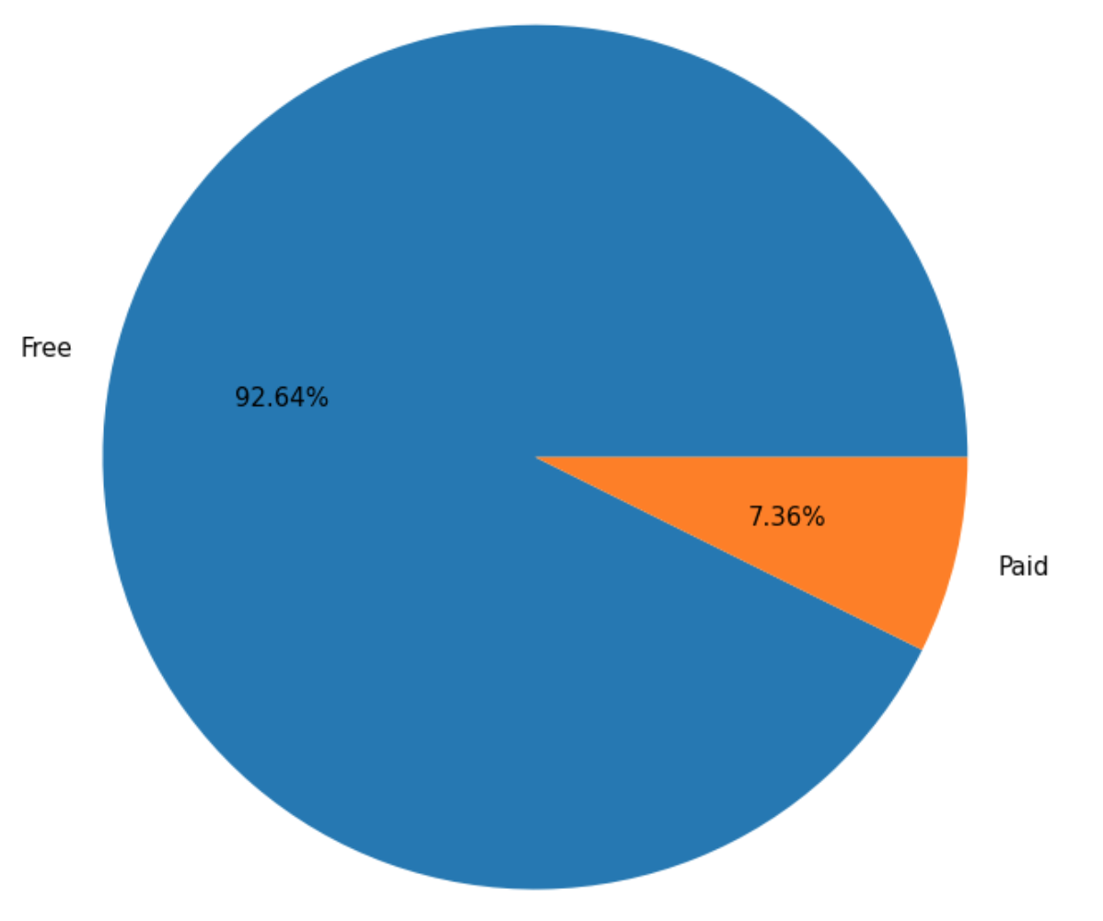
Visualization
Graph: Pie
Feature Visualizing: Type
How it helps us?

Slide 14
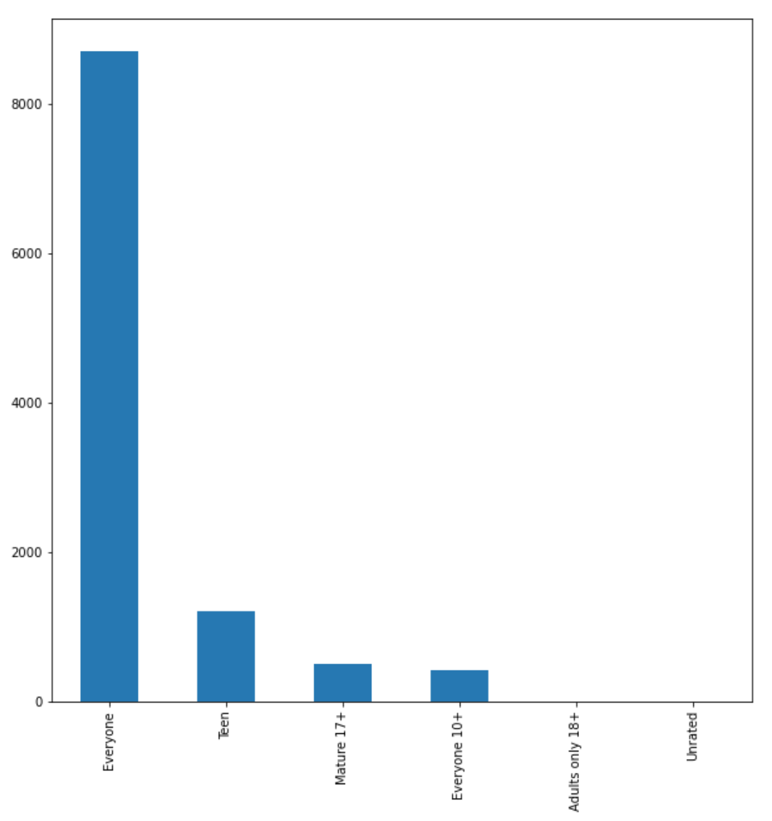
Visualization
Graph: Bar
Feature Visualizing: Content Rating
How it helps us?

Slide 15
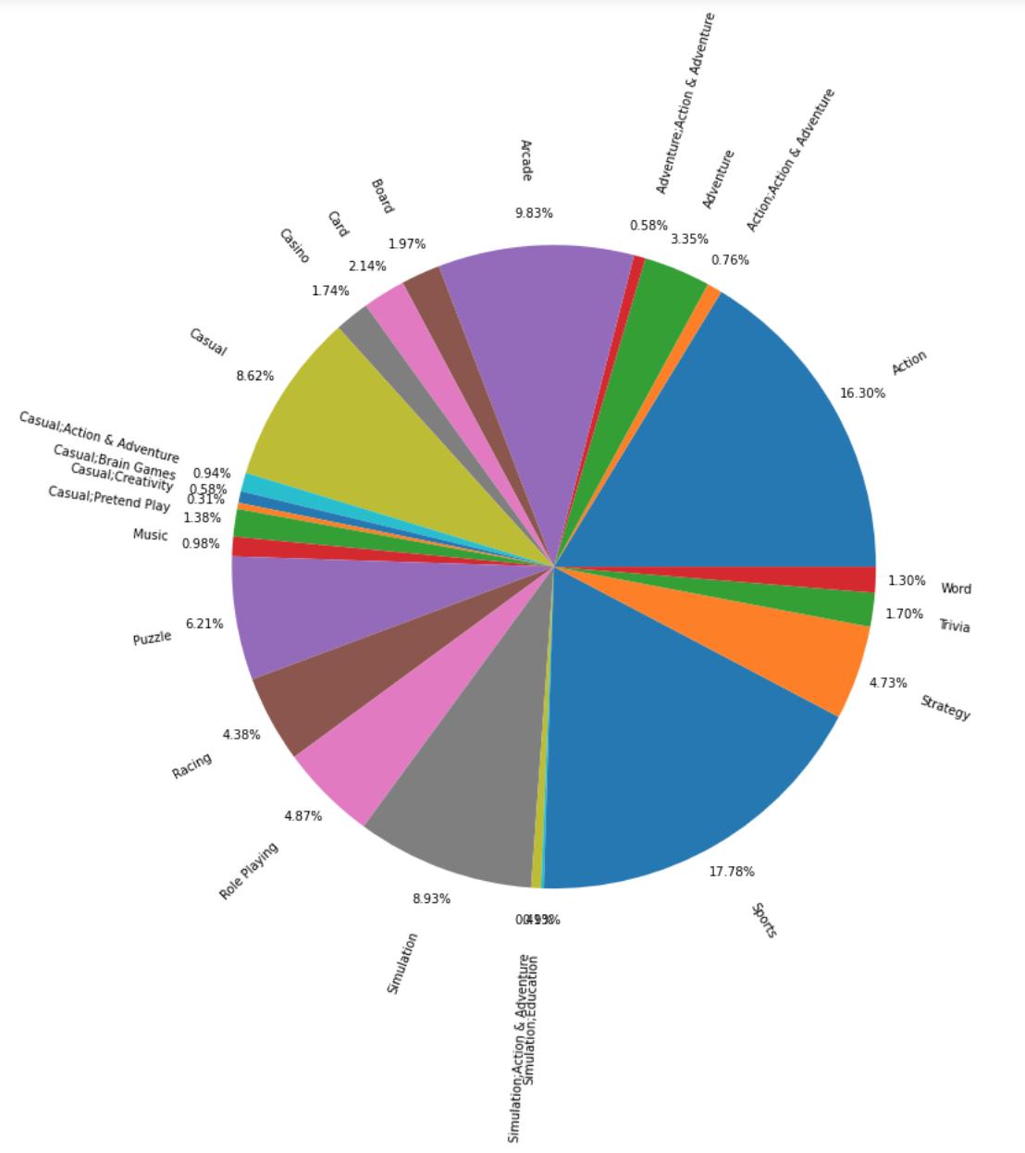
Visualization
Graph: Pie
Feature Visualizing: Category & Genres
Types of games that are most popular.
How it helps us?

Slide 16
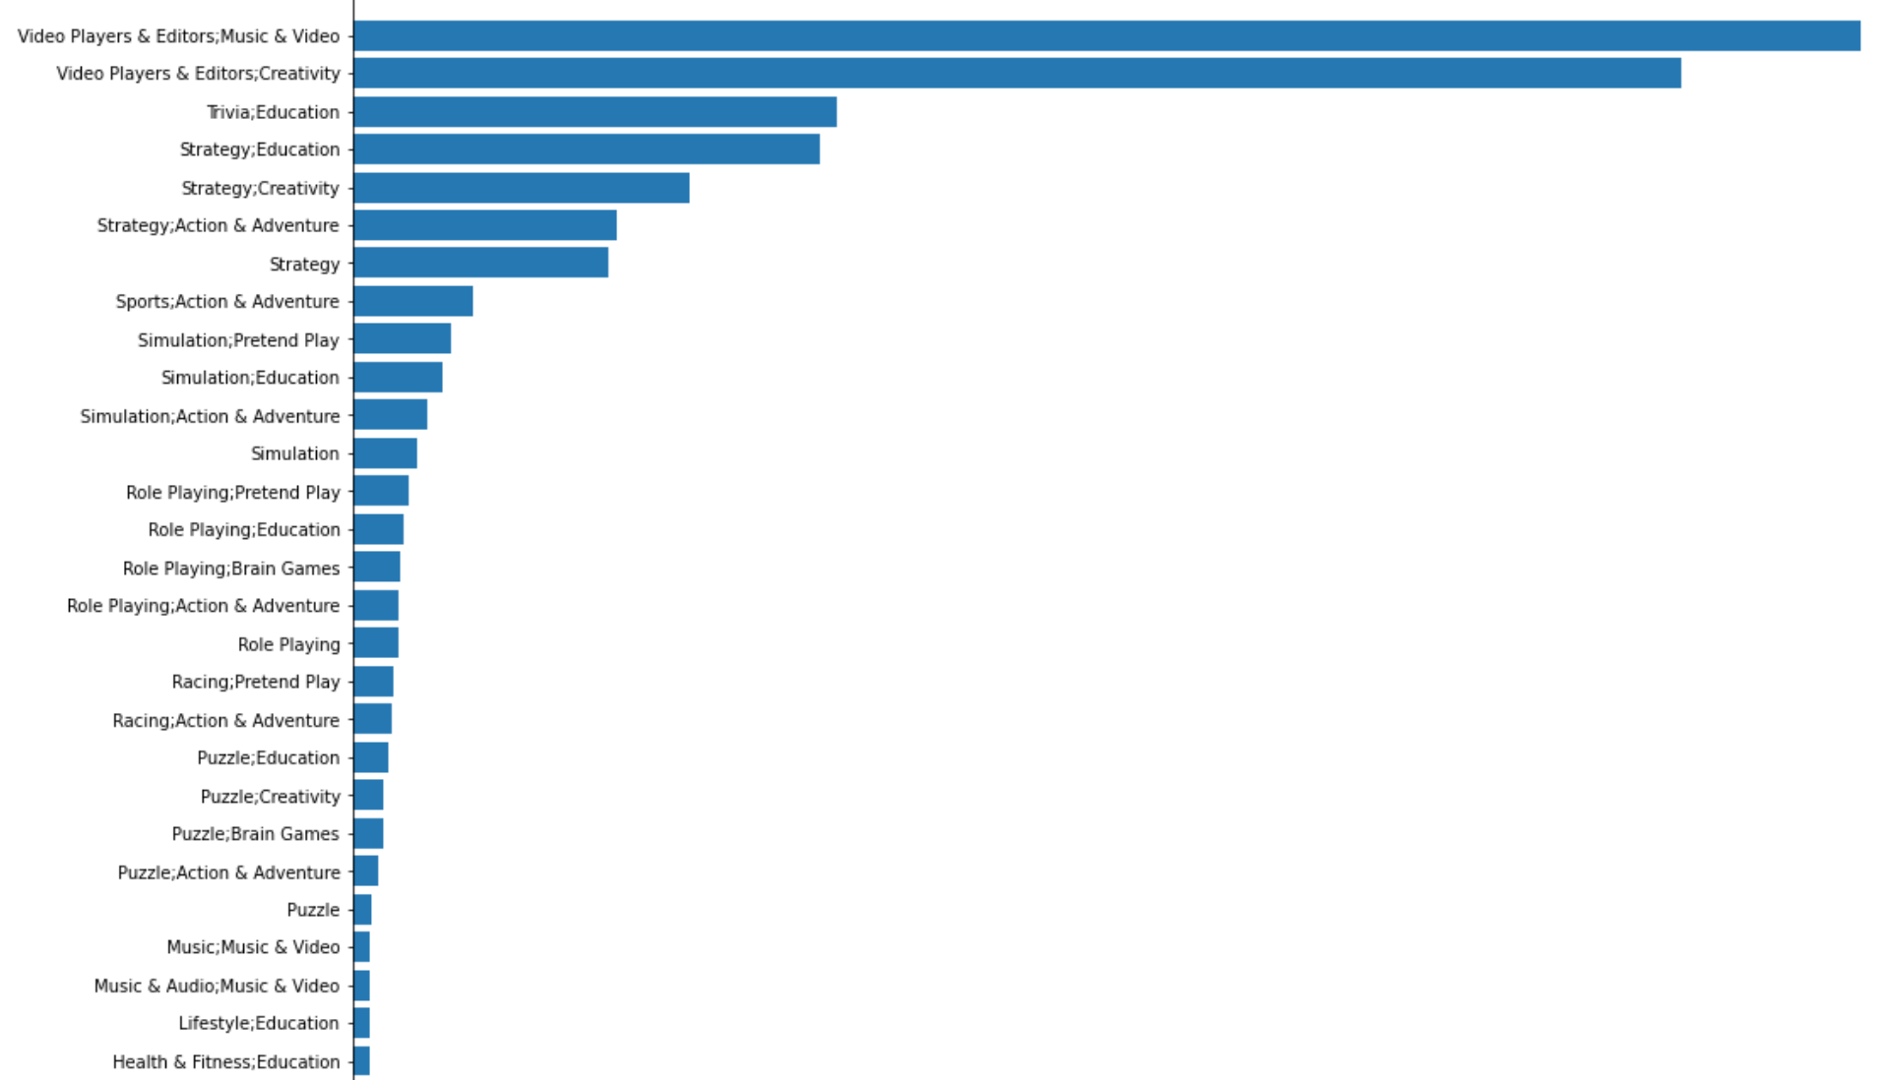
Visualization
Graph: Bar (H)
Feature Visualizing: Category & Genres
Types of family apps that are most popular.
How it helps us?

Slide 17
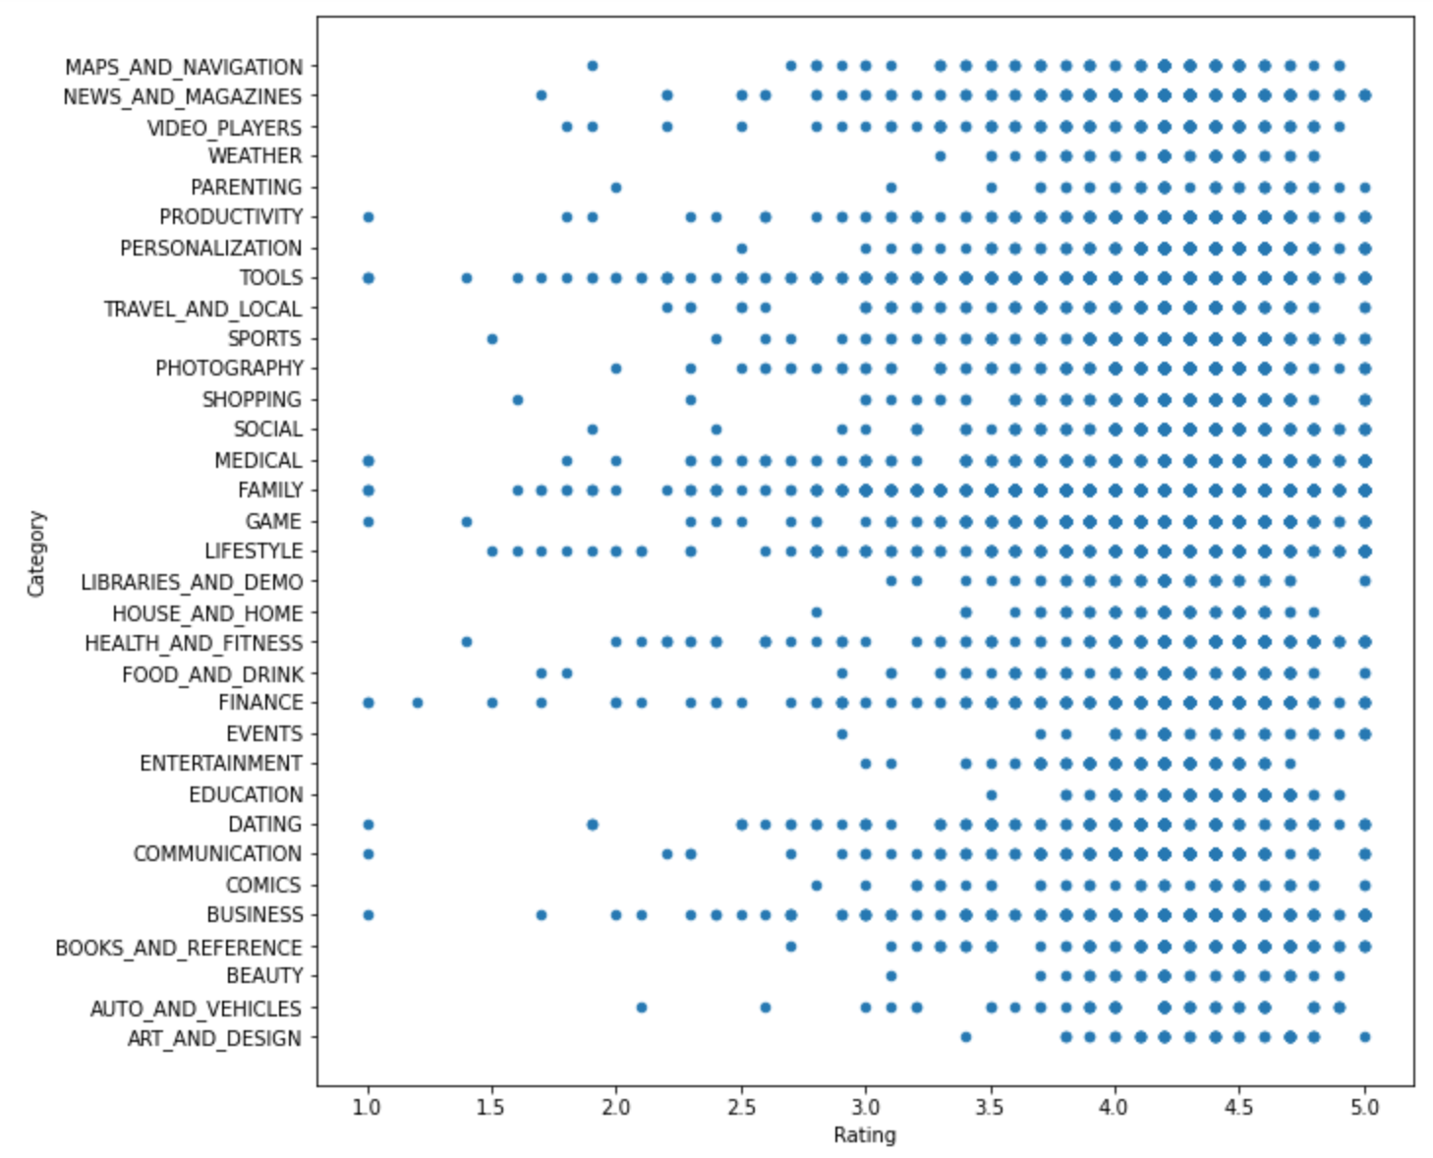
Visualization
Graph: Scatter
Rating vs Category
How it helps us?

Slide 18
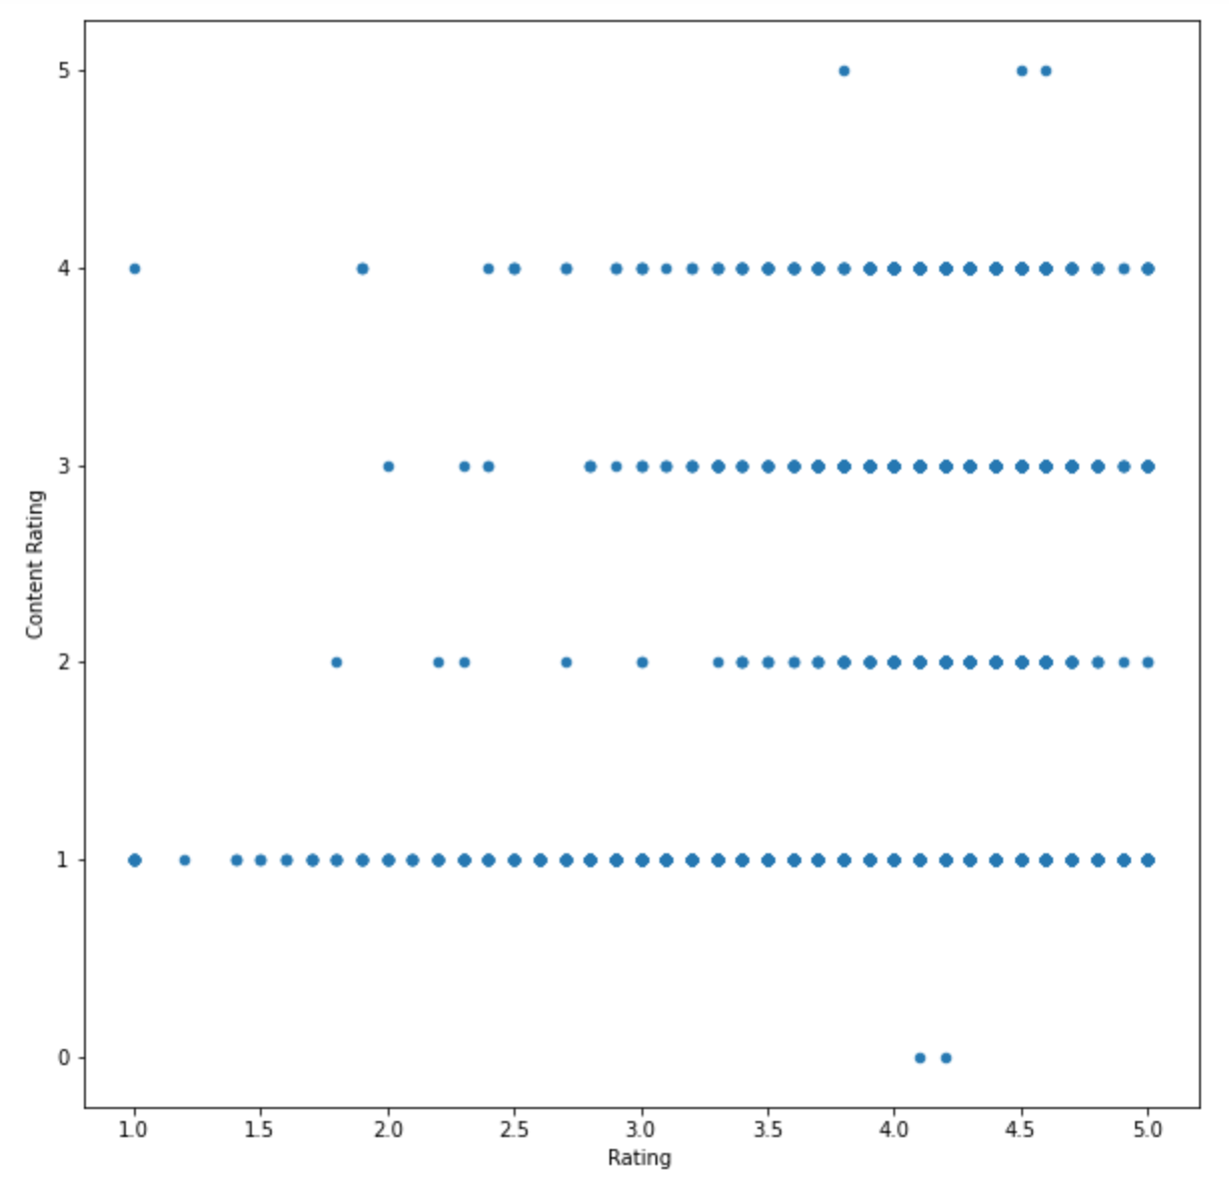
Visualization
Graph: Scatter
Rating vs Content Rating
How it helps us?

Slide 19
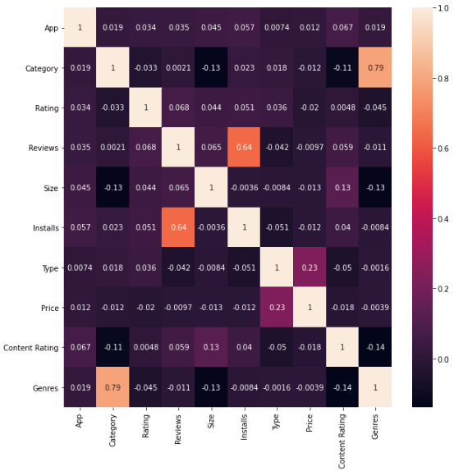
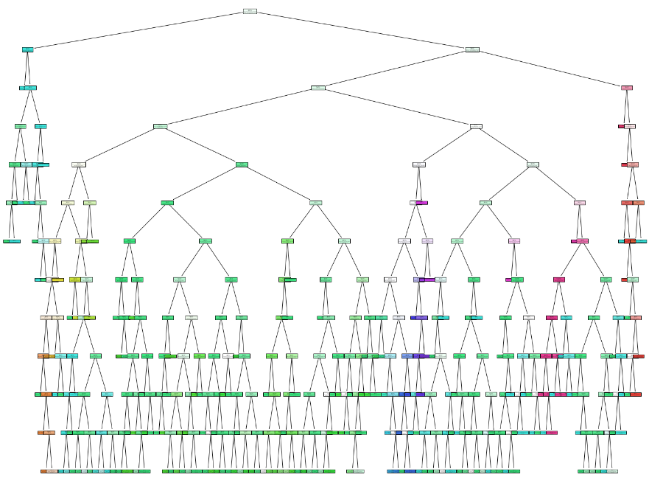
Next Step

Slide 20
Questions?

