Slide 1

Network Analysis Nation’s Position in International System: Block Model Approach
Dhruval Bhatt
December 9th, 2019

Slide 2
Objective & Agenda
Purpose: To model a study after Ronald Breiger’s work on “Structures of Economic Interdependence Among Nations” from the book, Continuities in Structural Inquiry for understanding network analysis for international trade.
Question: What is the positions of nations in the international system in 2008 and 2018 based on simultaneous exchange of different economic goods and CONCOR model?
Agenda
Background & Theory
Data
Analysis
Results
Conclusions

Slide 3
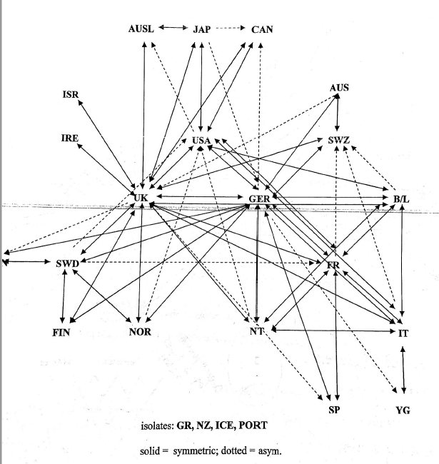
Background
Brieger (1981) studies is a structuralist perspective to patterns in world economy
Based on the World System Theory and trade data for OECD countries in 1972:
Can a procedure for categorizing states among their myriad import and export arrangements be found?
The author posits yes and tests his hypothesis against empirical data.
The core/periphery structure of the system is found to have multiple competing centers rather than just one center as implied above
CONCOR block Modeling:
Iterates correlations among columns of R
Splits the matrix into two structural equivalence blocks
Resulting Network Diagram for 1971 OECD data [from Dr. Padgett’s Notes]
Japan
USA
UK
G
Sweden
France
Japan
USA, UK, G
Sweden
France
Notes:
Immanuel Wallerstein’s theory: The traditional viewpoint of the world economic system: Individual states are categorized based on their interdependent relations within the system: o Core states soak up the surplus; o Periphery states produce labor intensive goods; o Semi-periphery states are both exploiters and exploited. •
a block model approach to international trade assigns states to positions according to the (1) structural similarity of the nations’ imports and exports to all other states, across various types of economic exchange, rather than on the basis of definitional aggregation.

Slide 4
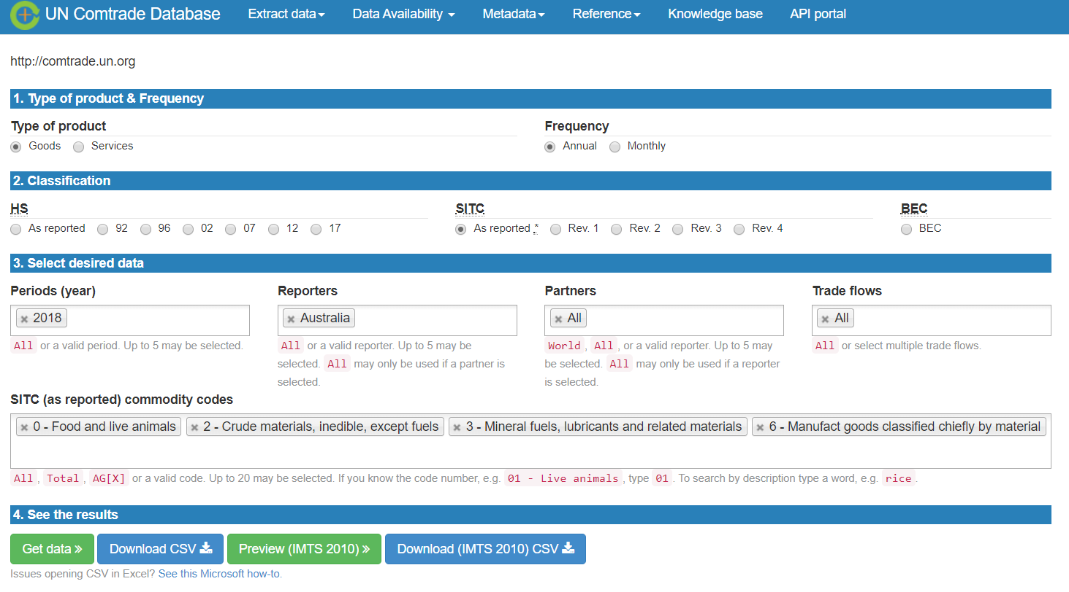
Data
Data is collected from UN Comtrade Database
The following data is downloaded:
Import/Export for same commodities that breiger considered for Year 2018 and 2008 for all countries in OECD + India, China, Brazil (ICB)
Goods trade for China for years: 2008 – 2010
Data is processed using Pandas in python to:
Remove countries that are not in OECD or India, China Brazil
Create n by n adjacency matrix for countries for block modeling
Only consider 5th of the volume (In progress)
Create edgelist for China to conduct egocentric analysis of trade patterns (In-Progress)
Notes:
Two major years for block modelling are considered – between major world financial crisis

Slide 5
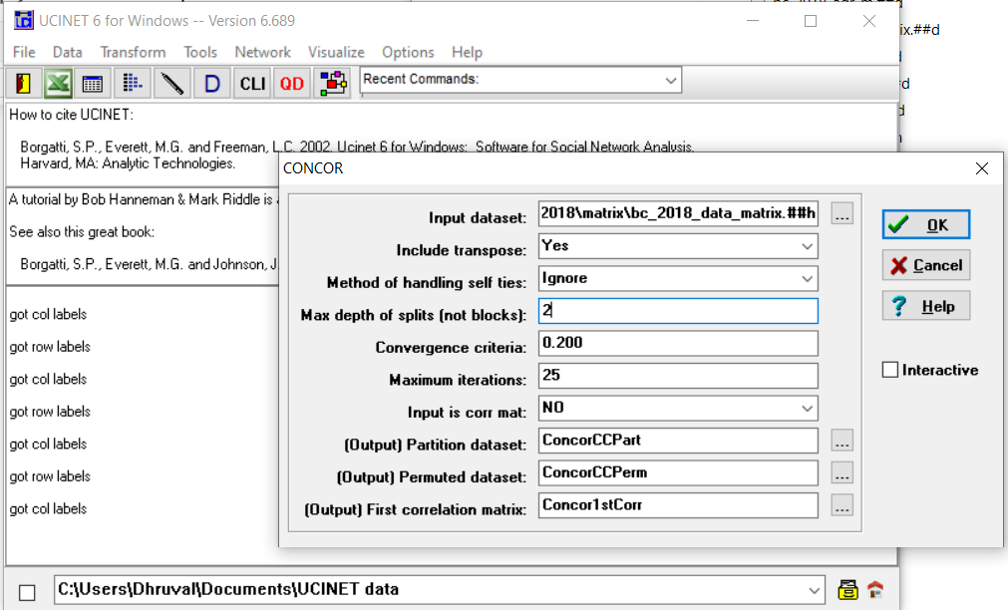
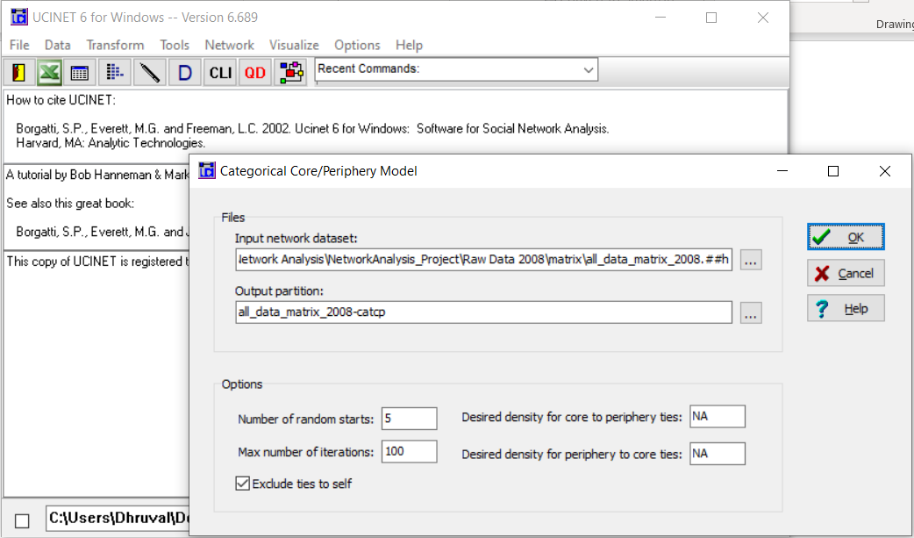
Method
Using program UCINET:
CONCOR
limiting the depth of split to 2
Core/Periphery Analysis
Notes:
Concor 1sr correlation

Slide 6
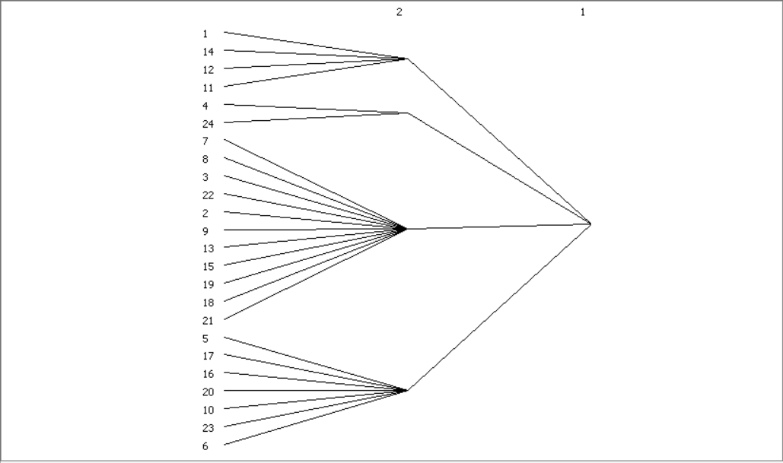
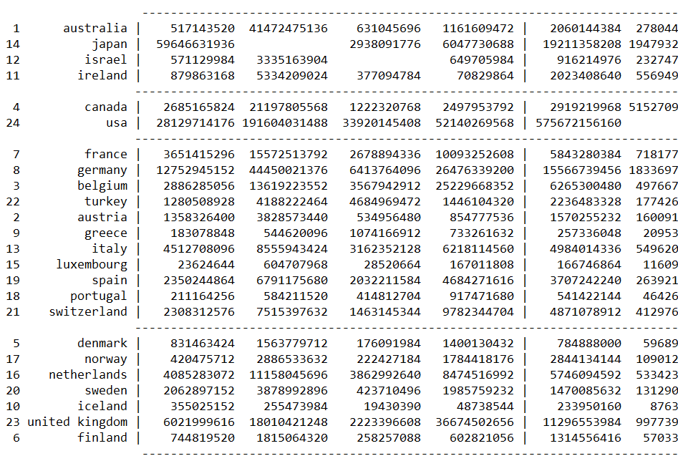
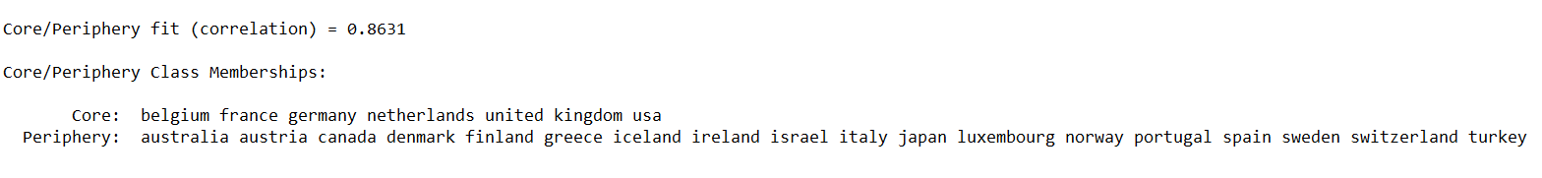
CONCOR: 2018 Data for 1972 OECD + Israel
Notes:
R2 = 0.5
There is a geographical similarity when we consider the same countries

Slide 7
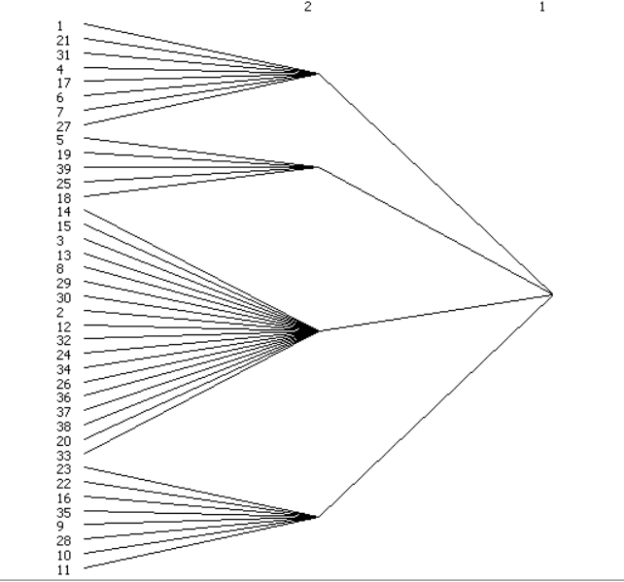
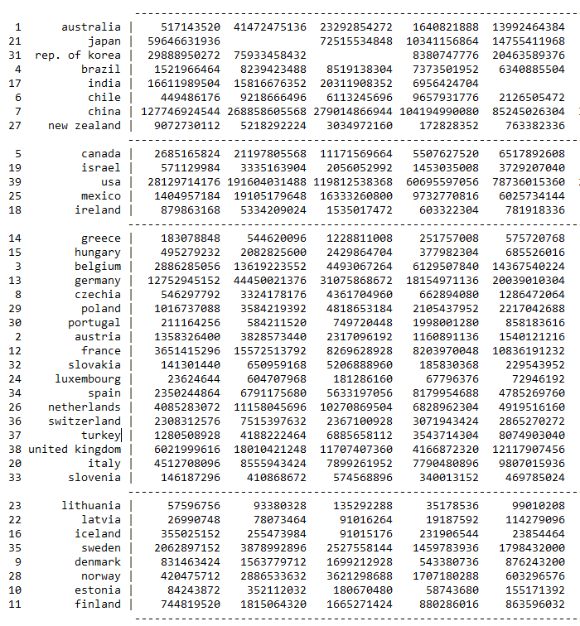
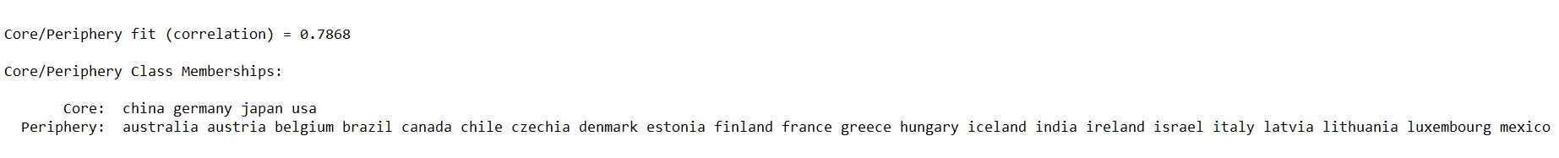
CONCOR: 2018 OECD + India, China, Brazil
Notes:
Additional levels made it lose meaning
R2 – 0.1

Slide 8
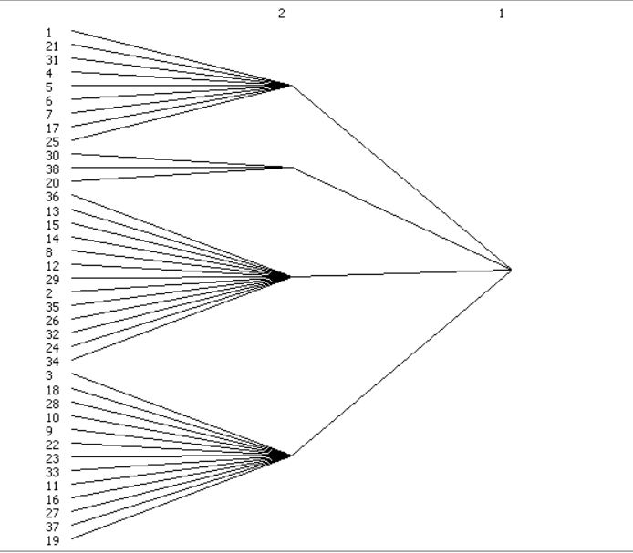
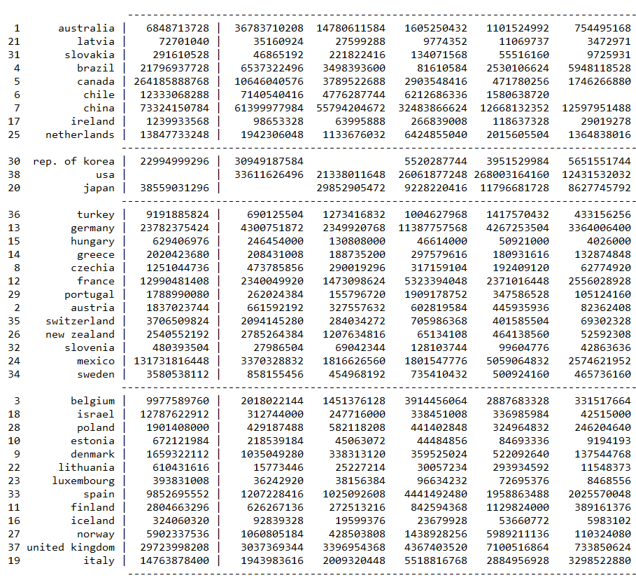
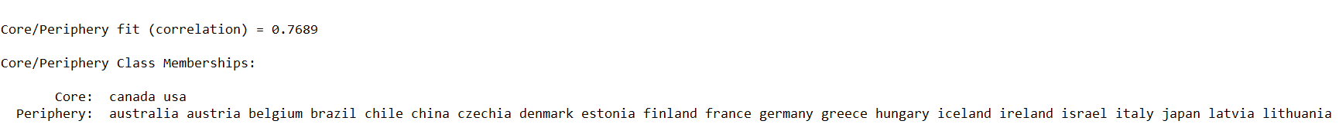
CONCOR: 2008 OECD + India, China, Brazil
Notes:
Additional levels made it lose meaning
R2 – 0.1

Slide 9
Conclusions & Future Work
If we looked at the exact same 24 countries that Brieger did: the following forms the core: USA, UK, Germany, Belgium, Netherlands and France
What is the effect of volume control?
With all OECD countries and India, China, Brazil in 2018 – China, Germany, USA, Japan form the core.
Smaller group of countries in the core
With all OECD countries and China, Brazil – USA, Canada form the core
Why? What is the role of financial crisis and how has China’s participation changed from 2008 to 2018?
Additional measures to consider to assess world theory system?
Services and intellectual transfer - to support/refute Wallerstein’s world system idea of unequal development this would be an important consideration in knowledge economy.
This is currently limited by data availability
Notes:
How much of trade does OECD + India, China, Brazil make?
Some descriptive statistics – who trades with who?

Slide 10
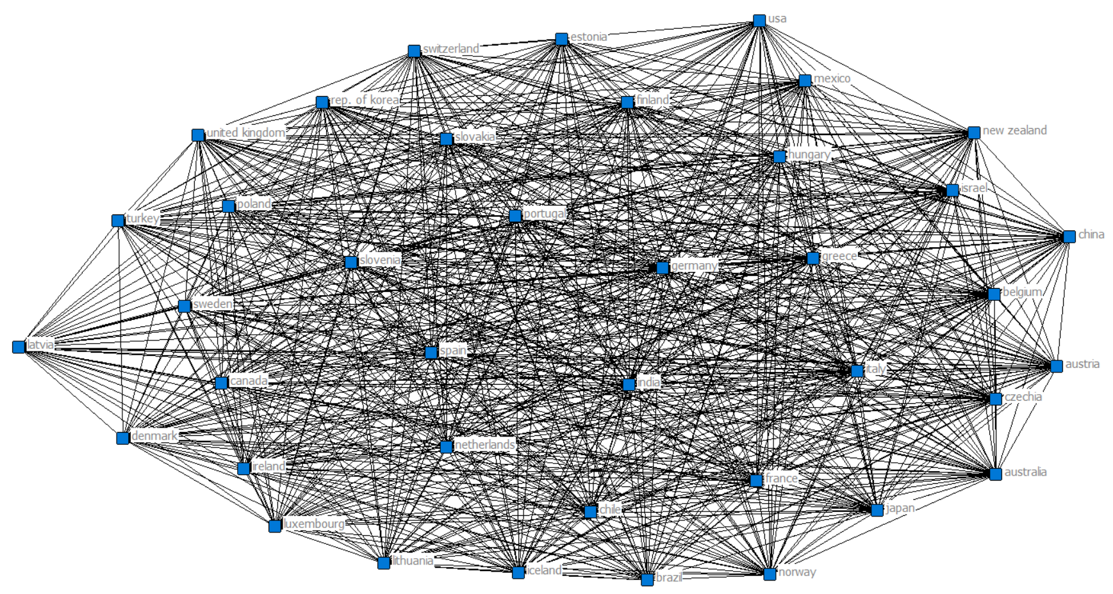
CONCOR: 2018 Data for 1972 OECD + Israel

