Slide 1
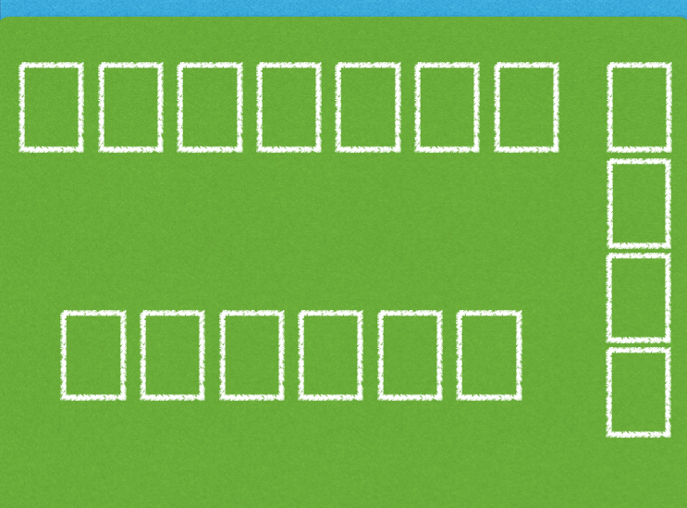




















































Initial Setup. 13 piles of 4 cards each, where all kings are at the bottom of their respective piles.
Notes:
Move 5 clubs to 6 clubs.

Slide 2

Moving a card from one pile to another.
Notes:
Move 5 clubs to 6 clubs.

Slide 3
Moving from one pile to another and getting rejected due to incorrect hierarchical order.
Notes:
Move 9 diamonds to 2 clubs.

Slide 4
Moving from one pile to another and getting rejected due to incorrect hierarchical order.
Notes:
9 diamonds gets rejected back to initial spot.

Slide 5
Moving to an empty Foundation. (Aces Only)
Notes:
Move Ace Diamond to Foundation.

Slide 6
Moving a card to a foundation of the same suit in hierarchical order.
Notes:
Move 2 of Diamonds to the Diamonds foundation.

Slide 7
Moving a card to an empty foundation when card is not an ace or of the same suit.
Notes:
Move Jack of hearts to empty foundation and get rejected.

Slide 8
Moving a card to an empty foundation when card is not an ace or of the same suit.
Notes:
Jack of hearts get rejected from empty foundation.

Slide 9
Winning the Game.
Notes:
Jack of hearts get rejected from empty foundation.

Slide 10
Winning the Game.
Notes:
Jack of hearts get rejected from empty foundation.

Slide 11
Winning the Game.
Notes:
Jack of hearts get rejected from empty foundation.

