Slide 1

SWIFT
Shaluvi Gautam
Noor Masood
Marcus Smith
Francis Kamadjou
Dhruval Darji

Slide 2
History
iOS, OS X, watchOS, tvOS apps
Builds on Objective-C, without the constraints of C compatibility
It was going to help new and existing developers write better code
It had automatic memory management and easy to understand syntax
It was built to be fast, including the best features from Objective-C without the bassage of C
Swift is designed to work with Apple’s Cocoa and Cocoa Touch frameworks and the large body of existing Objective-C code written for Apple products

Slide 3
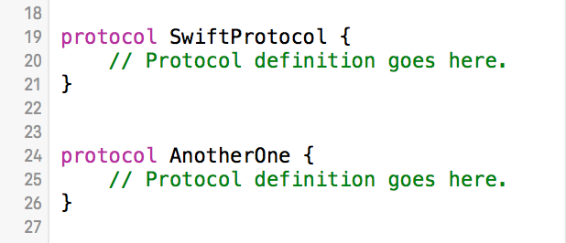
INHERITANCE
Supports protocol-based inheritance (multiple-inheritance of interfaces)
Protocol Syntax: define in a very similar way to classes, structures, and enumerations.
Notes:
What is protocols in swift?
- A protocol defines a blueprint of methods, properties, and other requirements that suit a particular task or piece of functionality. The protocol can then be adopted by a class, structure, or enumeration to provide an actual implementation of requirements.

Slide 4

INHERITANCE Cont.
The protocol’s name after the type’s name, separated by a colon. Multiple inherited protocols, separated by commas.

Slide 5
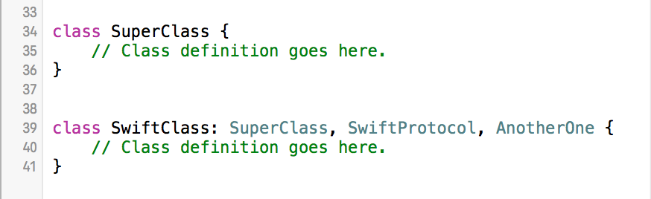
INHERITANCE Cont.
If a class has a superclass, list the superclass name before any protocols it adopts, followed by a comma:

Slide 6
CLASS OR COMPONENT REUSE
Swift supports class inheritance enables a high degree of code reuse.
When one class inherits from another, the inheriting class is know as a subclass, and the class it inherits from is known as its superclass.
Inheritance is a fundamental behavior that differentiates classes from other types in Swift.

Slide 7
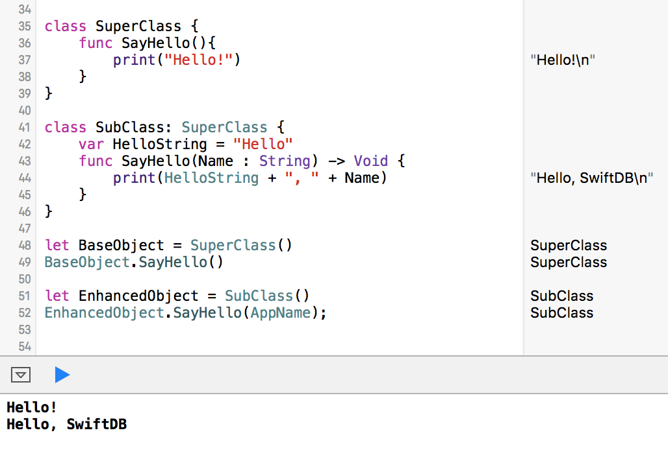

Slide 8
INFORMATION HIDING
Swift supports information hiding if objects of different classes can be used interchangeably and if they have a common superclass.
A simple example in which multiple instances can be used as a Graphicobject.

Slide 9
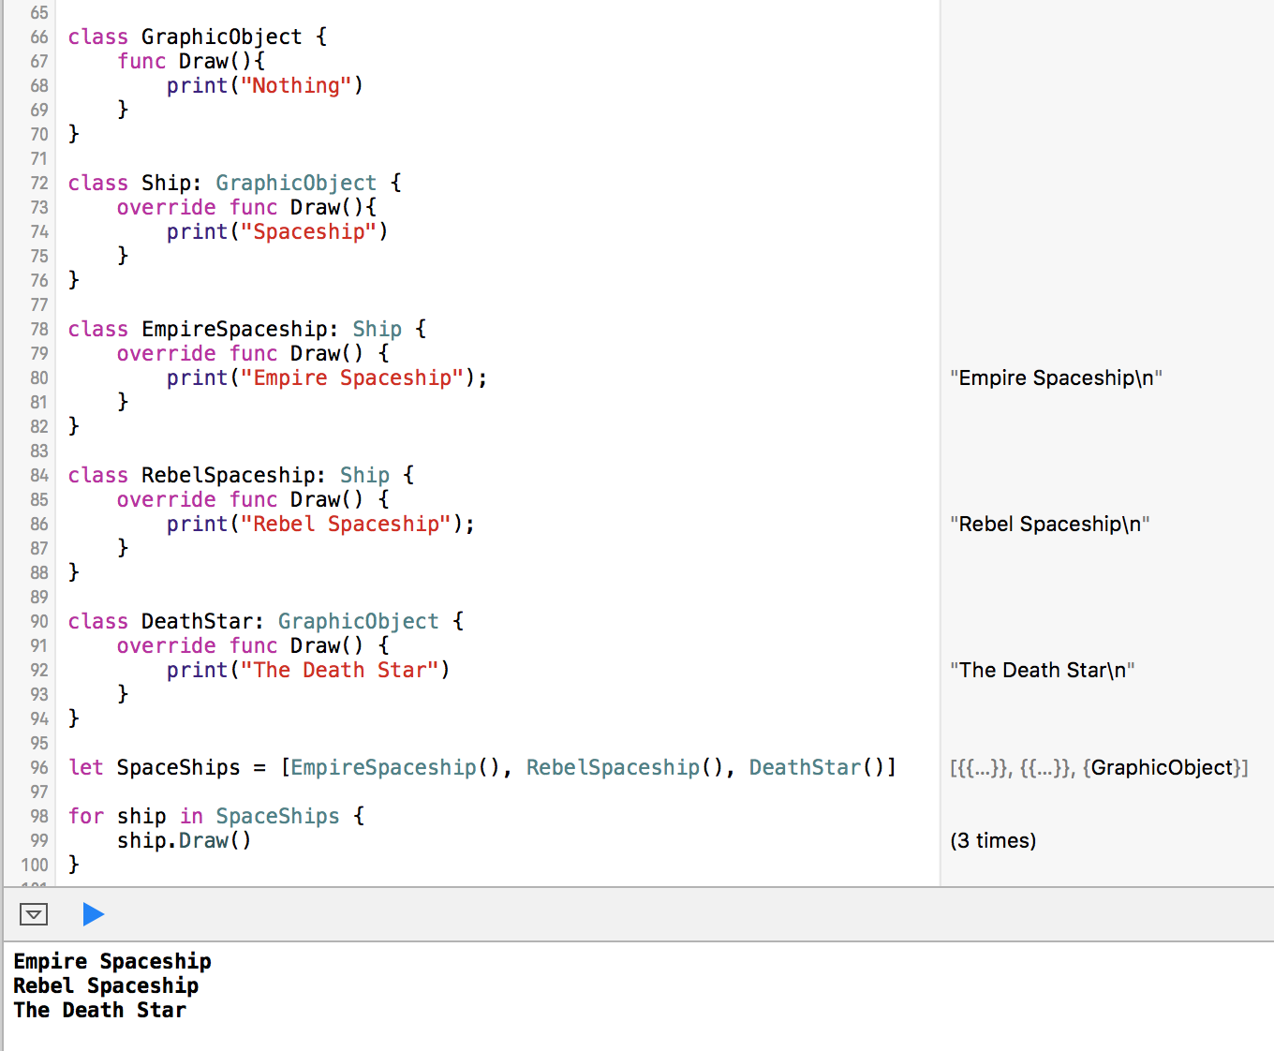

Slide 10
MESSAGE BINDING
Message binding is default for all Swift apps on OS X.

Slide 11
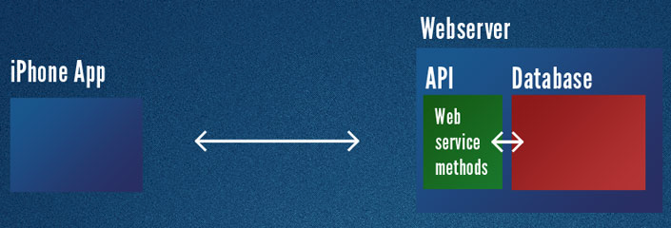
DATABASE SUPPORT
Standard is to create an API to broker the transactions between client and server

Slide 12
DATABASE SUPPORT
NSURLSessionDataDelegate protocol
NSURL class
NSURLSession class
NSURLSessionDataTask class

Slide 13
DATABASE SUPPORT
SQLite
Flying Meat Database
SwiftMongoDB
MySQL
FireBase
Parse

Slide 14
USABILITY
“Let” keyword
Types are optional
Keywords are not off limits if using `x`
Semicolons are not needed
Type Alias

Slide 15
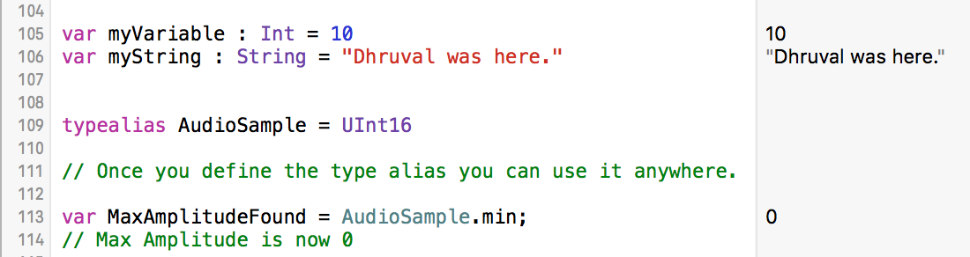
USABILITY

Slide 16
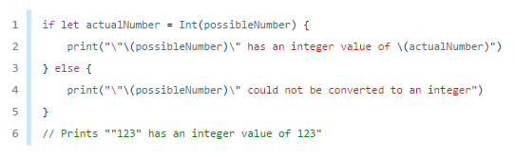
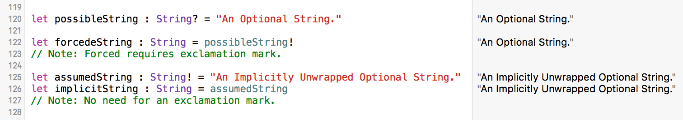
USABILITY
Optionals and Unwrapped Optional

Slide 17
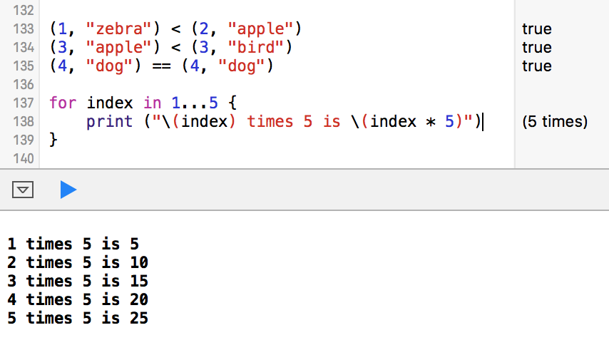
USABILITY
Tuple Comparison
Open Range and Half-Open Operator

Slide 18
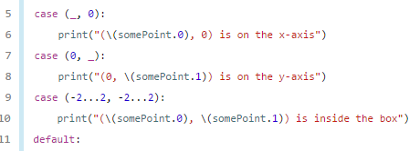

USABILITY
Repeat while == do while
Switch statements do not fall through
Interval Matching

Slide 19
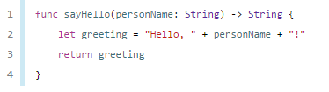
USABILITY
Functions

Slide 20
WEB DEVELOPMENT
Perfect
Perfect is a framework for developing web and other REST services in the Swift programming language.

Slide 21
Swift IDES - AppCode Vs Xcode

Slide 22
XCode IDE
First released in 2003,xcode is an integrated development environment(IDE) for apple and that is used to create apps that will be able to run on iphone,ipad apple watch and all the other apple products.

Slide 23
XCode IDE
Support many languages other than swift such as Objective-c,c,c++. It had evolved several times through the years.from 2011 to 2016 not less than 18 updates have been made to this product.

Slide 24
XCode IDE
The particularity of xcode is that with this single tool only , you are able to perform the creation the testing the optimization and submission of the app to th app store.
There are 3 main features that characterize xcode:

Slide 25
Single Window Interface
In Xcode there is a single window interface that shows you at the same time your code, the user interface design asset management as well as the testing and debugging.

Slide 26
Single Window Interface
Interesting in the sense that while you modify the code you can see your interface and the other content change at the same time.

Slide 27
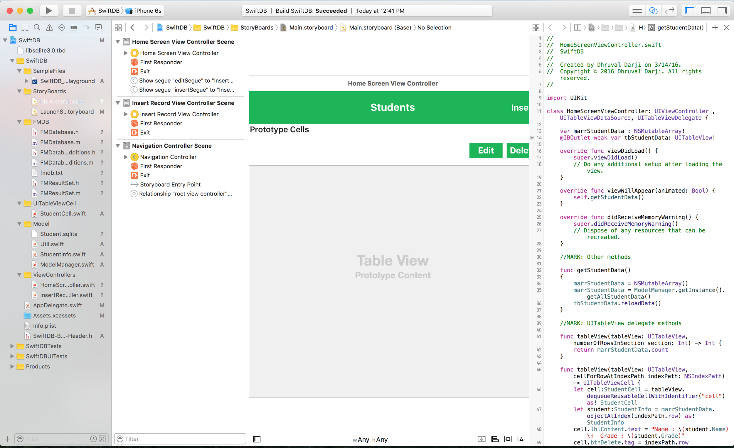

Slide 28
Assisted code
your code is check as you type and error are highlighted. That is very useful since it helps saves a lot of time.

Slide 29
Graphical UI Design.
xcode contains an interface builder that enables you to design your interface and layout and connect automatically the objects to your code.this is really innovative in the sense that it helps you to be more precise and save time.

Slide 30


AppCode IDE
Created by JetBrains - makers of Intellij IDEA, CLion, PyCharm and more
First released in april 2011, appcode is an IDE that support many languages such as swift, objective-c,c,c++,css,html,javascript just to name a few

Slide 31
AppCode IDE
appcode can be considered as an intelligent development environment and this is because it saves you from a lot of work
modifies and improve your code any time. it leads to a more accurate and reliable code
smart completion

Slide 32
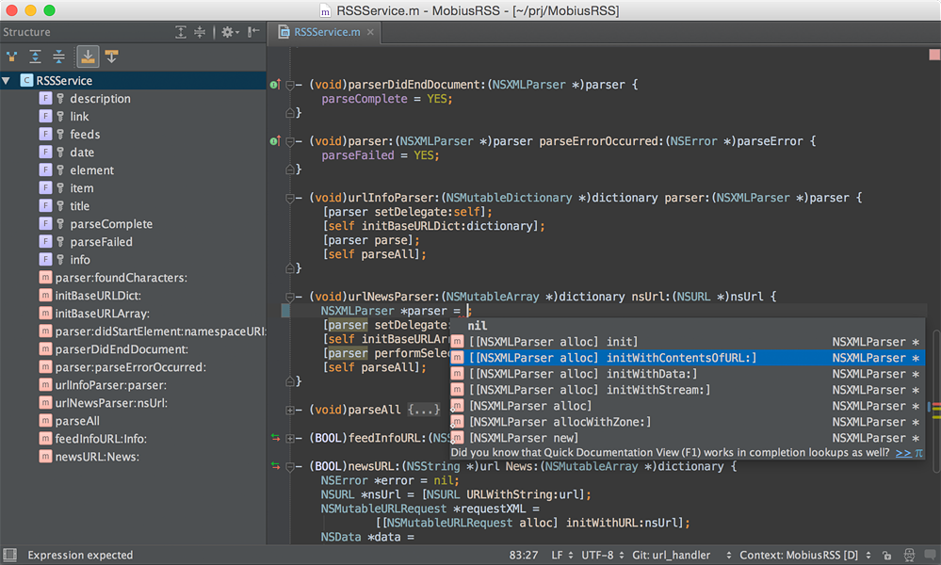

Slide 33
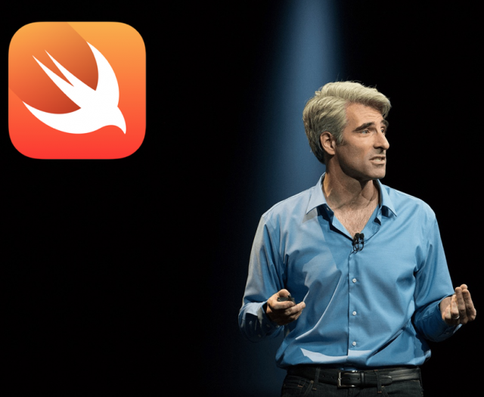
Windows “Support” of Swift
Cocoa API
Swift 2 Open source
Online Code Compilers (code bins)
Virtual Machine/Hackintosh
My Opinion?

Slide 34
Objective-C vs Swift
What Is Objective-C?
Will it still be used now that Swift is here?
Obj-C Swift
More Documentation/support
Easy transition from C
Generally higher learning curve due to syntax
Faster (next slide)
Very new language so limited documentation and pool of developers
Less coding needed/easier to understand

Slide 35
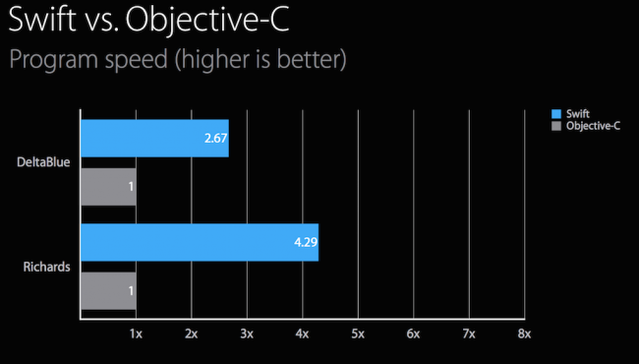
http://blog.novatec-gmbh.de/swift-2-introduction-comparison/

Slide 36
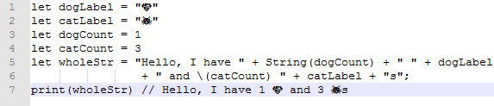
Objective-C vs Swift Comparison
Here we have a swift program that assigns strings to output how many dogs and cats there are
This slide is in Swift, the next slide is in Objective-C

Slide 37
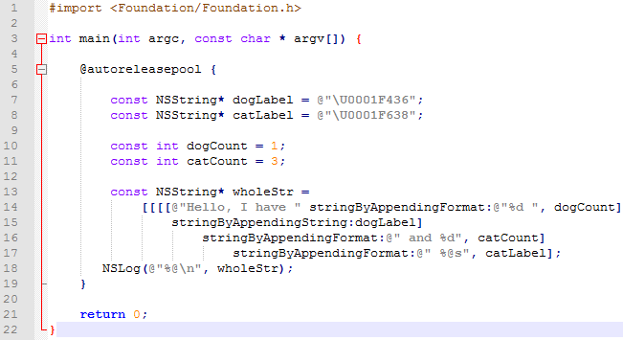

Slide 38

Swift & Linux
Official Port from Apple Blog Update (Dec 2015)
Swift without Objective-C runtime
Remember Swift is only 21 months old (June 2014)
Made open source only 9 months ago (June 2015)

Slide 39
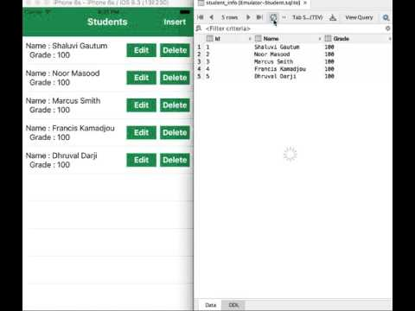
DEMO

Slide 40
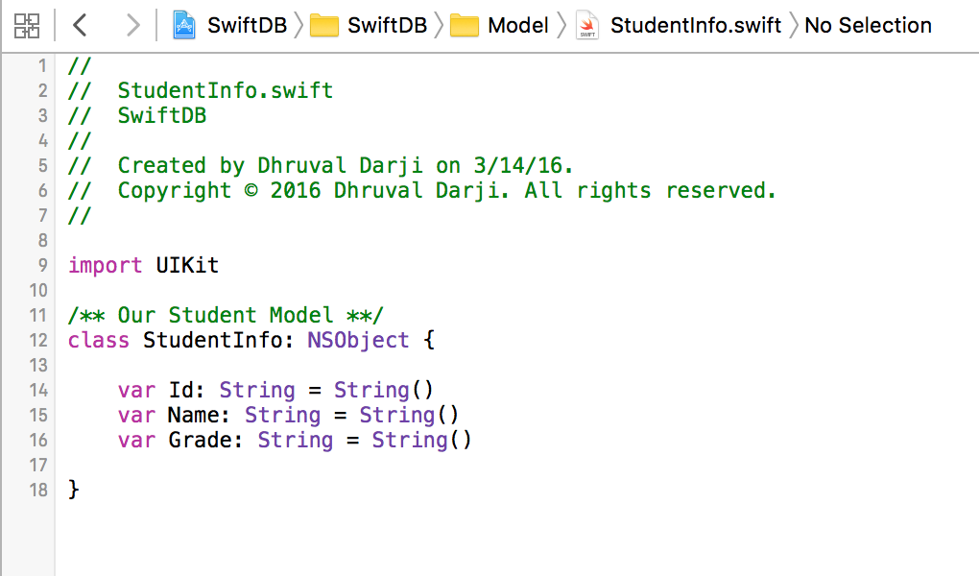
Code

Slide 41
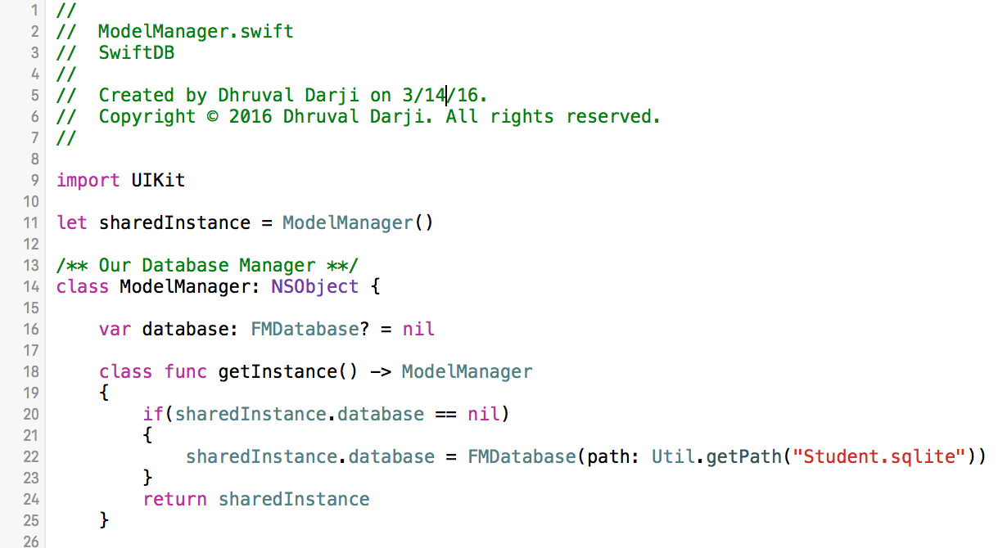
Code

Slide 42
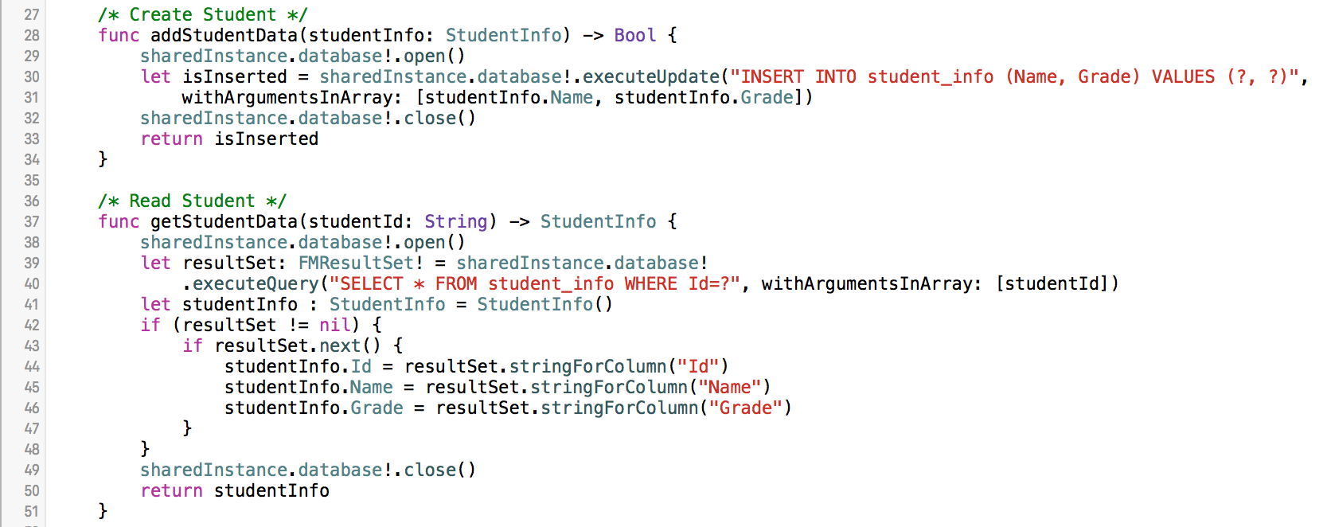
Code

Slide 43
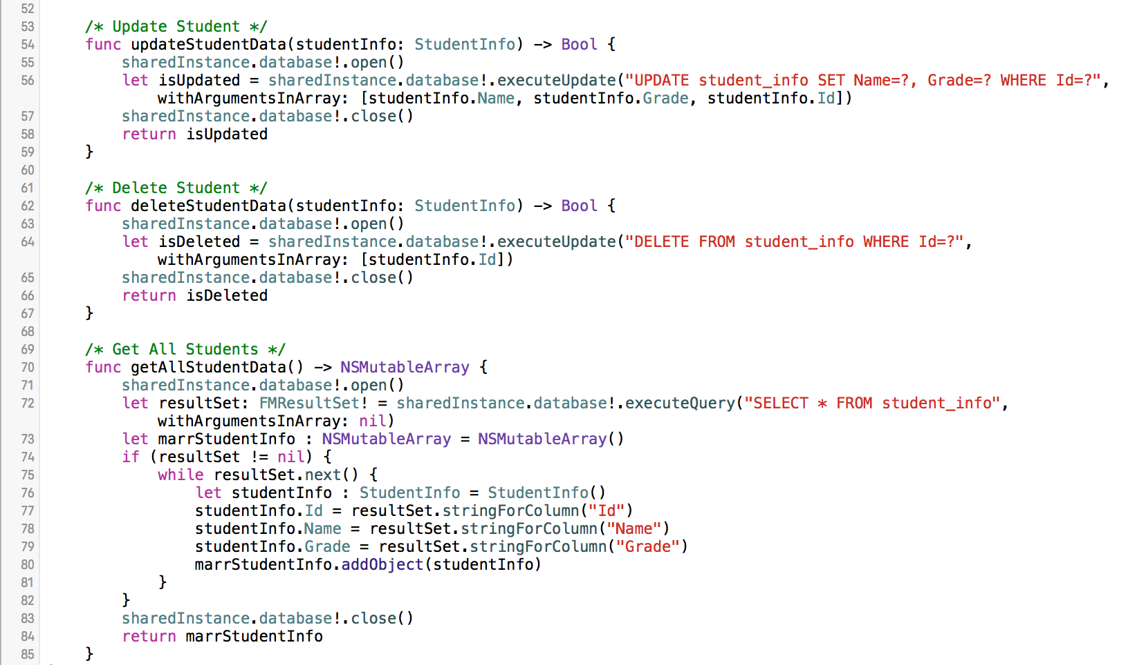
Code

Slide 44
My Thoughts on Using Xcode
Mobile/App Development
Coding Assistance
Database Assistance ?
Usability

Slide 45
BIBLIOGRAPHY
https://developer.apple.com/swift/
https://swift.org/
http://tnw.to/d4l1C
https://en.wikipedia.org/wiki/Swift_(programming_language)
http://code.tutsplus.com/tutorials/protocol-oriented-programming-in-swift-2--cms-24979
https://www.weheartswift.com/object-oriented-programming-sw
https://cocoapods.org/pods/SwiftMongoDB
http://www.theappguruz.com/blog/use-sqlite-database-swift
https://developer.apple.com/library/ios/documentation/Swift/Conceptual/Swift_Programming_Language/TheBasics.html#
http://codewithchris.com/iphone-app-connect-to-mysql-database/#connectiphonetomysql
https://www.perfect.org/about.html
https://developer.apple.com/library/mac/documentation/Foundation/Reference/NSURLSession_class/index.html#//apple_ref/occ/cl/NSURLSession

