Slide 1

Investigating Coordination Signals in Multi-Agent Tool-Using Language Models
Auditable actions, synthetic outcomes, and evidence boundaries
Dhruva N | PES University
30-minute research presentation | Reviewers and mentors

Slide 2
Why success is not the same as coordination
Outcome-only evaluation hides how the work was done
A shared result
A hidden process
A bounded signal
A group can complete a task while members act independently or repeat work.
Success alone does not show which actions changed state or who contributed.
Action traces expose behavior, but do not automatically establish emergence.
Study lens: actions + shared state + stopping outcome, interpreted within the evidence boundary.
EMERGENT COORDINATION | 02

Slide 3
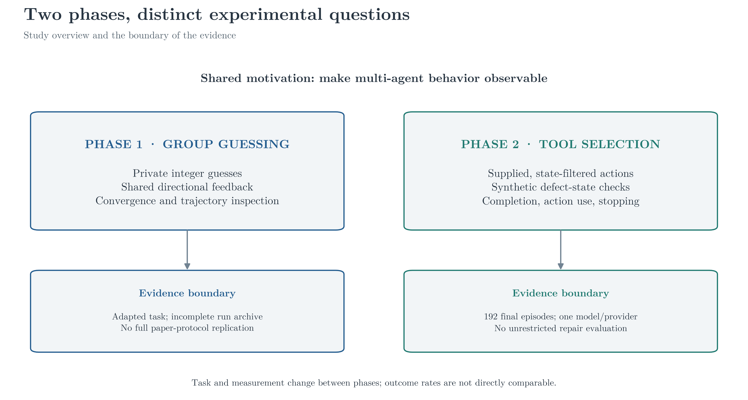
Two phases, different experimental questions
The tool-use study is an extension, not a direct replication
Earlier guessing-game and later tool-use outcomes are not directly comparable.
EMERGENT COORDINATION | 03

Slide 4
Three descriptive research questions
Matched assignments organize comparisons; they do not remove all design limits
01 Outcomes
02 Behavior
03 Stopping
How do success, partial, and failure counts differ across matched policies?
How do action volume, tool mix, and nominal actor participation differ?
When do episodes finalize with required work still unresolved?
Contribution: auditable action-to-outcome traces in a controlled synthetic environment.
EMERGENT COORDINATION | 04

Slide 5
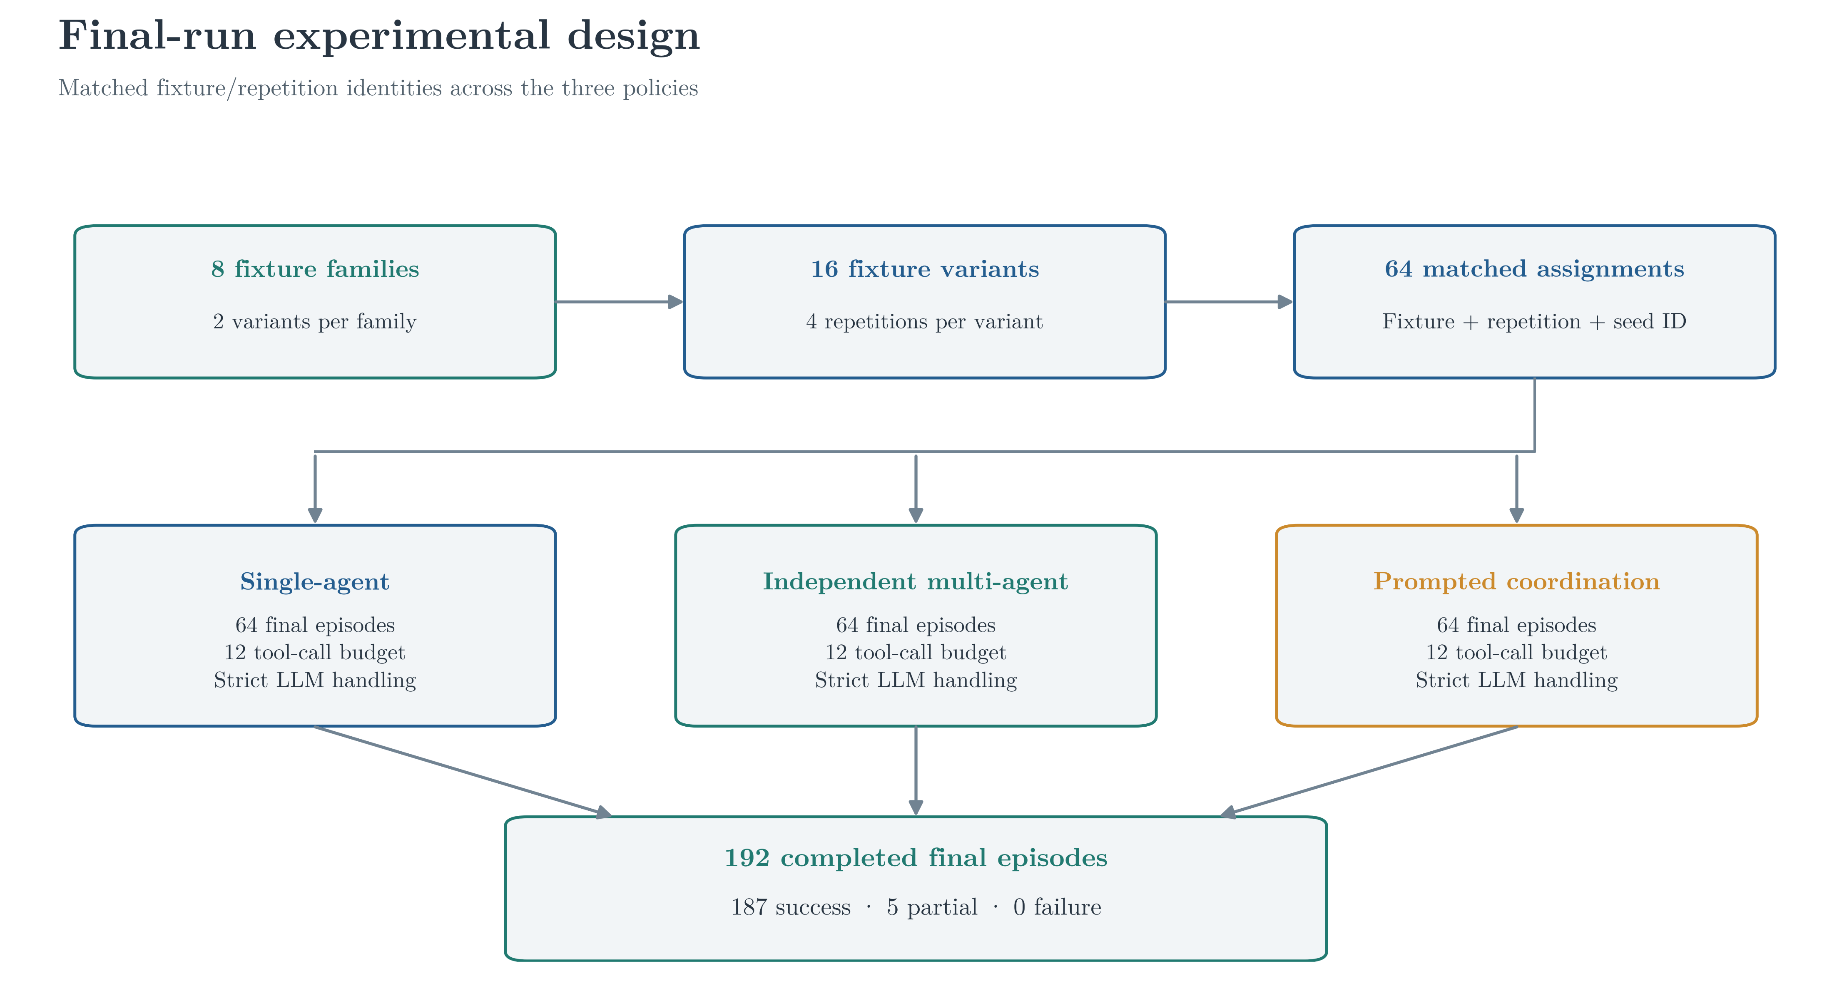
Final-run experimental design
Same fixture, repetition, and seed identities across all three policies
EMERGENT COORDINATION | 05

Slide 6
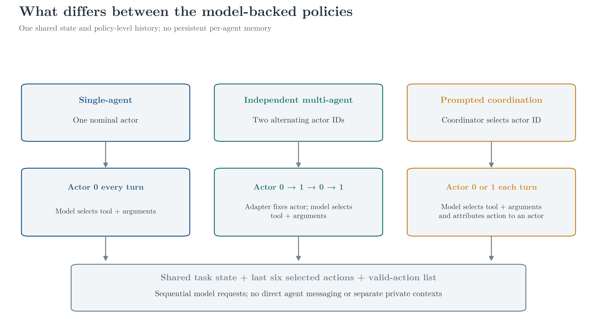
What differs between the model-backed policies?
Nominal actors are roles in one shared sequential action process
EMERGENT COORDINATION | 06

Slide 7
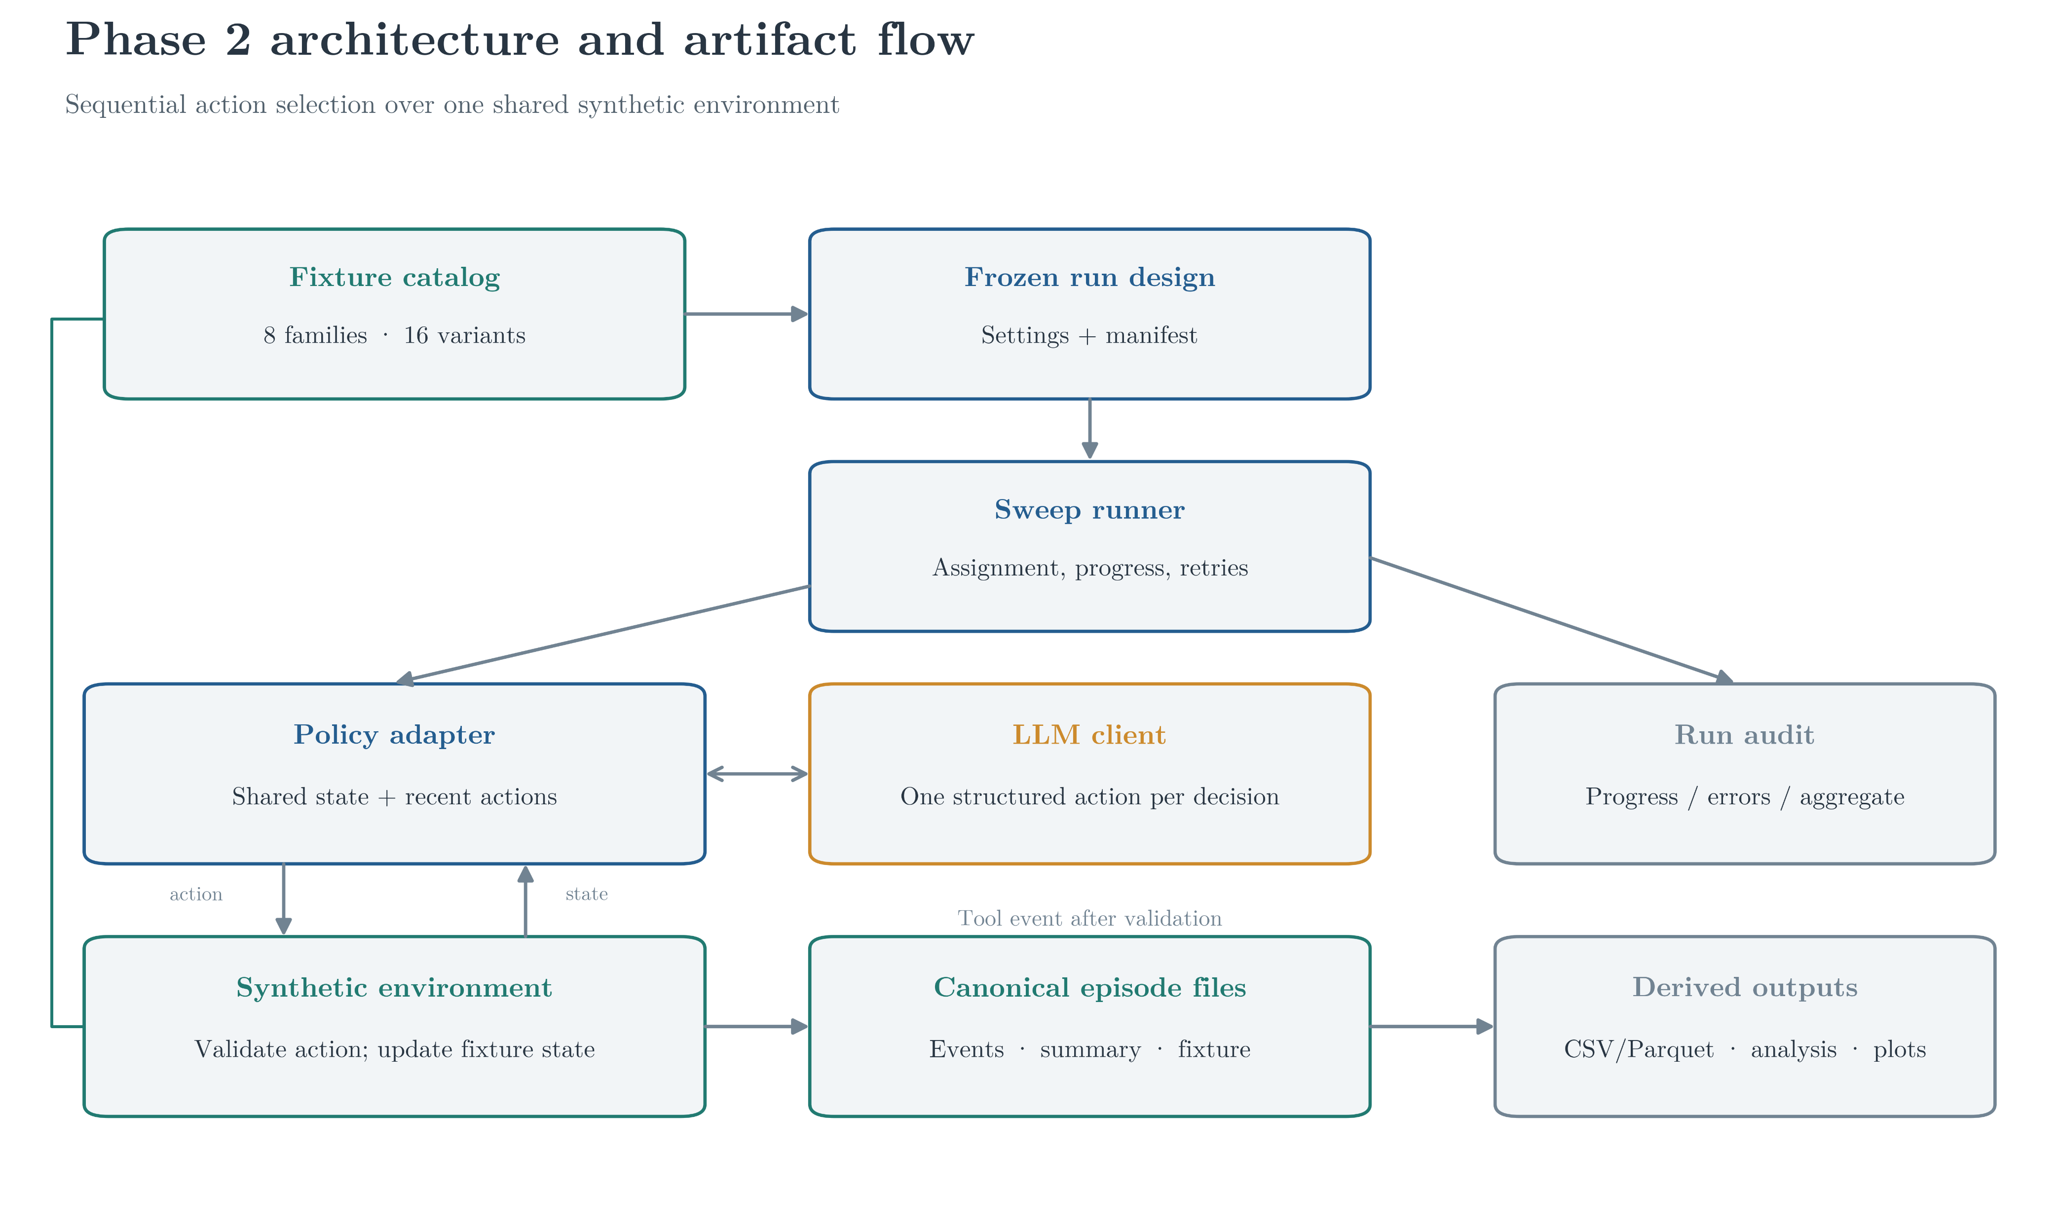
Phase 2 architecture and artifact flow
One action per decision over a shared synthetic environment
EMERGENT COORDINATION | 07

Slide 8
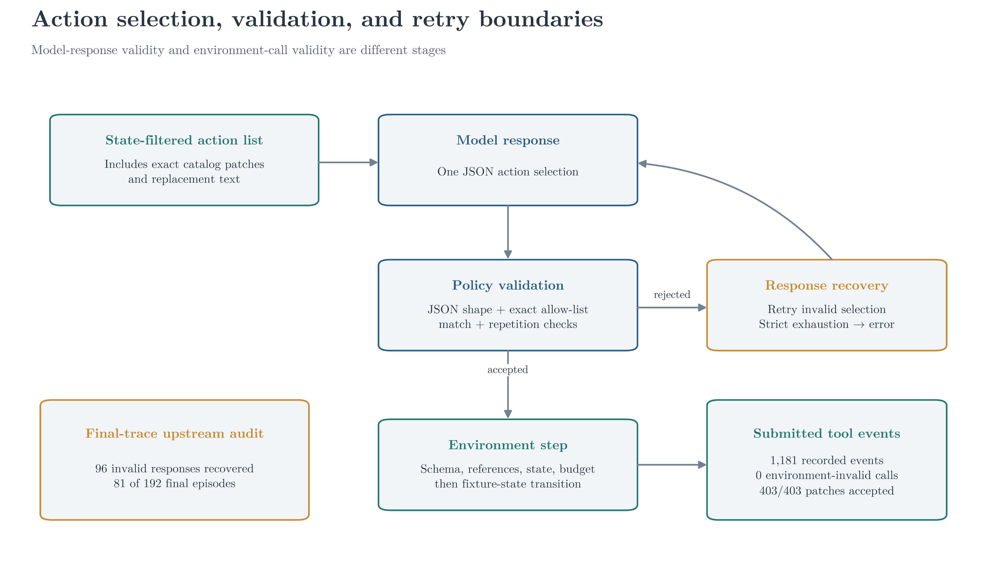
Action selection, validation, and retry boundaries
Model-response validity and environment-call validity are separate stages
EMERGENT COORDINATION | 08

Slide 9
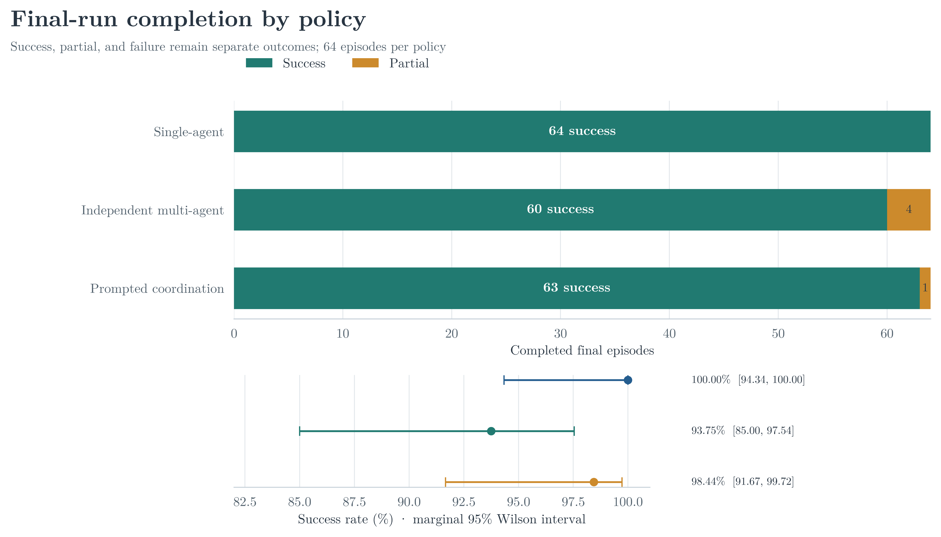
Final outcomes: near-ceiling completion
192 completed episodes; 64 final traces per policy
EMERGENT COORDINATION | 09

Slide 10
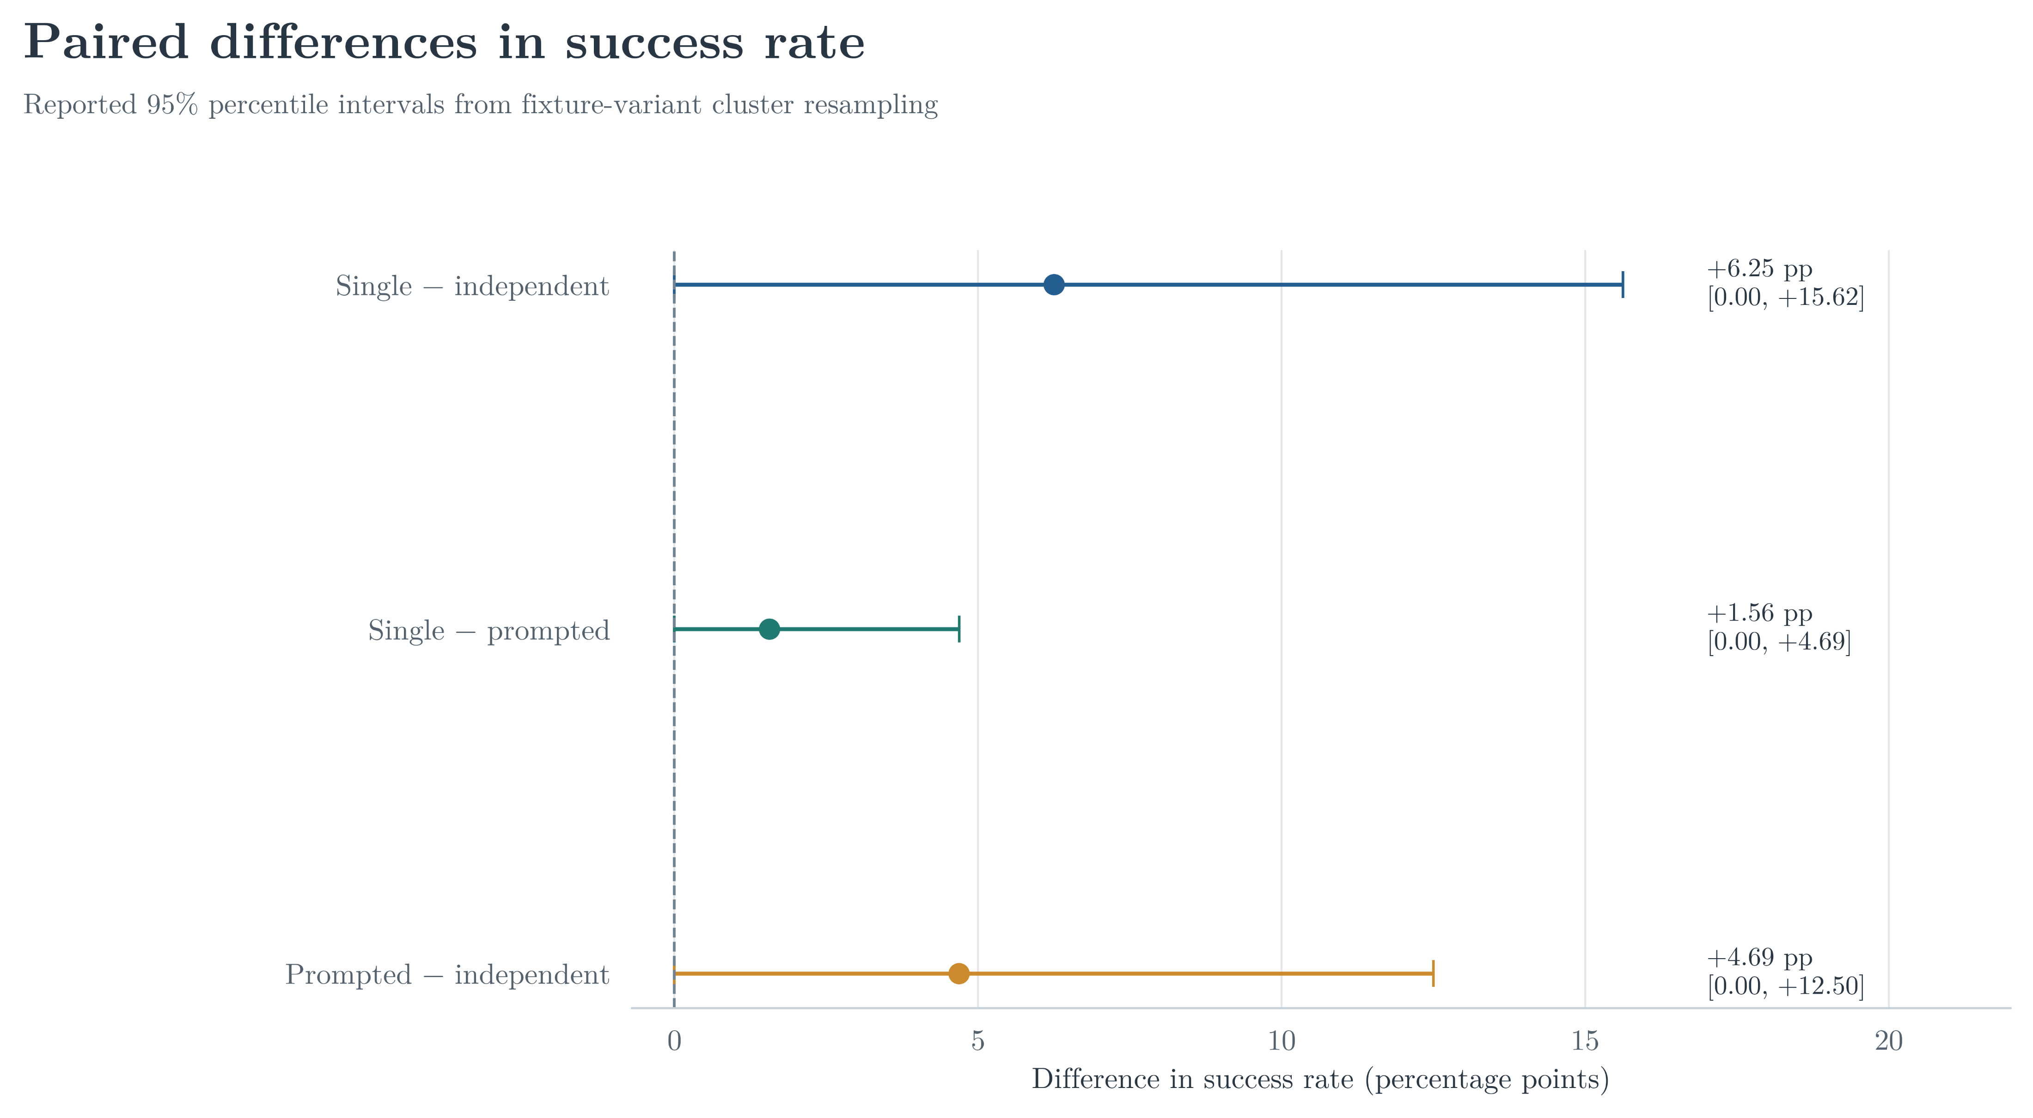
Matched success-rate differences are small
Reported 95% fixture-cluster bootstrap intervals include zero
EMERGENT COORDINATION | 10

Slide 11
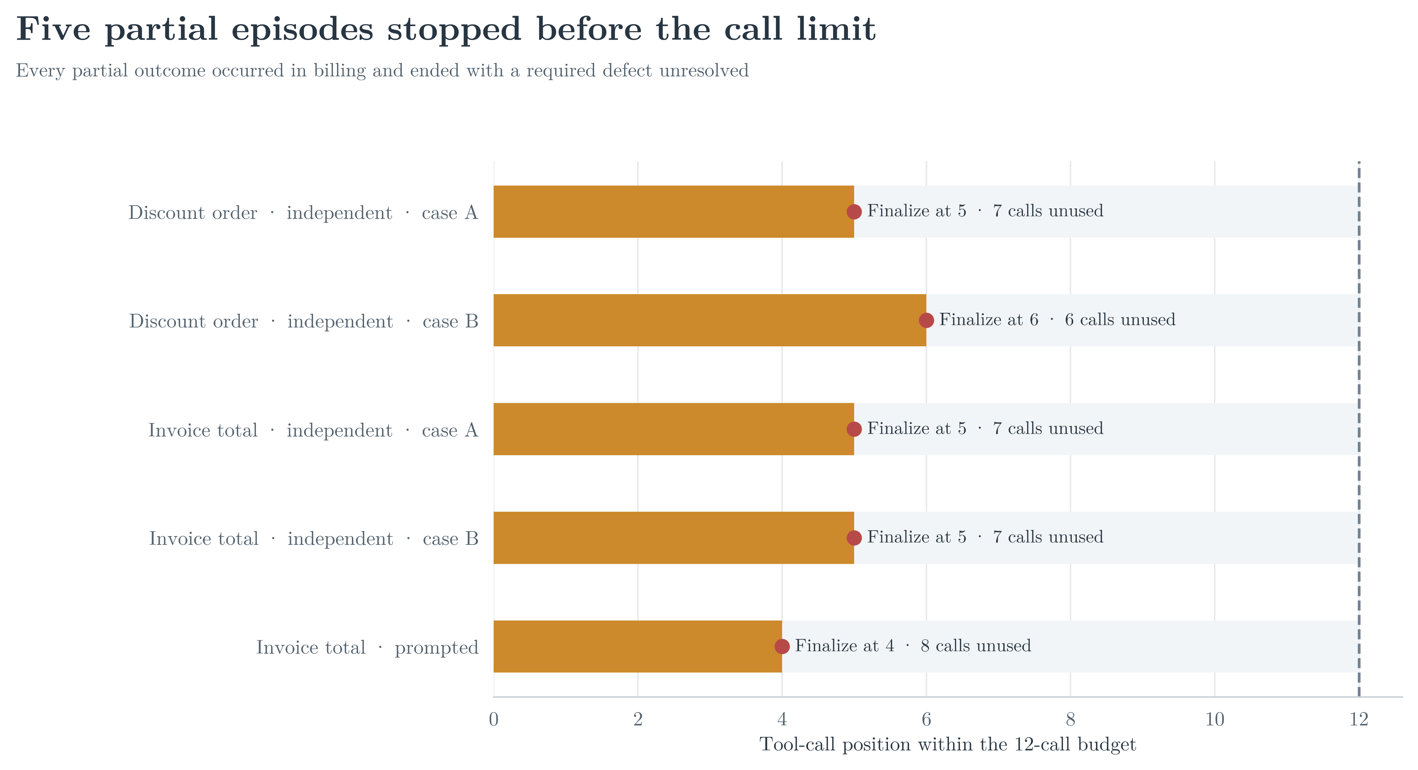
Five partial episodes stopped before the call limit
Every partial occurred in billing with required work unresolved
EMERGENT COORDINATION | 11

Slide 12
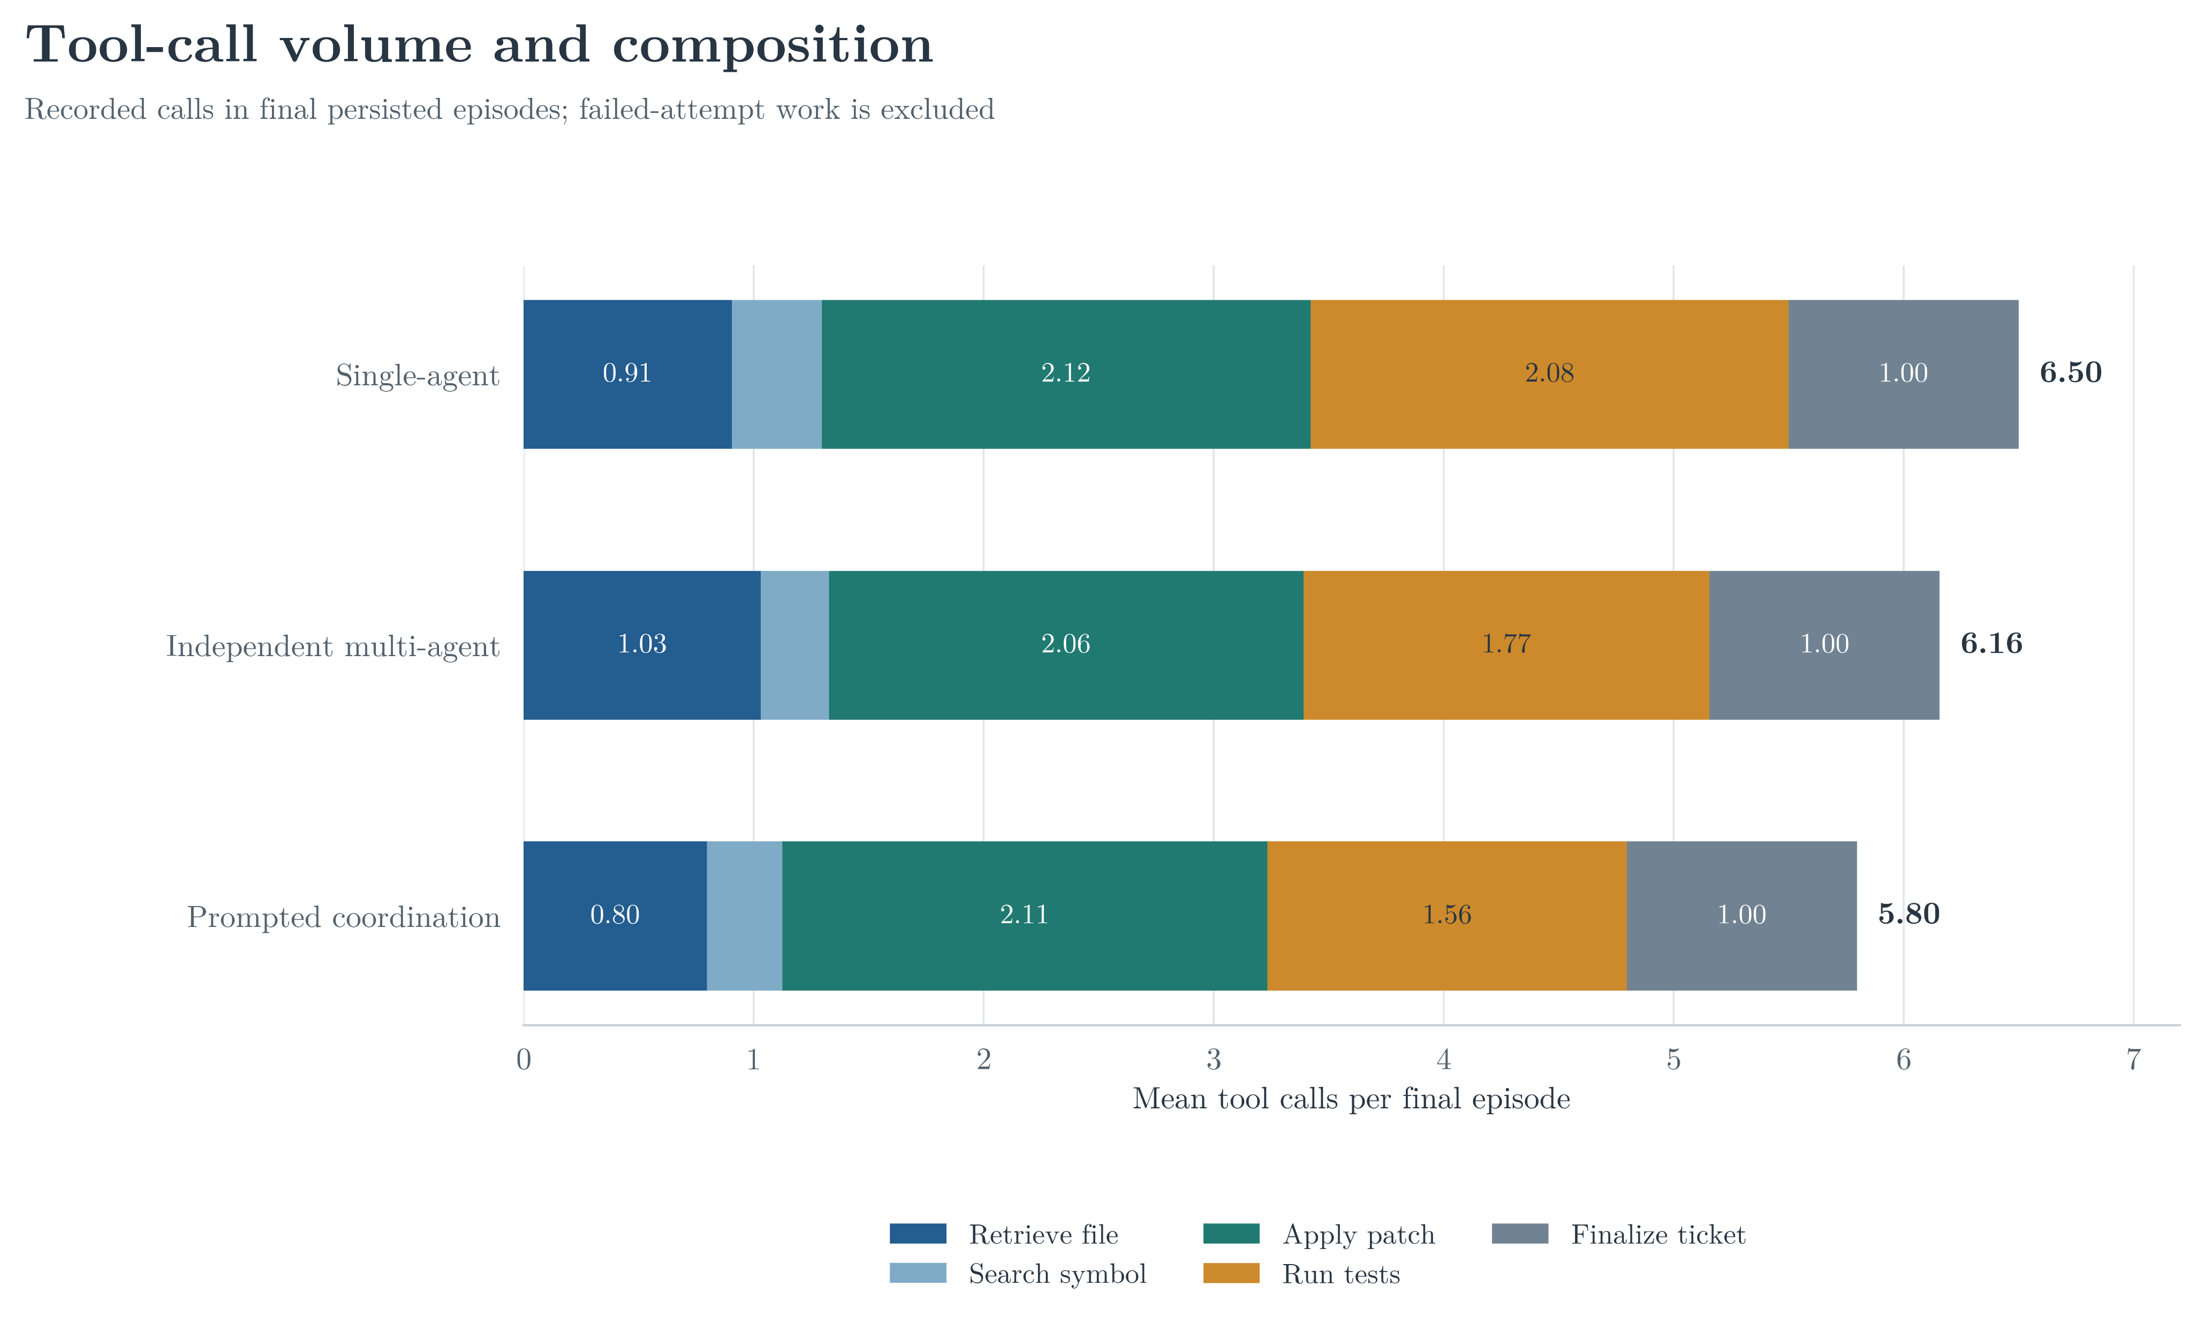
Tool-call volume and composition
Final persisted traces; failed-attempt work is excluded
EMERGENT COORDINATION | 12

Slide 13
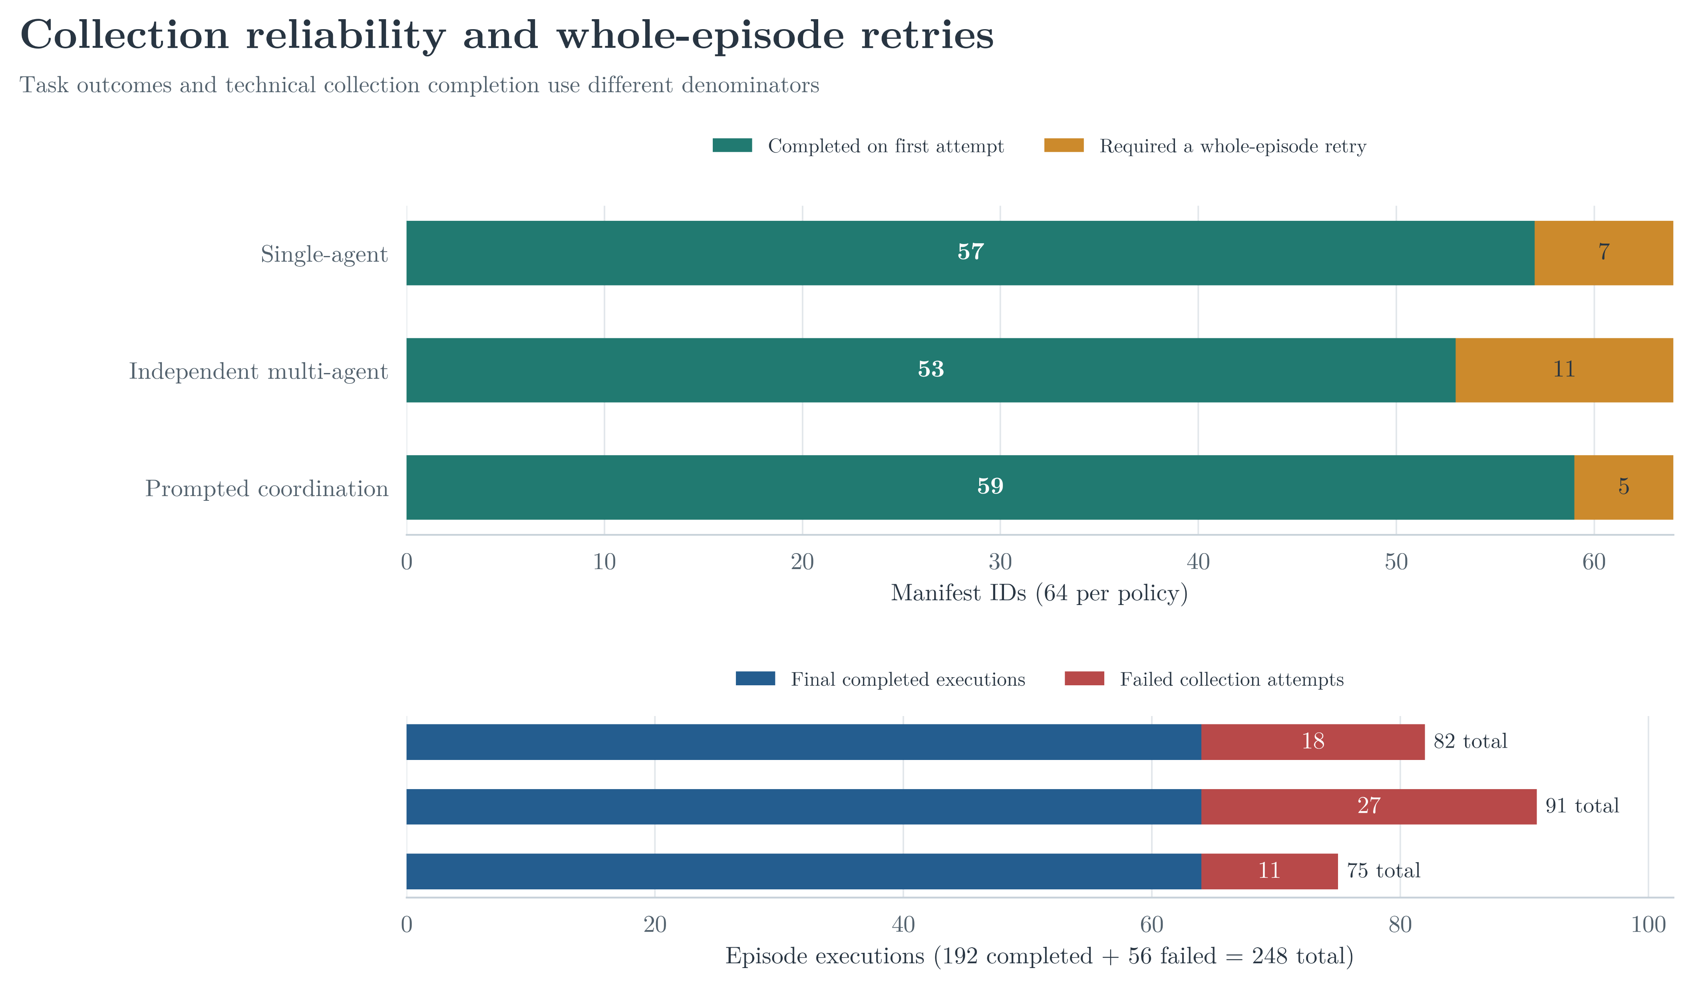
Collection reliability is not task performance
Response retries and whole-episode retries use different units
EMERGENT COORDINATION | 13

Slide 14
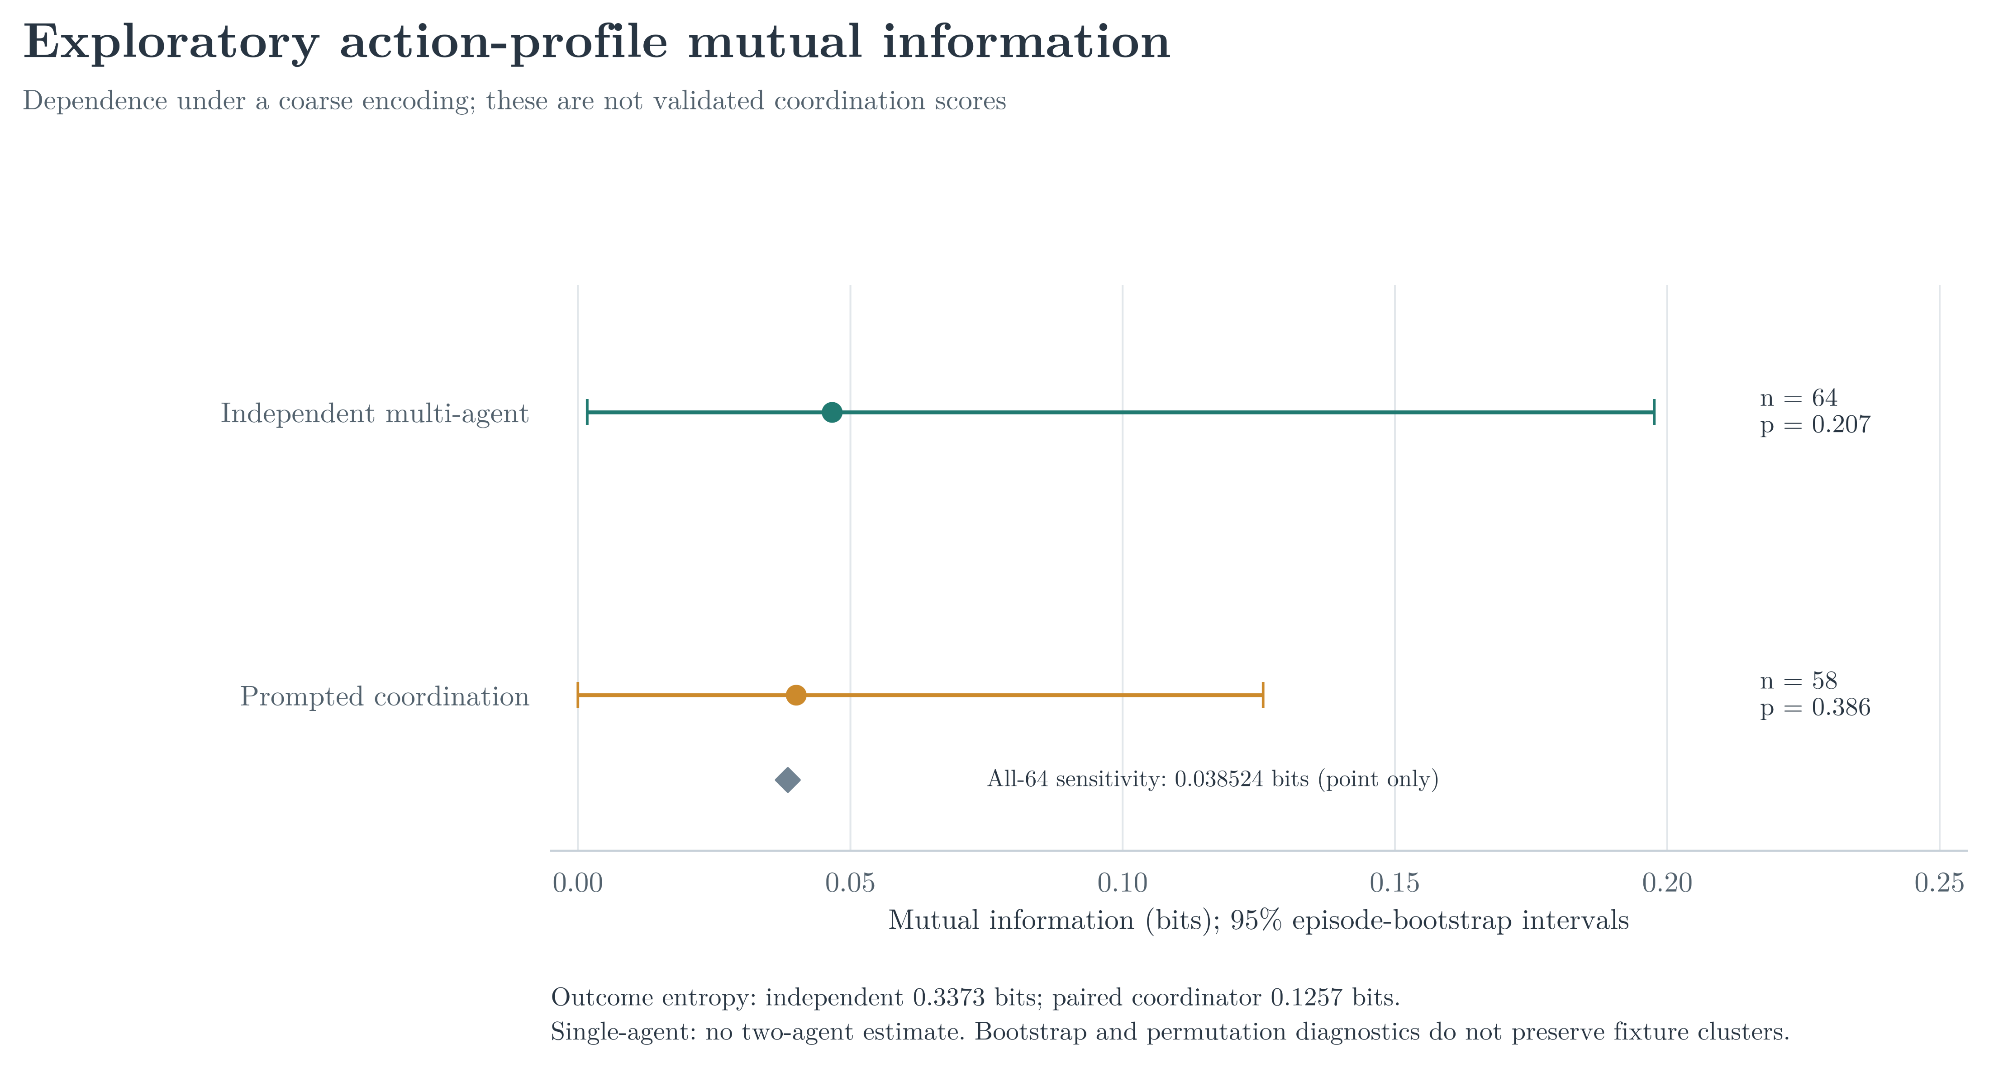
Action-profile mutual information is exploratory
Small estimates, sparse outcomes, and priority-compressed categories
EMERGENT COORDINATION | 14

Slide 15
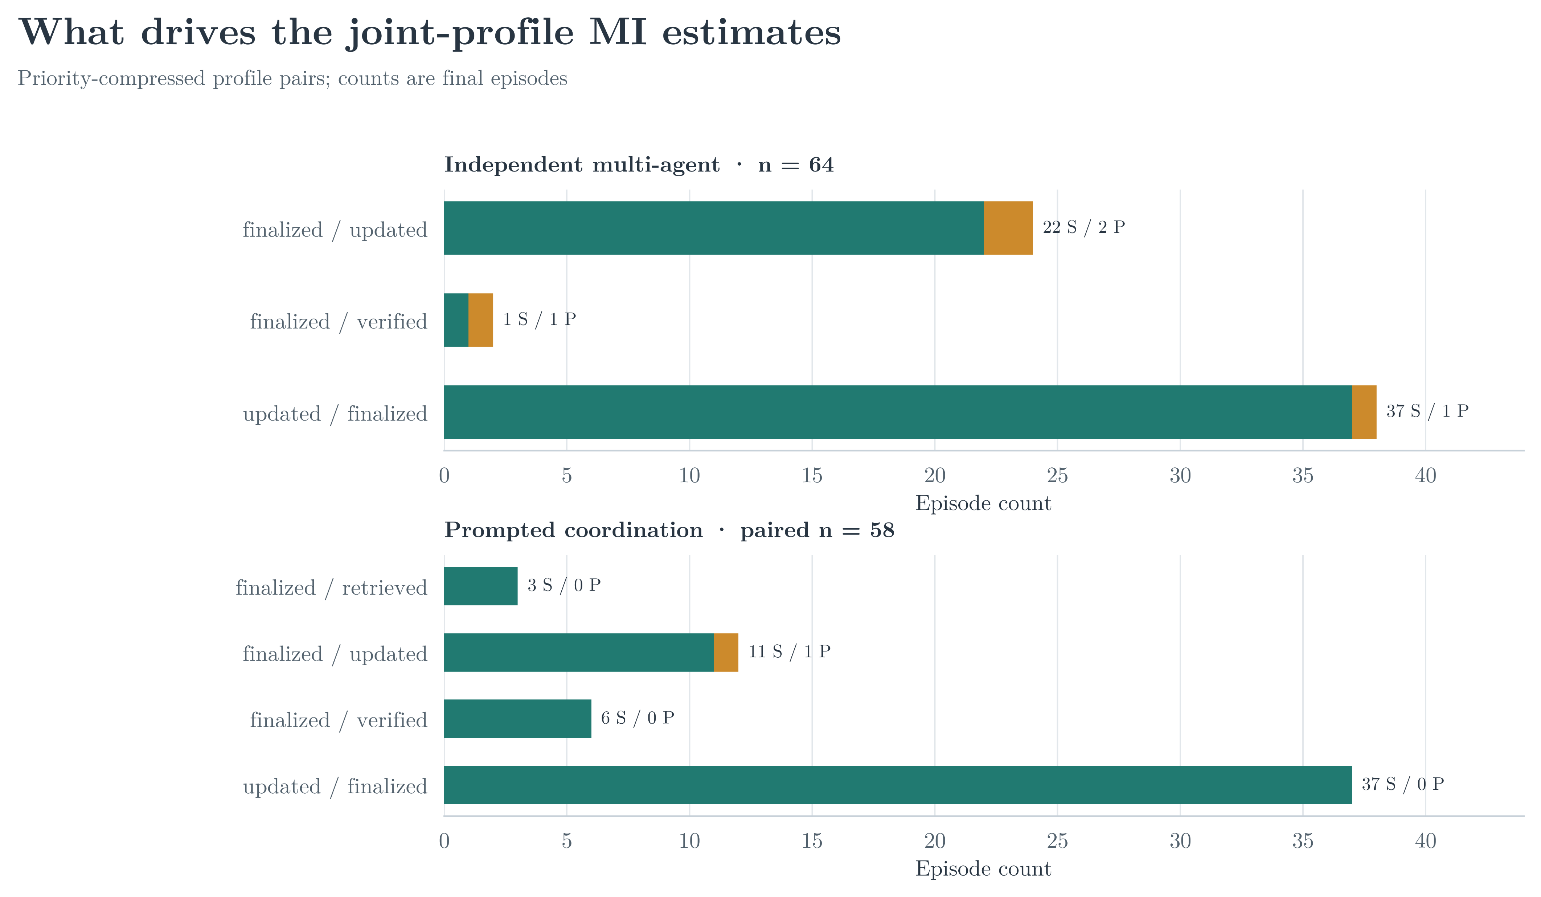
What drives the joint-profile estimates?
Every observed profile contains a finalized category
EMERGENT COORDINATION | 15

Slide 16
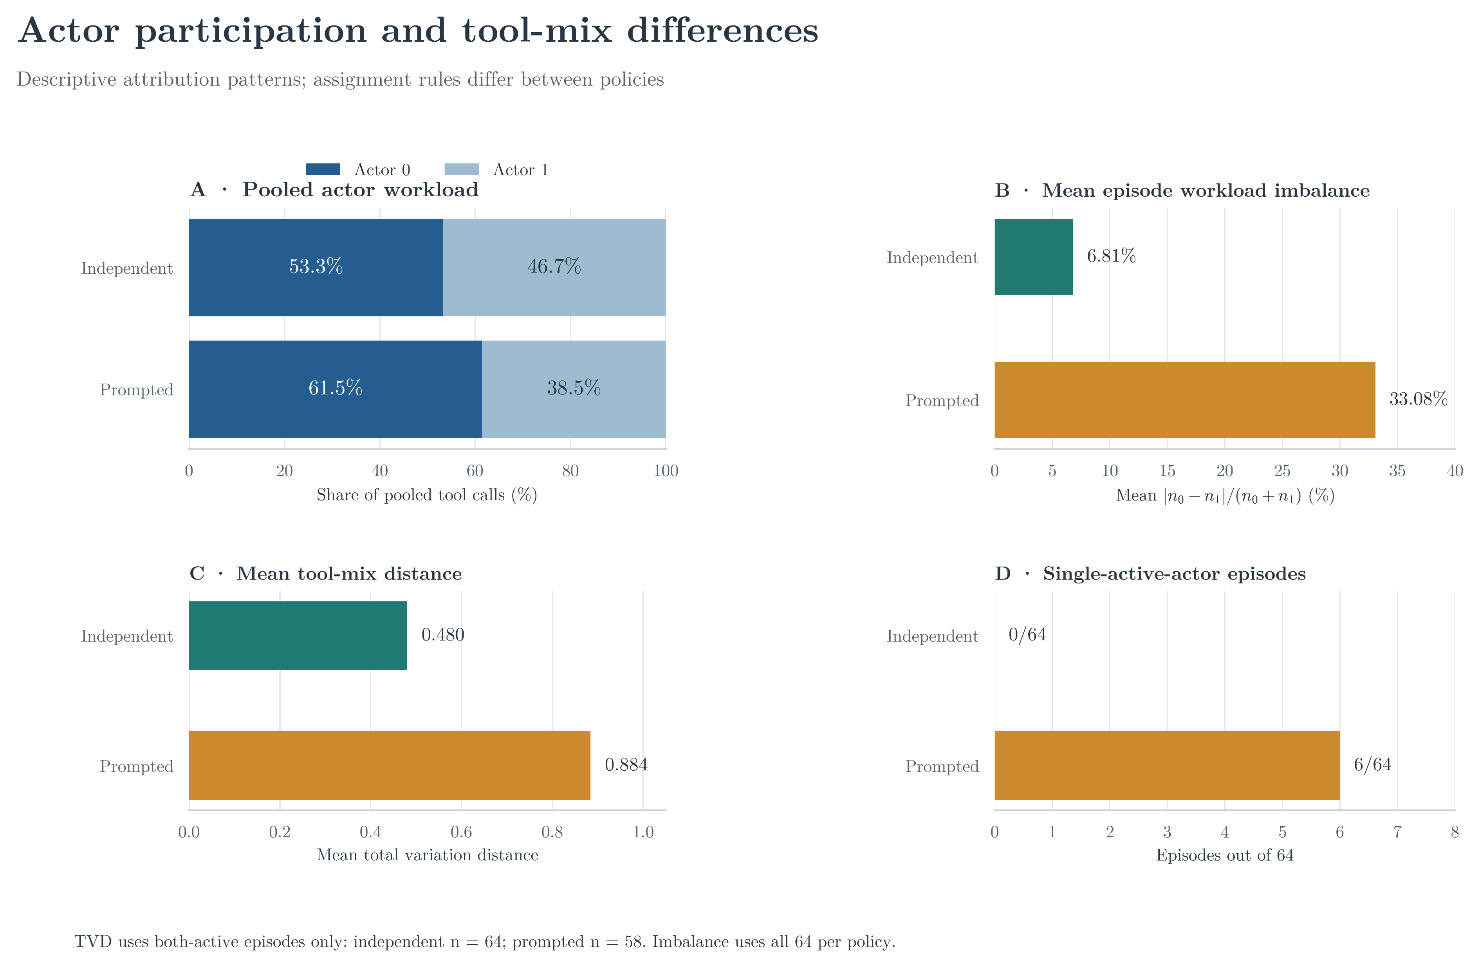
Actor participation and tool mix
Assignment rules differ; imbalance is not emergent specialization
EMERGENT COORDINATION | 16

Slide 17
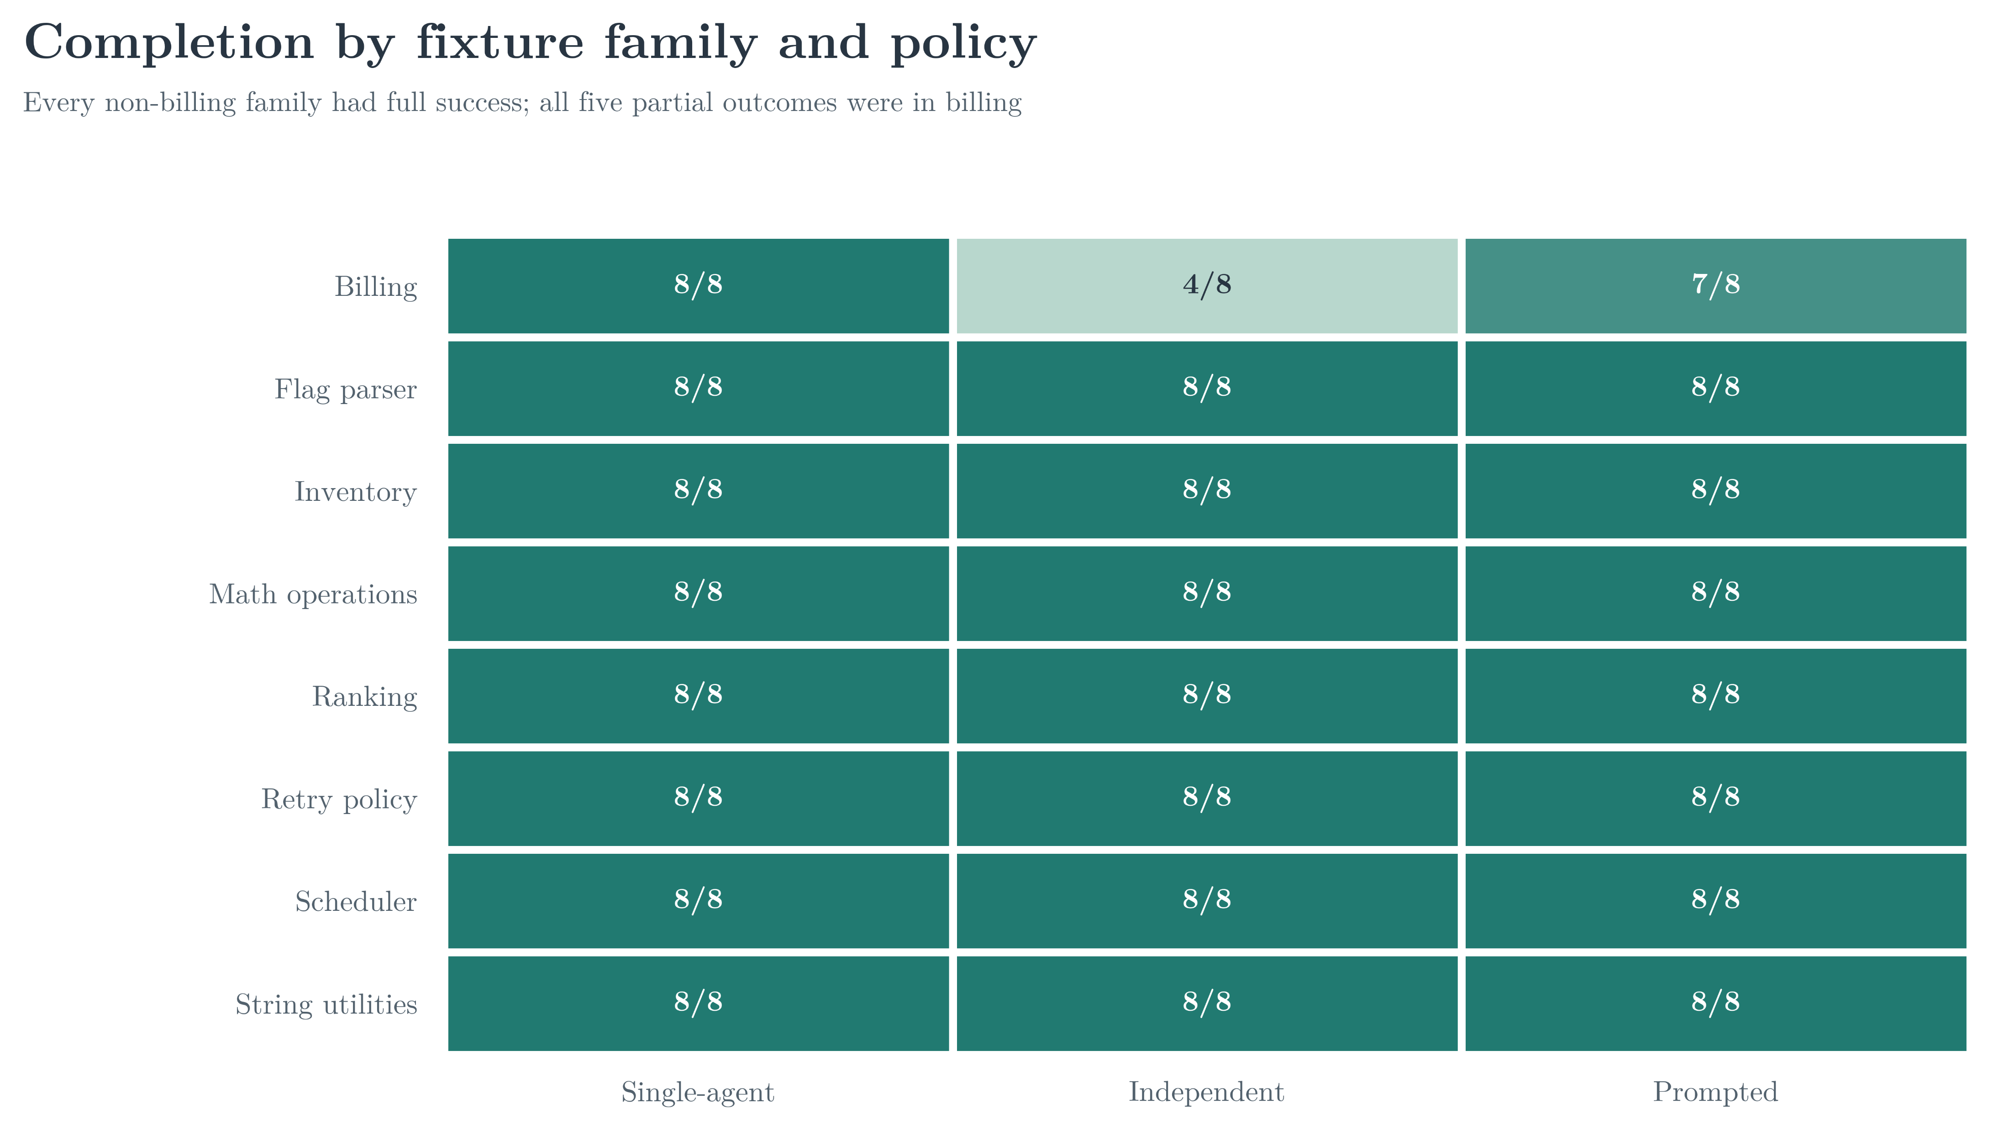
Partial outcomes were concentrated in billing
Every non-billing family had full success in this saved run
EMERGENT COORDINATION | 17

Slide 18
What the evidence supports - and does not
Interpret results within task, model, and action-interface boundaries
Supports
Does not establish
Important limits
Auditable traces; descriptive outcomes; a concrete early-finalization pattern.
Policy superiority, a prompt-only causal effect, or emergent specialization.
One model/provider; synthetic fixtures; supplied patches; tests do not execute code.
The MI statistic is not the motivating paper's temporal information decomposition.
EMERGENT COORDINATION | 18

Slide 19
Takeaways and next study
Stronger coordination claims need separable interventions and richer evidence
What we observed
What to test next
192 final traces; 187 successes; 5 partials; 0 failures. Every partial finalized early in billing.
Separate wording from actor assignment; preserve action order; broaden validated task difficulty.
Bottom line: action traces make behavior inspectable; current results remain descriptive and bounded.
EMERGENT COORDINATION | 19

Slide 20
Questions and discussion
What would distinguish useful coordination from shared task difficulty?
25-minute talk | 5-minute Q&A

