Slide 1
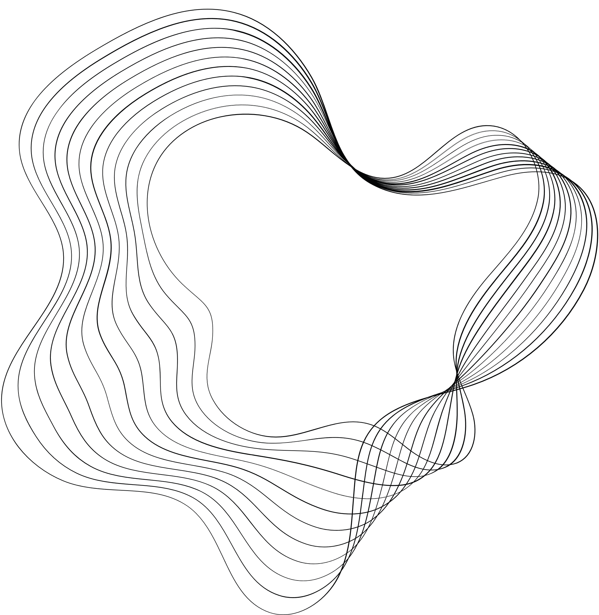

CREDIT CARD FRAUD DETECTION
PROJECT
DHRUV ARORA, KARAMVIR SINGH BATRA

Slide 2

PROBLEM STATEMENT
Build a machine learning model to detect fraudulent credit card transactions by analyzing transaction features and classifying transactions as either “normal” or “fraudulent.”

Slide 3
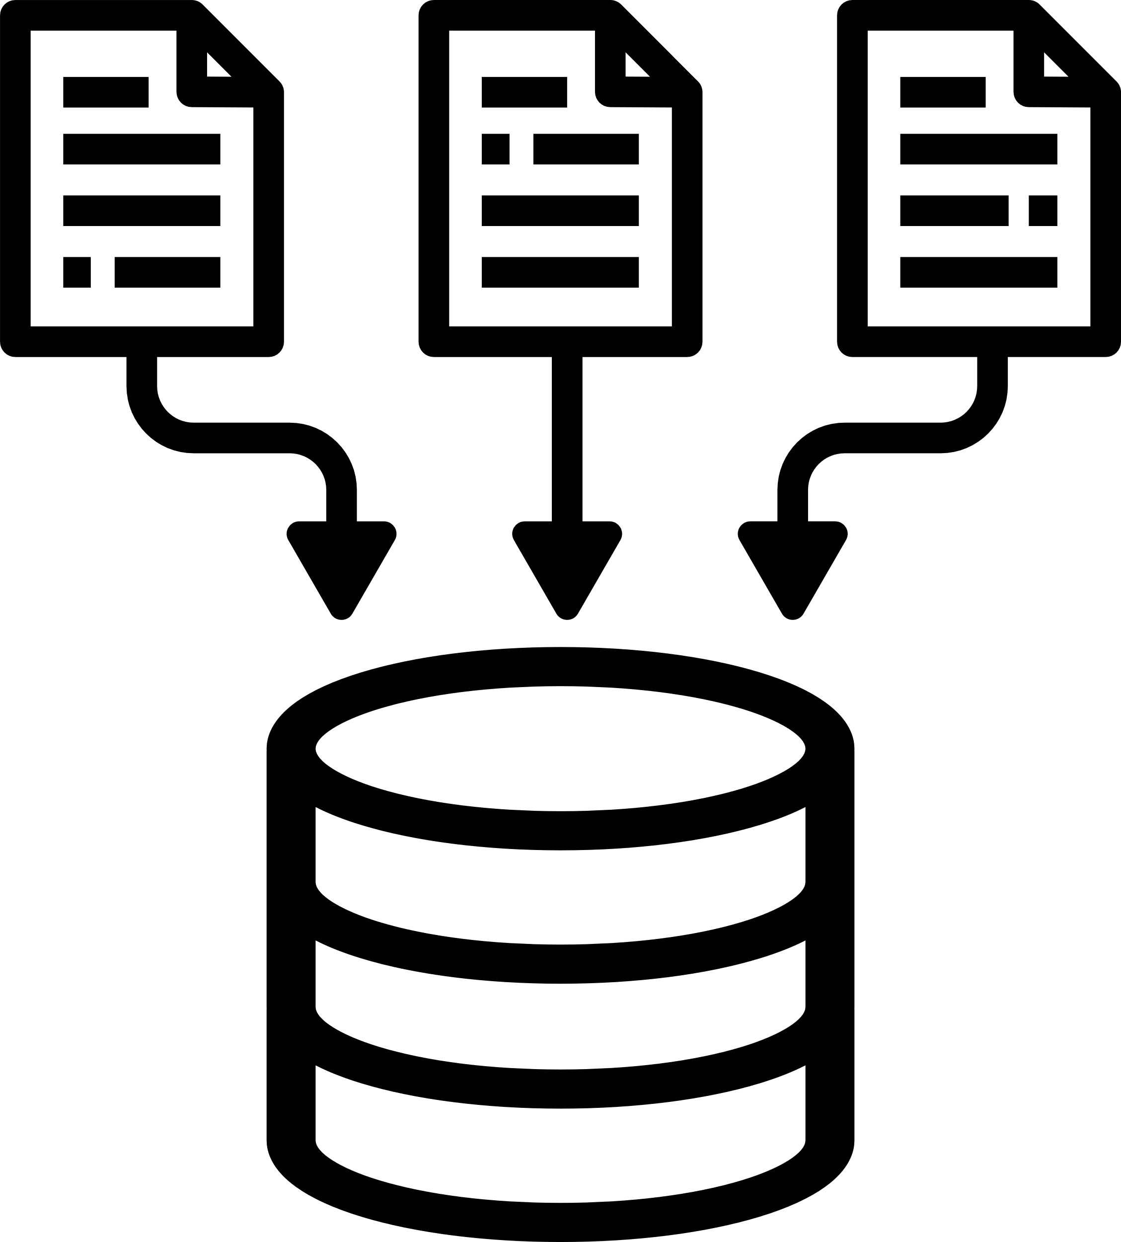





FLOW DIAGRAM
Train Models on this Data
Credit Card Data
Data Preprocessing
Deployement
Visualize Results
Evaluate Model Results

Slide 4

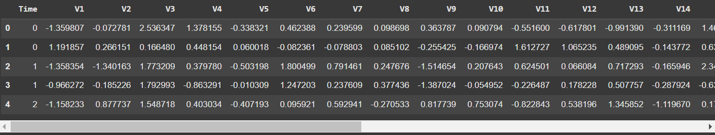
DATASET INFORMATION
AND SAMPLE
Dataset Source: Credit Card Transactions Dataset
Features: Time: Time, 28 different Attributes, Amount, Class: Target variable (1 = fraud, 0 = normal).
Data Dimensions: 284807 samples, 31 features (including target)

Slide 5

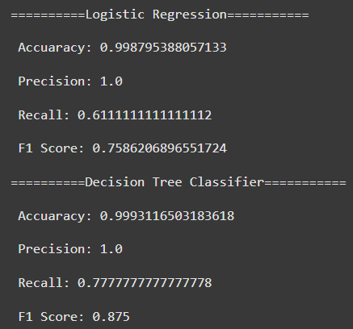
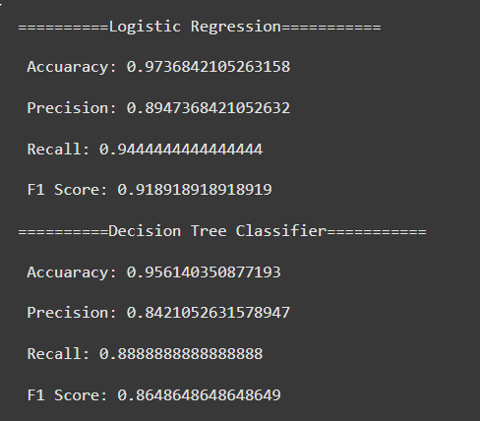
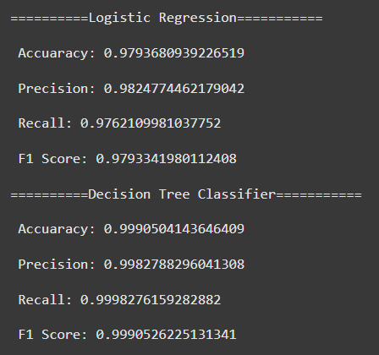
PERFORMANCE METRICS
We used Logistic Regression and Decision Tree Classifier to build and evaluate models for credit card fraud detection, comparing their performance on various metrics.
Accuracy: Percentage of correctly classified instances.
Precision: Ability of the model to correctly identify fraud cases (class 1).
Recall: Ability of the model to detect all fraudulent transactions.
F1 Score: Harmonic mean of precision and recall, providing a balanced measure
No Sampling
Undersampling
Oversampling

Slide 6
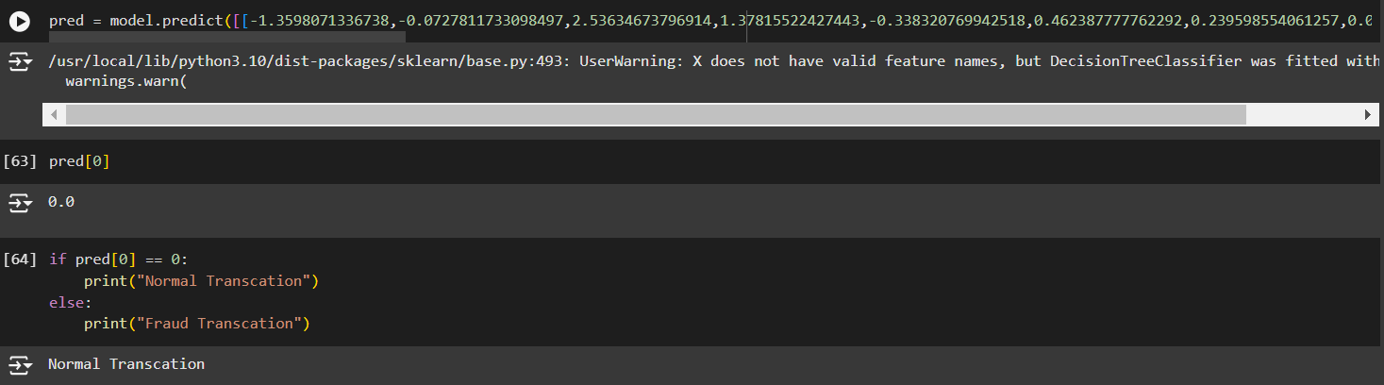
RESULTS
After training the model, the goal is to save it for future use and to make predictions on new, data.
Steps:
Saving the Model: The trained model is saved using joblib for reuse.
Loading the Model: The saved model can be loaded and used to predict fraudulent transactions on new datasets.
Prediction Example: Make a prediction for a new transaction using the trained model.

Slide 7
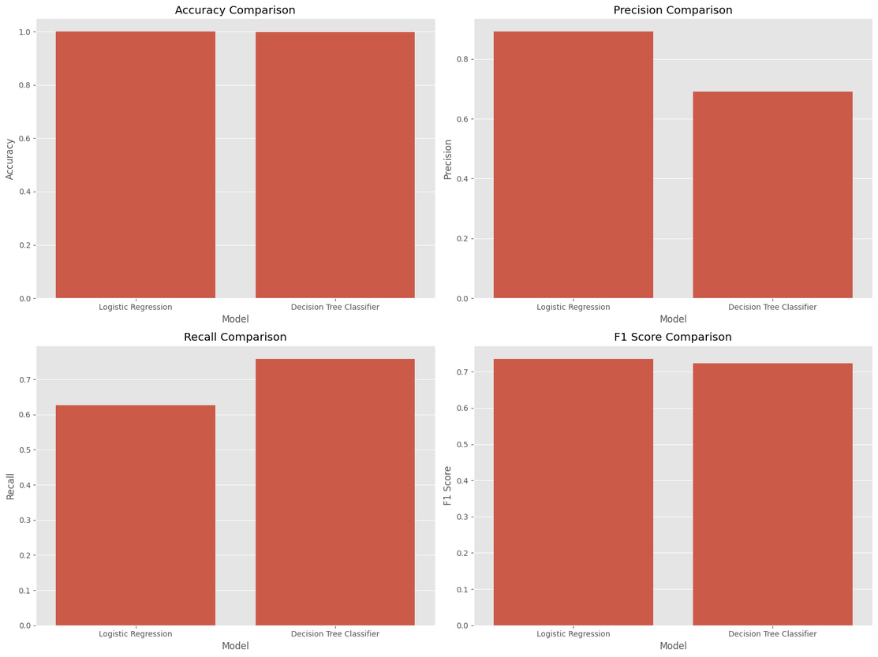
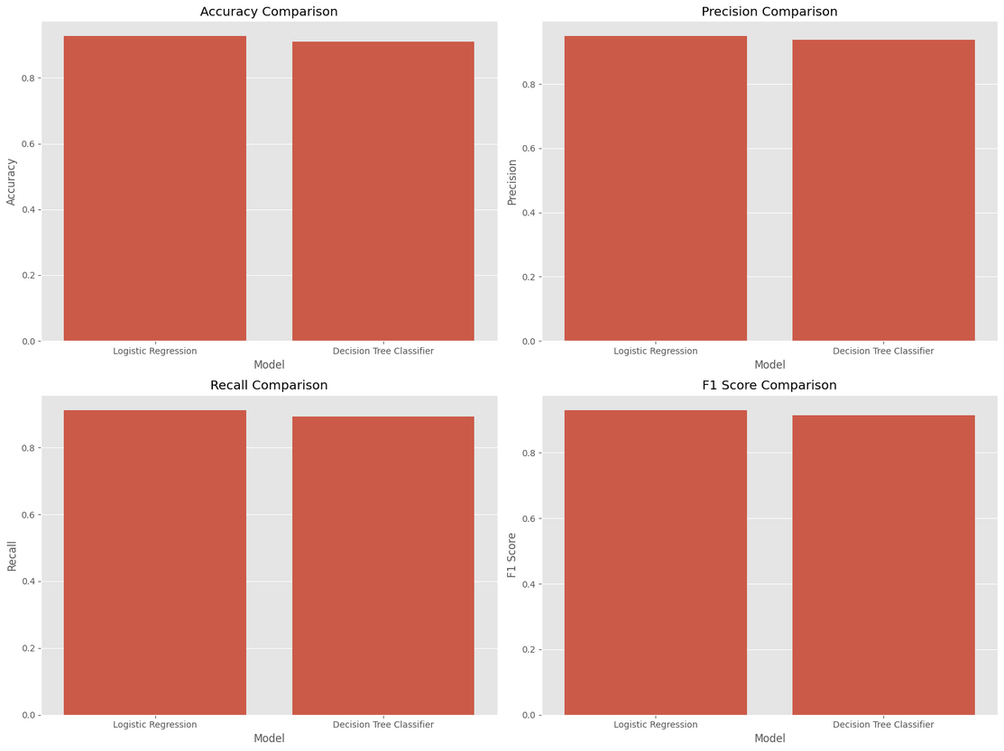
RESULTS
No Sampling
Under Sampling

Slide 8
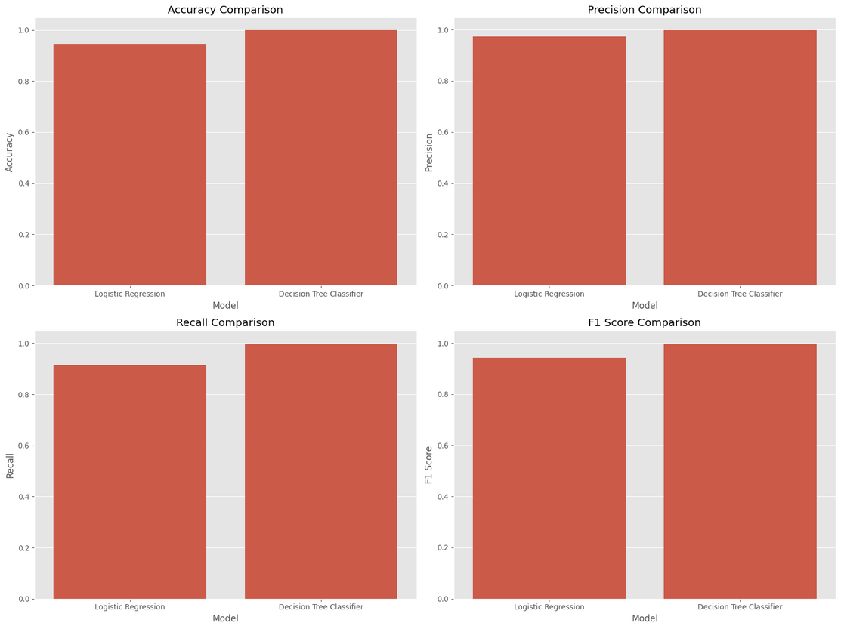
RESULTS
Over Sampling

Slide 9
REFERENCES
Dataset Source: Credit Card Fraud Detection Dataset
Available at: https://www.kaggle.com/datasets/mlg-ulb/creditcardfraud?resource=download
Tools and Libraries:
Pandas
scikit-learn documentation
matplotlib documentation
seaborn documentation

Slide 10
THANK YOU
We would like to express our gratitude to our teacher Dr Sanjeev Rao for giving us the opportunity to make this project. This project has not only enhanced our understanding of data analysis and machine learning but also allowed us to apply theoretical knowledge to solve real-world challenges.

