Slide 1
SharePoint Client Side Development
Using jQuery / Handlebars to develop SharePoint Applications
Dhruv Bhavsar and Michael Pullen
https://github.com/dhruvb14/SPFramework

Slide 2
SharePoint Client Side Development
jQuery
Handlebars
SharePoint Client Side Applications
SharePoint REST
Notes:
These are the main JavaScript frameworks we are using. Of course we have a lot of additional plugins and dependencies, but at it’s core all we are doing is using jQuery with Handlebars Templates. And since we are developing against SharePoint we will be retrieving data from the SharePoint REST API.
We are going to focus on how this development method works, what we need to-do to create a new widget, how we bundle our code, and how we test the bundle, and ultimately how this approach can simplify SharePoint development.

Slide 3
Overview
Application Lifecycle
How the bundle operates.
Dev VM Configuration
Getting your DEV VM Ready for Bundle Development
Development
Building a widget
Testing / Debugging
Testing your widget
Gotcha’s
Save time by avoiding common errors / issues.
Deployment
Everything is done, now we are going to deploy the bundle.
Notes:
These are the areas we will address today. At the end of the presentation there are links, as well as information on next steps.
There are several “TODO” that will help make development more uniform, I’ve identified them in the comments.

Slide 4
Application Lifecycle Phases
Init (Custom Action)
Injects /CSOM/init.js into every SharePoint page DOM using SharePoint Custom Action, or script link.
Loads bundle files into the DOM (.html, .css, .js)
Bootstrapper
Evaluates the DOM for elements containing [data-controller] tag.
For each data-controller tag, attempt to load the controller by using the data-controller tag value as the controller name, then calling controller.load
Controller
Load – entry point of the controller, should generate the initial view model, load data, then call render to bind the view model to the view.
Render – function should receive the view model, load the handlebars view template bind the view model to the view, and output the result back to the DOM.
Calls Contoso.bootstrap function (in bundle.js) to load the controllers
Notes:
JSBundle Loader – The custom action that is loaded into the script block. This custom action writes a script reference to /CSOM/init.js into the DOM on each SharePoint page within the site collection.
-- init.js loads the bundle files, in the order below. The bundle files contain the JavaScript controllers, the CSS styles and the Handlebars Template code.
-- bundle.html is inserted into the DOM of the page. This makes all of the handlebars templates available to the DOM. The controllers will load these templates from the DOM later on.
-- bundle.css is inserted into the DOM of the page. This makes all the CSS styles defined for the bundle available.
-- bundle.js is loaded into the DOM. This makes all the JavaScript that resides within the bundle available.
Q: What is Handlebars? A. Handlebars allows us to build semantic templates http://handlebarsjs.com/
Once all of those files are loaded, init.js calls OSC.bootstrapper() which performs the next series of actions to run the controllers on the page.
Bootstrapper – The bootstrapper function (located in OSC.js)
-- checks to see if the current page is in edit mode.
-- In edit mode we don’t load controllers, as the generated views are then saved back into the document. We might want to add another data-controller tag to the page.
-- If the document isn’t in edit mode, we use a jQuery selector for all elements with the [data-controller] tag defined.
var controllers = $('[data-controller]').each(function (index, value) { then attempts to find the controller, and call the controllers.load function }
NOTE (Magic happens here): The data-controller=“ControllerName” must match the Controllers.ControllerName in the JavaScript controller. The naming is how we map controllers to the page element.
Controller
load function
is the entry point for each controller it is called by the bootstrapper. The load function should generate an initial view model, of the data you will bind to your view, then load that data from data sources, then call the render function and pass the view model to render the widget.
Define the View Model
Load data into the view model
Call render and pass the view model.
render function
is the function that handles binding the view model to the handlebars template, and rendering the resulting HTML into the DOM. It should receive the view model as a parameter.
Loads the Handlebars Template.
Binds the View Model to the template to generate the HTML view.
Binds the view generated back to the DOM by using the data-controller=‘ControllerName’ tag.
Advanced: You can pass ID, and other parameters into the render function and target specific elements when you want to re-use the same controller multiple times on a single page.

Slide 5
Phase: Init
Inject
Load
/CSOM/init.js is injected into the DOM
Init.js function begins to load the bundle files.
Bundle.html inserted into the DOM.
Link to Bundle.css is inserted into the DOM
Script link to Bundle.js is inserted into the DOM.
Bootstrap
Finally init.js will call the Contoso.bootstrap function, which starts the next phase.
Notes:
JSBundle Loader – The custom action that is loaded into the script block. This custom action writes a script reference to /CSOM/init.js into the DOM on each SharePoint page within the site collection.
-- init.js loads the bundle files, in the order below. The bundle files contain the JavaScript controllers, the CSS styles and the Handlebars Template code.
-- bundle.html is inserted into the DOM of the page. This makes all of the handlebars templates available to the DOM. The controllers will load these templates from the DOM later on.
-- bundle.css is inserted into the DOM of the page. This makes all the CSS styles defined for the bundle available.
-- bundle.js is loaded into the DOM. This makes all the JavaScript that resides within the bundle available.
Q: What is Handlebars? A. Handlebars allows us to build semantic templates http://handlebarsjs.com/
Once all of those files are loaded, init.js calls OSC.bootstrapper() which performs the next series of actions to run the controllers on the page.
Bootstrapper – The bootstrapper function (located in OSC.js)
-- checks to see if the current page is in edit mode.
-- In edit mode we don’t load controllers, as the generated views are then saved back into the document. We might want to add another data-controller tag to the page.
-- If the document isn’t in edit mode, we use a jQuery selector for all elements with the [data-controller] tag defined.
var controllers = $('[data-controller]').each(function (index, value) { then attempts to find the controller, and call the controllers.load function }
NOTE (Magic happens here): The data-controller=“ControllerName” must match the Controllers.ControllerName in the JavaScript controller. The naming is how we map controllers to the page element.
Controller
load function
is the entry point for each controller it is called by the bootstrapper. The load function should generate an initial view model, of the data you will bind to your view, then load that data from data sources, then call the render function and pass the view model to render the widget.
Define the View Model
Load data into the view model
Call render and pass the view model.
render function
is the function that handles binding the view model to the handlebars template, and rendering the resulting HTML into the DOM. It should receive the view model as a parameter.
Loads the Handlebars Template.
Binds the View Model to the template to generate the HTML view.
Binds the view generated back to the DOM by using the data-controller=‘ControllerName’ tag.
Advanced: You can pass ID, and other parameters into the render function and target specific elements when you want to re-use the same controller multiple times on a single page.

Slide 6





Phase: Bootstrapper
Is Edit Mode
Find all [data-controller] tags
If the page is in edit mode, we stop
Get a jQuery reference to the container “Hook”
Get the Controller name from the value of the [data-controller] tag.
Attempt to load a Controller from the controller name
If a controller is defined
Call controller.Load function
attach the container to the controller.container property
If a controller is not defined
Log to Contoso.Log that no controller was found.

Slide 7
Phase: Controller
Load
Render
Create the view model.
Load data from SharePoint Data Source(s)
Once all data is returned (or errors), load the data into the view model
Call the render function with the view model
Load the Handlebars Template
Bind the Handlebars Template to the View to generate the view HTML
Insert the generated HTML into the DOM
Call any additional jQuery plugins / events, etc

Slide 8
Development VM Tools
NodeJS
GulpJS
Fiddler
Install NodeJS from nodejs.org and then open a PowerShell console.
Navigate to source directory and run the following commands one at a time:
npm install
npm install -g gulp
gulp
Open Visual Studio Code and begin working.
Notes:
NodeJS – required for gulpjs. Allows us to import JavaScript and gulp packages for development using node package manager NPM.
https://nodejs.org/en/
GulpJS – Used to bundle our HTML, CSS, and JavaScript files, can also be used to minimize these files, Gulp is a streaming build system.
It takes a stream (N+) of files, runs them through (N+) functions which modify that stream, then writes the stream of files out to one or more files. It starts with tasks and a watch system.
http://slides.com/contra/gulp#/
Fiddler – Web Debugging Proxy, used to enable developer to test bundle code without constant deployment of the bundle. This enables us to save the file, hit F5 and immediately see the updates without going through the painful deployment step of copying files into SharePoint.
Fiddler Configuration will be shown on a future slide. Documentation also exists.

Slide 9
Development – Building a Widget
Widgets are comprised of three parts:
Container (Hook) – an element on the DOM of the page which instructs the bootstrapper to load the desired widget. The Container lives on the SharePoint page(s), and is used by init.js and bootstrapper function to bind the widgets into the page DOM. The container also contains the widget configuration.
Controller – the JavaScript code that generates the view model and binds the view model to the Template, and renders the resulting HTML into the DOM. Controllers live in the bundle.js file.
Template – the Handlebars template that takes a view model and generates HTML that is rendered in the Hook as HTML. Templates live in the bundle.html file.
Widget
Container
Controller
Template
Notes:
Container – a div with a data-controller tag ex. <div data-controller=“HelloWorld”></div> The hook can contain additional data about how the controller should process data, or additional DOM elements that the controller can use to generate specific data calls.
-- (ContentBlock is a good example of how we can make a controller highly extensible, by having it read the DOM of the hook for additional information).
The hook ultimately lives on a page, determines where the widget will be rendered.
Controller – The controller is the JavaScript object (literally a JSON object) that is responsible for loading the view model, and the template (Handlebars Template), and rendering out the resultant HTML onto the page within the HTML of the Hook element.
The controller is responsible for the state of the widgets that it has rendered. All callbacks to the controller from the widget should reference the Controller object by it’s full name Controller.HelloWorld.doSomething. Also remember that Controllers do not use two way data-binding, so that if there are multiple widgets of the same basic type you will need to take additional care in your callbacks to ensure you don’t update the incorrect element.
Template – The handlebars template that controls all of the HTML output, and binds the view model to the view. Extend the functionality of handlebars templates using Handlebars Helpers. Templates should take care of all display concerns. We shouldn’t need to do data formatting inside our controllers, instead we should take data and push them through helpers to get the desired view information.
Take away:
-- A widget requires a container (hook), a controller, and a template, nothing happens without these three pieces.
-- Widgets do not have two way data-binding, so handle callbacks with care, widgets that will have more than a single instance on a page require some additional handling
-- Let the handlebars template handle formatting and display issues, don’t format / restructure data in the controllers.

Slide 10
Development – Process Overview
Add Controller Folder
Add a new Template Folder to /App/Templates/Controllers directory for your new template
Add JavaScript File
Update JavaScript File
Update App/Scripts config.js
Add HTML File
Update HTML Code
Update App/Templates config.js
Add Container
Add a new Controller Folder to /App/Scripts/Controllers directory for your new controller
Add a JavaScript file to the folder you created with a matching name.
Update your JavaScript code with the controller starter code, and update the code to implement you business logic
Update the config.js file located in /App/Scripts directory with your new controller.
Add Template Folder
Add an HTML file to the folder you created with a matching name.
Update your HTML code with the template starter code, and update the code to implement your view.
Update the config.js file located in /App/Templates directory with your new template file.
Add a container on the page in SharePoint you want your widget to appear on.
Notes:
Controllers – Add a new folder and JavaScript file (to hold the controller business logic)
Templates – Add a new folder and a html file (to contain the handlebars template)

Slide 11
Building a Hello World Widget – Container 1
1. On a SharePoint Page – add the following tag
<div data-controller=“HelloWorld”></div>
2. After the tag, add a script link to init.js
<script type=“text/javascript” src=“/CSOM/init.js”></script>
3. That is it for a simple container.
Widget
Container
Controller
Template
Notes:
Containers are simple easy. They are just a div tag with a data-controller element.
--NOTE: When you’ve deployed the custom action you will not need to perform Step 2, init.js will be injected into the page automatically.
*. For now we won’t worry injecting the init.js file with a custom action, we can just place the reference on our single page.

Slide 12
Building a Hello World Widget – Container 2
Configurable Widget Sometimes you want a configurable widget. The container will also hold the configuration information. <div data-controller=“HelloWorld” data-color=“blue” data-style=“alert”></div>
Complex Configurable Widget
Other times configuration is more complicated. To handle this you can use the following pattern.
<div data-controller=“ContentBlock” header=“News and Events” term=“contoso:news-and-events” data-id=“newsandevents”>
<div label=“News and Events” term=“contoso:news-and-events:news-and-events” count=“5”></div>
<div label=“Web Status” term=“contoso:news-and-events:web-status” count=“5”></div>
</div>
3. Use Configuration
Use configuration instead of making your controllers complex. This will increase re-usability, and keeping controllers simple should be a guiding principle.
Widget
Container
Controller
Template
Notes:
Containers are where our widget configuration options live. This enables us to use widgets using slightly different configurations that can be set when the container is added to the page, instead of updating code in the Controller.
The controller will read these configurations, and update the view model with this information. You can provide some default information this way, or supply configuration that we are pulling from page context or other sources as well.
The controller will replace the innerHTML of the container when the widget is rendered, but the innerHTML of the container is available as the widget is loaded, and before the widget performs the render operation.
TODO: create a “standard” <div id=“properties”></div> which would contain a list of web part properties. Create a parser that reads these properties, and a panel that renders then when the web part is selected, and in edit mode. This would give us a web part properties panel for these web parts.
<div data-type=“string” data-propertyname=“heading”>News and Events</div>
<div data-type=“string” data-propertyname=“term”>my-homeport:news-and-events”</div>
<div data-type=“object” data-propertyanme=“sections”>[{label:”News and Events”, term:”contoso:news-and-events:news-and-events”}, {label:”Web Status”, term: “contoso:news-and-events:port-conditions”}]</div>

Slide 13
Building a Hello World Widget – Controller (1)
Add a new Folder in /App/Scripts/Controllers folder named HelloWorld
Add a new JS file in the new folder, named HelloWorld.js
Copy the JavaScript starter code into the file.
Do a replace on current document and replace $name$ with HelloWorld
In the load function update the view model
var vm = { message: “Hello World”,
error: “”
};
Widget
Container
Controller
Template
Notes:
Obviously a simple example – Just wanted to quickly step through how to add a controller, as there are some manual steps, and naming is very important. The name of the controller and the string in the data-controller tag in the container have to match, if they don’t the bootstrapper won’t associate the controller to the container. This controller is just configuring the view model (which is a JSON object) with a single element, message with a value of “Hello World”.
TODO: Build an item template to replace the starter code, so that the controller naming is handled without all the renaming steps, look at using nuget to share item templates.

Slide 14
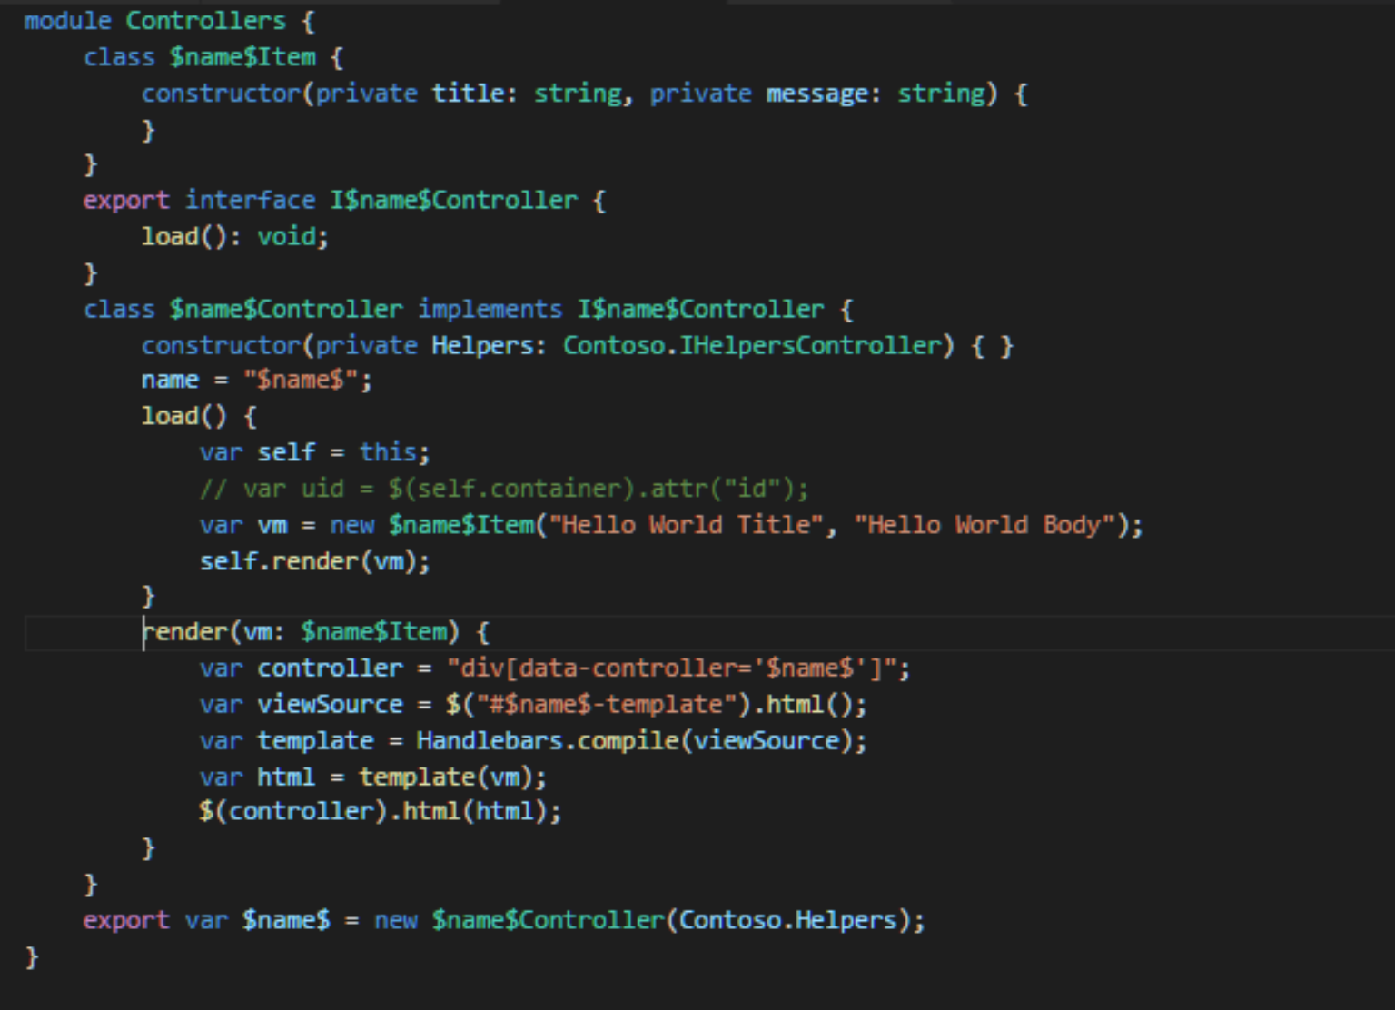
Building a Hello World Widget – Controller (2)

Slide 15
Build a Hello World Widget – Template (1)
Add a new Folder in the /App/Templates/Controllers folder named HelloWorld
Add a new *.HTML file to the folder named HelloWorld.html file
Copy the template starter code into the file.
Do a replace on the current document and replace $name$ with HelloWorld
Widget
Container
Controller
Template
Notes:
Controller Starter code: \App\Scripts\Controllers\_Starter
Template Starter code: \App\Templates\Controllers\_Starter

Slide 16
Building a Hello World Widget – Template (2)
<script id="$name$-template" type="text/x-handlebars-template">
<h1>{{title}}</h1>
<p>{{message}}</p>
</script>
Notes:
Again here’s what the template would look like.
Try to use a standard {{#if error}} to render the view if there is an error. Notice the {{#if}} {{else}} {{/if}} is a bit strange, it’s just part of handlebars templating.

Slide 17
Update the Bundle Configuration
When you are ready to see what your widget does…
UPDATE config.js files
You need to update the config.js file in both the scripts and template directory to include your new files. This is a bit of a pain, but gulp will not include your code if it isn’t in config.js file(s). When lots of changes are happening to these files in TFS, auto accept merging should work… I would suggest “GET LATEST” right before you want to update the config.js file, and once you’ve made your updates do a check-in.. Might make it easier for everyone.
Notes:
Just open the files, it’s pretty clear..
Remember to keep like with like, we have controllers, library and helper files in the scripts config. Also remember that there are multiple bundles for different web applications (CGPortal, Homeport, Homeport External, MySites) so if your code should target both restricted and unrestricted, you need to reference the file in both the Homport and HomeportExternal arrays within the config.js file.
Each config file is linked to a specific gulp task. The config.js file is basically an instruction set for how to bundle the code for all the different projects that are identified in the config.js file.
TODO: look into simplifying the solution to use a single config.js file. Would be good if we could do it will less complexity.

Slide 18
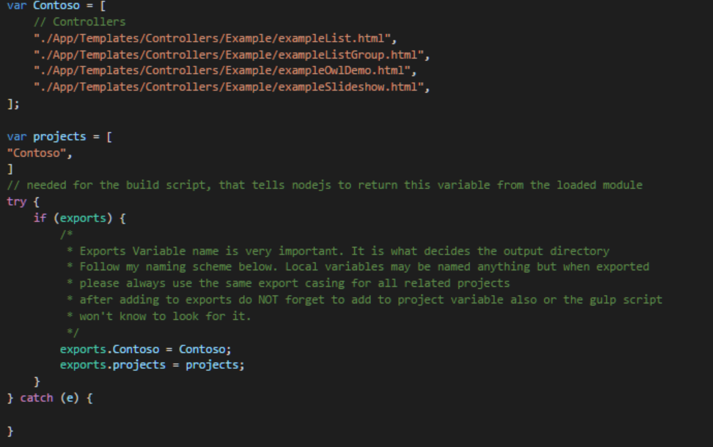

Config.js
Notes:
Each config is just an array of files that should be bundled, and the order in which the files should be bundled, and an array of projects, which are “build targets.
Finally we export a object which links our “projects” array with our file array, so that nodejs / gulp can map the files to a specific project we have defined in the configuration.
Make sure that the scripts config only references js files, the styles config only css files, and the template config only html files. Mixing these up will make the bundle inoperable.
Gulp fails if the file array is not a valid javascript array, so make sure we have closing “” and ,.

Slide 19


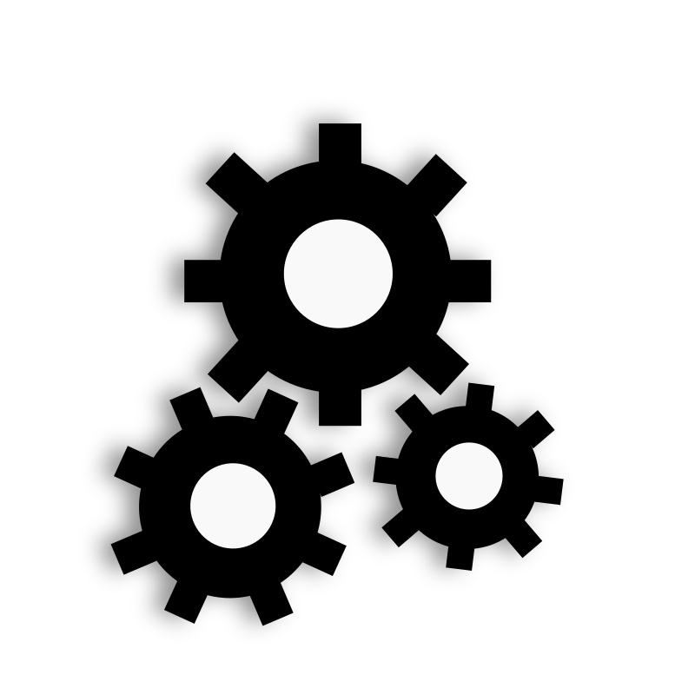
GULP (Build)
Run Gulp
Running gulp is the next step.
To run gulp, open PowerShell in the solution directory (where gulpfile.js is located) and type gulp. Leave the PowerShell window open for testing and deployment.
About Gulp
Streaming build system.
Using the power of node streams, gulp gives you fast builds that don't write intermediary files to disk.
Gulp is configured using the file (gulpfile.js) at the root folder of the solution.
The gulpfile.js is configured to look at the config.js files from the previous slide, and to load the projects we defined in config.js, and for each project build the bundle, and push it to the correct output directory.
The next slide details the specific gulp tasks we use to accomplish this.
Notes:
Gulp takes your development and bundles them
*You could just have Gulp running first thing
All the gulp configuration is already written, we just need to use gulp to generate the bundle, and when building the code for production release add
Gulp –type=production to enable minification of the JavaScript to make the bundle even faster.
Gulpfile.js is already coded, no changes are required. This just automates the bundling of the source files.

Slide 20
GULP Task Definitions
gulpfile.js Tasks
ts
css
html
watch
Generates bundle.js file for each project defined in the config.js file located in the App/Scripts directory.
Generates bundle.css file for each project defined n the config.js file located in the App/Styles directory.
Generates bundle.html file for each project defined in the config.js file located in the App/Templates directory.
Watches for file changes in the App/Scripts, App/Styles, and App/Templates and calls relevant task to rebuild bundle with updated files
preboot
Copies the init.js file into the output directory.
Notes:
All the gulp configuration is already written, we just need to use gulp to generate the bundle, and when building the code for production release add
Gulp –type=production to enable minification of the JavaScript to make the bundle even faster.
Preboot -- just moves the init.js file into the output directory for the projects identified in the /App/Scripts/config.js file
TS – takes all the files for each project in /App/Scripts/config.js and bundles them into bundle.js, and generates a jsmap file (useful for debugging). If you want to min the js bundle file include the –type=production when you run gulp (gulp –type=production)
css – takes all the files for each project in /App/Styles/config.s and bundles them into bundle.css
html – takes all the files for each project in /App/Templates/config.js and bundles them into bundle.html
watch – looks for file changes, then calls the other tasks identified when appropriate to keep the bundle up to date whenever a file is modified and saved. This means if gulp is running correctly after launching it once your bundle code will always reflect your latest changes.

Slide 21
Testing / Debugging
Run Fiddler
Proxies our local file system so browser retrieves local files instead of SharePoint files.
Enables us to use the latest bundle to look at our changes without having to re-deploy constantly.
Open Page in IE
Use IE Developer Tools
Debug JavaScript with IE Developer Tools
JS MAP file will map out the bundle.js file back to your source files so debugging is easier.
Notes:
Fiddler lets us see our local changes without having any deployment step.
It becomes similar to using the debugger in visual studio, enabling local file changes to be immediately reflected on your site.

Slide 22
Testing / Debugging
IE Developer Toolbar (Attach breakpoint Debugger to your Controller)
TEST / DEBUG
Make Changes to source file
Ensure Gulp is running, or run gulp.
Request Page (Open browser, or F5)
Fiddler intercepts /CSOM request and serves your bundle files
Notes:
Process
Launch Fiddler -
Open your browser –
Fiddler Intercepts and redirects requests for the bundle files.
Debug your controller code with IE Developer Toolbar
Make updates to your controller source file in visual studio.
Gulp watch should update your local bundle file(s).
Re-request the page (F5) to continue.

Slide 23
Configure Fiddler
Autoresponder
Autoresponder – Add Rules
Use response rules with regular expressions to proxy local content (bundle files)
Rule to proxy bundle files
Match: regex:https://tenant.sharepoint.com/CSOM/(\w*)”
Action: C:\dev\Output\Contoso\$1
Skip Decryption
Tools > Fiddler Options > HTTPS Tab
Enter the following hosts (1 per line) to avoid issues with ADFS
sso.adfs.url.com
Reduce RAM Usage
Next to Decode, look for button “Keep: All Sessions” update this to 100 sessions.
Notes:
Click Enable rules in the interface, and make sure fiddler is connected.
See documentation for specific details.

Slide 24

Gotchas
I’ve added my container onto the page, and coded my controller and template but I am not seeing anything.
Make sure that init.js is being called on the page.
Make sure that the config.js files reference your files
Make sure that gulp has run to add your code to the bundle.
Make sure fiddler is connected and configured correctly. (Or your latest bundle is deployed to your site)
Make sure your Controller and the Container are using the same name.
You can use IE Developer Tools to debug your controller code.
I need to have multiple instances of a widget on a single page and configure them a bit differently.
Make sure you are binding the view to the container using unique values. (Use id, or data-id).
Use additional data- attributes to map the configurable values to your controller
You can also use the DOM within the Container, to specify additional information to your controller.
Notes:
Example basic HTML and JS

Slide 25
Gotchas cont.
I am getting an error when I attempt to run gulp, my bundle files aren’t being updated.
Check the config.js file, sometimes you are missing a , which makes the array of files to build into the bundle invalid.
If gulp isn’t running at all make sure that gulp is installed on the DEV VM.
Notes:
Example basic HTML and JS

Slide 26
Deployment Details
Root Site Collection
bundle.html
bundle.css
bundle.js
vendor.js
init.js
vendor.css
Bundled Files are deployed to the Root Site Collection on the Web Application.
Notes:
Files -- Bundle files are deployed to /CSOM on the Root Site Collection on each web app.
Custom Action – Deployed to Each Site Collection as a USerCustomAction with a ScriptLink location

Slide 27
Best Practices
Containers:
Configuration over code, make widgets configurable when necessary.
Multiple Instance widgets – containers have to have a unique identifier.
Controllers:
Keep the controllers as simple as possible.
Keep REST calls as small as possible, use $select
Templates:
Keep the templates as simple as possible.
Include HTML5 sematic elements and alt tags to make templates more accessible.
Display loading / error elements in a standard way.
Use Office Fabric UI CSS styles.
Notes:
Simple Models
Keep view models as simple as possible. If view model starts getting complex consider why. If it’s to fit something in your template, look at using a handlebars helper instead, and keep view model simple.
Simple Views
Keep views as simple as possible. You can create partial views, and handlebars helpers to keep the handlebars template readable.

Slide 28
Advanced Topics
Handlebars Helpers
Handlebars Partial Templates
Multiple Instance Widgets
Repository Pattern
SharePoint REST API, Navigation, Web Properties
Components
Unit Testing
Notes:
Lots of “TODOs here”
Create a Handlebars Helpers file, so we can keep the helpers in a single place.
Build a good “starter file” for multi-instance widgets
Build a proper repository for Homeport, which enables us to retrieve Homport Data across the entire web application, and abstract the SharePoint REST API
Build re-usable components in handlebars, to build grids, and other standard controls.
Build some handlebars helpers around forms, and some standard callback methods to make handling forms easier.

Slide 29
Unit Testing
Navigate to the Test Folder using PowerShell
Run: npm install
Run: gulp
Open browser to http://localhost:8080

Slide 30
Links
NodeJS
https://nodejs.org/en/
Gulp
http://gulpjs.com/
Handlebars
http://handlebarsjs.com/
jQuery
https://jquery.com/
SharePoint REST API
https://msdn.microsoft.com/en-us/library/office/jj860569.aspx

Slide 31
DEMO

