Slide 1

Improvise GenAI based Financial Services Dhruv Bhatia August 2024

Slide 2
Business Objective
Equip banks with tailored LLMs to provide more relevant and useful Gen AI-based services.
Large Language Models (LLMs) are revolutionizing industries by automating complex tasks involving natural language understanding. In finance, accurately interpreting and responding to customer queries is crucial for maintaining trust and satisfaction. By fine-tuning LLMs for the finance sector, we aim to enhance customer service, streamline operations, and drive business growth.
Key Goals
Enhance Customer Service
Improve the precision of responses by adapting the model to financial terminology, ensuring customers receive accurate and relevant information.
Provide customized support that addresses the unique needs and preferences of each Bank’s customer, enhancing their overall experience.
Streamline Operations
Automate routine customer interactions, reducing the burden on human agents and decreasing response times.
Lower operational costs by minimizing the need for manual intervention in customer support.
Drive Business Growth
Enable the system to handle a growing volume of queries without compromising on quality.

Slide 3
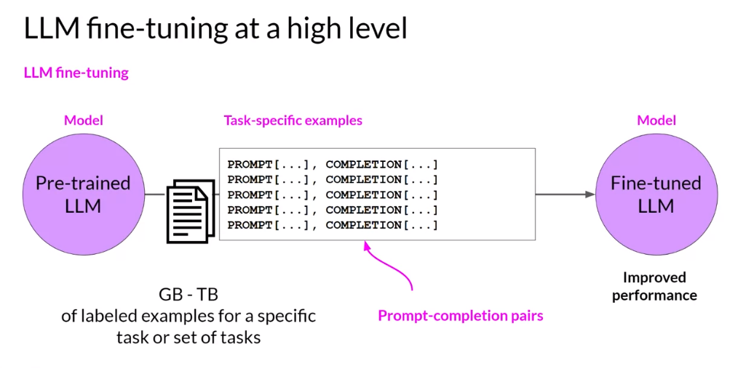
Strategic Steps for tailored LLMs
Refining LLMs Through Targeted Fine-Tuning
Approach focuses on fine-tuning Large Language Models (LLMs) to meet the specific demands of the finance sector. This targeted fine-tuning process involves adapting the LLM's capabilities to understand and respond accurately to industry-specific language and tasks.
High-Level key steps :
Model Optimization using domain adaptation :
Customizing LLMs to recognize and interpret financial terminology and concepts.
Key parameters adjustment of the LLM to enhance its performance in financial applications. This involves optimizing the model to efficiently handle financial data, improving both the accuracy of its predictions and its processing speed.
Continuous Improvement: Regularly update and refine the model to adapt to evolving industry standards and customer needs.
LLM fine-tuning takes pre-trained models and further trains them on smaller, domain-specific datasets to enhance their capabilities for specialized tasks.

Slide 4
Fine-Tuning Methods
Techniques to Customize LLMs for Financial Applications
Retraining All Parameters
Involves updating every parameter in a pre-trained model during the fine-tuning process. This method essentially treats the pre-trained model as a starting point and adjusts it fully to fit the new task.
Transfer Learning
Transfer learning involves using a pre-trained model and fine-tuning only the last few layers while keeping the rest of the model fixed.
Parameter Efficient Fine Tuning
PEFT involves fine-tuning only a small subset of the model parameters or adding a small number of new parameters that are tuned, leaving most of the original model parameters unchanged. Techniques like Low-Rank Adaptation (LoRA), QLoRA and Adapter modules are examples of PEFT.
Pros: All parameters of the model are retrained. Allows the model to fully adapt to the new domain. Resulting in highest possible performance. | Cons: Requires substantial computational resources. Too costly and time inefficient
Pros: Leverages pre-trained models, requiring fewer computational resources and less training time Can achieve good performance with smaller datasets | Cons: May not fully adapt to the new domain, especially if the new data is significantly different from the pre-trained data. Can only perform one particular task with high accuracy.
Pros: Reduces the training parameters significantly. Saves computational resources and time. Lower memory requirements. | Cons: Effectiveness depends on the quality and nature of the domain-specific data. Achieves lower performance when the size of dataset is small.

Slide 5
Exploring PEFT
Understanding LoRA and QLoRA
LoRA
LoRA (Low-Rank Adaptation):
A PEFT (Parameter-Efficient Fine-Tuning) technique.
Adapts large pre-trained models.
Introduces low-rank matrices into the model's weight matrices for quick computation.
Key Features:
Focuses on learning a small number of additional low-rank parameters.
Captures task-specific adjustments.
Updates fewer parameters compared to training all parameters.
Benefits:
Significantly reduces the number of parameters needing updates.
Around 5% of the total model parameters are updated.
Maintains performance without compromising quality.
QLoRA
QLoRA (Quantized Low-Rank Adaptation):
Extends LoRA by incorporating quantization techniques.
Key Features:
Introduces quantized low-rank matrices.
Designed to reduce memory usage and computational requirements.
Maintains model performance.
Quantization Process:
Converts from floating-point (16 bits) to simpler formats like integers (8 bits).
Helps reduce the memory requirements of the training process.
Benefits:
Achieved up to 4x reduction in memory usage.
Demonstrated effectiveness in experiments with large-scale transformer models.

Slide 6
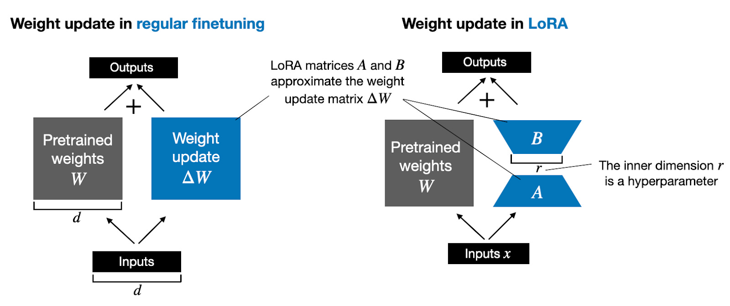
How LoRA reduces parameters?
For example, if the weight matrix has dimensions 100x100, the total number of weights updated would be equal to 10000.
If r = 8, then the new weight matrices would be of dimension 100x8 and 8x100 resulting in total parameters to be only 1600.

Slide 7
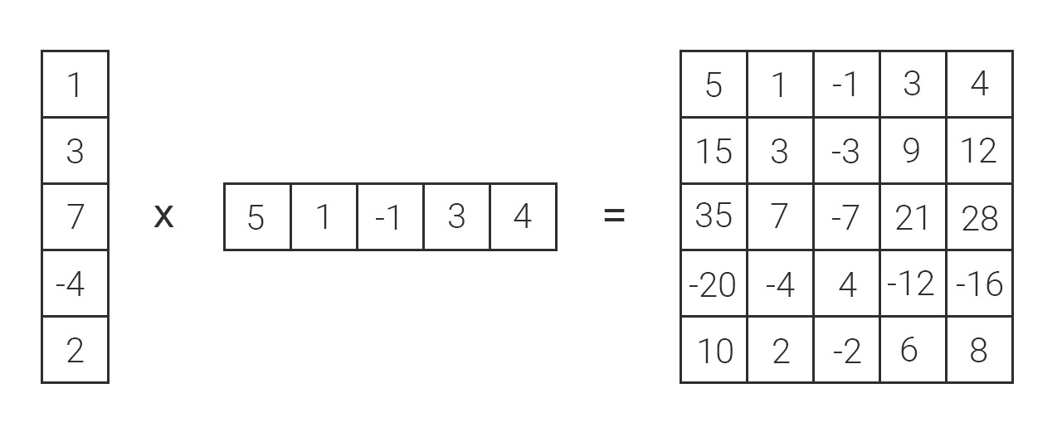
Matrix Decomposition

Slide 8
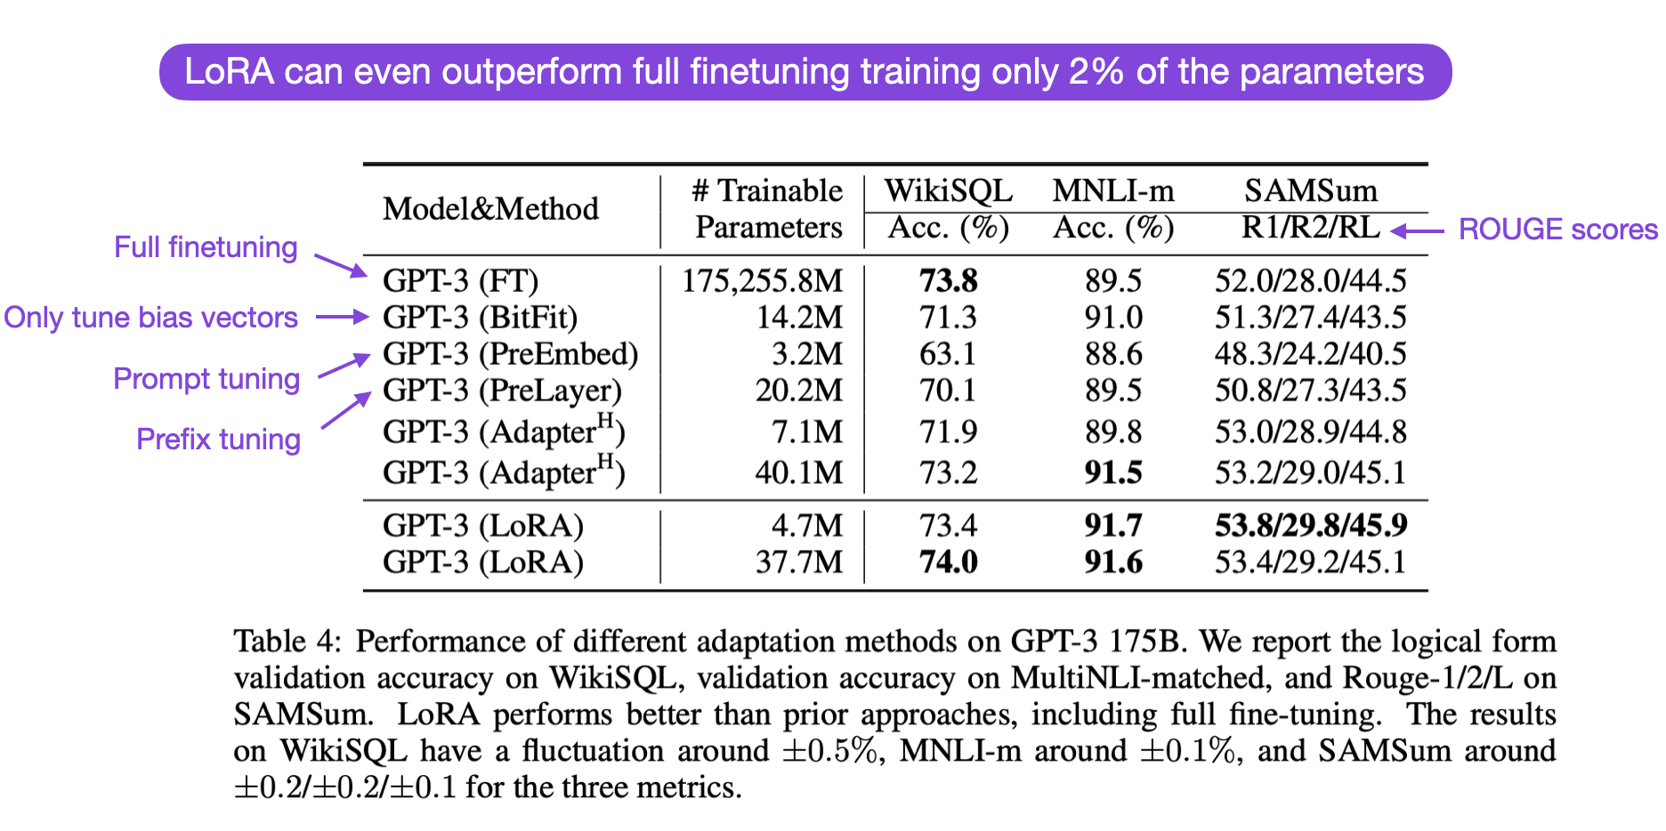
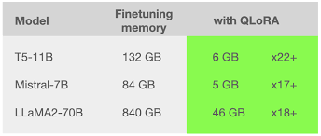
Impact of LoRA with QLoRA
QLoRA helps us in further reducing the memory footprint with almost similar performance to LoRA.
LoRA significantly reduces the training parameters without compromising performance.

Slide 9
Essential Dependencies
Tools and Libraries used for Fine-Tuning
Platform
Google Colab Notebook: Google Colab provides a cloud-based environment that is ideal for running Jupyter notebooks and performing model training. It offers access to a free GPU, making it suitable for resource-intensive tasks. Specifications: Equipped with an NVIDIA Tesla T4 GPU, 15GB of GPU memory, and 16GB of RAM.
HuggingFace: HuggingFace is an open-source platform which provides access to curated datasets, machine learning models, and AI-powered demo apps.
LLM
Llama-2 LLM: Llama-2 is an open-source large language model used as the base model for fine-tuning. It has over 7 billion parameters.
Libraries
BitsAndBytes: Offers quantization tools to reduce the memory footprint of models, enabling efficient use of hardware resources and faster processing.
Transformers: A library from HuggingFace that provides access to a wide range of pre-built language models and tools for fine-tuning. HuggingFace is a leading platform for NLP technologies, offering an extensive repository of models and datasets.
PEFT Library: A library designed to apply techniques like LoRA and QLoRA, optimizing the fine-tuning process by focusing on a subset of model parameters.
Accelerate: A HuggingFace library that speeds up training by utilizing multiple GPUs simultaneously, reducing training time and enhancing model performance.
SFTTrainer: A library that simplifies the process of supervised fine-tuning, enabling efficient training of language models on specific tasks by managing data and training configurations.

Slide 10




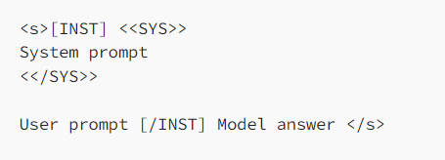
Approach steps in PEFT – Tailored
Following are the different steps which was followed to achieve customization with sample LLM – Llama 2
DATA
PROVISIONING
Environment creation
PEFT steps
TESTING AND VALIDATION
Collected a corpus of 1K financial advices from HuggingFace (Source for pre-existing open-source datasets and models).
Acquired additional data by web scraping the SBI bank website for FAQs.
Converted the collected data into a format compatible with the Llama 2 model.
Google Colab Notebook provides free of cost 15GB Graphic Card, 16 GB RAM and 75GB disk space
Installing required dependencies.
Load up the data and the pre-trained model from HuggingFace into the notebook.
Configure bitsandbytes for 4-bit quantization
Load the Llama-2 model in 4-bit precision on a GPU with the corresponding tokenizer
Load configurations of QLoRA, regular training parameters and pass everything to SFTTrainer (Supervised Fine-tuning Trainer).
Merge the weights from LoRA with the base model and upload it to HuggingFace.
The model is now ready for inferencing.
Use the HuggingFace pipeline for easy usage of model.
Prompt the model with financial questions and evaluate how accurately the model is giving the results.
Key Activities

Slide 11
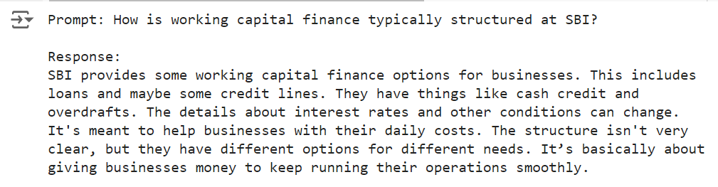
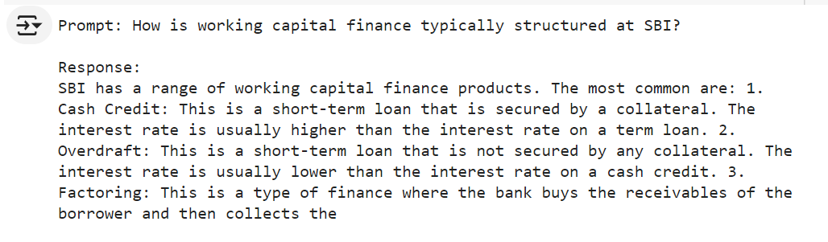
Outputs
Comparing Results: Pre-Fine-Tuning vs. Post-Fine-Tuning
BEFORE | AFTER

Slide 12
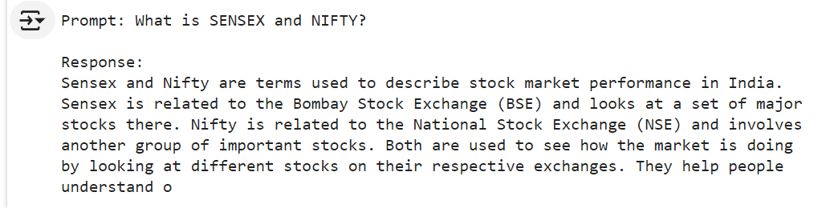
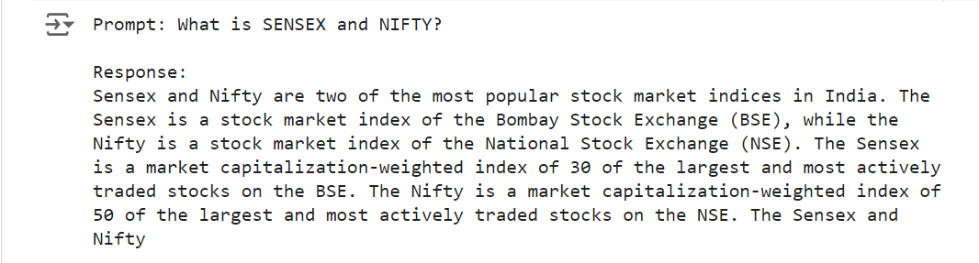
Outputs
Comparing Results: Pre-Fine-Tuning vs. Post-Fine-Tuning
BEFORE | AFTER

Slide 13
Way Forward
Next Steps in Leveraging Fine-Tuned LLMs for Banking
Developing an Evaluation Framework
Develop a method to evaluate the model's accuracy, focusing on metrics like response precision and relevance to customer queries.
Use the evaluation results to identify areas for further fine-tuning, ensuring the model remains up-to-date with evolving financial terminology and regulations.
Utilizing Fine-Tuned LLMs in Banking Operations
Deploy the fine-tuned LLM across various banking functions, such as customer support and personalized financial advising, to enhance customer service.
Exploring Retrieval-Augmented Generation (RAG)
RAG is a technique that combines the power of LLMs with real-time data retrieval to generate more accurate and context-aware responses.
Investigate the implementation of RAG to generate more precise and informed responses based on current financial information.

Slide 14
Key Learnings
Skills and Insights Gained Throughout the Project
Deepened Understanding of Generative AI
Gained a comprehensive understanding of how LLMs are trained, fine-tuned, and their applications in various industries.
Acquired knowledge in fine-tuning LLMs using techniques like LoRA and QLoRA optimizing model performance with minimal computational resources.
Enhanced Python proficiency
Improved my knowledge of Python while fine-tuning models, utilizing libraries like Transformers, PEFT, and others to optimize performance.
Learned how to web scrape websites for data collection, gaining practical experience in gathering and processing large datasets for model training.
Presentation and Storytelling skills
Enhanced my ability to convey complex technical concepts through clear, concise, and engaging presentations.
Learned how to structure content in a way that resonates with the audience, balancing technical details with storytelling for maximum impact.

Slide 15
Thank You

Slide 16
Appendix

Slide 17
The Power of Fine-Tuning LLMs for Finance
Addressing Industry Challenges with Enhanced Precision and Efficiency
While LLMs offer significant benefits for finance, fine-tuning these models on domain-specific data can further enhance their effectiveness. Here’s how fine-tuning directly addresses common challenges in the industry.
Increased Domain Expertise
Fine-tuning: Specializes the model in financial terminology, regulations, and context, allowing it to provide more accurate and nuanced responses. Pretrained Model: May lack specific knowledge about financial concepts, leading to generic or less relevant answers.
Improved Relevance and Accuracy
Fine-tuning: Adapts the model to the specific data of the organization, ensuring outputs are highly relevant and tailored to actual user queries. Pretrained Model: Offers general knowledge that might not fully align with the organization's needs, resulting in less precise responses.
Customization for Specific Use Cases
Fine-tuning: Allows the model to be tailored for specific financial tasks, such as fraud detection, risk assessment, or customer support, enhancing its effectiveness in those areas. Pretrained Model: Lacks customization for specialized tasks, limiting its utility for specific applications.

Slide 18
Approach
Refining LLMs Through Targeted Fine-Tuning
LLM fine-tuning takes pre-trained models and further trains them on smaller, domain-specific datasets to enhance their capabilities for specialized tasks.

Slide 19
Fine-Tuning Methods
Techniques to Customize LLMs for Financial Applications
Retraining All Parameters
Transfer Learning
Parameter Efficient Fine Tuning
Involves updating every parameter in a pre-trained model during the fine-tuning process. This method essentially treats the pre-trained model as a starting point and adjusts it fully to fit the new task.
Pros: All parameters of the model are retrained. Allows the model to fully adapt to the new domain. Resulting in highest possible performance. | Cons: Requires substantial computational resources. Too costly and time inefficient
Transfer learning involves using a pre-trained model and fine-tuning only the last few layers while keeping the rest of the model fixed.
Pros: Leverages pre-trained models, requiring fewer computational resources and less training time Can achieve good performance with smaller datasets | Cons: May not fully adapt to the new domain, especially if the new data is significantly different from the pre-trained data. Gives low performance for highly specialized tasks.
PEFT involves fine-tuning only a small subset of the model parameters or adding a small number of new parameters that are tuned, leaving most of the original model parameters unchanged. Techniques like Low-Rank Adaptation (LoRA), QLoRA and Adapter modules are examples of PEFT.
Pros: Reduces the training parameters significantly. Saves computational resources and time. Lower memory requirements. | Cons: Effectiveness depends on the quality and nature of the domain-specific data. Achieves lower performance than retraining all parameters.

