Slide 1
Surround

Slide 2
Introduction to Surround: -
Surround is a lightweight framework for serving machine learning pipelines in Python.
Surround uses group of stages to transform raw data into meaningful data.
It is designed to be easy and flexible to use.
A stage will read some information from Surround Data, process it, then put back new information that will be used by other stage or stages.

Slide 3
Deliverables: -
EPL prediction
Apple stock price prediction
User Manual Surround AI
Surround AI Framework Document

Slide 4
EPL prediction: -
Predictive model for EPL matches.
It can help for predicting wining chance of a team against another team.
Using Logistic regression to predict result.
We have created an algorithm using that we can generate a automatic mean to help prediction.
GitHub: -
https://github.com/skesineni1/Surround_AI_Suqad_2/tree/Skesineni

Slide 5
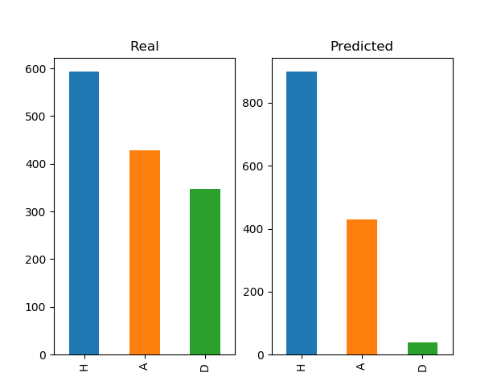
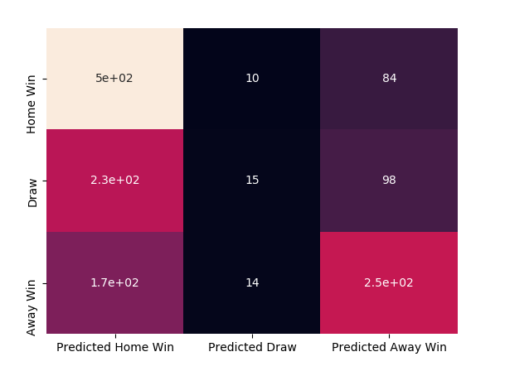
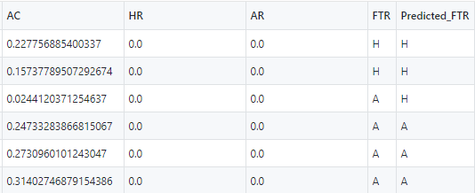
Output of Example 1: -
In image(1) We can see the comparison of the real output and predicted output.
In image(2)Confusion metrics of the result.
In image(3) Output results of the tested data.

Slide 6
Apple Stock price prediction: -
Predictive model for apple stock price.
It can help stock market ananlyst, stakeholders and investors.
Using SVM we can predict a set of unclassified data.
GitHub: -
https://github.com/skesineni1/Surround_AI_Suqad_2/tree/Skesineni

Slide 7
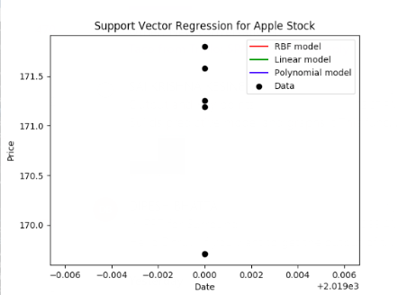
Output of Example 2: -
Place your screenshot here
We can see the data prediction points in the output they are predicting the upcoming prices of stock.

Slide 8
Thank You!!

