Slide 1
Anonymization of Social Networks
Sai Srujan Chinta
Ishan Khandelwal
Dhruv Chamania

Slide 2
Introduction
Social Network Analysis can be defined as the process of exploring and analyzing social structures through the use of networks and graph theory.
Networks are characterized in terms of nodes (actors or objects) and links (relationships or interactions) between the nodes.
With the rapid growth of social networks, such as Facebook and Linkedin, more and more researchers found that it is a great opportunity to obtain useful information from these social network data, such as the user behavior, community growth, disease spreading, etc.
However, it is paramount that published social network data should not reveal private information of individuals.

Slide 3
Why Anonymization?
The nodes in a social network can have several attributes associated with them. Some of these attributes contain very private information. These nodes are termed as ‘sensitive attributes’.
The purpose of anonymization in social networks is to prevent the unwanted disclosure of sensitive attributes.
Though it may appear that not publishing the sensitive attribute would ensure the privacy of the sensitive attribute, it is not true. Similarity attacks utilise other published information to identify the individuals and their sensitive attribute. Background knowledge attacks utilise pre-existing knowledge to attack the privacy.

Slide 4
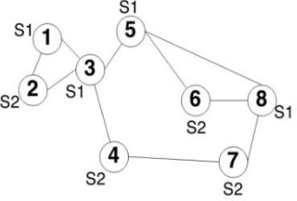


Basic Privacy Measures
2-degree anonymity
2-degree anonymous 2-diverse graph
K-degree anonymity [1] requires that for every node in the graph, there should exist at least k-1 other nodes in the graph with the same degree.
L-diversity [2] requires that every equivalence group must have at least ‘l’ distinct sensitive labels present.

Slide 5
Pre-processing
Centrality Values: A measure of the “importance” of nodes. Eg: Degree Centrality defines the “importance” of a node as its degree.
Generating the target degree sequence:
Depending on the type of privacy model chosen by the user, the target degree is generated for each node in the graph. Prior to this step, the nodes are arranged in decreasing order of their centrality values. The type of centrality which is to be used is also decided by the user. For every equivalence group, the target degree for all the nodes in it is taken as the degree of the first node of that group.

Slide 6
Generating Target Degree Sequence
Given the degree sequence P of the original graph, Algorithm K-L-BASED selects the first k elements in
P as a group. We keep on merging the next element into the current group until the l-diversity constraint is
satisfied.
After a group satisfies k-degree and l-diversity constraints, we calculate two costs:
Cnew : the cost of creating a new group for the next k elements (the total degree changes that make all the
nodes in this group have the same degree).
Cmerge : the cost of merging the next element into the current group and creating a new group for the next k
elements by skipping the next element.
When the remaining elements are less than k or contain less than l distinct sensitive labels, they are
Merged into the last group.

Slide 7
Ways to anonymise graphs
Clustering is to merge a subgraph to one super node, which is unsuitable for sensitive labelled graphs, since when a group of nodes are merged into one super node, the node-label relations have been lost.
Edge-editing methods keep the nodes in the original graph unchanged and only add/delete/swap edges.
However, edge editing may largely destroy the properties of a graph. The edge editing method sometimes may change the distance properties substantially by connecting two faraway nodes together or deleting the bridge link between two communities.
To address this issue, a new model was proposed to preserve important graph properties, such as distances between nodes by adding certain “noise” nodes into a graph.

Slide 8
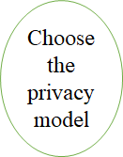
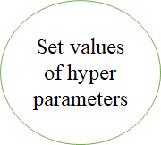
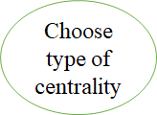
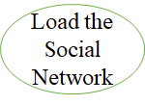
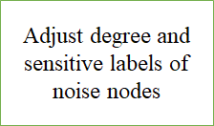
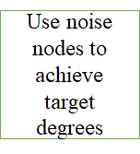
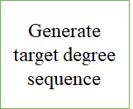
Model Architecture
Return Anonymised Graph

Slide 9
Constructing the anonymised graph from target degree sequence
So far, we have used noise node addition technique for constructing the anonymised graphs. The steps involved in the process are:
Neighbourhood edge editing technique
Case 1: Consider that Node u needs to increase its degree and v needs to decrease its degree and u and v are direct neighbors.
Case 2: u and v are two hop neighbors and both needs to increase their degree
Case 3: If two nodes u and v are direct neighbors and both need to decrease their degree to achieve their target degree

Slide 10
Constructing the anonymised graph from target degree sequence contd.
Adding noise node to decrease degree
In this step, the algorithm creates a noise node and connects it with the node which needs to decrease its degree to achieve the target degree. If the node needs to decrease its degree by m, then delete (m+1) edges connecting that node with its neighbouring nodes and connect the noise node with all those neighbouring nodes.
Adding noise nodes to increase degree
If node (n) needs to increase its degree to achieve the target degree, then the algorithm creates a single noise node and connects it to n. If any other node is present which also needs to increase its degree and within two hops distance of n, then the algorithm connects those nodes with the noise node. The above process of adding noise node is continued until n achieves its target degree.

Slide 11
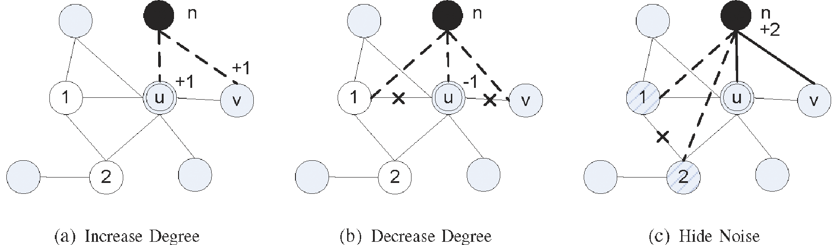
Constructing the anonymised graph from target degree sequence contd.

Slide 12
TESTING AND COMPARISON
As seen from the previous slides, for creating the software prototype there are multiple algorithms that we are going to implement. To check which of these algorithm is the best, we are defining certain test cases. These cover:
The amount of time taken for the algorithms to run across different scales of the graph (scalability).
The ease of making the algorithm.
The amount of memory used during running each algorithms
Looking to write more test cases for comparison, not fixed on what of those we should.

Slide 13
References
[1] L. Sweeney, K-Anonymity: A Model for Protecting Privacy, Int‟l J. Uncertain. Fuzziness Knowledge-Based Systems, 2002, vol. 10, pp. 557-570.
[2] A. Machanavajjhala, D. Kifer, J. Gehrke, and M. Venkitasubramaniam, L-Diversity: Privacy Beyond K-Anonymity, ACM Trans. Knowledge Discovery Data, Mar. 2007, vol. 1, article 3.

Slide 14
THANK YOU
QUESTIONS OR COMMENTS?

