Slide 1

Data Science Project
Battle for the Restaurants.

Slide 2
1. Introduction to the problem :
In this article, we’ll explore venues in Pune, India based on their rating and average prices. Whenever a person is visiting a city they start looking for venues to visit during their stay. Thus, our aim here is to identify places that someone can visit. In this problem we will talk about which places a client can start a hotel or a restaurant and which cuisine he/she should persue in the process.
We will also be able to display where exactly restaurants are located and by using population data we maybe able to see which areas show higher density of people so that the restaurant will have maximum food enthusiasts.
2. Data Utilized :
The data has been collected from API, Foursquare API . The first step was to search for venues within a radius of 4 Kilometers from Pune’s center point. After extracting over 100 locations using the Foursquare API, and the based on each cuisine we find the data required for the project. The population data will be available through kaggle which provides many datasets for projects.

Slide 3
Methodology
As a first step, we retrieved the data from Foursquare API . We extract venue information from the center of Pune, upto a distance of 4 Km. The latitude and longitude values are then used to fetch venue rating.
We have then obtained data set from Kaggle.com based on the Zomato data for Prices and Locality based Data.
The data from the two sources is carefully combined based on the name, latitude and longitude values from the two sources. The final dataset would include the rating and price values for each venue.
Next, we analyise the data that we created based on the ratings and price of each venue. We identify the top category types. We identify places where many venues are located so that any visitor can go to one place and enjoy the option to choose amongst many venue options. We also explore areas that are high rated and those that are low rated while also plotting the map of high and low priced venues. Lastly,. This will allow us to clearly identify which venues can be recommended and with what characteristics.
Finally, we’ll discuss and conclude which venues to be explored based on visitor requirement of rating and cost.

Slide 4
Analysis
During the analysis phase, I explored the venue categories, the rating distribution of the venues and the price range across the map of Pune.
Using Folium I have plotted 2 maps based on the dataset showing which locations have maximum restaurants and their respective price ranges as well as ratings.

Slide 5
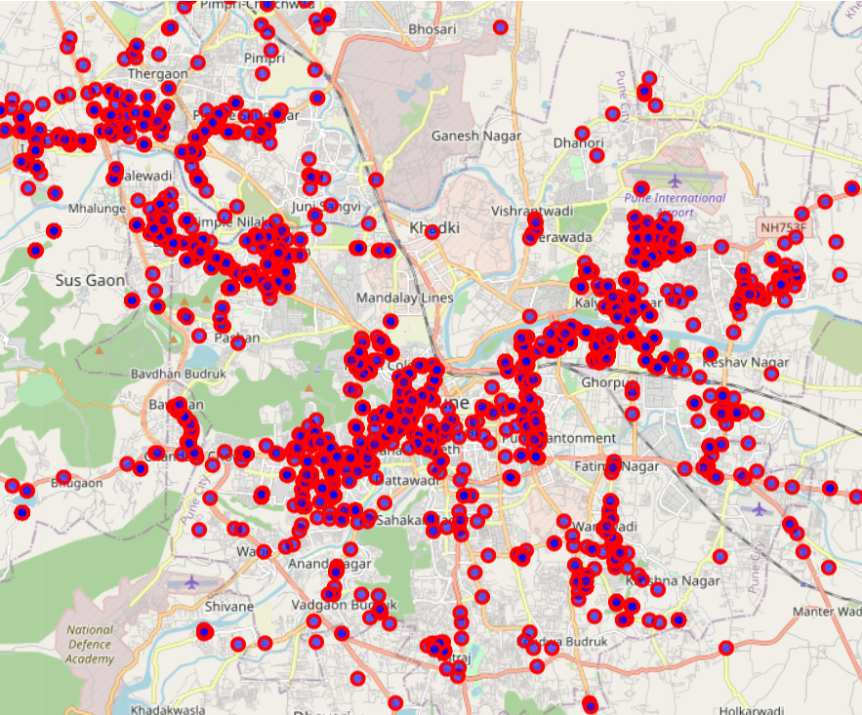
Analysis using Folium :
In this map it is clearly seen that a large cluster of Hotels and Restaurants in Kothrud and also in the Koregaon Park.
I have used folium and the coordinates of Pune.

Slide 6
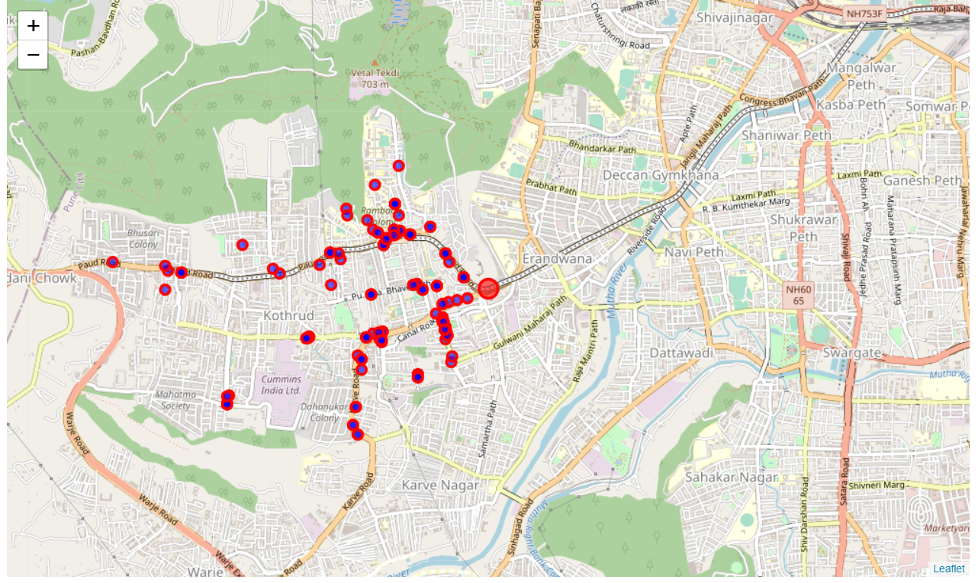
Restaurants in Kothrud :
The map shown here is of Restaurants in Kothrud
In the Karishma Society area there are many Restaurants with good ratings and decent price range.

Slide 7
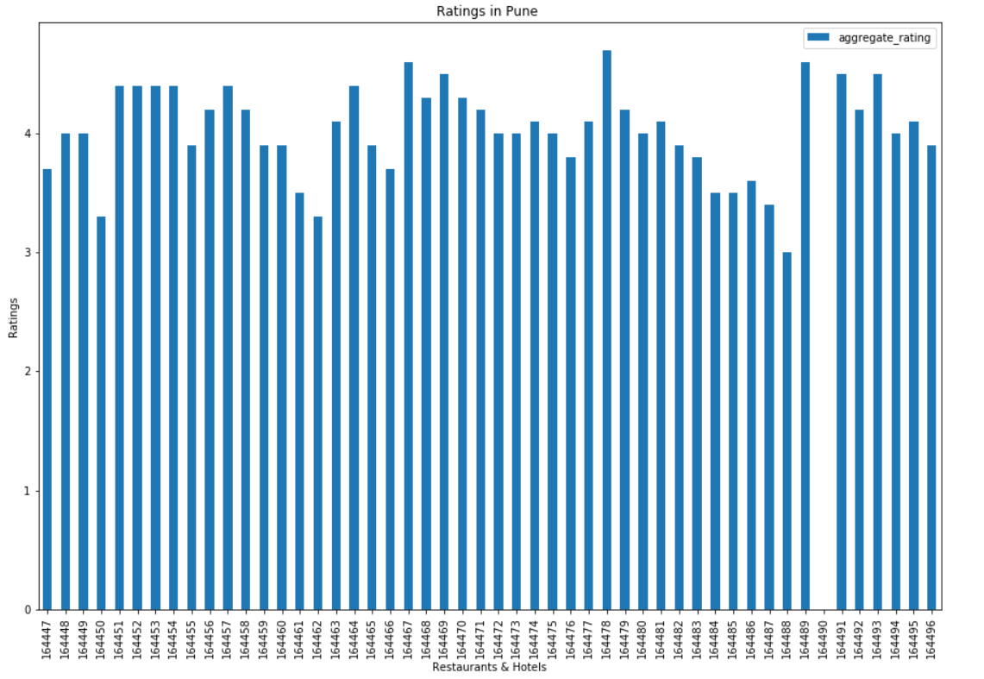
Ratings for the Top 50 Restaurants in Pune :
This Histogram shows the codes of the restaurants and their ratings in Kothrud.
We can see the ratings to be above 3 in almost all the restaurants .
Which shows that Kothrud is a good location for the Restaurant.

Slide 8
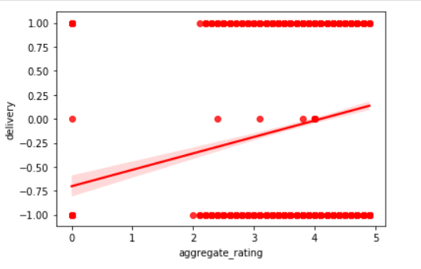
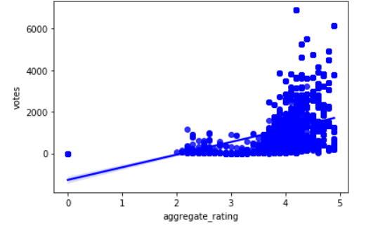
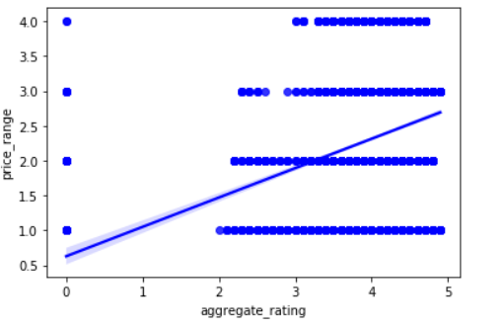
Scatter Plots
Based on these plots we can see that Delivery Options and Rating are not related ,
A more important observation is that as the price has increased the rating also increases from below 3 to only above 3.
That tells us that if the price is a little high it would give us more votes and higher ratings.

Slide 9
Report :
Based on the data acquired and data extracted from Foursquare API, it can be seen that there is a high concentration of Restaurants and Hotels in the central part of the city.
A few scatter plots show relations between ratings and Delivery options and it is clearly seen the Delivery options may it be Takeaway or Home Delivery ratings are not affected by it.
Higher concentration of Restaurants is in the Koregaon Park(223),Baner(208), Kalyani Nagar(113),FC Road(102),Phoenix Market City(98),Viman Nagar(98),Kothrud(90) localities with ratings greater than 4 which tells us that starting a Restaurant in these locations will yield more food enthusiasts and more income.
Price Range also shows that Koregaon Park has a higher overall price range which is 4 and serves all kinds of courses in that locality, Also the map shows a pretty high concentration of restaurants in the central part as I have told before.
Concluding this Report I would recommend that my client should start up his Restaurant in the Koregaon Park Locality.

