Slide 1
Edelweiss Global Markets Hackathon Team Name: Team display: flex;
By:
Mr. Jatin Saraf
Mr. Dhruv Daftary
Ms. Shreeja Ravikumar

Slide 2
Problem Statement:
To calculate and process market data and calculate Implied Volatility and display options chain screen of the data which is provided with a market data stream over TCP/IP which will contain the market data structure.
Additionally highlight the “in the money” options and “out of money” options differently.
The option chain should work in real time. As the market data changes, the fields should be recalculate and refreshed on screen without having to reload on the browser.

Slide 3
Solution Overview:
In today's digital world, data transmission and real-time processing are vital components of various applications. This project demonstrates a simple setup to collect data packets from a TCP/IP server, process the incoming data on a Node.js backend, and present the results using a React frontend.
The system involves three main components:
1. TCP/IP Server: The data source that generates and sends data packets over a TCP/IP connection.
2. Node.js Backend: Responsible for receiving, processing, and storing the data packets in a suitable format.
3. React Frontend: Displays the processed data in a user-friendly way, enabling users to interact with the real-time data stream.

Slide 4




Tech Stack Used:
Technologies used:
1. React JS – frontend development
2. Node JS – backend development
3. JavaScript - calculation of Implied volatility
4. WebSocket API – connection of client and server
Software Requirements:
1. GitHub – version control
2. Software development kit (SDK)
Hardware Requirements:
1. Quad core machine, 8 GB RAM, 100 GB free disk space.

Slide 5
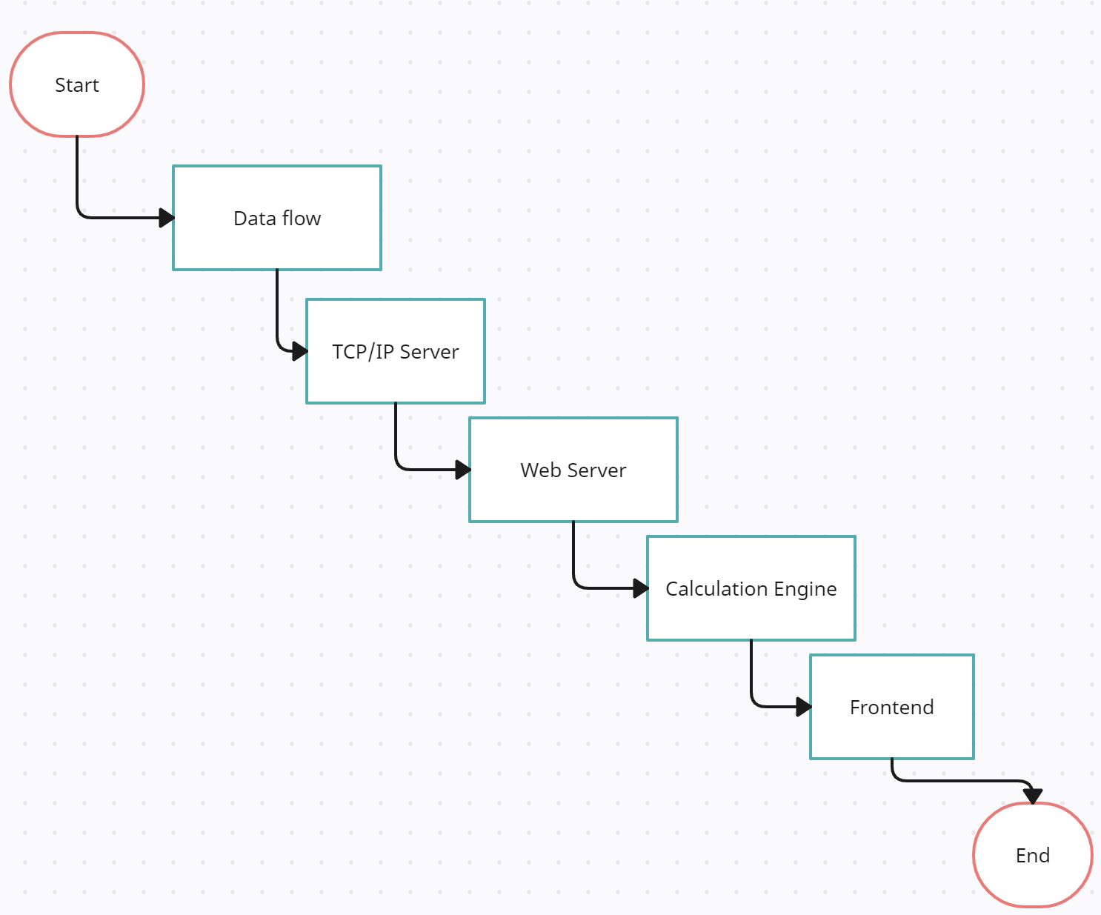
Architecture Diagram:

Slide 6
Key Features:
Programmed an algorithm for the value of Implied Volatility (IV) for all the given data.
Highlighted the “in the money” and “out of money” differently as required in problem statement.
A selection of underlying and different expiries is added for sorting of data with respect of the expiry dates.
The option chain works in a real time environment.

Slide 7
DEMO

Slide 8
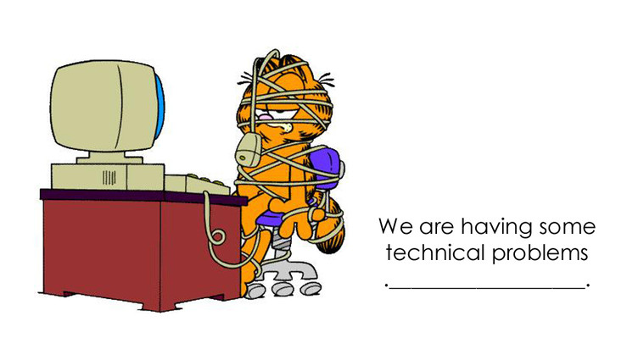
Implementation Challenges:
Limited resources: Due to nary knowledge about stock market and related subjects, learning the concepts was the biggest challenge faced by the team.
Technical issues: Getting data from the TCP/IP server and integrating it to a backend was also a difficulty that we bridled during this hackathon.

Slide 9
Team Collaboration and Roles:
J
D
S
Mr. Jatin Saraf
Mr. Dhruv Daftary
Ms. Shreeja Ravikumar
Backend developer
Full-Stack developer
Frontend developer

Slide 10
Conclusion:
In conclusion, the solution entails building a real-time options chain screen that processes market data, calculates Implied Volatility, and displays the data in a visually distinguishable manner for "in the money" and "out of the money" options. The solution handles a market data stream received over TCP/IP by considering following steps:
Establishment of TCP/IP connection
Processing and storing of market data
Calculation of Implied Volatility
Displaying options chain screen
Highlighting "in the money" and "out of the money" options
Handling data updates
Testing and optimization

Slide 11
Any Questions?

Slide 12
Thank You!

