Slide 1
Code Gladiators (Round 2)
Leader: Dhruv B. Dani
dhruvbdani@gmail.com
+91 9320099436
Member : Nilay K. Thakkar
nilay2620@gmail.com
+91 9727945621
Compiler & Debugging tool used : Turbo C (Windows 7/10)

Slide 2
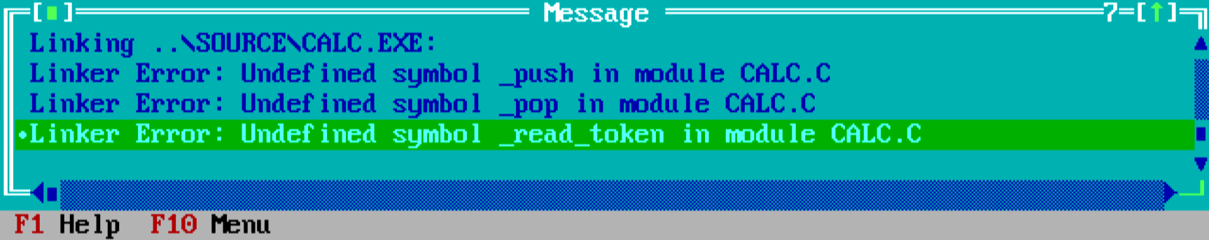
Changes in "calc.c" file
We have included "READTOKN.C" and "pushpop.C" files.
This step is taken to eliminate linker error.
Linker Error Occurs When an Object file or libraries can't be found by the linker
Linker error will not arise when we compile the program. But when we run a program, it will show us the error.

Slide 3
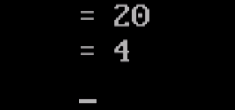
Changes in "calc.c" file
2. We added "puts(buf_out);" inside "case T_EQUALS".
This Statement is added to print output on the console which is stored in buf_out. The value inside buf_out is stored in sprintf() function.
Sample Output:

Slide 4
Changes in "calc.c" file
3. We added clrscr() and getch() methods.
*(Optional to keep output screen active and clear screen for every new execution)
clrscr() is use to clear the console screen.
getch() pauses the output console until a key is pressed.

Slide 5
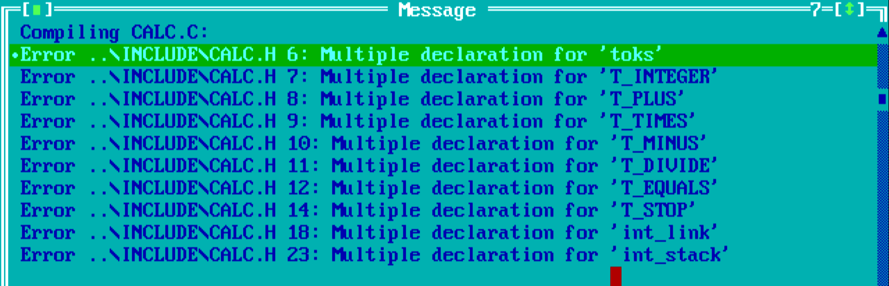
Changes in "PUSHPOP.C" file
We have Removed #include "calc.h" statement to avoid Multiple Declaration Error.
This Error Arises because "PUSHPOP.C" is included in "calc.c" file in which already a header file "calc.h" has been included,so there is no need of including "calc.h" header file again in "PUSHPOP.C"

Slide 6
Changes in "READTOKN.C" file
We have Removed #include "calc.h" statement to avoid Multiple Declaration Error.
This Error Arises because "READTOKN.C" is included in "calc.c" file in which already a header file "calc.h" has been included,so there is no need of including "calc.h" header file again in "READTOKN.C"

Slide 7
Sample Input: 9 13 – = 8 + = 2 * = 4 / =
Output: = 4
= 12
= 24
= 6

Slide 8
THANK YOU

