Slide 1
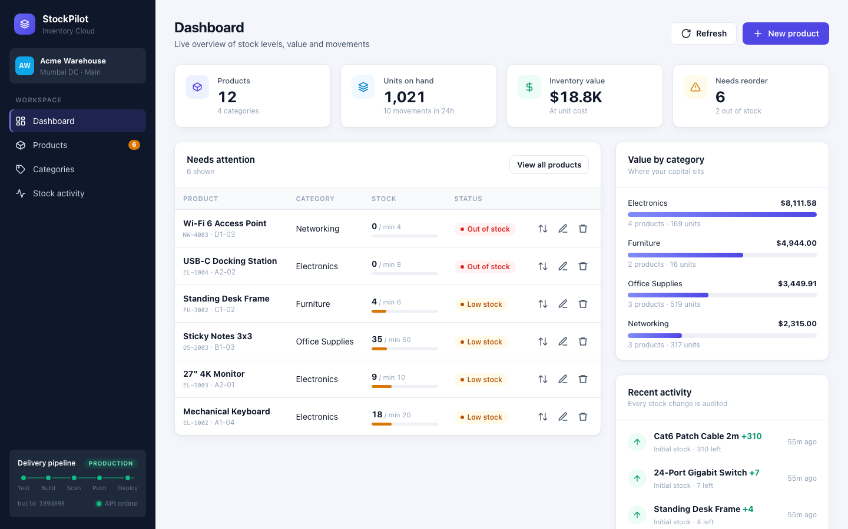
StockPilot
Inventory management, delivered from a Git commit to a monitored Kubernetes cluster on AWS
DevOps Final Capstone
Dhruv · October 2026
Notes:
Hi, I'm Dhruv. This is StockPilot, my DevOps capstone. It's an inventory management app, and the point of the project is the journey: how a single Git commit travels through testing, security scanning, a container registry and Terraform-built AWS infrastructure, into a monitored, autoscaling Kubernetes cluster.

Slide 2
The application
1
React + Vite frontend
Responsive dashboard, served by Nginx
2
FastAPI backend
14 REST endpoints + /health, /ready, /metrics
3
PostgreSQL
SQLAlchemy models, Alembic migrations
4
32 automated tests
24 pytest + 8 Vitest, run on every push
Notes:
The app has a React frontend, a FastAPI backend with fourteen REST endpoints, and PostgreSQL with Alembic migrations. You can manage products and categories, and every stock change is written to an audit log. It also exposes health, readiness and Prometheus metrics endpoints. Thirty-two automated tests run on every push.

Slide 3
From commit to cluster
Git push
›
Tests
›
Docker build
›
Trivy scan
›
GHCR
›
Helm
›
EKS
GitHub Actions
Terraform-built AWS
Commit SHA
Quality gate
Keyless
is the image tag on every build
failed test or CVE = no release
OIDC to AWS, no stored access keys
Notes:
Here's the delivery path. A push to main triggers GitHub Actions: backend and frontend tests first, then both Docker images are built and scanned with Trivy. If a test fails or Trivy finds a fixable high or critical vulnerability, the pipeline stops and nothing ships. Images go to GitHub Container Registry, tagged with the commit SHA, and Helm deploys them to EKS. The deploy job logs in to AWS through OIDC, so no AWS keys are stored in GitHub.

Slide 4
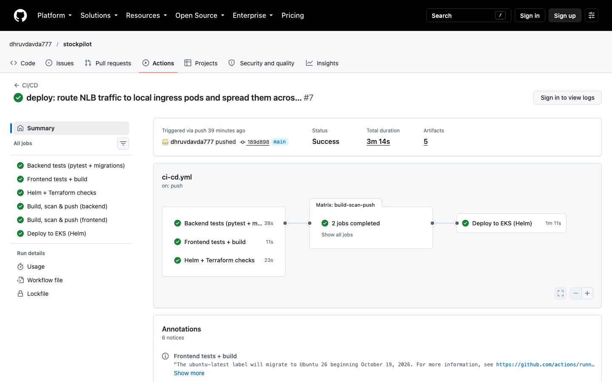
CI/CD and security
6 / 6 jobs
green, ending in the EKS deploy
0
HIGH/CRITICAL CVEs, both images
SHA-pinned
every third-party GitHub Action
Notes:
This is a real run: all six jobs green, ending with the deploy to EKS. Trivy found zero high or critical vulnerabilities in both images, which run as non-root users. Every third-party GitHub Action is pinned to a commit SHA, which protects the pipeline against tampered action tags.

Slide 5
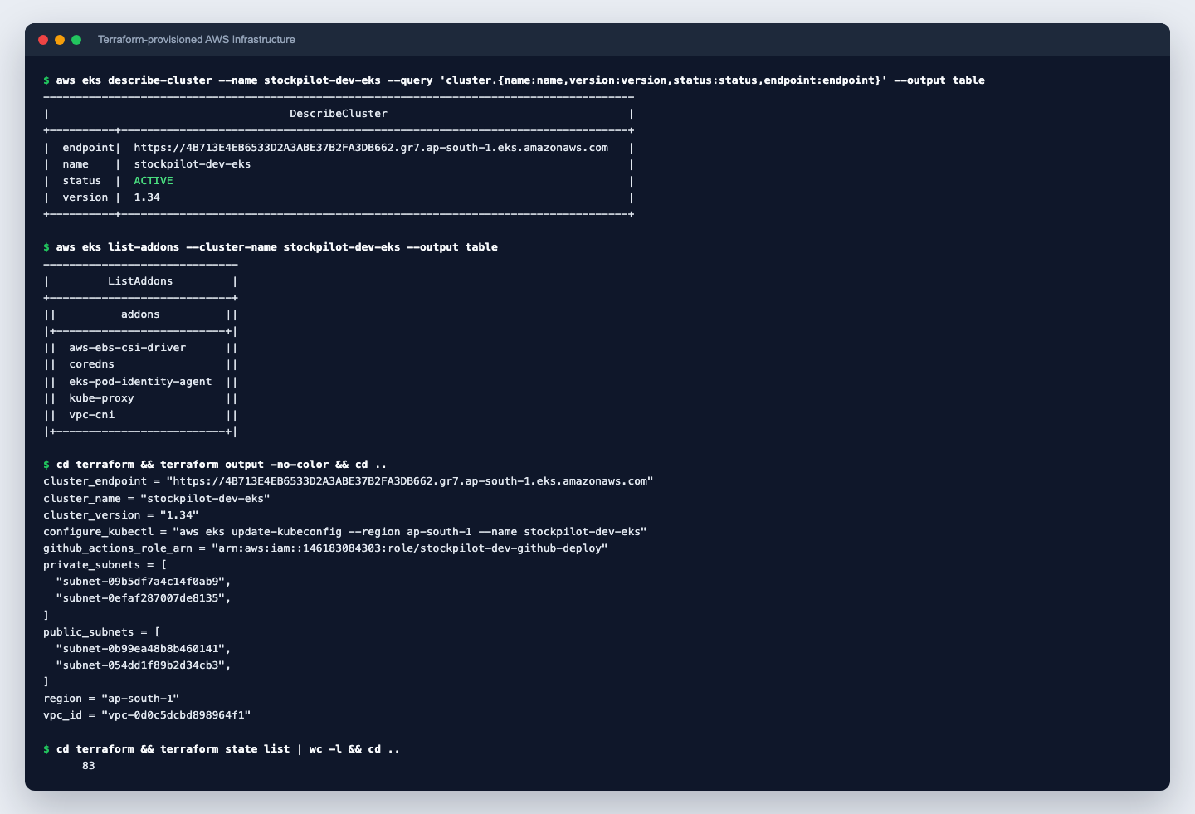
Infrastructure as code
1
VPC across 2 AZs
Public subnets + NAT, private subnets for nodes
2
EKS 1.34 + managed nodes
VPC-CNI, CoreDNS, EBS CSI via Pod Identity
3
GitHub OIDC deploy role
Scoped to main and the production environment
4
64 resources, one command
terraform plan, apply, and destroy when done
Notes:
All AWS infrastructure is Terraform: a VPC across two availability zones with public and private subnets and a NAT gateway, an EKS cluster with a managed node group, and the GitHub OIDC deploy role. Sixty-four resources from one command, and I destroyed all of it after recording to avoid cost.

Slide 6
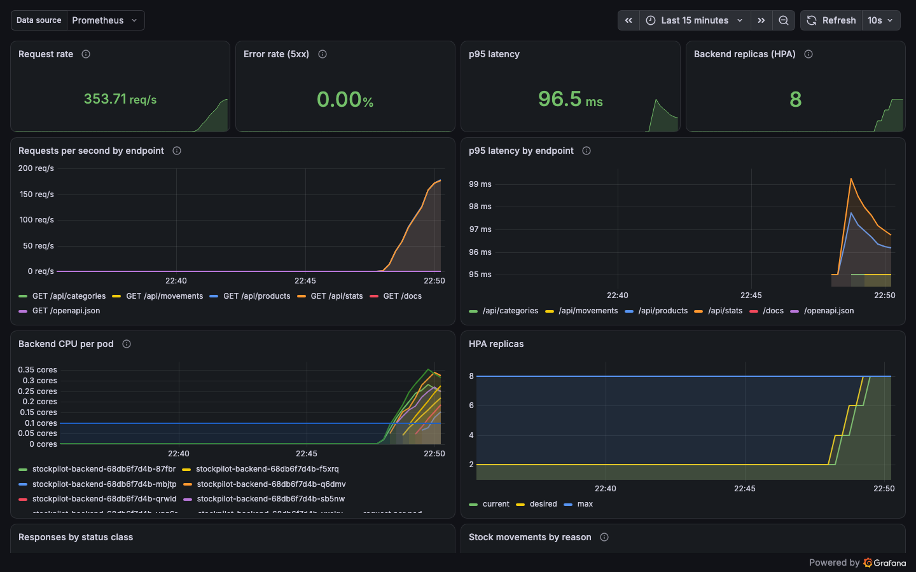
Autoscaling and monitoring
2 → 8 pods
HPA scaled the backend under load
353 req/s
with 96 ms p95 latency
0.00%
errors, scraped by Prometheus
Notes:
Helm deploys the frontend, backend and PostgreSQL behind an Nginx Ingress. During a load test, the Horizontal Pod Autoscaler scaled the backend from two to eight pods. Prometheus scrapes each pod's metrics endpoint, and this Grafana dashboard shows about 350 requests per second, 96 milliseconds p95 latency and zero errors, along with the replicas climbing.

Slide 7
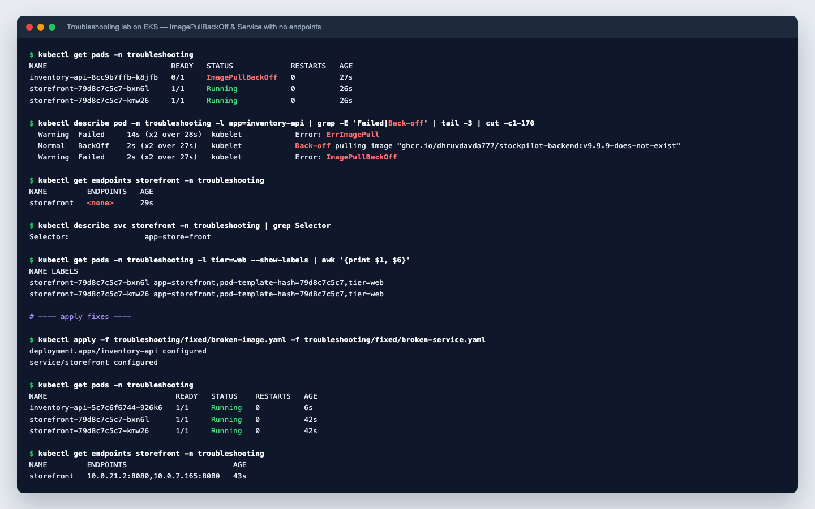
Troubleshooting lab
1
ImagePullBackOff
Wrong image tag, found with describe pod
2
Service with no endpoints
Selector didn't match the pod labels
3
Probe, config and memory
0/1 Ready, CrashLoopBackOff, OOMKilled
4
Database outage
Pods leave the Service, no restarts
Notes:
Finally, troubleshooting. I built five broken scenarios: a wrong image tag, a Service whose selector doesn't match, a bad readiness probe, a missing Secret and an out-of-memory limit. Here on EKS you can see the ImagePullBackOff and the empty endpoints, then both fixed. I also took the database down: readiness pulls pods out of traffic, and liveness keeps them from restarting.

Slide 8
Every step automated and observable
32
0
2 → 8
5
automated tests
critical CVEs
pods autoscaled
failure drills
github.com/dhruvdavda777/stockpilot
Notes:
To sum up: thirty-two tests, zero critical vulnerabilities, autoscaling from two to eight pods, and five failure drills, all on a pipeline that goes from a Git push to a monitored Kubernetes cluster without manual steps. The code, Terraform, Helm chart and screenshots are all in the GitHub repo. Thank you.

